Slide 1
CAS Exemption Update
Bill Gair
Contracts & Grants Accounting Services
(352) 273-3098 wrgair@ufl.edu

Slide 2
Changes to Application Process
Historically, CAS Exemption applications were physically signed by the Project Manager, Chair and Dean and scanned and emailed to DSP for review and approval.
As of 14 August 2017, CAS Exemptions must be entered via SmartForm and approved in UFIRST by the Project Manager and Unit Fiscal Authority (UFA).
Once approved by the UFA, the exemptions will be routed to C&G leadership for review and approval.

Slide 3
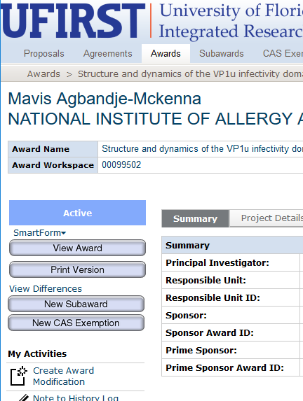
CAS Exemption SmartForm Application
Step 1: Locate the Award record that contains the project to which you would like to request a CAS Exemption.
Step 2 : From the Award Workspace click the New CAS Exemption button.
Step 3: On the CAS Exemption SmartForm answer questions 1.0 through 4.0. Click Continue.
Step 4: If the answer to Page 1.0 Question 3.0 ‘Is this a request to charge administrative and clerical salaries directly?’ was Yes, Page 2.0 appears.

Slide 4
CAS Exemption SmartForm Application:
Administrative and Clerical Salaries
On Page 2.0 Question 1.0 upload the awarded budget and narrative. If the administrative or clerical costs were not in the approved budget, attach the sponsor grant or contracting officer prior approval.
Step 5: In field 2.0 ‘Explain…’ provide a description about how these services are essential to the project.

Slide 5
CAS Exemption SmartForm Application:
Administrative and Clerical Salaries
Step 6: In field 3.0 select Add to open the pop-up window and enter information regarding the personnel that requires the CAS Exemption.
Click OK to return to Page 2.0 Administrative and Clerical Salary, upload any supporting documents helpful to the Office of Research review and click Continue.

Slide 6
CAS Exemption SmartForm Application:
Non-Salary Items
Step 7 : If the answer to Page 1.0 Question 4.0 ‘Is this a request to charge normally indirect or normally unallowable non-salary items directly?’ was Yes, questions on Page 3.0 need answered. In question 1.0 select Add to open the pop-up window and select the non-salary accounts for which you are requesting a CAS Exemption. Complete the rest of the questions in the pop-up box and then select OK to return to page 3.0
If the items on this request are normally F&A, the sponsor must have approved these items by inclusion in the awarded budget or explicitly by other written communication. Upload either the approved budget or sponsor approval containing the items. Also attach any supporting documents helpful to the Office of Research review and click Continue.
Click Finish on Page 4.0.

Slide 7
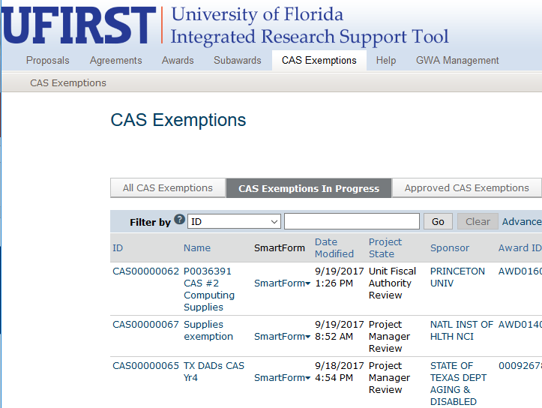
CAS Exemption SmartForm Application
Step 8: From the CAS Exemption Workspace execute the Submit for Review activity to route the CAS Exemption for review and approval. The Project Manager, Unit Fiscal Authority and Contracts & Grants Accounting Services will be sequentially routed the exemption before the charges will be allowed to post.
View the status of the application in UFIRST as it is routed for approval.

Slide 8
CAS Exemption Update
Department Grant Staff
Project Manager
UFA
C&G
If you have any questions about this update or suggestions for future enhancements, please contact us at ufirst@research.ufl.edu or wrgair@ufl.edu.

Slide 9


