Slide 1
Contract and Grants: Cost Transfer Approval
Bill Gair
wrgair@ufl.edu
Chelsea Wilson
wilsonc7@ufl.edu

Slide 2
Key Principles
IT DEPENDS
Risk is determined by a combination of factors
We must treat cost transfers consistently, but each request is unique
OUR GOAL IS TO DOCUMENT, NOT DISALLOW
Fewer than 5% of cost transfers are denied
Often due to deadlines, encouraged to resubmit with stronger documentation
It is considerably more work for all involved when a cost transfer is denied

Slide 3
Levels of Review
Low Risk
Medium Risk
High Risk
Timely
Originally charged to non-sponsored funds
Simple explanation for delay
Late award
Default chartfield
New appointment
Timely
Originally charged to an unrelated sponsored award
Both awards are ongoing with healthy balances
Clerical error
Similar titles
Didn’t go according to plan
Fiscal year rollover
Not timely
Non-Payroll: >90 days (federal)
Payroll: certified effort
Originally charged to an unrelated sponsored award
One or both awards are ending, being spent down, or have a negative balance

Slide 4
Adequate Documentation It depends.
Low Risk
Medium Risk
High Risk
Cost Transfer Form
Must be signed by Project Manager for non-payroll cost transfers
Cross-college or prior-year retros may require additional signatures per the college
Documentation that Project Manager is aware and approves the specifics
PM email requesting change
PM signed PDRR
Confirmation upon request
Faculty narrative
Attests to the specifics of the cost transfer request
Journals: PM explains why the mistake was not rectified within 90 days
Retros: Certifying faculty explains why he or she certified when the allocation was incorrect
Carefully evaluated on a case-by-case basis

Slide 5
Method of Allocation Where did the numbers come from?
Acceptable
Not Acceptable
About 40% of the test tubes were used for Project A
“Approx 2 hrs/week in April” is 5.86% when using pay period begin/end dates
Specific allocation based on separate work locations, logged clinic hours, number of samples analyzed, etc.
Individual spent 30% of her time on the project, but there is only enough budget to support 22.25%, so the remaining 7.75% is allocated to overhead
Project was overspent by $469.29, and that amount is a reasonable portion of this equipment to allocate to an unrelated project
Effort was 10% for fall and spring, but fall effort was certified without this allocation, so 20% salary must be charged in spring
Upon reconciliation, PM decided 12.964% payroll increase (which spends down project to $0.07) is reasonable

Slide 6
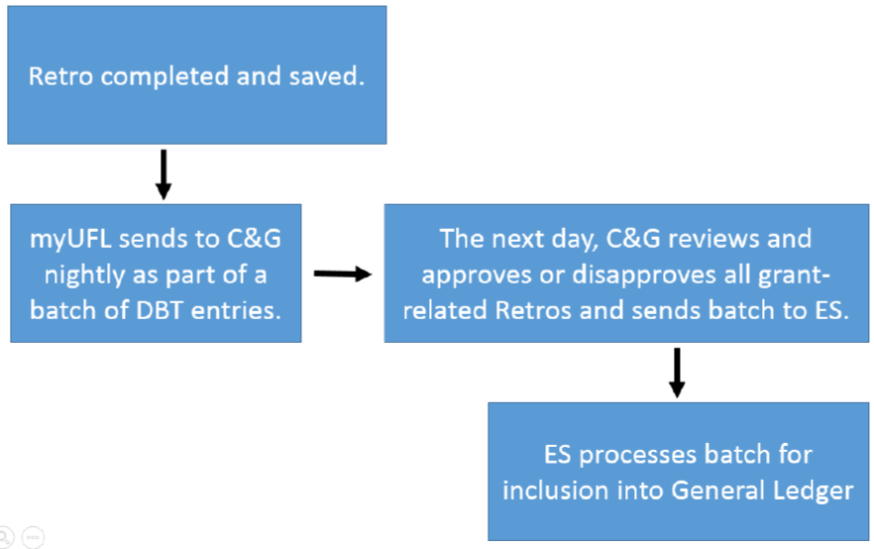
When will my retro post? It depends (but not on us!)
Day 1
Day 2 - 5
Day 3 - 8
http://training.hr.ufl.edu/instructionguides/commitment_accounting/ca_retro_flowchart-lifecycle-timeline.pdf

