Slide 1
Export Controls
BRAiN
Karen Priola, M.S.
Administrative Support II
352.392. 9174

Slide 2
What We’ll Cover Today
Export Control Regulations & Key Definitions
Discuss Fundamental Research
Identifying Red Flags
Export Compliance at UF
Case Studies
Observations
Questions

Slide 3
What are Export Controls?
Laws that control and restrict the release of articles, chemical and biological materials, information, technical data, software, source code, and services to foreign persons or countries.
Purpose of restrictions is to protect U.S. national security and promote U.S. foreign policy, manage short supply, anti-terrorism, and non-proliferation interests.
Notes:
History major
TWEA 1917;
Even in KS, Germans hid underground in Ellinwood KS, changed Kaiser Wilhelm Park

Slide 4
Applicable Regulations
International Traffic in Arms Regulations (ITAR)
  Administered by the Department of State
  Control technologies with military and space applications
Export Administration Regulations (EAR)
  Administered by the Department of Commerce
  Control civil and dual-use (both military and civilian applications) technologies
Assistance to Foreign Atomic Energy Activities (DOE Regulations)
  Administered by the Department of Energy
  Control activities related to special nuclear material
Office of Foreign Assets Control (OFAC)
  Administered by the Department of Treasury
  Control fiscal and trade transactions, travel, and other activities with sanctioned countries and entities
Notes:
DoS- Mainly Foreign Policy, slow to react Arms Export Control Act 1979
Commerce – Export Administration Act 1979- commerce, money, INDUSTRY, BIG push ECR to move items from ITAR to EAR. Destroyed satellite and chip industry domestically,
OFAC – quick reaction to impose sanctions, comprehensive, $

Slide 5
Prohibited Activities
Export of controlled goods, technology, or software/source code without a license or other authorization to prohibited destinations, end-users, or end-uses
Certain activities with, or some travel to, U.S. sanctioned countries
Iran | Cuba
Sudan | North Korea
Syria | *And others with fewer sanctions
Notes:
22 - (Balkans, Belarus, Burma, Burundi, Central African Republic, Cote d’Ivoire, Cuba, Congo, Iran, Iraq, Lebanon, Liberia, Libya, North Korea, Somalia, Sudan, Syria, Crimea Region of Ukraine, Venezuela, Yemen, Zimbabwe) – OFAC list
Currently ONLY Iran, Sudan, and Syria are State Sponsors of Terror (Dept of State).
8 Country: Belarus. Burma. China. Cuba. Iran. North Korea. Syria. Venezuela. Policy of Denial for defense articles/services.
12 - Afghanistan, CAR, Cyprus, DRC, Eritrea, Haiti, Iraq, Lebanon, Libya, Somalia, Sudan, Zimbabwe. Denial w/ exceptions.
Haiti. Good example. DoS approved activities for ITAR (defense articles/services. (j) Haiti. (1) It is the policy of the United States to deny licenses or other approvals for exports or imports of defense articles and defense services destined for or originating in Haiti, except that a license or other approval may be issued, on a case-by-case basis, for:
(i) Defense articles and defense services intended solely for the support of or use by security units that operate under the command of the Government of Haiti, to include the Coast Guard; UN etc

Slide 6
What’s an Export?
The transfer of controlled goods, technology, software/source code, or assistance to a foreign person either outside or inside the United States
Exports can occur through:
  Shipping items to other countries
  Visual inspection of ITAR-controlled equipment or data
  Emails
  Phone calls or in-person conversations
  Presenting controlled information at conferences
  Hand-carrying controlled items during international travel
Notes:
§120.17 Export.
(1) An actual shipment or transmission out of the United States, including the sending or taking of a defense article out of the United States in any manner;
(2) Releasing or otherwise transferring technical data to a foreign person in the United States (a “deemed export”);
(b) Any release in the United States of technical data to a foreign person is deemed to be an export to all countries in which the foreign person has held or holds citizenship or holds permanent residency.
Deemed export biggest risk in University. If you transfer article or technology to someone in US, you have exported item to that country.
12 miles = export

Slide 7
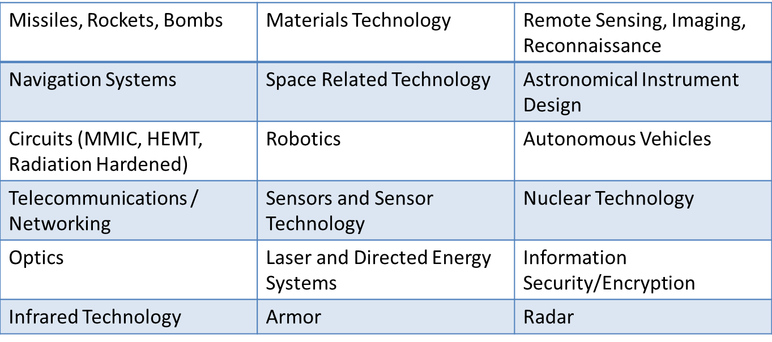
Which Technologies are Controlled?
Items and information specifically listed on the United States Munitions List (USML) or the Commerce Control List (CCL)
In general, items, information, and software related to the following areas may be controlled: (*Not All-Inclusive List*)
Notes:
Macbook Pro – 5A992 CCL
UAS generally 9A112
Can buy ITAR controlled items on Amazon (IR scopes, cameras, etc). Still have to protect.

Slide 8
Fundamental Research Exclusion
Basic and applied research, AND
At an accredited institution of higher learning in the U.S., AND
Research results are ordinarily published and shared broadly within the scientific community
As long as these conditions are met, the results of the research (information or software arising during or resulting from the research) are not subject to the ITAR or EAR even if the research’s subject area appears on the USML or CCL
Notes:
Effort to harmonize the terms, but broadly
NSDD 189 signed by Pres Reagan, policy to encourage unrestricted research at universities as much as possible.
DOD memos in 2008 and 2010 reiterated that policy, stating 6.1 and 6.2 funded research should be FR. Only in “exceptional cases” should research be restricted from foreign persons or publication restrictions.
Also, memo says 6.3 and higher funding can perform research without restrictions.
ITAR is actually called “public domain” exclusion, EAR is called publicly available.
EAR : FRE can be outside of US if it would be FR in the US
No Foreign person Restrictions for national security reasons.
- 1970s, technology leaking from Universities, updated AECA and EAA, STOP RUSSIA, allow CHINA

Slide 9
FRE Is Destroyed If:
UF or the researcher accepts any restrictions on publication of information resulting from the research; or
UF or the researcher accepts a prohibition on foreign persons participating in the research
Notes:
not be considered fundamental research if:
(i) The University or its researchers accept other restrictions on publication of scientific and technical information resulting from the project or activity, or
(ii) The research is funded by the U.S. Government and specific access and dissemination controls protecting information resulting from the research are applicable.
EAR similar language, but generally speaking a “review” does not destroy the FRE, only a review and approval. Review should generally be less than 30 days and insure not inadvertently divulging proprietary information.
Cover again later, but want DIST STATEMENT A – unlimited for public release.

Slide 10
Export Control Red Flags
Listed Technologies (USML, EAR, proprietary)
Foreign Travel, Collaboration, or Sponsor
Physical Exports (What, Where, Who, End Use)
Military Research
Fundamental Research
Contractual Issues (Pub, dissemination, participation restrictions)
Clauses (DFARS, Distribution)
Agreements (MTA, NDA, PIA, MOU)
Notes:
DFARS – some boilerplate
DFAR 252.204-7000 Disclosure of Information (AUG 2013) . If FR, Free to publish in this clause.
DFAR 252.204-7008 Requirements for Contracts Involving Export-Controlled Items
DFARS 252.204-7012 – Safeguarding of Unclassified Controlled Technical Information

Slide 11
Travel & Conferences
In general, travel to most countries and bringing typical/usual items with you will not require a license (e.g., standard laptop, cell phone, personal items)
Caution: Comprehensively Embargoed Countries (Cuba, Iran, North Korea, Sudan, Syria)
Caution: Hand-Carry or Shipping Special Equipment (e.g., infrared camera)
Caution: Do not present or discuss any controlled information, even at domestic conferences

Slide 12
Visitors &
International Collaborations
Two main concerns: (1) access to ITAR or EAR information and (2) working with denied parties
Foreign partners in U.S. on valid Visa may participate in any work within the scope of the Visa
  But, still cannot access certain controlled equipment and information without a license or exemption
Notes:
How many in here have RPS access?
Exemption, many can apply or ask for a license

Slide 13
Visitors &
International Collaborations
The U.S. government has identified certain persons and entities with whom exports and collaborations are either prohibited or require special approval → Denied Parties
Before you host an international visitor in your lab or begin an international collaboration, request restricted party screening from Division of Research Compliance

Slide 14
Export Control at UF
DSP & DRC Grants/Contracts Review
  Identify red flags
  If controlled, develop TCP
  Apply for licenses for foreign persons
Review International MTAs, High-Risk OTL Disclosures
Assist with approvals for travel to and hosting visitors from embargoed countries
Obtain licenses or perform exception approval for exports of controlled equipment and technology
Provide export control training
Notes:
TCPs:
ID the CATD
ID all parties involved, sign acknowledgement
ID Roles and responsibilities
ID and implement security protocols

Slide 15
EC Process for Research Projects
Award
Dept, RA, PI
Notes:
You are a big part of the screening process. I heard 6,000 projects, and we only receive ~ 1,500. Excellent job identifying the EC issue and getting us involved.
- Conducting ANNUAL REVIEWs currently, meeting with the PIs

Slide 16
Your Role in Export Compliance
Identify potential export control issues.
Review terms of sponsored program agreements, material transfer agreements and other non-monetary agreements to identify restrictions on publication and dissemination of research results and flag such restrictions.
Identify international components of sponsored program agreements and potential export control issues in the proposed international component.
Forward potential export control issues DRC
Communicate with DRC about any changes in awards that necessitate a re-review of the project for export controls.

Slide 17
Case Study: Pre-award
Professor Gator wants your help in applying for a subcontract from industry to work on improved radar techniques for military surveillance and detection systems. The prime sponsor is the U.S. Army.
In reviewing the STTR solicitation, you find the following language:
The technology within this topic is restricted under the International Traffic in Arms Regulation (ITAR), which controls the export and import of defense-related material and services. Offerors must disclose any proposed use of foreign nationals, their country of origin, and what tasks each would accomplish in the statement of work in accordance with section 5.4.c.(8) of the solicitation.

Slide 18
Case Study: Pre-award
What else should you look for in the proposal?
  Foreign persons participating
  Publication restrictions
  International travel
  Equipment purchases or shipments
What should you tell the PI?
  Budget for additional IT security needs
  Consult with Research Compliance
Notes:
In order to assist the PI, some items to look at.

Slide 19
Case Study: Contracting
Great news: Prof. Gator was awarded the contract! You’re negotiating the contract, and you find the following terms:
DFARS 252.204-7000 (Oct. 2016) – Disclosure of Information
UF cannot release any project information unless “the information results from or arises during the performance of a project that involves no covered defense information…and determined in writing by the contracting officer to be fundamental research….”
Distribution Statement D – Distribution Authorized to the DoD and DoD Contractors Only
“No foreign nationals may participate in this project without prior approval from the assigned U.S. Army contracting officer.”
Notes:
7000 Clause.
Need statement in writing from contracting officer this is FR.
Again, 6.1 and 6.2 funding should be FR. Only exceptional cases where it is not, and YOU should push for “HIGH LEVEL COMPONENT MANAGEMENT” approval to say otherwise. NOT the CONTRACTING OFFICER>

Slide 20
Case Study: EC Analysis
DRC reviewed the SOW and determined that the project is likely controlled by Category XI of the ITAR. But, Prof. Gator says that his work can’t be export controlled because “I’m only testing various algorithms that could have both military and non-military applications. This is an educational institution, what about academic freedom? It’s basic science!”
Can we rely on the fundamental research exclusion in this case?
  It Depends
  Yes, if contracting officer provides statement this is fundamental research.
  No, the publication and foreign person restrictions prevent us from classifying Prof. Gator’s work as “fundamental research.”
Notes:
Again, need to push 6.1 and 6.2 funding to the FR statement AND if not determined, get statement from “HIGHEST LEVEL COMPONENT MANAGEMENT” as to why this is an “EXCEPTION CASE” when NOT applying the 2010 memo Guidelines.

Slide 21
Questions?
Contact Information
Division of Research Compliance
352-392-9174 or compliance@research.ufl.edu
http://research.ufl.edu/faculty-and-staff/research-compliance/export-controls.html
Notes:
Not really true, but Prof Roth good example

