Slide 1
RCR Summer Seminar Series
Special Topic:
Material Transfer Agreements &
International Shipping
Carter Post & William Bucha
UF Research Integrity, Security & Compliance

Slide 2
Reminders
You must log in with UFL email in order to receive certificate credit
Please take the survey after the class—we value your feedback
In order to allow for free flow of ideas and questions, we will not record the session
Slides and other materials will be sent to attendees after the class

Slide 3
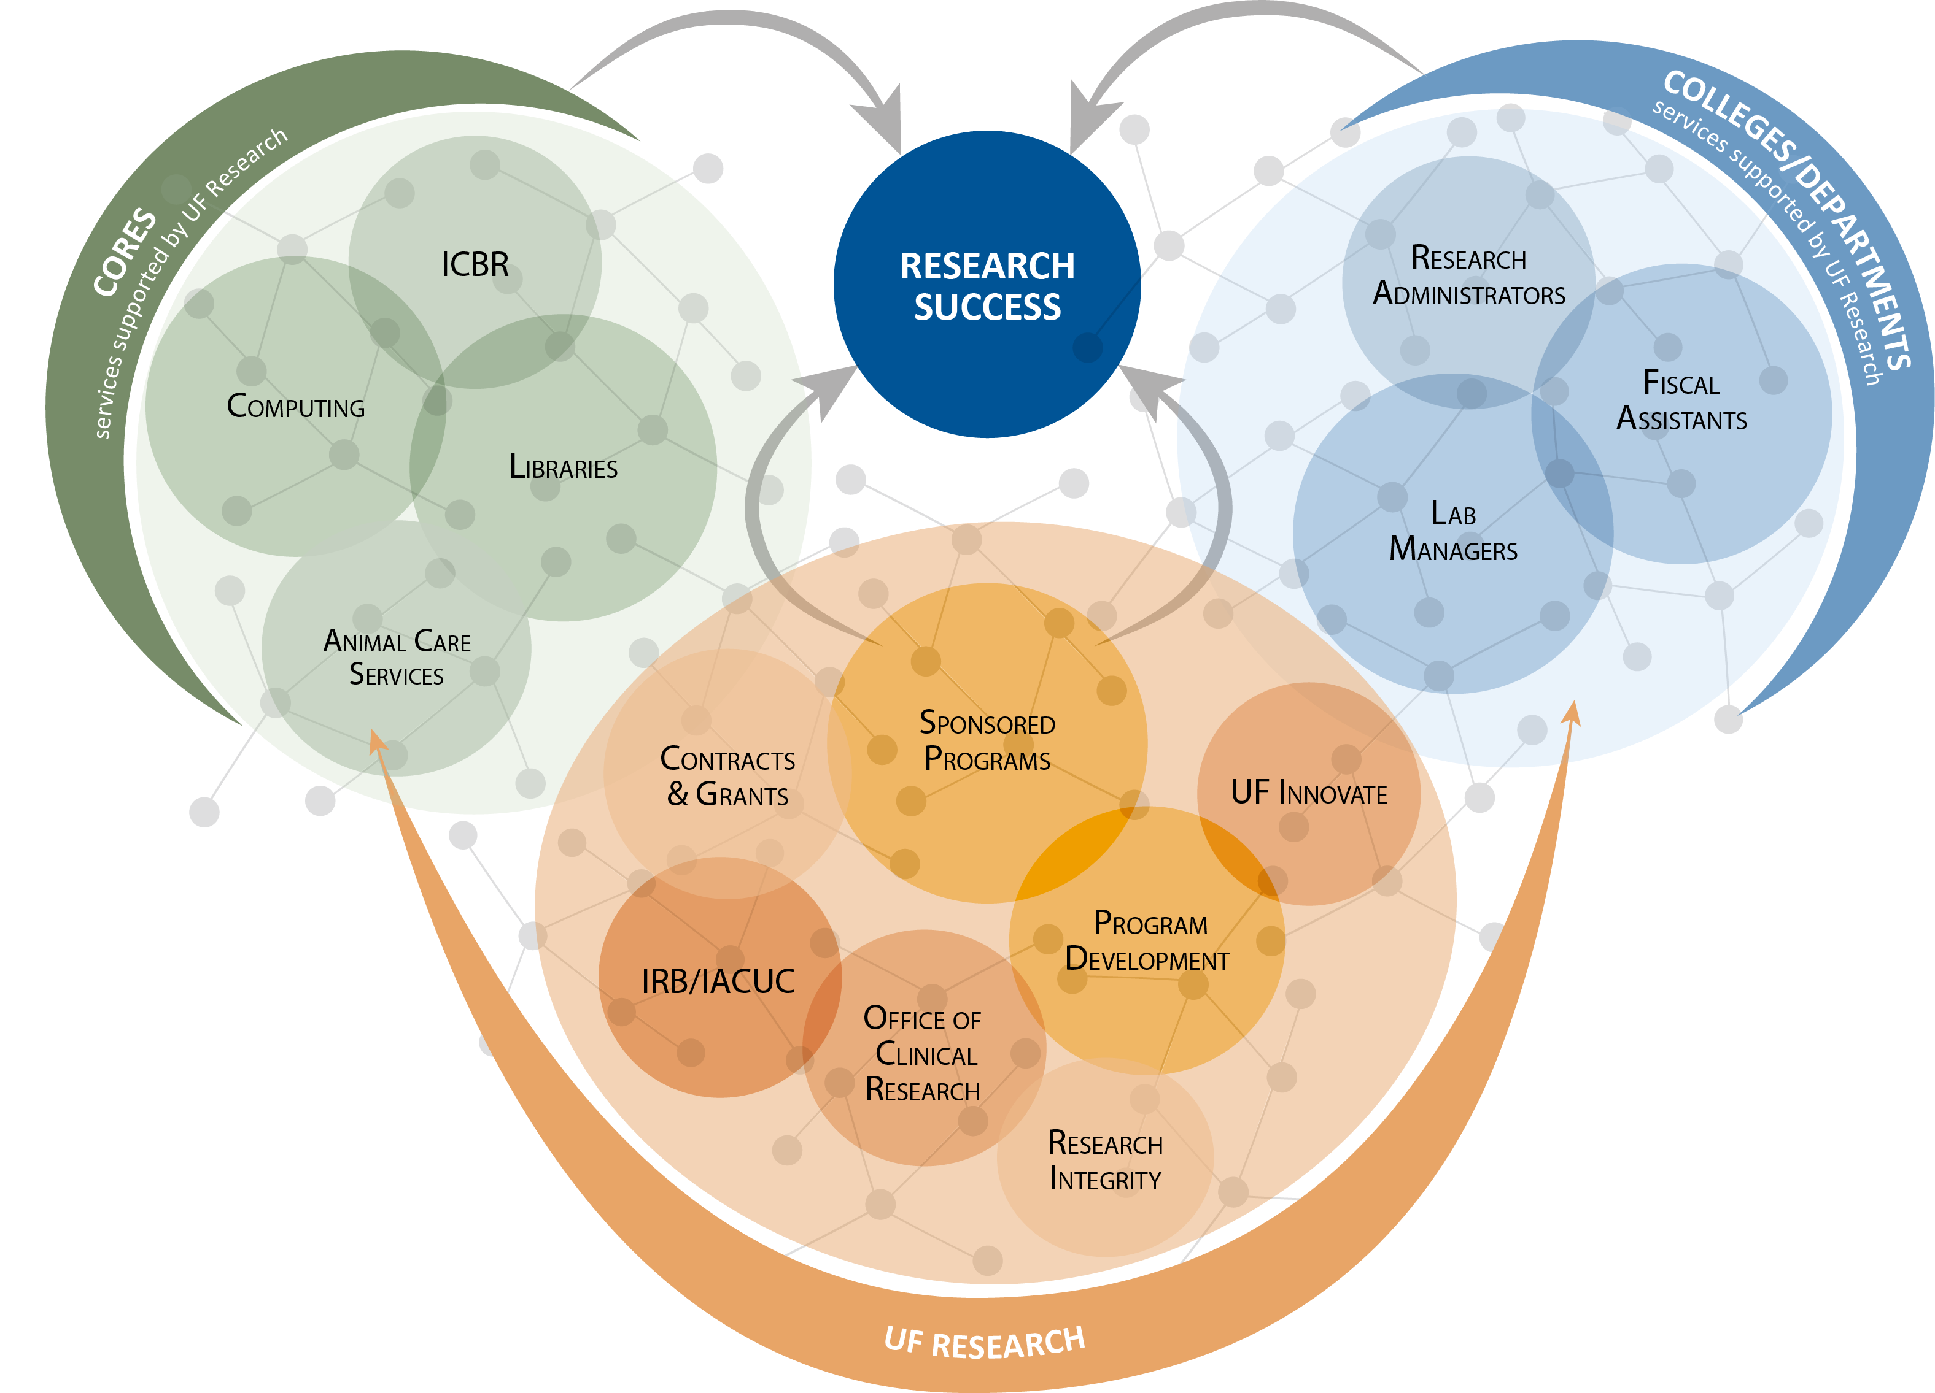
UF Research Enterprise
Notes:
Use to highlight where the presentation topic fits within the research enterprise at UF. (Note: the answer may be everywhere!)

Slide 4

Introduction
Marsha Pesch
Associate Director
Export Control Officer
UF Research Integrity
Carter Post
Export Compliance Specialist, III
UF Research Integrity
William E. Bucha, Jr., JD
Export Compliance Specialist, III
UF Research Integrity
Call UF RISC at 352-392-9174 or email us at exportcontrol@research.ufl.edu

Slide 5
Agenda
Export Controls for Researchers in Brief
Export Control Requirements for International Shipments
Breakout Rooms: Shipping Scenarios
Material Transfer Agreements (MTAs)
International Shipments of Biological Materials & Animals
Additional Resources
Q&A

Slide 6
Who Regulates Export Controls?
U.S. Department of Commerce, Bureau of Industry and Security (BIS)
  Export Administration Regulations (EAR) Controls commercial, dual-use, and less sensitive military items
  Controlled items are either described on the Commerce Control List (CCL) with an Export Control Classification Number (ECCN) or designated “EAR99”
U.S. Department of State, Directorate of Defense Trade Controls (DDTC)
  International Traffic in Arms Regulations (ITAR) Controls military items
  Controlled items are described on the U.S. Munitions List (USML)
U.S. Department of the Treasury, Office of Foreign Assets Control (OFAC)
  Administers and enforces economic and trade sanctions
  Comprehensively Sanctioned: Cuba, Iran, North Korea, Syria, Crimea Region of the Ukraine
Note: Other agencies also have a role in limited circumstances, e.g., NRC, NOA, DOE.
Notes:
Poll after finishing this slide: During your time at UF, have you shipped an item or helped someone in your unit ship an item internationally, or have to travel internationally or helped someone travel internationally on UF business? A. I have shipped or help ship an item internationally, B. I have travelled or helped someone travel internationally, C. Both A & B, D. Neither A nor B

Slide 7
What is an International Shipment?
The transfer of equipment, materials, or technology out of the U.S.
  Examples
    Shipping items purchased by UF funds to an international destination (i.e. via FedEx or UPS)
    “Hand-carrying” a UF-owned laptop on a flight to an international destination
    Requesting a Material Transfer Agreement with the UF OTL to ship a licensed material to an international collaborator
Before shipping internationally, please contact UF RISC for an Export Control review. Some shipments may require an export license or registration.

Slide 8
Shipping/Hand-Carry Checklist
What is being shipped?
  UF-owned capital asset or attractive property with a UF Decal # (i.e. a UF owned laptop).
    Foreign Travel Request in the myAssets portal, which will notify UF RISC for a review.
  Commercial item purchased from a manufacturer or vendor.
    Contact UF RISC for classification and export review. Please provide as much detail as possible (i.e. Manufacturer, Model/Part #, Purchase Price, etc.)?
  Custom item designed and built by UF researchers.
    Contact UF RISC for classification and export review.
Where is the final international destination?
  China, Crimea Region of Ukraine, Cuba, Iran, North Korea, Russia, Syria, Venezuela are countries of concern, which require extensive review from UF RISC. Please contact our office prior to any engagement with these countries.
Notes:
All of these countries require reporting on items being shipped

Slide 9
Shipping/Hand-Carry Checklist continued
Who is receiving the shipment?
  Who is the receiving party and are they the intended user of the shipped item.
    Restricted Party Screening – Visual Compliance.
    Individual receiving the shipment
    Associated Entity
    End User of item
    UF Travel Hand-Carry – UF traveler maintaining “effective control” of item
Why is the item being shipped?
  What is the end use of the item and is the end use permissible without a License
    Fundamental Research and Education. Fundamental research exemption does not include physical items.
    Military, Government support, other prohibited uses
How long will the item remain abroad?
  More or less than 364 days

Slide 10










High Risk Physical Items and Technologies
Optics
Controlled Biologicals
Marine
Materials
Radar
Electronics
Computers
UAVs
Energy Systems
Software

Slide 11
Restricted Party Screening
Restricted Party Lists
  Entity List (BIS, Dept. of Commerce)
  Unverified List (BIS, Dept. of Commerce)
  Arms Embargoes List (Dept. of State)
  Specially Designated Nationals List (OFAC, Dept. of Treasury)
Visual Compliance Screening
  Restricted Party Screening
  All U.S. Restricted Lists
  International Authorities Consulted
With few exceptions, the University of Florida will not host visitors, enter into contracts or other agreements, do business, or engage in any activity with entities listed on a U.S. government restricted party lists.
Notes:
All of these require interaction with the US government.

Slide 12
Other Shipping Considerations
Electronic Export Information (EEI) Filing
  Automated Export System (AES)
  Census Bureau
  Greater than 364 days
  License Required/Received
  Value over $2,500
  Countries of concern
  Facilitated by UF RISC or Designated Shipping Company
International Import Regulations
  ATA Carnet
    Carnets facilitate temporary imports into foreign countries and re-importation into the U.S. By presenting an ATA Carnet document to foreign customs, you pass duty free and import tax free into a carnet country for up to one year. ATA Carnets also serve as the U.S. Certificate of Registration of goods (CBP 4455) upon re-importation.
    College/Department Responsibility

Slide 13

Shipping/Hand-Carry Best Practices
Ask questions before you ship | Remember that every export is also an import at the international destination
Retain records of rationale for shipping decisions | Be aware of red flags, such as shipping items to unknown persons that don't have a need for that item
Use online screening tools: UF subscribes to Visual Compliance | Be aware that compliance related to shipping hazardous materials & dangerous goods is separate from issues related to export controls

Slide 14
UF Shipping/Hand-Carry Reminders
Contact UF RISC (exportcontrol@research.ufl.edu) prior to any international shipment. Please provide sufficient time and as much information as possible for an export control review.
Travel Authorizations for UF travelers
  my.UFL.edu
UFIC Registration for all UF persons traveling abroad on UF business
  https://internationalcenter.ufl.edu/travel/online-travel-registration
Asset Management Registration for foreign travel and shipping UF-owned items
  https://myassets.fa.ufl.edu/ext/#/fta

Slide 15
Breakout Room Scenarios
For each shipping scenario, please discuss:
  What necessary information is present?
  What additional information is needed?
  What are the next steps needed prior to shipping?
    What UF authorizations and registrations need to be completed?
    Which foreign entities need to be screened?
    What needs to be supplied to UF RISC for an export control review?

Slide 16
Scenario #1
UF Professor, Dr. Tebow, is planning traveling to London for one week to conduct research with his collaborator, Dr. Leak, at the University of London. Dr. Tebow is bringing his UF-owned laptop (UF Decal #000000154114) on the trip, which has a value of $1,000 and will remain in his “effective control” at all times.

Slide 17
Scenario #1
UF Professor, Dr. Tebow, is planning traveling to London for one week to conduct research with his collaborator, Dr. Leak, at the University of London. Dr. Tebow is bringing his UF-owned laptop (UF Decal #000000154114) on the trip, which has a value of $1,000 and will remain in his “effective control” at all times.
Travel Authorization, UFIC Registration, Foreign Travel Request in myAssets Portal, conduct Restricted Party Screening of Dr. Leak and University of London. UF RISC will review FTR in myAssets Portal.

Slide 18
Scenario #2
UF Professor, Dr. Wambach, is planning to ship lab supplies to her collaborator Dr. Barnhill, who is running a research lab at the University of Sao Paulo in Brazil. Dr. Wambach purchased $5,000 worth of laboratory supplies and is currently boxing them up in her office in Turlington. To help in the shipping process, Dr. Wambach created a spreadsheet detailing each lab supply’s manufacturer, part number, brief description, price and quantity.

Slide 19
Scenario #2
UF Professor, Dr. Wambach, is planning to ship lab supplies to her collaborator Dr. Barnhill, who is running a research lab at the University of Sao Paulo in Brazil. Dr. Wambach purchased $5,000 worth of laboratory supplies and is currently boxing them up in her office in Turlington. To help in the shipping process, Dr. Wambach created a spreadsheet detailing each lab supply’s manufacturer, part number, brief description, price and quantity.
Restricted Party Screening of Dr. Barnhill and University of Sao Paulo, send spreadsheet of lab supply to UF RISC, ASAP. UF RISC will conduct export control review, determine if a license or an EEI filing is necessary, and communicate results for review to Dr. Wambach and staff.

Slide 20
Scenario #3
UF Professor, Dr. McMurtry, is planning to take her custom-built Unmanned Ariel Vehicle (UAV) on an extended trip to Russia to perform a field research with collaborators at the University of Moscow. The UAV contains components that require a license to export to Russia.

Slide 21
Scenario #3
UF Professor, Dr. McMurtry, is planning to take her custom-built Unmanned Ariel Vehicle (UAV) on an extended trip to Russia to perform a field research with collaborators at the University of Moscow. The UAV contains components that require a license to export to Russia.
Travel Authorization, UFIC registration, Restricted Party Screening of collaborators and University of Moscow. Contact UF RISC ASAP for export control review. Since Russia is a Country of Concern and the UAV is a high risk, custom-built item, the review may take an extended period of time.

Slide 22
Material Transfer Agreements (MTAs)
MTAs document the transfer of material between the university and third parties and specify the rights, obligations, and restrictions concerning:
  Ownership and Intellectual Property
  Publication
  Distribution and Commercialization
  Permitted Uses
  Liability, and
  Regulatory Compliance/Commitments
Contact: Penelope M. Gianelli, J.D., MTA Coordinator, UF Innovate
  Email: penelopegianelli@ufl.edu
  Phone: 352-294-0990
Notes:
Mention this slide to Penny – May have MTAs that flow through UFIRST

Slide 23
Do I Need An MTA?
You are required to use a Material Transfer Agreement (MTA) that meets the legal and policy requirements of UF if:
You are sending or receiving materials, and
These materials are not already covered by another agreement.

Slide 24
Do I Need An MTA?
Not required for sending out de-identified human sample(s) for research, if:
Sample(s) is not apart of an existing or planned invention disclosure to UF Innovate; OR
Sample(s) is not protected under an issued or pending patent application; OR
Sample(s) has not been licensed to an entity outside UF; OR
Sample(s) is not part of a contract with distribution restrictions.

Slide 25







MTA Export Review
Recipient/Sender Information
  Entity Legal Name (e.g. “Kings College London,” “Keio University,” “Love A Child,” etc.).
  Address & Location.
  Authorized Signatory Official.
  Recipient Principal Investigator.
  Contact Person, if different than PI.
Material Description
  Should include a brief description, or specific title of what is being sent:
    e.g. Modified AAV plasmids for the purpose of treating Parkinson’s.
  Should also include a specific citation for any material that is contained in a research publication.
  NOTE: If the material includes any pathogen or infectious disease, this should be indicated in the material description.
Recipient’s Intended Use Of Material
  The purpose of the material should indicate the following:
    The intended use or research involving the material – this can be an abstract or similar content.
    Indication on application in human studies.
    Indication on use in commercially funded research.
    Duration of use for the material.
Notes:
Poll Question: Which of the following is not a necessary piece of information that UF RISC requires when reviewing an MTA? (a) Who is receiving the materials (b) Where the material is going (c) The amount of publications the recipient has submitted (d) What the material is that is being sent (e) What the recipient will be doing with the materials they are receiving.
True or False: A description of the material is only necessary when it is not included in a publication. FALSE

Slide 26

Shipping Biological Material – Export Control Concerns
https://www.ehs.ufl.edu/programs/bio/
Certain biological materials that are listed on either the United States Munitions List (USML) or Commerce Control List (CCL) require a license from the appropriate U.S. governing agency prior to leaving the United States.
Examples of biological materials listed on the CCL: Cholera toxin, Ebola virus, E. coli (EHEC), Pseudorabies virus, Salmonella typhi, and Vibrio cholera.¹
Genetically Modified Organisms (GMOs) that contain both export controlled material and non-export controlled material can still be listed on the CCL and will still require a license.
  Example:
    Foot and mouth disease virus (ECCN 1C351) combined with
    Human Adenovirus 5 (EAR99/no license required) →
    Genetically modified human adenovirus 5 – FMDV (ECCN 1C353; 1C991 once formulated into a vaccine).
https://www.ehs.ufl.edu/programs/bio/shipping/export_control/
Notes:
Poll Question: Would Vesicular Stomatitis Virus (controlled on the CCL) expressing SARS-CoV-2 spike protein (not controlled on the CCL) still be controlled on the CCL? (a) Yes, (b) No, (c) What is the CCL.

Slide 27
Shipping Biological Material –
Case Study: Princeton Samples (2021)
https://www.ehs.ufl.edu/programs/bio/
WHAT HAPPENED?
  February 1, 2021, BIS announced a settlement with Princeton University over alleged exported animal pathogens and genetic elements of animal pathogens without required export licenses to researchers in the U.K., Canada, Australia, Europe, South Korea, India, Singapore, and China.¹
    The items were classified under ECCN 1C351, 1C352 or 1C353, controlled for Chemical and Biological Weapons reasons, and valued in total at approximately $27,000.^{1,2}
WHAT WAS THE RESULT?
  BIS imposed a penalty of $54,000,
  BIS mandated two audits of Princeton’s export compliance program, and
  BIS further mandated submission to BIS of two reports detailing enhancements to Princeton’s export control processes.²
https://www.wiggin.com/wp-content/uploads/2021/02/WD21-Advisory-Biologics-Researchers-and-Suppliers-Beware_v1.pdf
https://efoia.bis.doc.gov/index.php/documents/export-violations/export-violations-2021/1287-e2642/file

Slide 28
Shipping Biological Material – Environmental Health & Safety (EH&S) Concerns
https://www.ehs.ufl.edu/programs/bio/
For shipping purposes, many biological materials fall into the category of “dangerous goods”
Articles or substances which are capable of posing a risk to health, safety, property or the environment & which are shown in the list of dangerous goods in the Regulations or which are classified according to these Regulations. See 49 CFR Parts 100-185 & IATA 1.0.
Examples: Biological Toxins, Infectious Substances, Diagnostic Specimens, Biomedical Waste, Cultures, and Genetically Modified Organisms.
In order to ship biological materials, it is required that you must first have a Shipping and Transport of Biological Materials Training Certificate from UF Bio Safety Office in Environmental Health & Safety.
Training is valid for 2 years and is a federal requirement.
To Register: Email bso@ehs.ufl.edu and provide your First Name, Last Name, and UFID number.
In addition, safe transport of items within facilities and around campus is also required. These topics are covered in the “Shipping and Transport of Biological Materials” training.
**Note: You must contact UF Biological Safety prior to any shipping of material under Category A¹. For more information, please contact EH&S at bso@ehs.ufl.edu.
https://www.iata.org/contentassets/b08040a138dc4442a4f066e6fb99fe2a/dgr-62-en-3.6.2.pdf

Slide 29
Shipping Biological Material – Animal Care Services (ACS)
https://www.ehs.ufl.edu/programs/bio/
Before any animals can be exported to another institution (e.g. rodents), ACS will provide the following to the Receiving Institution for review:
  animal information,
  facility information, and
  the last 12 months of health reports
Once this information has been approved by the Receiving Institution, shipment will be coordinated by ACS and the Receiving Institution.
The ACS Import/Export Coordinator can be reached at ACS-ImportExport@acs.ufl.edu or 352-273-8322.

Slide 30
Additional Resources
UF RISC Website: https://research.ufl.edu/compliance.html
UF International Center - Travel: https://internationalcenter.ufl.edu/travel/
UF Asset Management – Foreign Travel or Shipment Request: https://www.fa.ufl.edu/directive-categories/foreign-travel-requests-and-off-site-certifications/
UF Innovate – MTAs: https://innovate.research.ufl.edu/tech-licensing/innovators/mta/
UF EH&S – Shipping and Transport of Biologicals: https://www.ehs.ufl.edu/programs/bio/shipping/

Slide 31
Q&A

Slide 32
Thank you!
Please take the survey at:
https://ufl.qualtrics.com/jfe/form/SV_1WVLQUcrykr7YFM

