Slide 1
RCR Summer Seminar Series
Conflicts of Interest
Amber Moore
Assistant Director, Research COI UF Research Integrity

Slide 2
Agenda
Reminders for the session
Logistics – polls and breakout rooms
Research COI Program responsibilities and campus partners
UF and federal policies
Types of conflicts of interest
Significant Financial Interests
Management controls
Case studies

Slide 3
Reminders
You must log in with UFL email in order to receive certificate credit
Please take the survey after the class—we value your feedback
In order to allow for free flow of ideas and questions, we will not record the session
Slides and other materials will be sent to attendees after the class

Slide 4
RCR Certification
Mentor/Mentee Relationships- Finding the Right Balance
Collaborative Research
Conflicts of Interest
Data Management and Artificial Intelligence
Compliance at UF &
Research Misconduct Overview
Research Misconduct: Plagiarism
Research Misconduct: ORI: The Lab
Ethics of Authorship
Rigors of Peer Review
Reproducibility & Replicability
IRB & Informed Consent
Export Control Overview Including an overview of Dual Use Technology
Putting it All Together

Slide 5
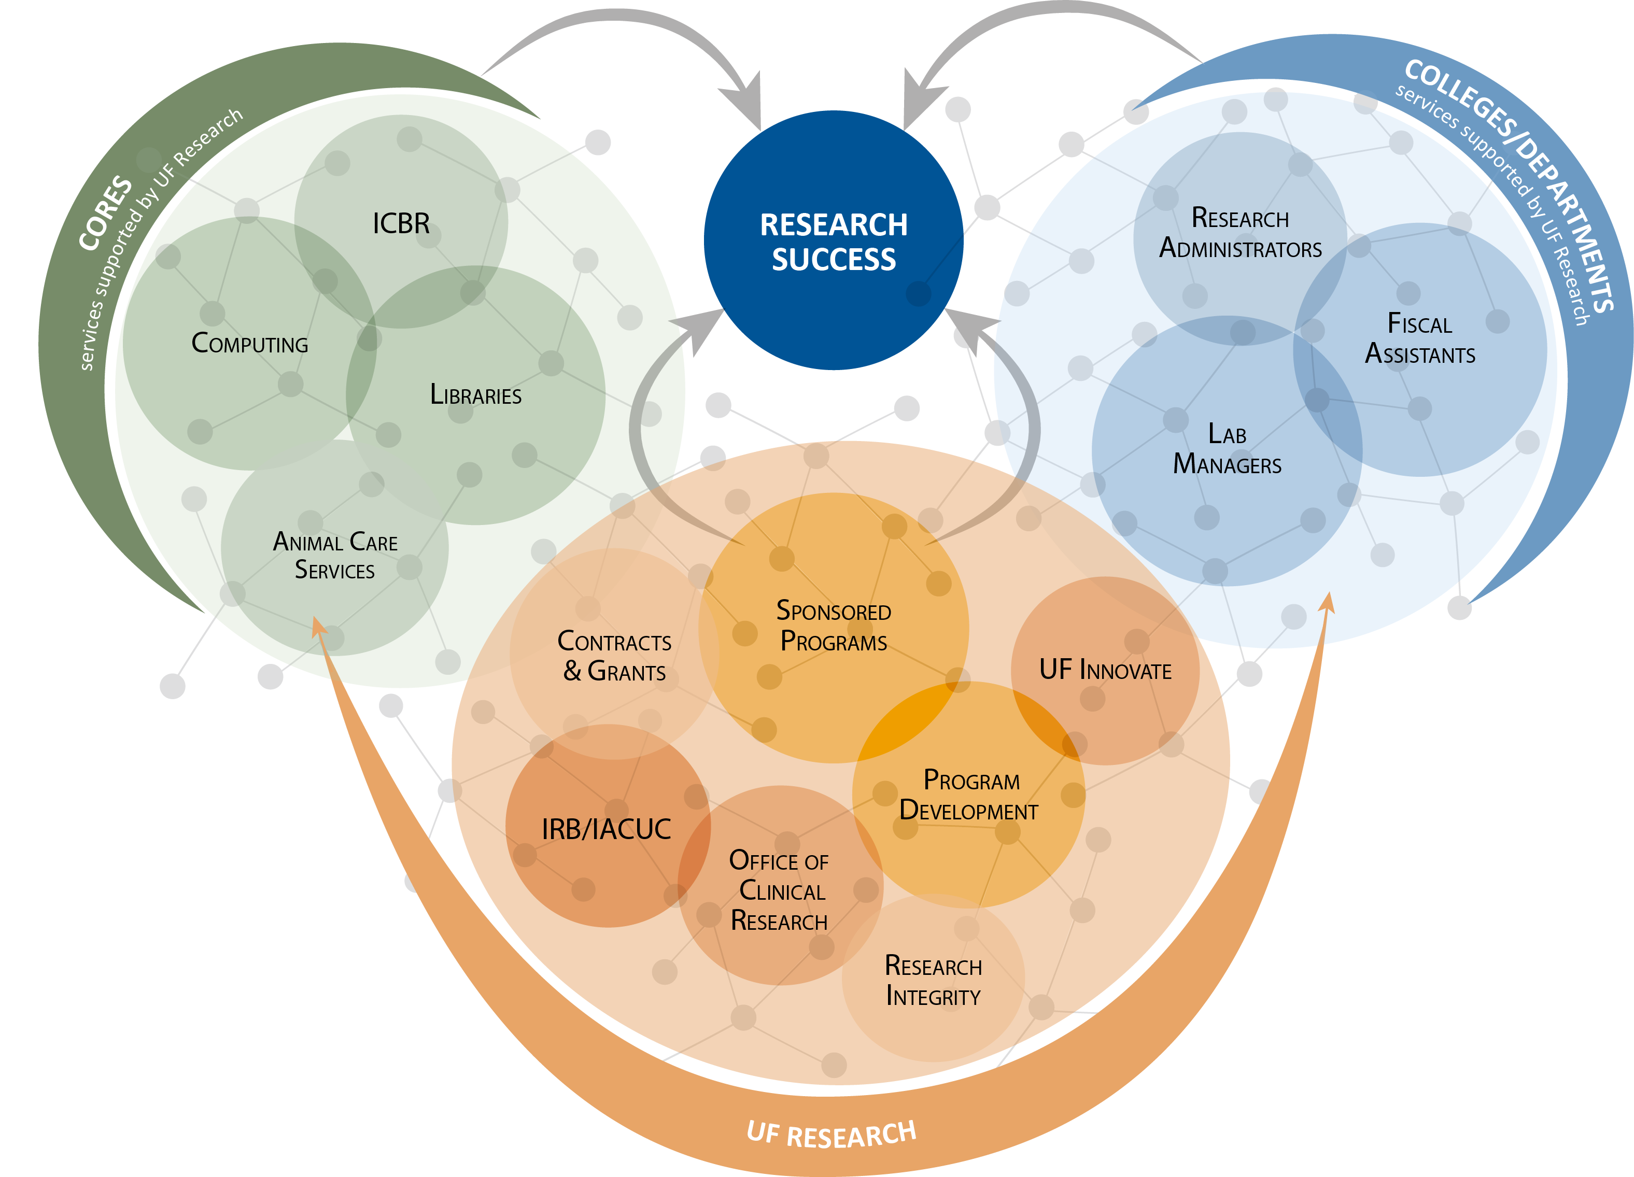
UF Research Enterprise

Slide 6
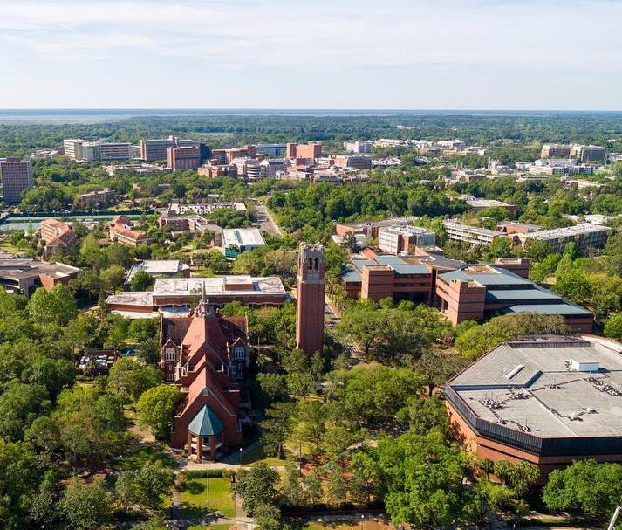
Research Conflict of Interest (RCOI)
RCOI administers UF’s Conflict of Interest in Research Policy. Our office reviews and manages Significant Financial Interests that have the potential to bias research to ensure compliance with sponsor COI regulations.
RCOI partners with the COI Program (UFOLIO), Division of Sponsored Programs (UFIRST) and UF Institutional Review Boards (myIRB and WIRB Checklist) to receive disclosures of Significant Financial Interests.
RCOI serves as a resource to staff, students and faculty on conflicts of interest related to research.

Slide 7
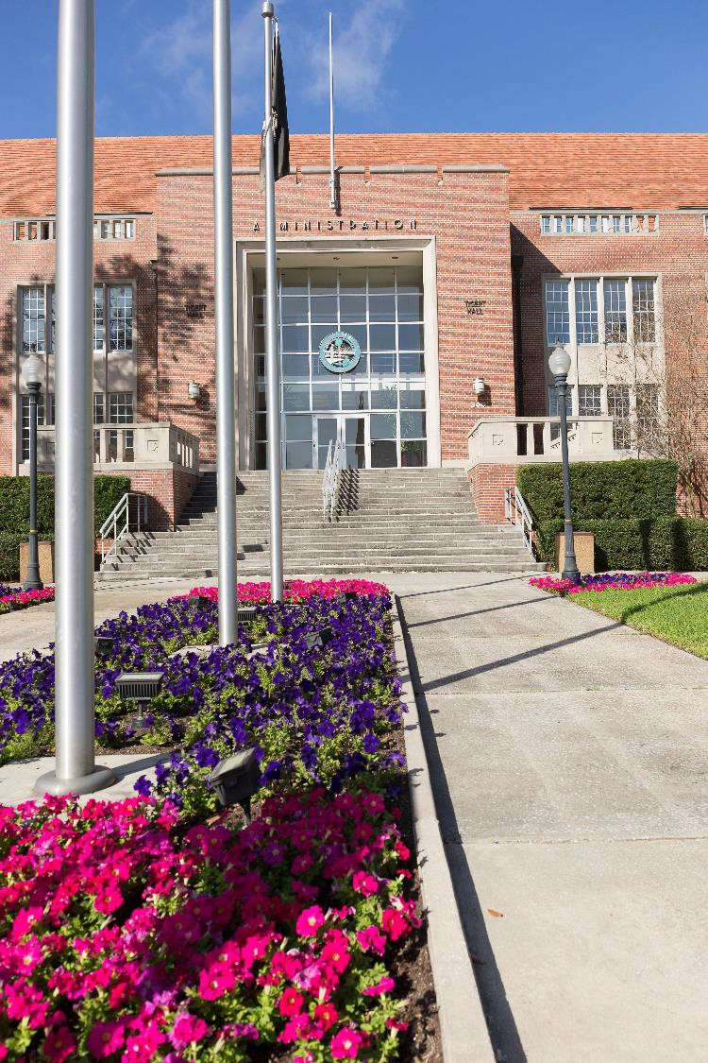
UF Conflicts of Interest Program
The UF Conflicts of Interest (COI) Program is
an office established under the purview of
the Provost and Senior Vice President for Academic Affairs.
The UF COI Program administers UFOLIO (UF
Online Interest Organizer), UF’s online
reporting system for Outside Activities and
certain financial interests (prospective approval).
In collaboration with campus partners, the UF COI Program seeks to identify and manage conflicts of interest that could undermine institutional integrity.

Slide 8
Federal Regulation & Policy
Key elements of the PHS and NSF COI policies:
Individual financial conflicts of interest
Disclosure required for actual financial interests (within specified timeframes)
Disclosure prior to proposal submission and annually
Investigators (“anyone responsible for design, conduct or reporting”) must disclose
Specific thresholds for what is considered a Significant Financial Interest
Reporting obligations to the sponsor (varies by sponsor)
Subrecipient compliance
Training requirements (PHS)
Public accessibility (PHS)
Retrospective review for non-compliance (PHS)

Slide 9
Types of Conflicts of Interest
(Research Projects/Contracts)
Individual (PHS and NSF COI policies, UF Research COI Policy)
In the context of research, an individual conflict of interest exists when an investigator’s private interests may compromise, or have the appearance of compromising, an investigator’s professional judgment in the design, conduct or reporting of the research.
Institutional (no federal requirement, best practice and risk mitigation)
In the context of research, an institutional conflict of interest may exist when the institution or one of its senior officials has a financial interest related to research.
Organizational (contractual language and FAR clauses)
Government is typically concerned about three things: unequal access to information, biased ground rules, and impaired objectivity.

Slide 10
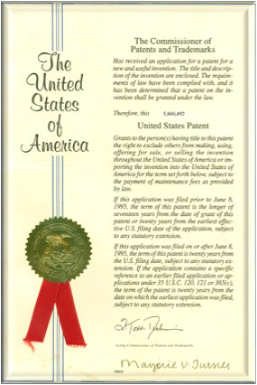
Significant Financial Interests
Consulting, Advising and Speaking
Ownership
Intellectual Property
Reimbursed and Sponsored Travel
Thresholds: RCOI Website and Policy

Slide 11
Management of Research COIs
Management is aimed at:
Reducing opportunity for bias
Preserving public trust
Protecting human subjects
For interventional human subjects research, there is a rebuttable presumption that the UF interested investigators and/or UF, if also financially interested, should not conduct the research.
Presumption can be overcome if compelling circumstances exist.

Slide 12
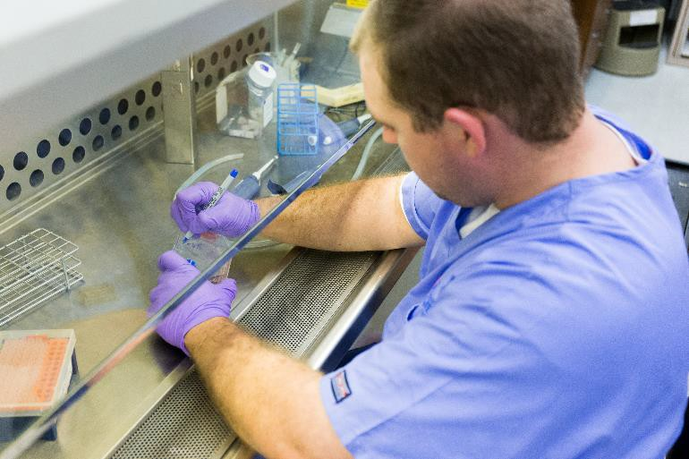
Special Considerations for Human Subjects
Research
Compelling Circumstances
the nature of the research;
the magnitude of the significant financial interest and the degree to which it is related to the research;
the extent to which the significant financial interest could be directly and substantially affected by the research;
the degree of risk to the human subjects involved that is inherent in the research protocol;
the extent to which the conflicted Investigator is uniquely qualified to perform a research study with important public benefit, and;
the extent to which the FCOI is amenable to effective oversight and management.

Slide 13
What is a COI management plan?
The purpose of a COI management plan is to document management of potential conflict(s) of interest related to the research and includes:
A summary of the research purpose, • Trainees working on the study
aims & procedures
Inherent controls
Any relevant approvals (human, animal, _{• Additional controls}
etc.)
The role of the investigator in the study • Compelling circumstances, if applicable
Outside entities involved in the research
Amount and nature of interest
Summary of discussion/rationale
Monitoring schedule

Slide 14
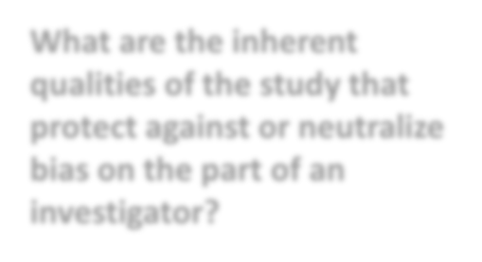
Inherent Controls
What are the inherent qualities of the study that protect against or neutralize bias on the part of an investigator?
Management plan identifies inherent controls such as:
Investigators blinded to treatment groups
Low percentage of enrollment at the investigator’s site
Non-interested co-investigators conducting the research and/or data analysis
External, non-interested lab involved in sample and/or data analysis
Objective endpoints
Early stage/pilot research that requires additional studies prior to commercialization
External monitor

Slide 15
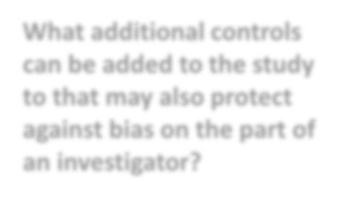
Additional Controls
What additional controls can be added to the study to that may also protect against bias on the part of an investigator?
Institution may also add controls such as:
Public disclosure in presentations and publications
Safe harbor for students
Disclosure to human subjects research participants through informed consent
Notification to research personnel on the study
Limited role for interested investigator (e.g. does not obtain consent or recruit)
External IRB review (for institutional conflicts)
Monitoring of research by an independent reviewer(s) or DSMB
Reduction or elimination of SFI or severance of relationships

Slide 16
Case Study #1
Dr. Hammond is a highly-respected researcher who has several research grants, both federal and non-federal funding. Dr. Hammond is also on an advisory board for DrugMaker Inc., a pharmaceutical company, and has received between $10,000 and $20,000 over the past 12 months for advising.
Dr. Hammond advises on a particular disease state and the company’s clinical trial progression for relevant treatments.
DrugMaker Inc. is conducting a multi-center, placebo-controlled, double-blinded, Phase 3 clinical trial, and Dr. Hammond proposes to be the PI for one of the trial sites.
The trial will enroll 2,500 patients, and the UF investigational site will enroll 12 patients.
Dr. Hammond and all UF study staff will be blinded to the treatment and control groups.
DrugMaker Inc. is using a Clinical Research Organization to monitor the study and perform data analysis.

Slide 17
Breakout Room
What are the inherent controls (aspects of the research design the limit Dr. Hammond from introducing bias into the research)?
What additional controls would be appropriate for this research?
What questions do you have for Dr. Hammond?

Slide 18
Case Study #1: Inherent Controls
Investigators blinded to treatment groups
Low percentage of enrollment at the investigator’s site
Monitoring of research and data analysis by CRO
Additional questions:
What are the roles of the interested investigator?
Are the study endpoints objective?
Does the study include any non-interested faculty/physicians?

Slide 19
Case Study #1: Additional Controls
Dr. Hammond may not obtain informed consent.
The informed consent document will contain COI disclosure language.
Dr. Hammond must disclose the interest to research personnel and in resulting publications or presentations.
Additional questions:
Are there trainees working on the study?
Should there be an independent data reviewer?
Is this study being reviewed by an external IRB?

Slide 20
Case Study #2
AKA Conflict of Interest management isn’t just for clinical research!
BikeSafe is a small, non-publicly traded company seeking to develop a new product line that includes additional embedded technologies.
Dr. Linter developed a bicycle technology to help bicyclists be warned of potential dangers. UF Innovate has submitted a patent application for the technology.
BikeSafe proposes to license the technology and also to sponsor a study testing the technology with Dr. Linter, the inventor, as an investigator on the project.
UF accepts an equity interest in the company as part of the license agreement.

Slide 21
Breakout Room
What are the inherent controls?
What additional controls would be appropriate for this research?
What additional questions do you have for Dr. Linter?

Slide 22
Case Study #2: Inherent Controls
Need additional information for existing inherent controls:
What are the roles of the interested investigator?
Are the study endpoints objective?
Are there any non-interested investigators?
Is the research basic & in early stages?

Slide 23
Case Study #2: Additional Controls
Dr. Linter must disclose the interest to research personnel and in resulting publications or presentations.
Dr. Linter must disclose the university’s interest in resulting publications and presentations.
An external IRB will conduct the ethical review of the human subjects research
Additional questions:
Are there students working on the study? If so, what protections should be implemented for them?

Slide 24
If You Suspect Research Misconduct…
Research Misconduct means fabrication, falsification, or plagiarism in proposing, performing, or reviewing research, or in reporting research results.
Questionable Research Practices are reports of careless, irregular, or contentious research practices, as well as authorship disputes, may not meet the standard for research misconduct but may be a research integrity violation.
Make a confidential report to the UF Research Integrity Officer (RIO)
Cassandra C. Farley
(352) 273-3052 | cfarley@ufl.edu
You may also report anonymously UF Compliance Hotline: 877-556-5356
Still not sure if it is Misconduct or a QRP? The RIO can help you better understand the situation. You can speak in hypotheticals as you consider making an official allegation.

Slide 25
Federal and State Regulations
PHS Regulation | https://www.govinfo.gov/content/pkg/FR-2011- 08-25/pdf/2011-21633.pdf
NSF Proposal & Award Policies & Procedures Guide | https://www.nsf.gov/bfa/dias/policy/
Florida State Statute 112.313 (Standards of conduct for public officers, employees of agencies, and local government attorneys) | http://www.leg.state.fl.us/statutes/index.cfm?App _mode=Display_Statute&Search_String=&URL=010 0-0199/0112/0112PARTIIIContentsIndex.html
Florida State Statute 1012.977 (Disclosure of contracts that affect the integrity of state universities or entities) | http://www.leg.state.fl.us/Statutes/index.cfm?App _mode=Display_Statute&Search_String=&URL=100 0-1099/1012/Sections/1012.977.html

Slide 26
University of Florida Online Resources
Research COI | UFRI | https://research.ufl.edu/compliance.html
UF COI Program | https://coi.ufl.edu/
UFOLIO | https://compliance.ufl.edu/ufolio/
Disclosing Foreign Activities | https://research.ufl.edu/foreign-activities- disclosure.html
UFIRST | https://grants.research.ufl.edu

