Slide 1
RCR Summer Seminar Series
Ethics of Authorship
Michelle Leonard

Slide 2
Agenda
Welcome!
Review of the RCR Seminar Series Authorship: 6 questions you need to ask Case Study
Resources
(adapted from Kalichman, Macrina)
Notes:
Presenter
2021-06-22 19:30:20
--------------------------------------------
Go to poll 1 &2

Slide 3
Responsible Conduct of Research Series
Mentor/Mentee Relationships – Finding the Right Balance Collaborative Research
Conflicts of Interest
Data Management-Overview
Research Misconduct: Regulation Overview & Introduction to Fabrication and Falsification Research Misconduct: Plagiarism
Research Misconduct: ORI: The Lab Ethics of Authorship
Rigors of Peer Review Reproducibility & Replicability IRB & Informed Consent
Export Control Overview Including Dual Use Technology Putting it All Together
RCR
On
Campus
Notes:
Presenter
2021-06-22 19:30:20
--------------------------------------------
Go to poll 1

Slide 4
Ethics of Authorship:
6 questions you need to ask

Slide 5
Question 1:
Why is authorship important to academics?
Intellectual merit: new knowledge is being gained
Broader impact: affects society as a whole, field of study
Write about what you do. You report on it.

Slide 6
Question 2: What are the criteria for authorship?
Substantial contributions to the conception or design of the work; or the acquisition, analysis, or interpretation of data for the work; AND
Drafting the work or revising it critically for important intellectual content; AND
Final approval of the version to be published; AND
Agreement to be accountable for all aspects of the work in ensuring that questions related to the accuracy or integrity of any part of the work are appropriately investigated and resolved.
(International Committee of Medical Journal Editors)
Notes:
Presenter
2021-06-22 19:30:21
--------------------------------------------
All authors on the paper have a stake in their published work. Defining that stake can be tricky, and that is why you need author guidelines. (show the exceptions)

Slide 7
Authorship criteria, con’t
Proceedings of the National Academy of Sciences (PNAS):
Designed research
Performed research
Contributed new reagents or analytical tools
Analyzed data; or
Wrote the paper
Notes:
Presenter
2021-06-22 19:30:21
--------------------------------------------
Both the ICMJE and PNAS address author accountability to present the reported research. They cover a breadth of scientific disciplines, and they are updated frequently as authorship evolves. But it’s equally important for authors to follow the guidelines of the journal, or conference to where they are submitting.

Slide 8
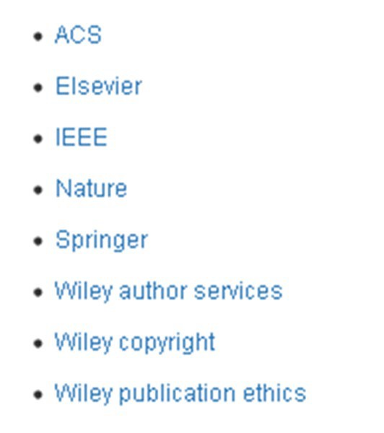
Question 3: Are there written guidelines or rules for authorship?
Every lab or research group should have authorship guidelines
Every journal has authorship guidelines
Every conference call for participation has authorship guidelines
Associations list authorship
guidelines
RCR
On
Campus
Notes:
Presenter
2021-06-22 19:30:22
--------------------------------------------
What are they?
Are they typically followed?

Slide 9
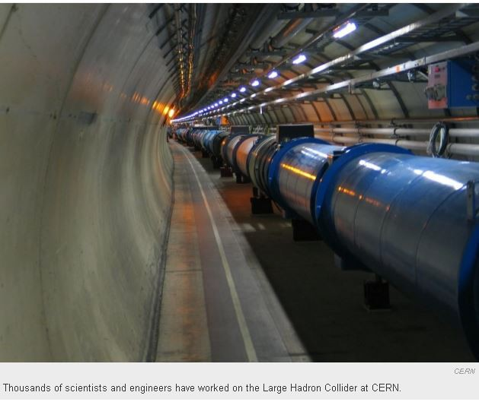
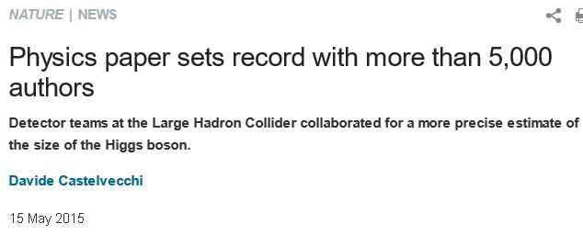
Exceptions!
Notes:
Presenter
2021-06-22 19:30:22
--------------------------------------------
Quadruple-digit author lists are not unusual in fields such as particle physics. A physics paper with 5,154 authors has — as far as anyone knows — broken the record for the largest number of contributors to a single research article. Only the first nine pages in the 33-page article, published on 14 May in Physical Review Letters1, describe the research itself — including references. The other 24 pages list the authors and their institutions.
Some large multi-author groups designate authorship by a group name, with or without the names of individuals. When submitting a manuscript authored by a group, the corresponding author should specify the group name if one exists, and clearly identify the group members who can take credit and responsibility for the work as authors.

Slide 10
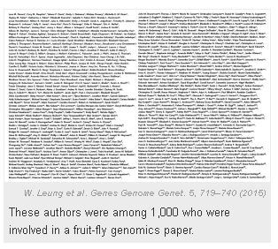
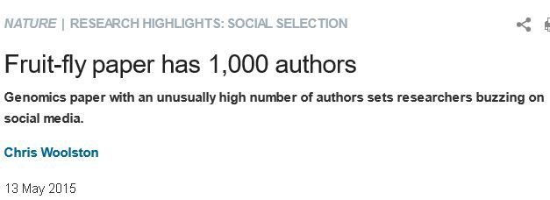
Exceptions!
1,014 authors, with more than 900 undergrads
http://www.nature.com/news/fruit-fly-paper-has-1-000-authors-1.17555
Notes:
Presenter
2021-06-22 19:30:22
--------------------------------------------
Hyperauthorship. The paper, published in the journal Genes Genomes Genetics, names 1,014 authors — with more than 900 undergraduate students among them. Zen Faulkes, an invertebrate neuroethologist at the University of Texas-Pan American in Edinburg, questions on his blog whether every person made enough of a contribution to be credited as an author. But the paper’s senior author, geneticist Sarah Elgin at Washington University in St. Louis, Missouri, says that large collaborations with correspondingly large author lists have become a fact of life in genomics research. “Putting together the efforts of many people allows you to do good projects,” she

Slide 11
Question 4: If there is more than one author, what is the significance of the order of authorship?
It varies….. discipline, research team, journal
Examples: amount of contribution, order of last name, order of seniority
Have this discussion PRIOR to writing the article
Notes:
Presenter
2021-06-22 19:30:22
--------------------------------------------
Give example of nsf project

Slide 12
Authorship Classification
Senior
First
Contributed heavily
Co-author
By order of work done
PI
Group leader
corresponding
alphabetical
Notes:
Presenter
2021-06-22 19:30:23
--------------------------------------------
Distinction of placement

Slide 13
Inappropriate Authorship
Hyperauthorship Ghost
Guest/Gift
Met authorship criteria but denied
Too many authors
Expectation of inclusion
Raise visibility of the status of the paper
Large collaborations
Omitted from paper
Notes:
Presenter
2021-06-22 19:30:23
--------------------------------------------
Hyperauthorship: trustworthiness? cronin
Ghost authorship removes responsibility and transparency Guest authorship is honorary credit when none is due

Slide 14
Unethical authorship: reasons
‘honorary authorship’, where senior researchers are named as authors because of their stature within the institution where the research took place, or because they helped to obtain the funding. (Harvey)
when researchers feel they ‘owe’ authorship to a current or previous colleague in return for their help or mentorship.
a 2017 study of more than 12,000 researchers based in the US and found that roughly one-in-three reported adding honorary authors to their publications. Women and junior faculty were the most likely to do so. (Fong)
Citation: https://www.natureindex.com/news-blog/gift-ghost-authorship-what-researchers-need-to-know

Slide 15
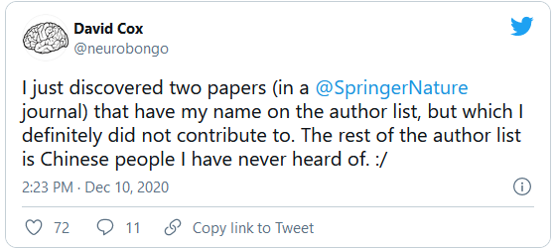
Unethical authorship
http://retractiondatabase.org/RetractionSearch.aspx?

Slide 16
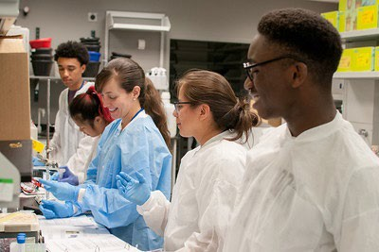
Question 5: How can credit be given to someone who has made an important
contribution?
Acknowledgement
advising about the statistical analysis
collecting or entering the data
modifying or structuring a computer program
conducting routine observations or diagnoses for use in studies
https://www.flickr.com/photos/nihgov/30861587086
Notes:
Presenter
2021-06-22 19:30:24
--------------------------------------------
Leads to transparency. Authors to show their appreciation. Boosts the confidence of students, shows collaboration, it’s what a good leader, a good mentor does when it’s earned.

Slide 17
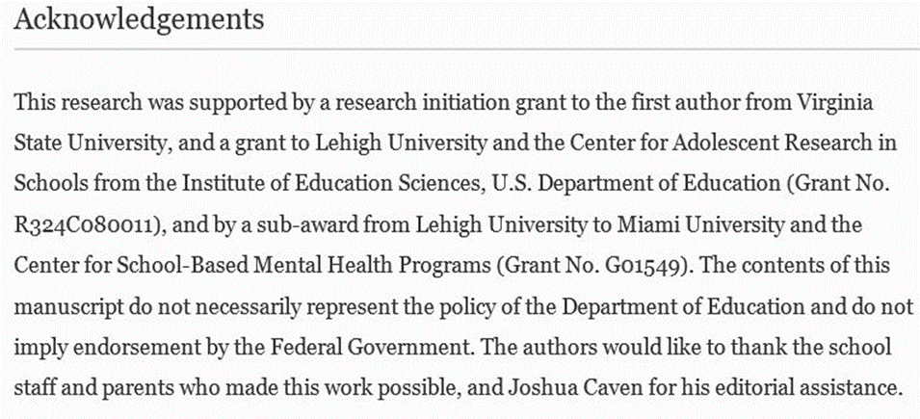
Acknowledgements
Notes:
Presenter
2021-06-22 19:30:24
--------------------------------------------
Leads to transparency. Authors to show their appreciation. Boosts the confidence of students, shows collaboration, it’s what a good leader, a good mentor does when it’s earned.

Slide 18
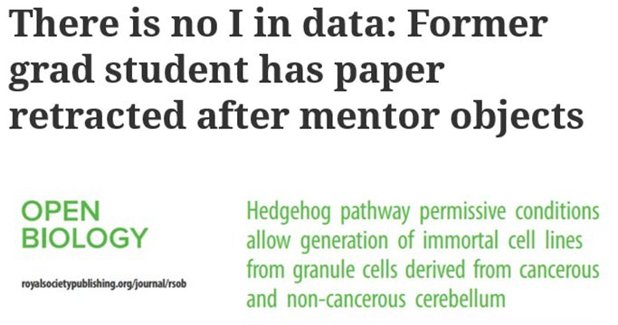
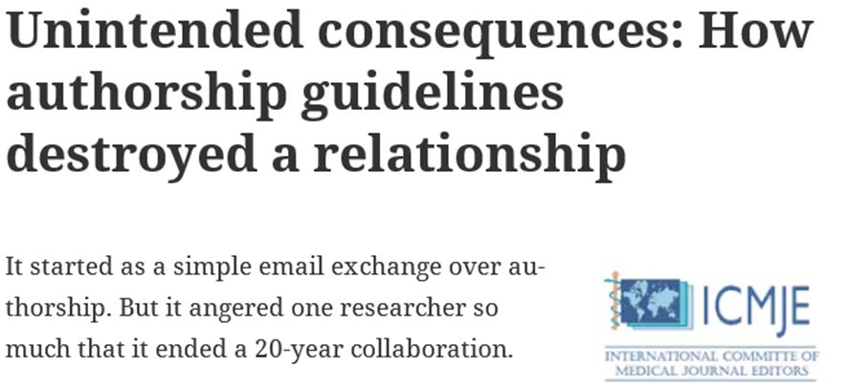
Question 6: What can be done to minimize the risk of disputes about authorship?
Retractionwatch.com
Notes:
Presenter
2021-06-22 19:30:25
--------------------------------------------
Breakout room: come up with an author agreement! Top 3. 6 minutes!

Slide 19
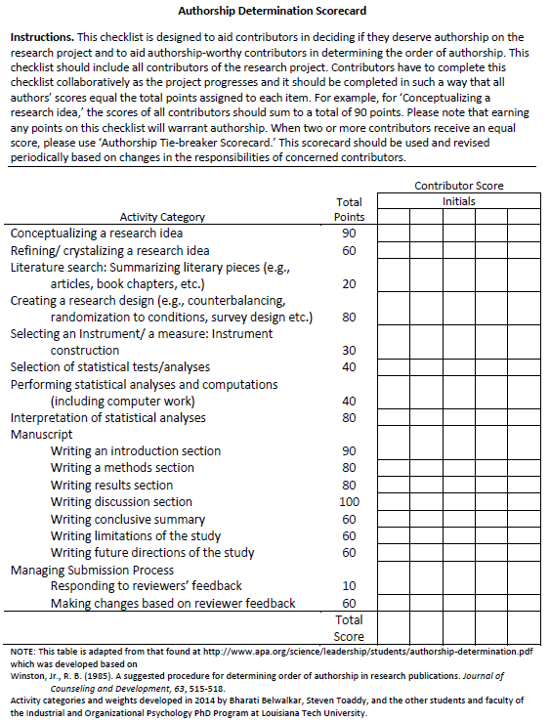
https://www.apa.org/science/leadership/st udents/authorship-determination- scorecard.pdf

Slide 20
Common Authorship Mistakes
Notes:
Presenter
2021-06-22 19:30:25
--------------------------------------------
Need to see the big picture. Many parts.

Slide 21
Common authorship mistakes
References cited
Accurate citations
Justification for research
Interpreting statistics
Reporting graphical information
Deciding on the appropriate statistical methodology
COIs
Self plagiarism
Duplicate publication
Dealing with outliers
Dealing with missing values
Level of contribution
Completeness of literature review

Slide 22
Case Study
Notes:
Presenter
2021-06-22 19:30:26
--------------------------------------------
Need to see the big picture. Many parts.

Slide 23
Citation: On Being A Scientist
Notes:
Presenter
2021-06-22 19:30:26
--------------------------------------------
Written policies of the company? Journal? Discipline? Refer to the guidelines of ethical authorship
LACK of communication

Slide 24
Resources
Notes:
Presenter
2021-06-22 19:30:26
--------------------------------------------
Need to see the big picture. Many parts.

Slide 25
Best practices
Create a clear policy before the start of a project
Establish roles and authorship at the beginning of a project/research
Create a partnership agreement
Develop authorship guidelines for your lab/dept
Transparency
How was the research funded?
Avoid overlapping publication
Understand rules for reusing texts or images

Slide 26
An old saying….
“ If you are willing to take the credit, you have to take the responsibility”

Slide 27
If You Suspect Research Misconduct…
Make a confidential report to the UF
Research Misconduct is fabrication,
Research Integrity Officer (RIO)
Cassandra C. Farley
Associate Director, UF Research Integrity
(352) 273-3052 | cfarley@ufl.edu
falsification, or plagiarism in proposing, performing, or reviewing research, or in reporting research results.
Questionable Research Practices are reports of careless, irregular, or contentious research practices, as well as authorship disputes. They may not meet the standard for research misconduct, but may be a research integrity violation.
You may also report anonymously UF Compliance Hotline: 877-556-5356
Still not sure if it is Misconduct or a QRP? The RIO can help you better understand the situation. You can speak in hypotheticals as you consider making an official allegation.

