Slide 1
RCR Summer Seminar Series
Rigors of Peer Review
Michelle Leonard & Suzanne Stapleton
Marston Science Library
June 24, 2021

Slide 2
Reminders
You must log in with UFL email in order to receive certificate credit
Please take the survey after the class—we value your feedback
In order to allow for free flow of ideas and questions, we will not record the session
Slides and other materials will be sent to attendees after the class

Slide 3
RCR Certification
Mentor/Mentee Relationships- Finding the Right Balance
Collaborative Research
Conflicts of Interest
Data Management and Artificial Intelligence
Compliance at UF &
Research Misconduct Overview
Research Misconduct: Plagiarism
Research Misconduct: ORI: The Lab
Ethics of Authorship
Rigors of Peer Review
Reproducibility & Replicability
IRB & Informed Consent
Export Control Overview Including an overview of Dual Use Technology
Putting it All Together
Notes:
Use if you are teaching a core course; move the highlight box to the session you are presenting

Slide 4
Agenda
Welcome!
Part 1:
What is Peer Review
Types of Peer Review
Examples & Case Studies
Part 2:
Constructive Peer Review
Best Practices & Recommendations

Slide 5
Objectives
Learn the peer review process from both author and reviewer perspectives
Recognize the foundational value of peer review to development of new knowledge
Critique various forms of peer review
Demonstrate formats of providing constructive peer review

Slide 6
Part I. Peer Review: What Authors Need to Know
Notes:
Need to see the big picture. Many parts.

Slide 7
What is peer review?
Notes:
Most common

Slide 8
Publishing Process:
Author writes a paper: review or original research
Find a journal that meets the scope
Initial review by the journal editor
Identifies and sends manuscript to reviewers
Reviewer submits recommendations to the editor
Authors receive notification and follow next steps
GOAL: get published!
Notes:
Before we understand the peer review process, we need to understand the publishing process. Briefly…
Alternative image from Wiley: https://authorservices.wiley.com/Reviewers/journal-reviewers/what-is-peer-review/the-peer-review-process.html

Slide 9
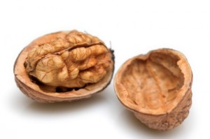
What is peer review? In a nutshell
Is it true?
Is it new?
Is it of interest?
Notes:
Is it true: Can your work be reproduced or even replicated?
Is it new: What new knowledge is being created? How does it move the field forward? Does the work meet the editorial board’s definition of “original” work?
Is it of interest: Are the problems discussed of substantial interest? Would this research advance the knowledge, theory, methods or applications? Does the research clarify the understanding or create new knowledge in the discipline?
Show example of UFJUR rubric

Slide 10
Types of peer review
Notes:
Most common

Slide 11
Types of Peer Review
Definition
Assign your article to another subject-related journal
Reviewers work with each other or with the author
The author does not know who the reviewers are
Revisions/review continue after publication
The reviewers do not know who the authors are, and authors do not know who the reviewers are
Identity of the reviewers and authors are known to all
Open
Single blind
Double blind
Transferable
Collaborative
Post publication
Notes:
Poll. Which type of review do you prefer?

Slide 12
Pros & Cons of Each Type of Peer Review
Single
Pro: author doesn’t know the reviewer; honest review
Con: reviewer bias (i.e., gender, nationality, competitor, delay publication, accept a poorly written paper based on author reputation)
Double:
Pro: reduces bias
Con: reviewer could delay publication based on competition
Open
Pro: hold reviewers accountable
Con: compromised reviews; early career reviewers may need to be careful
Notes:
Most common

Slide 13
Pros & Cons of Each Type of Peer Review
Collaborative
Pro: team of peer reviewers
Con: team of peer reviewers
Post Publication:
Pro: continuously improve the article
Con: when do the corrections cease?
Transferable
Pro: another option of where to publish if 1st choice is rejected
Con: additional revisions of new reviewers
Notes:
Most common

Slide 14
Examples of Peer Review Misconduct
Notes:
Need to see the big picture. Many parts.

Slide 15
Examples of what goes wrong…..
From: RetractionWatch.com

Slide 16
Case Studies
Notes:
Need to see the big picture. Many parts.
[Check time: if 2:20, use both case studies – else choose 2nd or move to end of workshop.]

Slide 17
Case Study
Alana is a medical student researcher in the laboratory of Prof. Hayes. Prof. Hayes has received a manuscript for review for possible publication in a biomedical journal and asks Alana to review the manuscript.
Alana knows that the review process is intended to be confidential, so she asks if the journal editor has been notified of this request. Prof. Hayes says that this is not necessary.
Alana asks for your advice.
http://research-ethics.net/topics/peer-review/#discussion

Slide 18
Case Study
Dr. George Adams receives a manuscript for ad hoc review from the editor of a scientific journal. George gives the manuscript to Al Nance, his senior postdoctoral fellow. He asks Al to read the manuscript and prepare some written comments critiquing it.
One week later, Al provides to Dr. Adams one page of comments. Al also provides Dr. Adams with an extensive verbal critique of the paper. Dr. Adams then prepares a written review which is submitted to the editor of the scientific journal.
A few weeks later, Dr. Adams learns that Al made photocopies of the entire literature citation section of the manuscript because it contained "some useful references". Dr. Adams proceeds to verbally reprimand Al, telling him that no part of a manuscript received for review should be copied.
Comment on the behavior of both the faculty member and the postdoctoral fellow in this scenario.
http://research-ethics.net/topics/peer-review/#discussion

Slide 19
Part 2. Becoming A Peer Reviewer
Notes:
[Suzanne]
Need to see the big picture. Many parts.

Slide 20
The skills you develop as a Reviewer
will benefit your skills as an Author

Slide 21
Importance of Peer Review
Peer reviewing is “the cornerstone of our profession,
on which we need to build all other endeavors”
“Peer review is how we ensure the overall quality of our work,
how we support each other, how we can push and constructively
challenge each other to be truly innovative,
how we can make sure that our work connects with and
is relevant for others, and how we can drive impact and change
that are appropriately targeted at the needs of different communities.”
Köhler, T., González-Morales, M., Banks, G., O’Boyle, E., Allen, J., Sinha, R., . . . Gulick, L. (2020). Supporting robust, rigorous, and reliable reviewing as the cornerstone of our profession: Introducing a competency framework for peer review. Industrial and Organizational Psychology, 13(1), 1-27. doi:10.1017/iop.2019.121
Notes:
3 benefits of peer review:
Develops authors & ideas
Vetting process for quality, relevancy & rigor
Rewarding for reviewers (intrinsic & extrinsic)
Introducing a Competency Framework for Peer Review
Quotes from p2
Society for Industrial and Organizational Psychology (SIOP)
Industrial and Organizational Psychology journal

Slide 22
Constructive Peer Review
Notes:
So you’ve been invited to serve as a reviewer…
First off – can you complete the review in the time requested? If not, say no.
If yes, then think about how you can contribute a constructive peer review.

Slide 23
Elements of a Constructive Review
Supportive
Provides big picture and detailed examples
Impartial, unbiased
See also 10 Simple Rules for Reviewers Rules 3, 4 and 9 https://doi.org/10.1371/journal.pcbi.0020110
Notes:
See also 10 Simple Rules for Reviewers
Rules 3, 4 and 9
https://doi.org/10.1371/journal.pcbi.0020110

Slide 24
Develop Your Own Steps for Peer Review
Overview of journal expectations & forms
First read-through of the submission
Take notes: explain research question & contribution, identify any major flaws
Detailed reading of each section
Organize your notes and thoughts
Write your review
Read your review for constructiveness before submitting it
Modified from Wiley’s Steps in the Peer Review Process https://authorservices.wiley.com/Reviewers/journal-reviewers/how-to-perform-a-peer-review/step-by-step-guide-to-reviewing-a-manuscript.html#15
Notes:
Your Own Steps
Some start with Abstract, Intro and Conclusion
Some start with Figures and Tables
Some follow along in order
Enter into Chat: where do you like to start reading an article?
https://authorservices.wiley.com/Reviewers/journal-reviewers/how-to-perform-a-peer-review/step-by-step-guide-to-reviewing-a-manuscript.html#15

Slide 25
Comments to Author
Short letter
Summary of main findings of submission
Comment on context and relevancy from your expertise
Identify areas for improvement
Attach a marked-up file or detailed points with evidence and recommended actions
Notes:
Comments to Author
Short letter (be succinct & well organized)
Summary of work (start out with your two sentence summary of the work – the topic and major conclusions)
Based on your expertise and knowledge of field & journal, how relevant and novel is this work? What does it contribute to the field?
Areas for improvement: Identify the most critical aspects needed to make this publishable. How can this writing be improved? Provide supporting evidence and actionable notes, specific suggestions

Slide 26
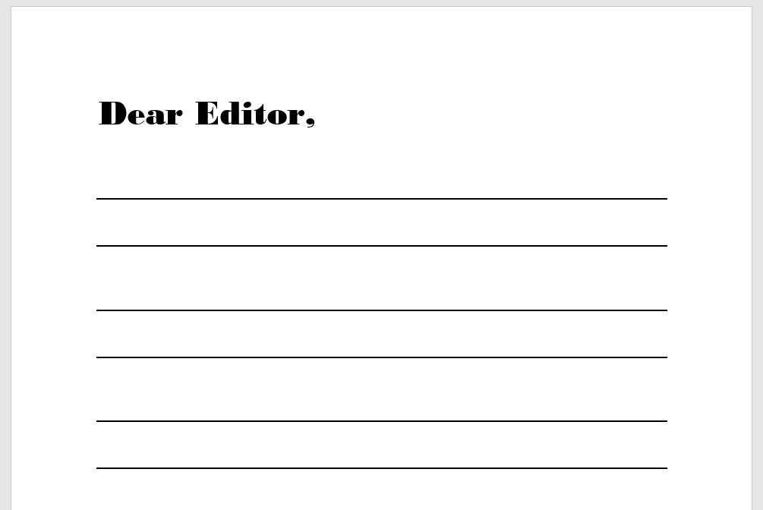
Comments to Editor
Confidential
Subject-specific perspective of the
strengths & weaknesses
Explain your recommendation
Notes:
Comments to Editor
Confidential
Subject-specific perspective (the reason you were invited to review) of the strengths & weaknesses of the article
Explain your recommendation
Can be helpful in evaluating split decisions

Slide 27
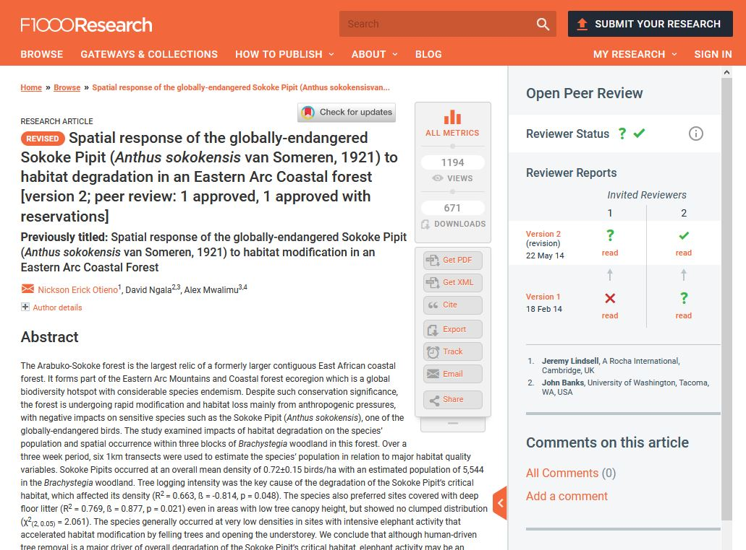
Example of a Journal with Open Review
Otieno NE, Ngala D and Mwalimu A. Spatial response of the globally-endangered Sokoke Pipit (Anthus sokokensis van Someren, 1921) to habitat degradation in an Eastern Arc Coastal forest [version 2; peer review: 1 approved, 1 approved with reservations]. F1000Research 2014, 3:59 (https://doi.org/10.12688/f1000research.3-59.v2)
Notes:
Remember the Types of Peer Review?
F1000Research uses an open peer review system “without editorial bias”
https://f1000research.com/for-referees/peer-reviewing-tips
https://f1000research.com/about

Slide 28
Excerpts from a Constructive Review
“This article addresses the links between habitat condition and an endangered bird species in an important forest reserve (ASF) in eastern Kenya. It addresses an important topic, especially given ongoing anthropogenic pressures on this and similar types of forest reserves in eastern Kenya and throughout the tropics. Despite the rather small temporal and spatial extent of the study, it should make an important contribution to bird and forest conservation. There are a number of issues with the methods and analysis that need to be clarified/addressed however; furthermore, some of the conclusions overreach the data collected, while other important results are given less emphasis that they warrant. Below are more specific comments by section:
Results:
The pruning result is arguably the most important one here – this suggests an intriguing trade-off between poaching and bird conservation (in particular, the suggestion that pruning by poachers may bolster Pipit populations – or at the very least mitigate against other aspects of habitat degradation). Worth highlighting this more in Discussion.”
Banks J. Peer Review Report For: Spatial response of the globally-endangered Sokoke Pipit (Anthus sokokensis van Someren, 1921) to habitat degradation in an Eastern Arc Coastal forest [version 2; peer review: 1 approved, 1 approved with reservations]. F1000Research 2014, 3:59 (https://doi.org/10.5256/f1000research.3556.r3739)
Notes:
Here is an excerpt of a review by John Banks of an original submission that was revised and published in 2014.
Details that make it constructive? [Enter into Chat phrases from this review that are constructive to author]
-places work in context “important topic”, “important contribution”
-rigor: need to clarify methods & analysis, conclusions should not “overreach the data”
-specific comments to address (Methods, Discussion p 7)
-tone: ”Please clarify”
Banks J. Peer Review Report For: Spatial response of the globally-endangered Sokoke Pipit (Anthus sokokensis van Someren, 1921) to habitat degradation in an Eastern Arc Coastal forest [version 2; peer review: 1 approved, 1 approved with reservations]. F1000Research 2014, 3:59 (https://doi.org/10.5256/f1000research.3556.r3739)
https://f1000research.com/for-referees/peer-reviewing-tips

Slide 29
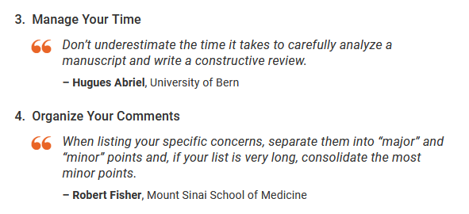
Peer Reviewing Tips
https://f1000research.com/for-referees/peer-reviewing-tips
Notes:
https://f1000research.com/for-referees/peer-reviewing-tips

Slide 30
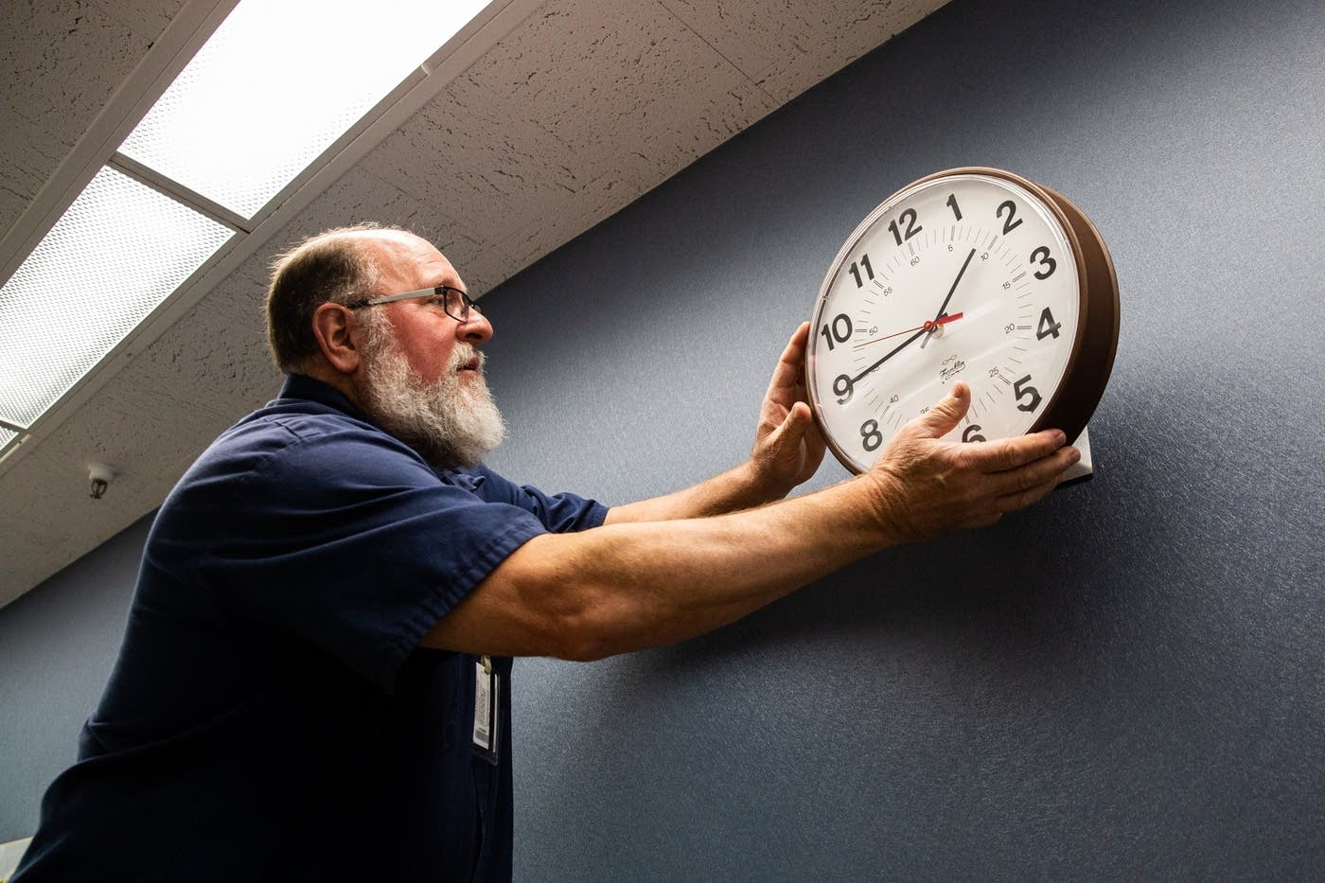
Good Reviews Take Time
Should your service as a reviewer for scholarly publications be rewarded?
If yes, how?
Image: Evan Frost, MPR News, 11/1/2019
Notes:
Poll: Good Reviews Take Time
Should your service as a Reviewer for scholarly publications be rewarded? Yes; No; Don’t Know
If yes, how? (respond in Chat)
Publisher options:
Provide reviewers free access to one of their products, (e.g. Elsevier –Scopus)
Annual Acknowledgement in the journal
Financial reward –payment uncommon, discount on purchases (e.g 20% APC fee discount on your next publication)
Certificate

Slide 31
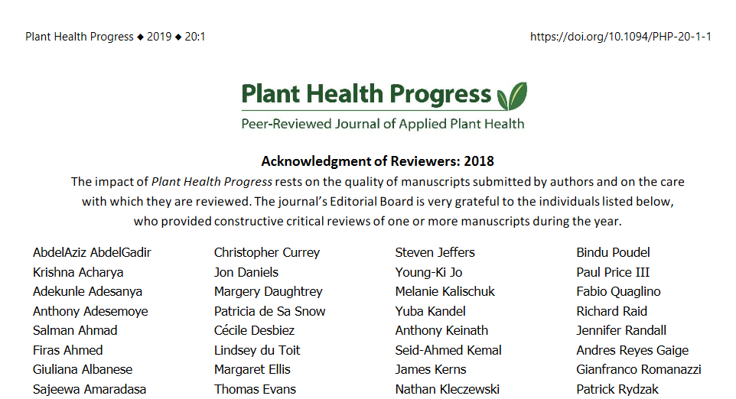
Reviewer Acknowledgement
Notes:
Poll: Good Reviews Take Time
Should your service as a Reviewer for scholarly publications be rewarded? Yes; No; Don’t Know
If yes, how? (respond in Chat)
Publisher options:
Provide reviewers free access to one of their products, (e.g. Elsevier –Scopus)
Annual Acknowledgement in the journal
Financial reward –payment uncommon, discount on purchases (e.g 20% APC fee discount on your next publication)
Certificate

Slide 32
Publons from Clarivate Analytics Web of Science
Evidence of peer review scholarly output
Recognition for your contributions as a reviewer
https://publons.com
Notes:
Web of Science Publons
UF: 2,001 (UF 1,915 + UF IFAS 8 + COM 54 + Cof Dentistry 8+ CofPharmacy 1992 + CoMJAX 2001) 6/24/2021
What it is: designed to provide evidence of peer review scholarly output
How it works
Metrics for Reviews as well as Publications
Reviews verified with Publisher
Displayed after article published
Displays journal(s) you reviewed for
Compare your output of reviews to others in your field
review to publication ratio
Post publication review: scoring for quality & Significance
Private vs public profile
Metrics based only on Web of Science Core Collection
https://play.vidyard.com/JXzPkrTRM7swRB7XFM1XUY
UF: 1,967 (UF + UF IFAS+ UF College of Medicine + College of Dentistry + College of Pharmacy + College of Medicine JAX) 7/29/2020

Slide 33
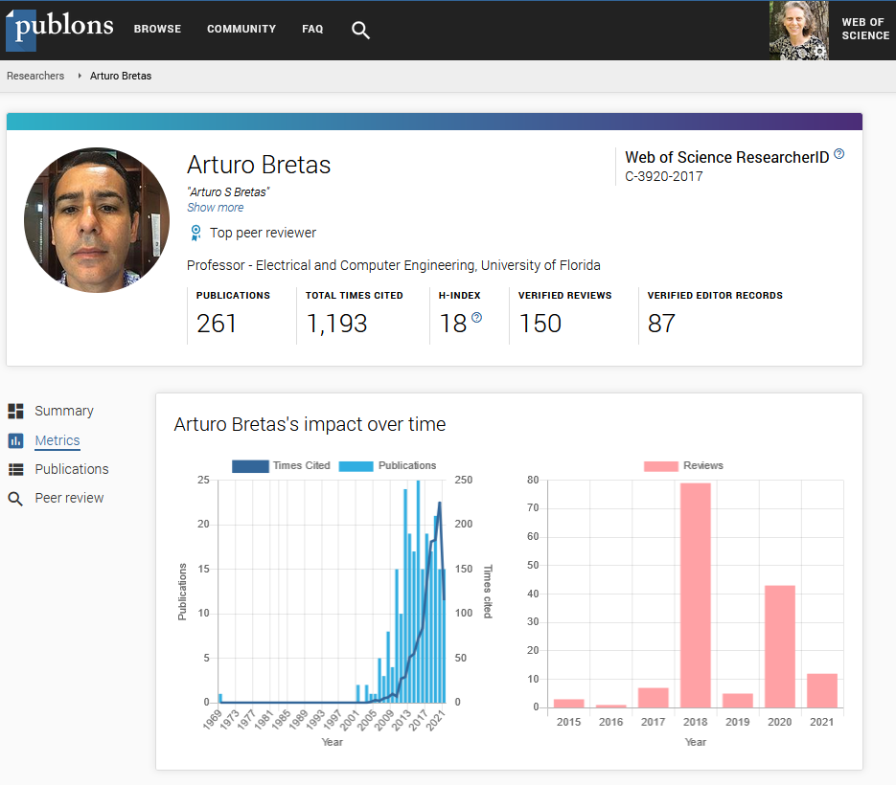
Publons: A look inside
Tips:
Explore your research field
Create a free profile with areas of expertise and availability
Publons Public Profile Metrics
for Dr. Arturo Bretas, UF Electrical & Computer Engineering, 6/24/2021
Notes:
Web of Science Publons
UF: 1,967 (UF + UF IFAS+ UF College of Medicine + College of Dentistry + College of Pharmacy + College of Medicine JAX) 7/29/2020
What it is: designed to provide evidence of peer review scholarly output
How it works
Metrics for Reviews as well as Publications
Reviews verified with Publisher
Displayed after article published
Displays journal(s) you reviewed for
Compare your output of reviews to others in your field
review to publication ratio
Post publication review: scoring for quality & Significance
Private vs public profile
Metrics based only on Web of Science Core Collection
Optional display of h-index (due to tendency for it to be mis-used as proof of productivity & impact, rather than potential indicator)

Slide 34
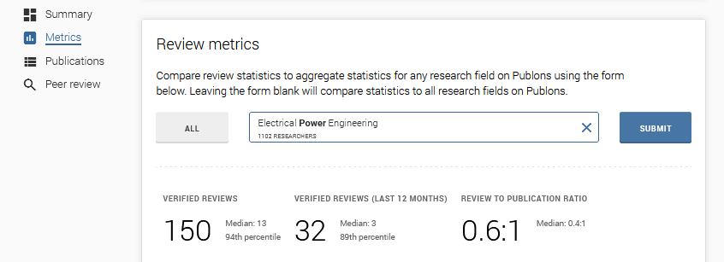
Publons: Review Metrics by Discipline

Slide 35
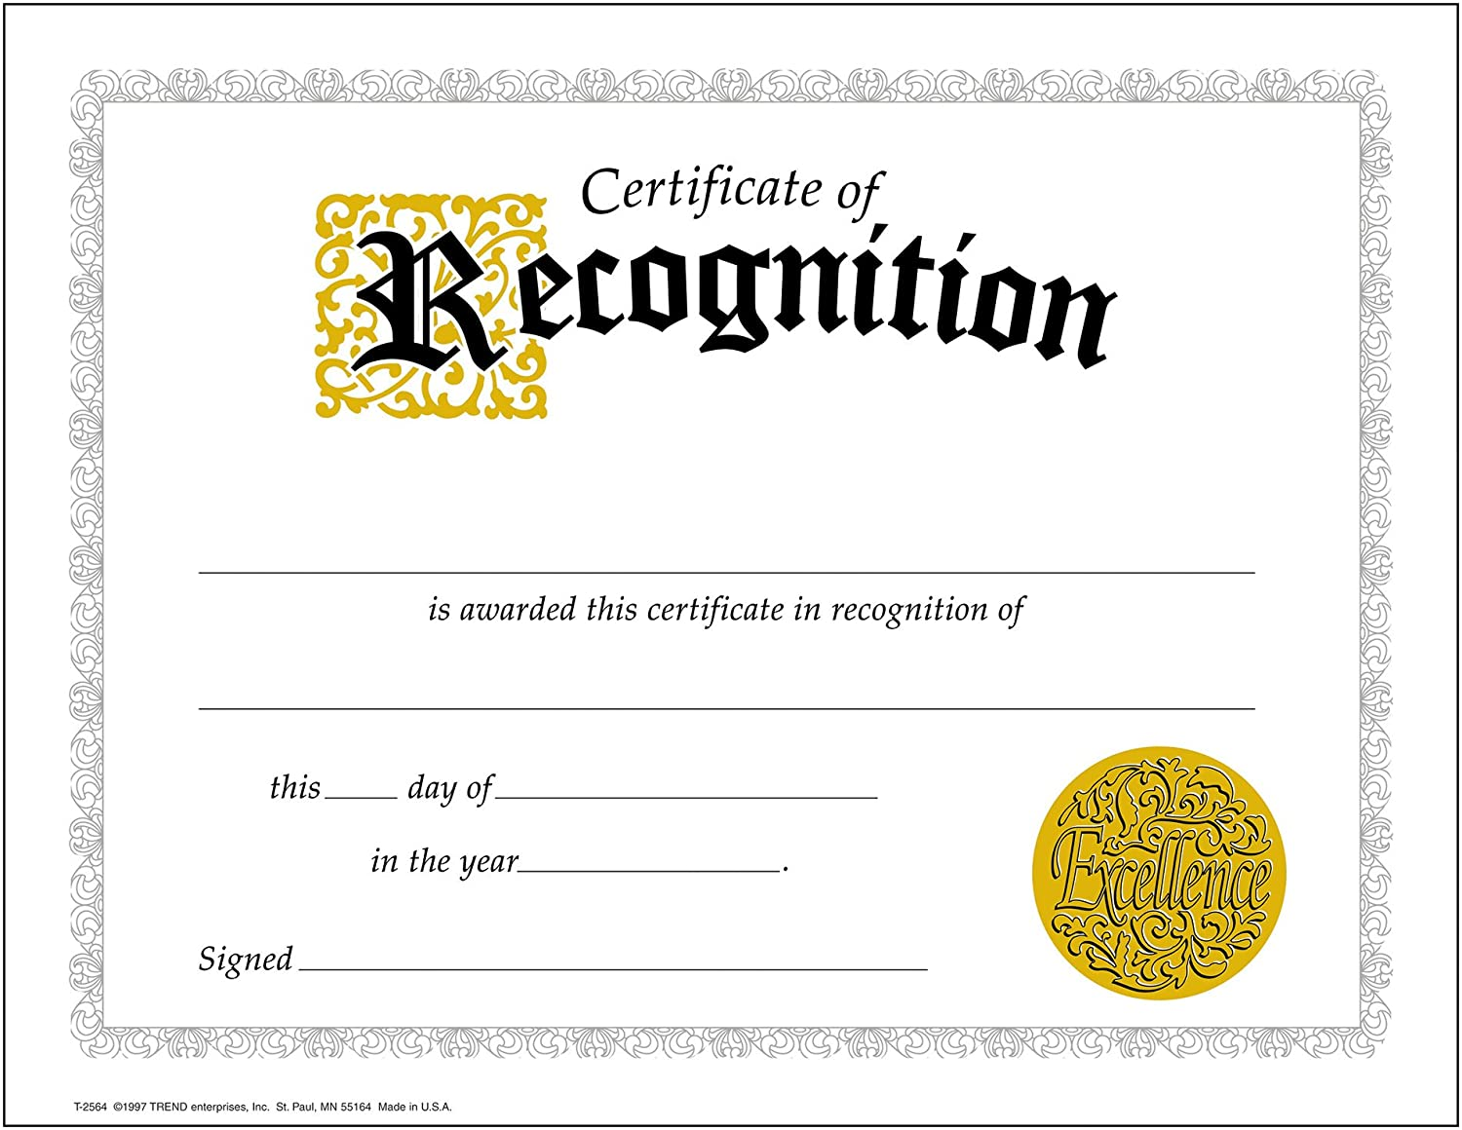
Develop Skills as a Reviewer
A Few Reviewer Certification Programs
Web of Science Academy
https://webofscienceacademy.clarivate.com/learn
BioMedical Journal Reviewer Training
https://www.bmj.com/about-bmj/resources-reviewers/training-materials
The Optical Society OSA Reviewer Certification
https://www.osapublishing.org/reviewer_certification/?module=getting_started
Notes:
Many publishers now offer online training for new reviewers. Pros/Cons – may lead to invitations to review!
Reviewer Certifications
Publons Academy Publons Academy video: https://play.vidyard.com/bnfagcQ9QJmz3GYkeDGfXf
publons.com/community/academy/ As of May 31, 2021, redirect to Web of Science Academy
https://webofscienceacademy.clarivate.com/learn
BioMedical Journal Reviewer Training
https://www.bmj.com/about-bmj/resources-reviewers/training-materials
The Optical Society OSA Reviewer Certification
https://www.osapublishing.org/reviewer_certification/?module=getting_started
OSA reviewer recognition and perks: https://www.osapublishing.org/reviewer/?page=reviewer_recognition_and_rewards_program

Slide 36
Be Constructive
“Be constructive, view your reviewer role as an opportunity to help improve the paper you are reviewing.”
B. Maclver, Stanford University

Slide 37
Reviewers are rated
Editors and Publishers rate their Reviewers on:
Timeliness
Quality of Review
Good Communication
Notes:
Reviewers are rated
Editors & Publishers rate their Reviewers
At the Springer journal where I worked, reviewers were rated on timeliness, quality of review, and good communication
Low ratings lead to fewer invitations
Be honest and fair to authors – do not accept if cannot complete on time, unbiased, recuse if conflict of interest, provide a thorough review, communicate in an effort to improve the publication (not to criticize the authors), maintain good communication with the editor

Slide 38
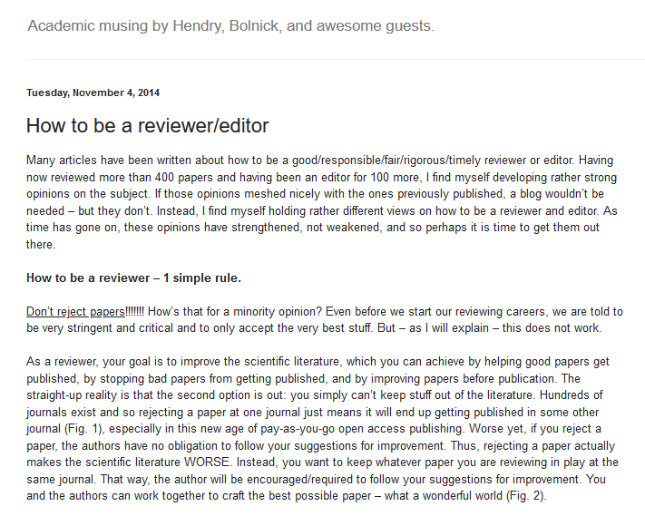
Discussion
Eco Evo Eco Evo blogpost, 11/4/2014. https://ecoevoevoeco.blogspot.com/2014/11/how-to-be-reviewereditor.html
Notes:
“How to be a reviewer/editor” blogpost by Andrew Hendry
https://ecoevoevoeco.blogspot.com/2014/11/how-to-be-reviewereditor.html
1 simple rule: Don’t reject papers!!!!
“As a reviewer, your goal is to improve the scientific literature, which you can achieve by helping good papers get published, by stopping bad papers from getting published, and by improving papers before publication.” Andrew Hendry, 11/4/2014
Is the paper a good idea but poorly executed? Even if the science is well done, does it advance knowledge in the field? How much time is it worth working with authors to improve a manuscript?
What do you think? [enter reactions, thoughts, comments into Chat]

Slide 39
Best Practices & Recommendations
Notes:
Need to see the big picture. Many parts.

Slide 40
Best practices
Agree to review manuscripts in your area of subject expertise
Respect the confidentiality policy of the journal
Do not use information obtained during the peer-review process
Declare all Conflicts of Interests before accepting invitation to review
Train and practice
Notes:
Best practices: Train & Practice: Remember The skills you develop as a Reviewer will benefit your skills as an Author
Reviewer certification
Practice
Serve as a co-reviewer
Learn from mentors
Volunteer!

Slide 41
Selected Resources
10 Simple Rules for Reviewers by P E Bourse & A Korngreen, https://doi.org/10.1371/journal.pcbi.0020110
Standing Up for Science 3: Peer Review; The nuts and bolts: A guide for early career researchers
https://senseaboutscience.org/activities/peer-review-the-nuts-and-bolts/
PLOS Peer Review Essential Series, https://plos.org/resources/for-reviewers/peer-review-toolbox/
Opinions & Discussions about Peer Review Process from the Scholarly Kitchen blog archive, https://scholarlykitchen.sspnet.org/collection/peer-review/
Notes:
Selected Resources
10 Simple rules for reviewers by P E Bourse & A Korngreen, https://doi.org/10.1371/journal.pcbi.0020110
Standing up for Science 3: Peer Review; The nuts and bolts: A guide for early career researchers
https://senseaboutscience.org/activities/peer-review-the-nuts-and-bolts/
PLOS Peer Review Essentials Series: https://plos.org/resources/for-reviewers/peer-review-toolbox/
Opinions & Discussions about Peer Review Process from the Scholarly Kitchen blog archive, https://scholarlykitchen.sspnet.org/collection/peer-review/ for example: Scholarly Kitchen blog 9/16/2019. https://scholarlykitchen.sspnet.org/2019/09/16/quality-is-multi-dimensional-how-many-ways-can-you-define-quality-in-peer-review/
Others:
Wiley’s Reviewing with Empathy: https://authorservices.wiley.com/asset/Reviewing_with_Empathy.pdf
PreReview – preprint review platform: https://prereview.org/
F1000Research Peer Review Examples
https://f1000research.com/for-referees/peer-reviewing-tips/examples

Slide 42
Thank you!
Please take the survey at:
https://ufl.qualtrics.com/jfe/form/SV_1WVLQUcrykr7YFM

Slide 43
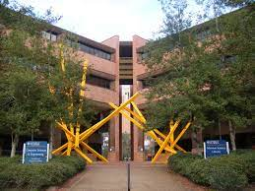
Questions?
Michelle Leonard
mleonard@uflib.ufl.edu
Suzanne Stapleton
suzanne@ufl.edu

Slide 44
If You Suspect Research Misconduct…
Research Misconduct means fabrication, falsification, or plagiarism in proposing, performing, or reviewing research, or in reporting research results.
Questionable Research Practices are reports of careless, irregular, or contentious research practices, as well as authorship disputes, may not meet the standard for research misconduct but may be a research integrity violation.
Make a confidential report to the UF Research Integrity Officer (RIO)
Cassandra C. Farley
(352) 273-3052 | cfarley@ufl.edu
You may also report anonymously
UF Compliance Hotline: 877-556-5356
Still not sure if it is Misconduct or a QRP? The RIO can help you better understand the situation. You can speak in hypotheticals as you consider making an official allegation.

Slide 45
JUR Peer Review Rubric

Slide 46
Additional Case Study
Alana is a medical student researcher in the laboratory of Prof. Hayes. Prof. Hayes has received a manuscript for review for possible publication in a biomedical journal and asks Alana to review the manuscript.
Alana knows that the review process is intended to be confidential, so she asks if the journal editor has been notified of this request. Prof. Hayes says that this is not necessary.
Alana asks for your advice.
http://research-ethics.net/topics/peer-review/#discussion

