Slide 1
RCR Summer Seminar Series
Data Ethics
Dan Maxwell, Brian Stucky UF Research Computing

Slide 2
Reminders
You must log in with UFL email in order to receive certificate credit
Please take the survey after the class—we value your feedback
In order to allow for free flow of ideas and questions, we will not record the session
Slides and other materials will be sent to attendees after the class

Slide 3
RCR Certification
Mentor/Mentee Relationships- Finding the Right Balance
Collaborative Research
Conflicts of Interest
Data Ethics
Compliance at UF &
Research Misconduct Overview
Research Misconduct: Plagiarism
Research Misconduct: ORI: The Lab
Ethics of Authorship
Rigors of Peer Review
Reproducibility & Replicability
IRB & Informed Consent
Export Control Overview Including an overview of Dual Use Technology
Putting it All Together

Slide 4
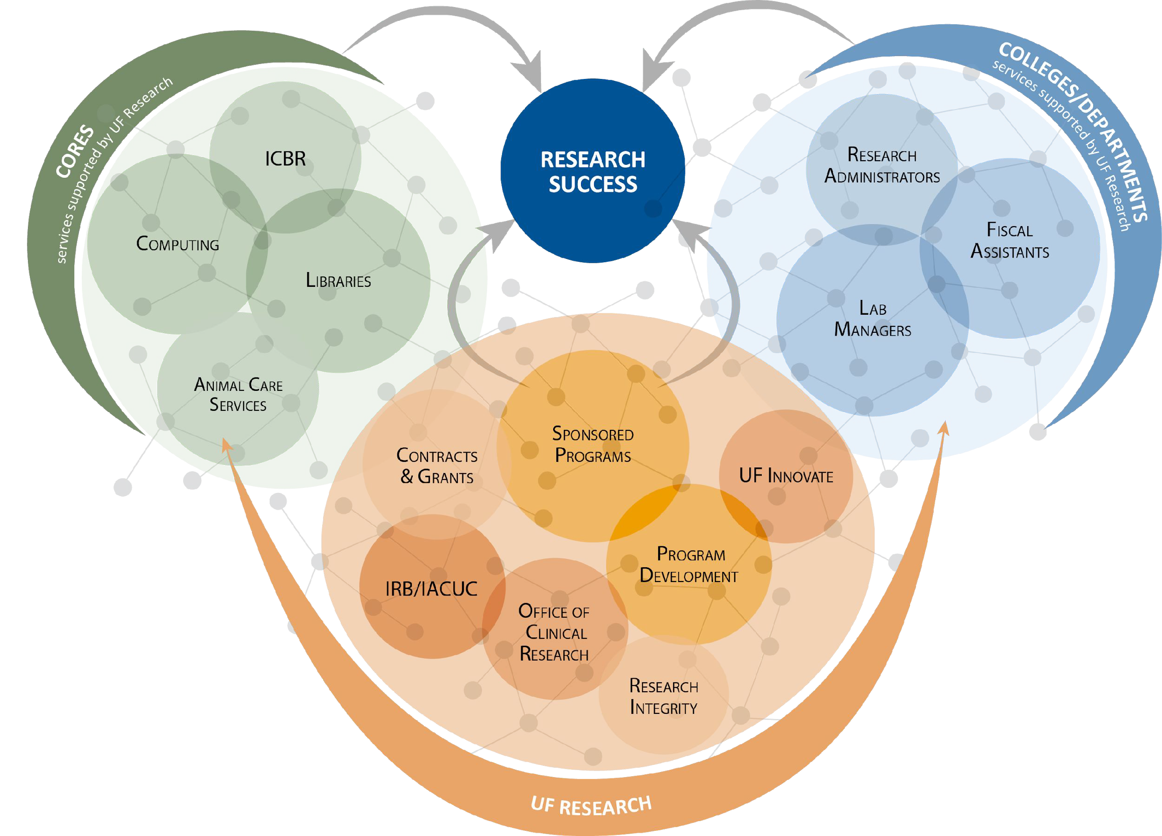
UF Research Enterprise

Slide 5
Agenda
Case study #1
Philosophical context
Practical guidelines
Case study #2
Case study #3

Slide 6
Case study #1

Slide 9
Practical guidelines (based on RC’s draft dataset hosting policy)
Can I legally use the data? (data licensing issues)
Can I ethically use the data?
If the data include personal identifiable information (PII), were the subjects
aware that the data were being collected and did they b) agree to contribute the data for arbitrary research use?
Does the dataset have a clear, well-documented curation process?
Are there any known problems with the dataset?
Is the proposed research use ethical? (IRB approval, e.g.)
Are there any other relevant data use restrictions?

Slide 10
Case study #2

Slide 11
Case study #2 - group notes
Is it (ever) ethical to use leaked, private data for research?
No. (Ends do not justify the means.) Seems many groups concluded it was not ethical.
Authors argue that no additional harm was done, but that is hard to assess.
What if the data use contributes to public health or national security (hard to draw that line)?
Was it ethical to study the social media users without their knowledge or consent?
Several groups concluded it was not ethical, and could not understand how an IRB would sign off on it.
Even more of an issue with AI research - unethical research could lead to unethical applications of AI models. (Bad input -> bad output.)

Slide 12
Case study #3

Slide 13
Case study #3 - group notes
Were human subjects involved in the study?
At least one group thought so.
Another group: technically, perhaps not, but there clearly was still risk to participants in the study.
Is it ever acceptable to study human subjects without obtaining informed consent?
Deontologically, no.
A consequentialist would say yes, sometimes.
Informed consent is really tricky in a “big data” world.

Slide 14
Thank you!
Please take the survey at: https://ufl.qualtrics.com/jfe/form/SV_1WVLQUcrykr7YFM

Slide 15
If You Suspect Research Misconduct…
Research Misconduct means fabrication, falsification, or plagiarism in proposing, performing, or reviewing research, or in reporting research results.
Questionable Research Practices are reports of careless, irregular, or contentious research practices, as well as authorship disputes, may not meet the standard for research m^{RC}is^{R}conduct but may be a research
Make a confidential report to the UF Research Integrity Officer (RIO)
Cassandra C. Farley
(352) 273-3052 | cfarley@ufl.edu
_{You m}Sti_{a}ll n_{y}ot_{a}su_{l}r_{s}e_{o}if it_{re}is M_{p}i_{o}sco_{r}n_{t}du_{a}c_{n}t o_{o}r a_{n}Q_{y}R_{m}P? T_{o}h_{u}e R_{s}IO_{ly}can
help you better understand the situation. You can
sp_{U}ea_{F}k i_{C}n h_{o}yp_{m}oth_{p}et_{l}i_{i}c_{a}al_{n}s a_{c}s _{e}you_{H}co_{o}ns_{t}i_{l}d_{i}e_{n}r m_{e}a:king an
official allegation.
877-556-5356
On
_{i}C_{n}am_{t}p_{e}u_{g}s
rity violation.

