Slide 1



7/14/2021
RCR Summer Seminar Series
Budgeting Basics for Research Proposals
Amber Hardie
Sponsored Programs Manager
Sponsored Programs
RCR
On Campus
Reminders
You must log in with UFL email in order to receive certificate credit
Please take the survey after the class—we value your feedback
In order to allow for free flow of ideas and questions, we will not record the session
Slides and other materials will be sent to attendees after the class
1

Slide 2
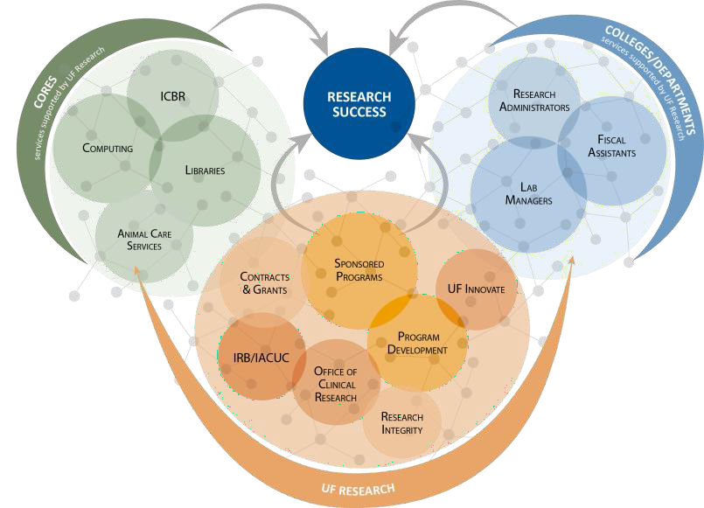
RCR Certification
7/14/2021
Mentor/Mentee Relationships- Finding the Right Balance
Collaborative Research
Conflicts of Interest
Data Management and Artificial Intelligence
Compliance at UF &
Research Misconduct Overview
Research Misconduct: Plagiarism
Research Misconduct: ORI: The Lab
Ethics of Authorship
Rigors of Peer Review
Reproducibility & Replicability
IRB & Informed Consent
Export Control Overview Including an overview of Dual Use Technology
Putting it All Together
RCR
On Campus
UF Research Enterprise
1

Slide 3
Strategic Budgeting
7/14/2021
Read the solicitation
Who is the sponsor? (i.e. Federal, Industry, Non-profit)
Utilize internal resources and work with your departmental staff and admins
Your Department and/or College may have more stringent rules than
the overarching UF rules
Do NOT share more budget details than the sponsor requires
Use calendar months whenever possible to report effort to the sponsor
RCR
On Campus
What is a budget?
A budget is a financial proposal that reflects the cost of the work proposed.
A budget is anticipated project costs that represent the researcher's
best estimate of the funds needed to support the proposed work.
A budget contains information about activities planned and personnel who will serve on the project provides reviewers with an in-depth picture of how the project will be structured and managed.
1

Slide 4
What are Direct Costs?
7/14/2021
Direct costs are those budget items that support performing the scope of work and are reasonable, easily identifiable and allocable to the project.
The Principal Investigator is responsible for assigning costs
appropriately.
https://research.ufl.edu/dsp/proposals/budgeting.html
RCR
On Campus
Developing a Budget
Some Common Budget Categories for Direct Costs (as seen in UFIRST):
Personnel Subrecipients Travel
Participant Support Costs Equipment
Materials & Supplies Rental Fees
Publication Costs Consultant Services Other:
Tuition Scholarships/Fellowships Animal / Human Subject Costs
1

Slide 5
Personnel
7/14/2021
Who will be working on the project (e.g. collaborators, consultants, subrecipients, undergraduate students, graduate students)?
Have you included at least the minimum graduate student salary and associated tuition?
Does the sponsor have a salary cap or limitation?
Have you included the recommended 3% escalation?
Are any faculty expected to receive tenure during the project?
RCR
On Campus
Personnel
One of the major components of any budget will be accounting for the people who will be working on the project.
Quantified Effort is a commitment!
If you propose to work 1.2 calendar months on a project, you must meet
that commitment.
Ideally, all personnel effort will be paid from the grant/contract funding the project. If not, the PI’s department is cost sharing the portion of time that is not being charged to the sponsor.
1

Slide 6
Personnel: Salary Cap
Some sponsors have a salary cap, which limits how much salary can be requested for any personnel on the project.
7/14/2021
The most common cap is used by Public Health Service sponsors and is tied to Executive Level II that is updated annually, currently: ?
Sponsors that use this cap:
National Institutes of Health
Centers for Disease Control and Prevention
Other sponsors may follow this cap for certain programs, or may have their own salary cap, so always check the solicitation!
RCR
On Campus
Personnel: Key vs Non-Key
Key Personnel
Individuals who are essential to carrying out the scope of work on the project and who are responsible for the scientific and technical direction of the project.
Non-Key Personnel
Anybody else whose effort is required to complete the project, yet are not directing its scientific development or execution. Individuals performing these duties can generally be replaced by someone of similar class or training.
1

Slide 7
Fringe Benefit Rates
7/14/2021
UF has federally negotiated “fringe rates” that capture the cost of employee benefits:
Current Rates
New rates become effective annually in July!
Faculty | 31.0%
COM Faculty | 18.3%
Exempt TEAMS | 40.7%
Non-Exempt TEAMS | 54.6%
Grad Students & Postdocs | 10.9%
Student/Fed Work Study | 1.9%
RCR
On Campus
https://research.ufl.edu/wp-content/uploads/FA-agreement.pdf
UF Tuition
At UF, tuition remission is considered a component of a graduate research assistant’s compensation package for the work performed.
The tuition should be charged to the grant or contract in proportion to the graduate student’s budgeted effort.
Tuition recovery will increase at 10% for all non-Engineering departments in 2021-2023 and 5% in 2024. Budget for this!
If the Sponsor does not allow tuition to the grant or contract, the tuition must be covered from another funding source.
https://research.ufl.edu/dsp/proposals/budgeting/graduate-student-salary-tuition-costs.html

Slide 8
Personnel: Non-UF
7/14/2021
What if the personnel aren’t UF employees?
If non-UF personnel will be included on the project, more information will be needed to understand what role they play.
Caveat: Some sponsors have very specific guidelines for classifying an individual as a collaborator vs. consultant.
RCR
On Campus
Consultants
UF faculty CANNOT be paid as consultants from UF sponsored projects.
UF faculty devoting time to a sponsored project should be budgeted in the personnel line, with the appropriate amount of salary and fringe corresponding to the effort devoted to the project.

Slide 9
Subrecipients
7/14/2021
When UF has included a subrecipient in their budget at the time of proposal, the UF PI is required to obtain the following:
Minimum required documents:
Signed endorsement from the sub’s authorized official
Detailed scope of work
Detailed budget
Detailed budget justification
RCR
On Campus
Travel
Does the scope require require travel?
Does you need to disseminate research results?
Does you need to meet with subrecipients or collaborators?
Does the sponsor allow travel?
Will you need to leave the US?

Slide 10
Travel
7/14/2021
Travel may be required for the scope of work proposed, or by the sponsor for mandatory meetings, or to disseminate research results at a conference.
Research the necessary travel costs using today’s rates, but think about future cost increases. Travel can be escalated in multi-year projects.
RCR
On Campus
Travel
Travel charges may include airfare, hotel charges, taxis, visas, passports, entry or exit taxes, per diems and rental cars. Most sponsors require (in the budget justification section) the purpose, destination and time span for each trip, and the number of individuals for whom funds are requested. This must be fully explained, outlining the benefit of the travel to the project.
Sponsored research funds are subject to both sponsor and State of Florida rules and regulations.

Slide 11
Equipment
7/14/2021
Useful life of more than 1 year
Acquisition cost of $5000 or more. Includes: Invoice amount, sales tax, freight costs, installation costs, and other cost incurred to acquire
Sponsor may have different thresholds (i.e. State of Florida is $1,000)
RCR
On Campus
Participant Support Costs
Costs that are paid to or on behalf of participants or trainees (but NOT employees) in connection with conferences or training projects.
Participants do not provide deliverables, perform work, or provide training.
Direct costs for items such as:
o Stipends
o Meal allowances
o Travel allowances
o Registration fees

Slide 12
Facilities & Administrative (F&A) Costs
7/14/2021
UF’s full applicable F&A rate should be used unless the non-profit or government agency has a published F&A limitation outlined in their sponsor guidelines or published on their website.
UF does not accept a F&A limitation from a for-profit company, even if that rate is published in the sponsor guidelines. These entities are expected to pay UF’s full applicable F&A rate.
RCR
On Campus
Cost Share
It is the policy of the University that only mandatory cost sharing is offered to sponsors. Mandatory cost sharing requirements are usually defined by law, statute, sponsor regulations, or written in the application guidelines for a specific program.
A copy of the request for proposal (RFP), regulations or guidelines must be submitted with the proposal, when there is a mandatory cost share requirement.

Slide 13
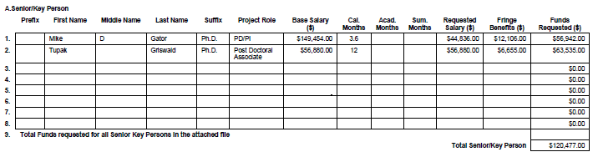
Budget Justification
7/14/2021
The budget justification is a written narrative that explains the rationale for including all the costs included in the budget.
The costs in the justification should exactly match the costs as they are broken down in the sponsor budget.
Include all the same categories as shown in the budget and use this space to identify precisely who and what is covered by each cost.
RCR
On Campus
Budget vs. Budget Justification
Budget Justification Excerpt:
Mike Gator, Ph.D. (Principal Investigator; 2.6 summer months). Dr. Gator will direct and coordinate the proposed studies.
Tupak Griswald, Ph.D. (Postdoctoral fellow; 10 calendar months). She will help direct, execute, and interpret the studies described in Aims 1 and 3.
Martha Stewart, D.V.M., Ph.D. (Collaborator, 0.6 calendar) is a Professor of Experimental Pathology College, University of Florida. She will help in the studies described in Aim 2. No salary or other support is requested by Dr. Stewart.

Slide 14

Thank you!
7/14/2021
Please take the survey at:
https://ufl.qualtrics.com/jfe/form/SV_1WVLQUcrykr7YFM
Amber Hardie Sponsored Programs Manager
Sponsored Programs ahardie@ufl.edu or 352-392-8581
RCR
On Campus
If You Suspect Research Misconduct…
Research Misconduct means
fabrication, falsification, or plagiarism in proposing, performing, or reviewing research, or in reporting research results.
Questionable Research Practices are reports of careless, irregular, or contentious research practices, as well as authorship disputes, may not meet the standard for research misconduct but may be a research integrity violation.
Make a confidential report to the UF Research Integrity Officer (RIO)
Cassandra C. Farley
(352) 273-3052 | cfarley@ufl.edu
You may also report anonymously UF Compliance Hotline: 877-556-5356
Still not sure if it is Misconduct or a QRP? The RIO can help you better understand the situation. You can speak in hypotheticals as you consider making an official allegation.
RCR
On Campus

