Slide 1

RCR Summer Seminar Series
Recognizing Predatory Publishing
Michelle Leonard Suzanne Stapleton Terry Kit Selfe, Ph.D, DC
RCR
On Campus

Slide 2
Reminders
You must log in with UFL email in order to receive certificate credit
Please take the survey after the class—we value your feedback
In order to allow for free flow of ideas and questions, we will not record the session
Slides and other materials will be sent to attendees after the class
RCR
On Campus

Slide 3
RCR Core Courses
Seminar |  |  | Instructor | Date
Mentor/Mentee Relationships- Finding the Right Balance |  |  | Linda Searby | May 20 | 2:00-3:00pm
Collaborative Research |  |  | Michelle Leonard & Cassandra Farley | May 25 | 2:00-3:30pm
Research Conflicts of Interest |  |  | Amber Moore | May 27 | 2:00-3:30pm
Research Misconduct Overview |  |  | Cassandra Farley & Laura Schaecher | June 3 | 2:00-3:30pm
Research Misconduct: Plagiarism |  |  | Cassandra Farley & Laura Schaecher | June 8 | 2:00-3:00pm
Research Misconduct: ORI: The Lab |  |  | Bob Kolb & Terry Selfe | June 15 | 1:00-2:30 June 17 | 1:00-2:30
Ethics of Authorship |  |  | Michelle Leonard | June 22 | 2:00-3:00pm
Rigors of Peer Review |  |  | Michelle Leonard & Suzanne Stapleton | June 24 | 2:00-3:00pm
New! Data Ethics for Trustworthy A.I. |  |  | Dan Maxwell & Brian Stucky | June 28 | 2:00-3:00pm
Reproducibility & Replicability |  |  | Hao Ye | June 29 | 2:00-3:00pm
 |  |  | Tiffany Pineda | July 1 | 2:00-3:30pm
IRB & | Informe | d Consent
Export | Contro | l Overview | Marsha Pesch | July 8 | 2:00-3:30pm
 |  |  | Michelle Leonard & Cassandra Farley | July 15 | 2:00-3:00pm
Putting it All Together
RCR
On
Campus

Slide 4
Special Topics
Seminar |  |  | Instructor | Date
New! Research Material Transfer Agreements and International Shipping |  |  | William Bucha & Carter Post | May 26 | 2:00-3:00pm
New! The Effects of Culture on the Research Lab Dynamics and Study Design |  |  | Tiffany Pineda | June 2 | 1:00-2:30pm
New! International Engagements in Research Update |  |  | Cassandra Farley | June 23 | 2:00-3:00pm
Introduction to Research Metrics and Impact |  |  | Tara Cataldo, Terry Selfe, & Suzanne Stapleton | June 30 | 1:00-2:30
New! Budgeting Basics for Research Proposals |  |  | Amber Hardie | July 12 | 1:00-2:00pm
New! Predatory Journals |  |  | Michelle Leonard, Terry Selfe, Suzanne Stapleton | July 14 | 1:00-2:30pm
New! | CV an | d Biosketch Truthfulness | Terry Selfe | July 21 | 1-2:30
New! | Leader | ship Roundtable* | Terra Dubois, Moderator | August, TBD
RCR
On
Campus

Slide 5
Agenda
Reminders for the session
Defining predatory publishing scams
OMICS scandal
Warning signs
Adam Ruins Everything
A cautionary tale
Proactive approaches to ethical scholarship
This Photo by Unknown Author is licensed under CC BY-NC
RCR
On Campus

Slide 6
Poll
RCR
On Campus

Slide 7
Defining predatory
“Predatory” refers to fraudulent or dishonest
Publishing, journals, conferences
Academic research integrity/scholarly misconduct
Ethics of authorship
Rigor (or lack thereof) peer review
Business
Unethical, deceptive, failure to deliver on goods & services
RCR
On Campus

Slide 8
FTC vs OMICS Group, Inc 3 counts
Deceptions:
Promise of peer review
Promise of “expert” editors
Promise of high impact factors
Promise of indexing
Misrepresented conference practices
Failure to adequately disclose publishing fees
$50.1 million judgement
RCR
On Campus
https://www.ftc.gov/system/files/documents/cases/omics_ca9_ftc_answering_brief_10-11-19.pdf

Slide 9
FTC vs OMICS Group
May 1, 2018
Aug 26, 2016 Complaint for permanent injunction & other equitable relief
FTC releases Motion for Summary Judgement & Memorandum of Support
Oct 11, 2019
FTC vs OMICS Group, Inc, Brief
Nov 22, 2017 Order granting preliminary injunction, denying defendant’ motion to dismiss
April 3, 2019 Order Granting
Summary Judgement; Court rules in favor of FTC; imposes $50.1
MILLION judgement against OMICS that made false claims and hidden publishing fees
RCR
On Campus

Slide 10
Worldwide problem….
“….the race to meet publishing targets should not compromise standards”
“It is primarily weak research that leads authors to find substandard journals to get published, but in some cases the authors are not aware about predatory journals and sometimes newly launched journals are wrongly categorised as predatory”
~ Masoom Yasinzai, rector of the International Islamic University, Islamabad
RCR
On Campus

Slide 11
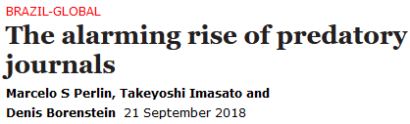
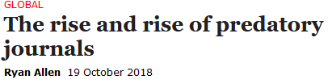
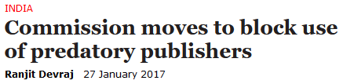
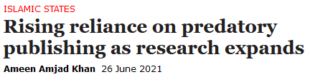
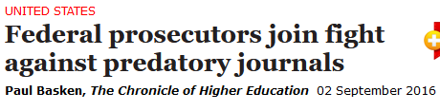
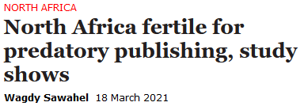
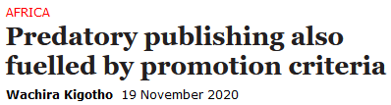
RCR
On Campus

Slide 12
Poll
RCR
On Campus

Slide 13
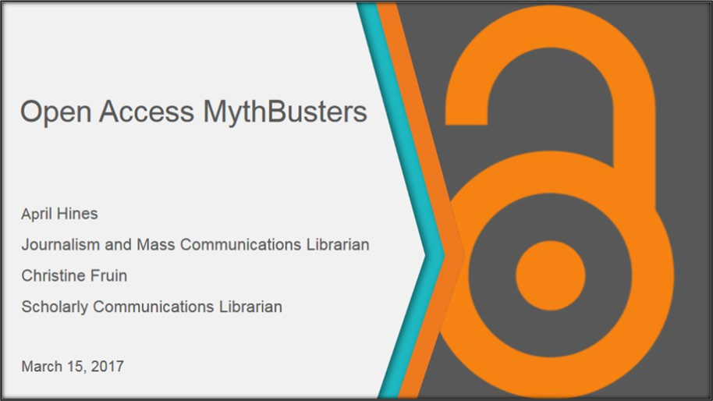
Where did predatory publishing come from?
Rise of online publishing
Open access online publishing model with author fees
Quality of a journal: takes time to establish indicators of quality
Reasonable costs to publish open access vary
http://ufdc.ufl.edu/IR00009658/00001
RCR
On Campus

Slide 14

Warning Signs
Critically appraise where to share your research
Recognize warning signs of fraudulent publishers
Green for credible publishers/publications
Yellow warning – need more research to confirm credibility
Red = stop, this outlet appears untrustworthy
No single tool or list is sufficient to confirm credibility of a publication/publisher
Fraudulent publishing is a separate issue from quality of a publication and reasonable costs to publish
RCR
On Campus

Slide 15
Warning Signs: Top Three Considerations
Ethical practices are followed to publish quality content:
Does the expertise of the Editorial Board reflect the scope of the journal?
Does the publication state peer review and retraction policies?
Any and all publishing fees are transparent prior to submission
Publication is registered and indexed
RCR
On Campus

Slide 16
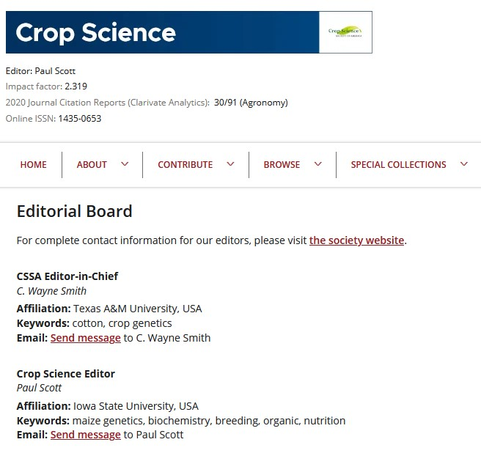
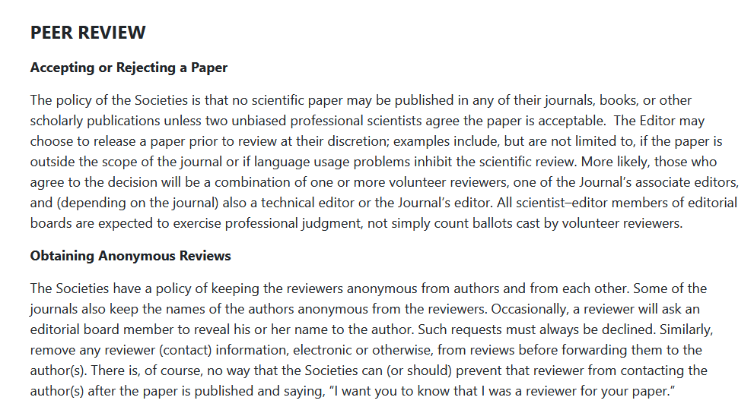
Ethical Practices to Publish Quality Content
Editorial Board Composition
Transparent Review Policy
RCR
On Campus

Slide 17
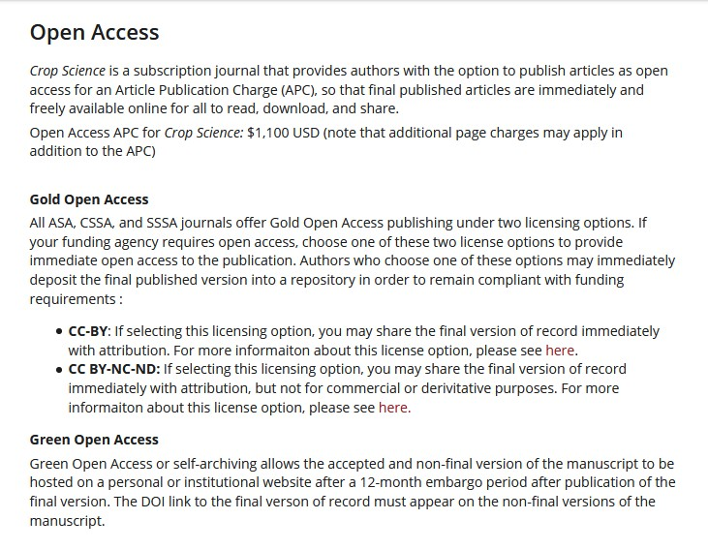
Transparent Publishing Fees
Publishing fees may be called Article Processing Charges (APCs) or Page Charges.
All publishing fees should be clearly defined and explained prior to article submission
If there are no fees to publish, this should be stated.
RCR
On Campus

Slide 18

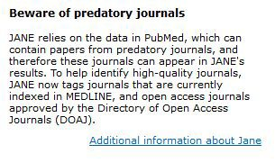
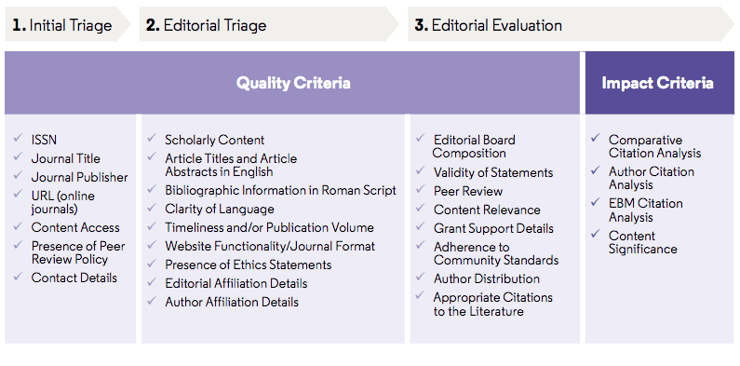
Publication is registered and indexed
Registered ISSN
Indexed
ISSN and/or eISSN
Abstracting & Indexing
Where can the content of this publication be found?
Variety of databases with a range of inclusion criteria
Journal Inclusion Criteria Example: Web of Science
RCR
On Campus
https://clarivate.com/webofsciencegroup/journal-evaluation-process-and-selection-criteria/

Slide 19
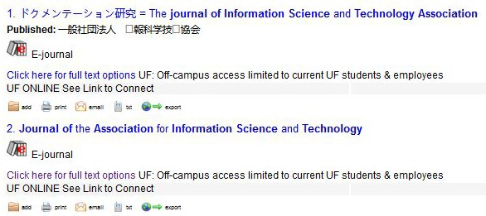
Be aware of mimicry
Check the url
Confirm the journal name in another source
ISSN Portal
Ulrich’s Global Serials Directory
RCR
On Campus

Slide 20

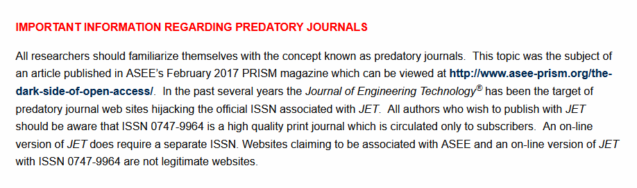
Hijacked
RCR
On Campus

Slide 21
Signs of Credibility: Green Light Examples
Journal name is clear and unique
ISSN is displayed on journal website and verified in ISSN Portal
Editor-in-Chief and Editorial Board names and affiliations provided and professional expertise matches journal scope
Submission and review process is clearly described
All fees listed prior to submission or statement that no fees are required for publication
Journal contents is indexed in reputable subject-specific database. For help identifying databases, see https://guides.uflib.ufl.edu/
RCR
On Campus

Slide 22
Warning Signs: Yellow Flag Examples
Rapid review process
ISSN registered but no publisher information available
Additional fees mentioned but not described
Incomplete editorial board information – names and institutional affiliations for each member
Name of journal very similar to others
Questionable website url
Contents are not indexed in reputable subject-specific database
RCR
On Campus

Slide 23
Warning Signs: Red Flag Examples
No ISSN or displayed ISSN is not verified in ISSN Portal, https://portal.issn.org/
No individual person with street address provided as a contact for the journal
No Editorial Board members identified or members do not have expertise appropriate for the journal scope
No statement of fees, if any are charged, available prior to submission
RCR
On Campus

Slide 24
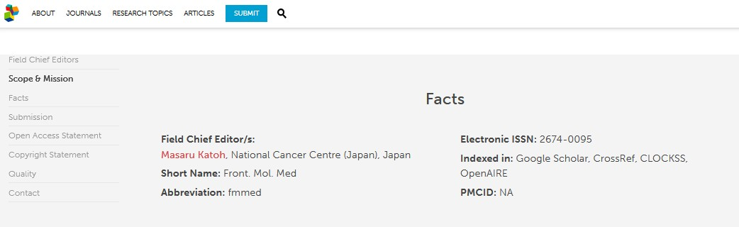
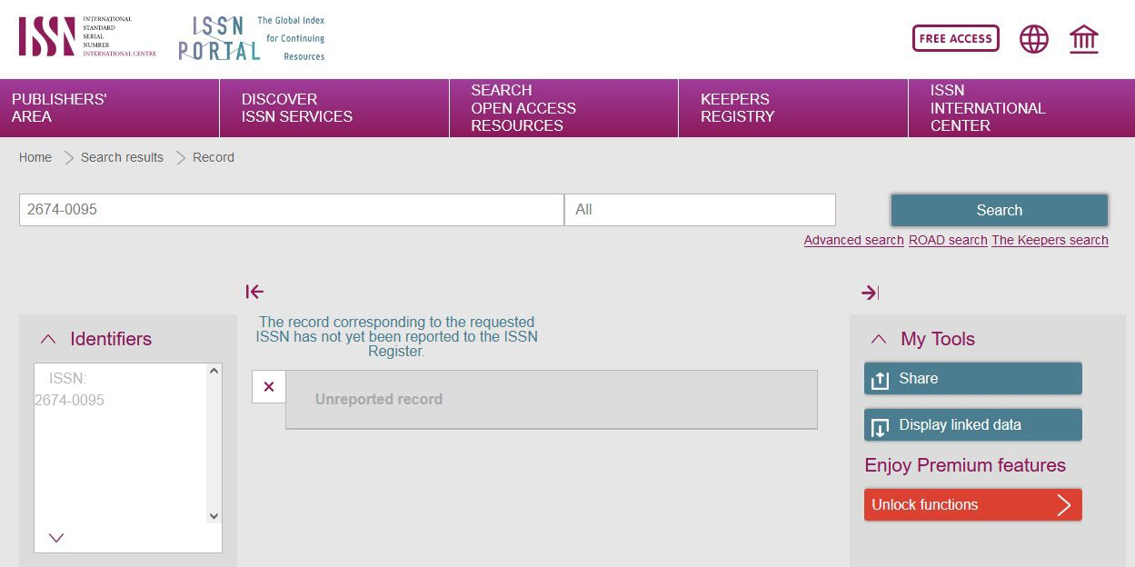
Poll
Journal Website
Do you see a Green Light, Yellow Flag, or Red Flag for the credibility of a journal whose ISSN does not appear in the ISSN Portal?
ISSN Portal
RCR
On Campus

Slide 25
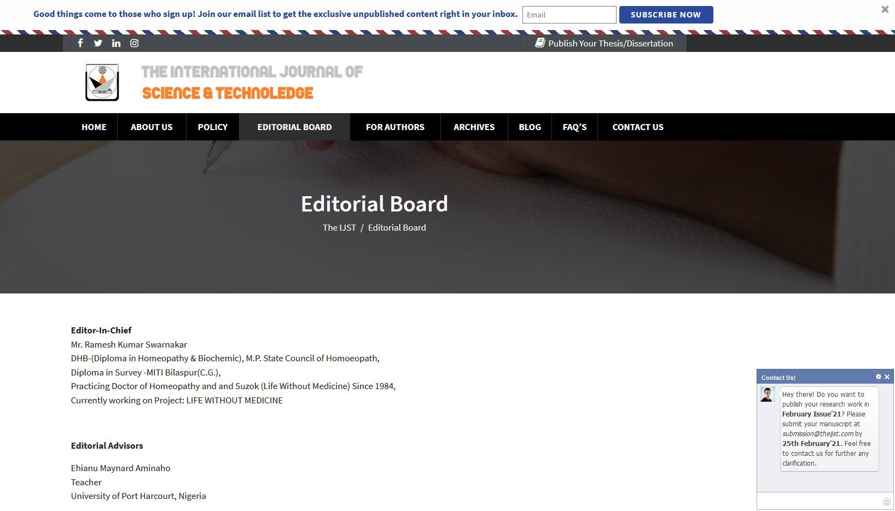
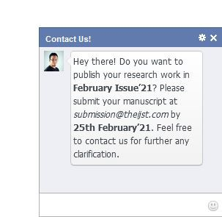
Poll
Do you see a Green Light, Yellow Flag, or Red Flag for the credibility of The International Journal of Science & Technoledge, based on this journal website image?
RCR
On Campus

Slide 26

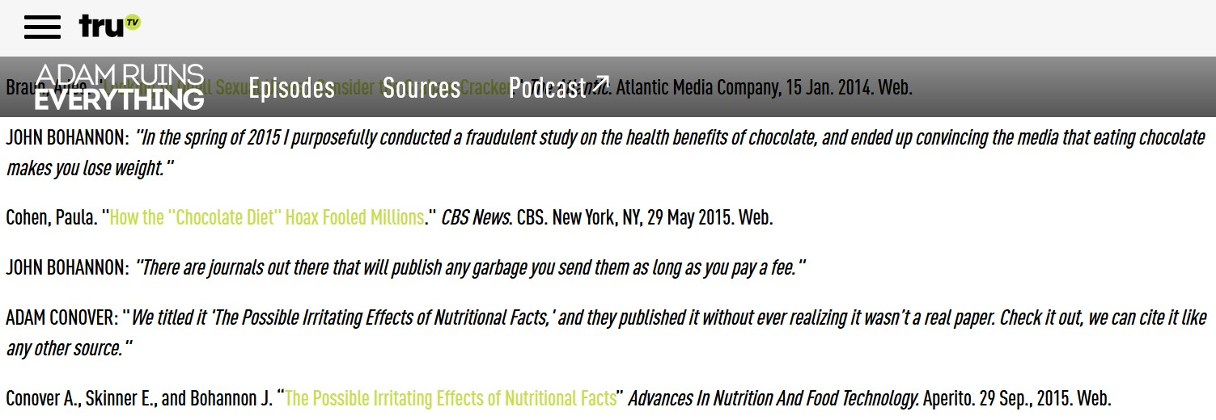
Adam Ruins Everything: Fake Paper
Adam’s article Vol 2, No 1
https://www.trutv.com/shows/adam-ruins-everything/articles/adam-ruins-nutrition
https://www.youtube.com/watch?v=29v6rNFjlLI&list=PLiEBV2MyUPnhP74VlvAJmynde 48umGPp1&index=1

Slide 27
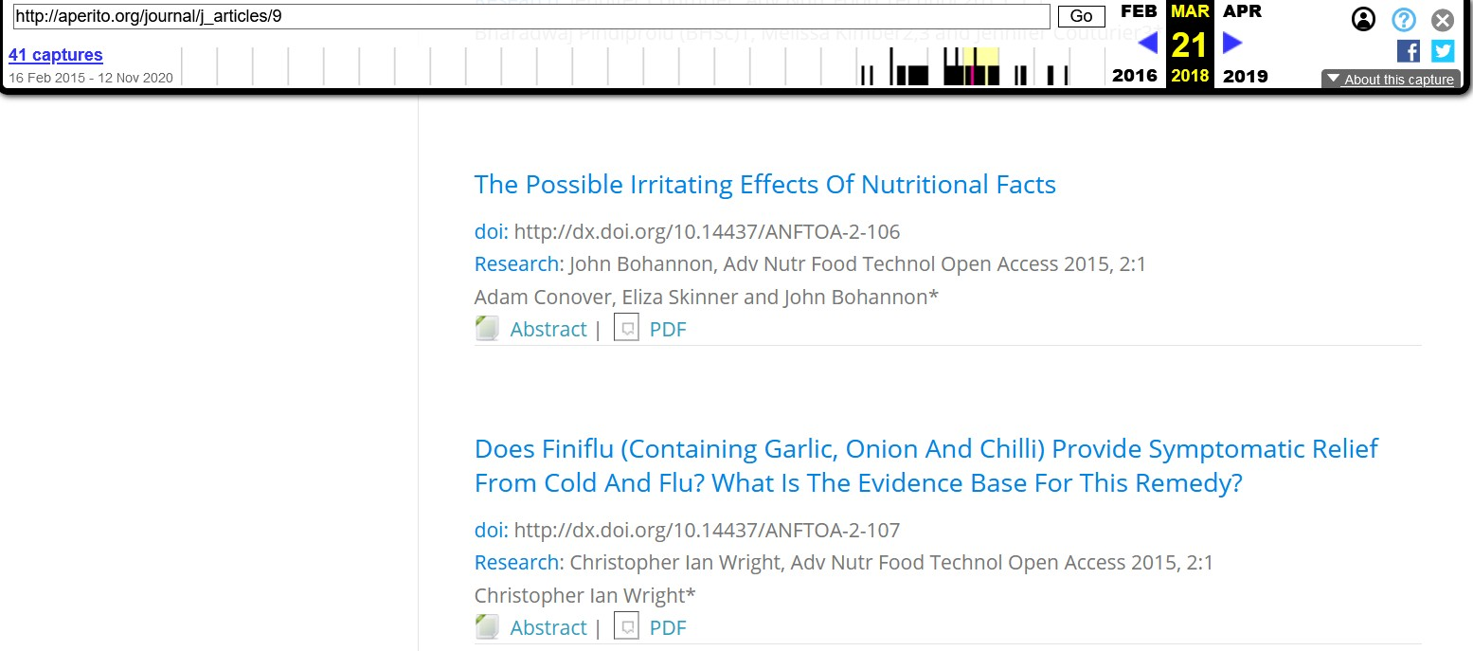
Journal Table of Contents - from Wayback Machine
Adam’s article Vol 2, No 1
https://web.archive.org/web/20180321170341/http://aperito.org/journal/j_articles/9

Slide 28
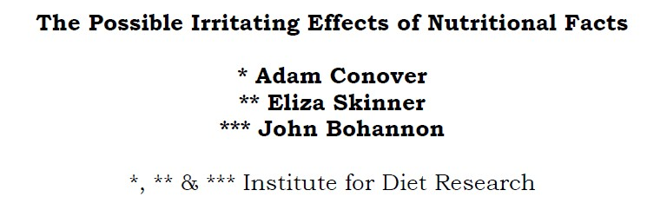
Article Content
https://www.scribd.com/document/357537947/the-possible-irritating-effects-of-nutritional-facts-pdf

Slide 29
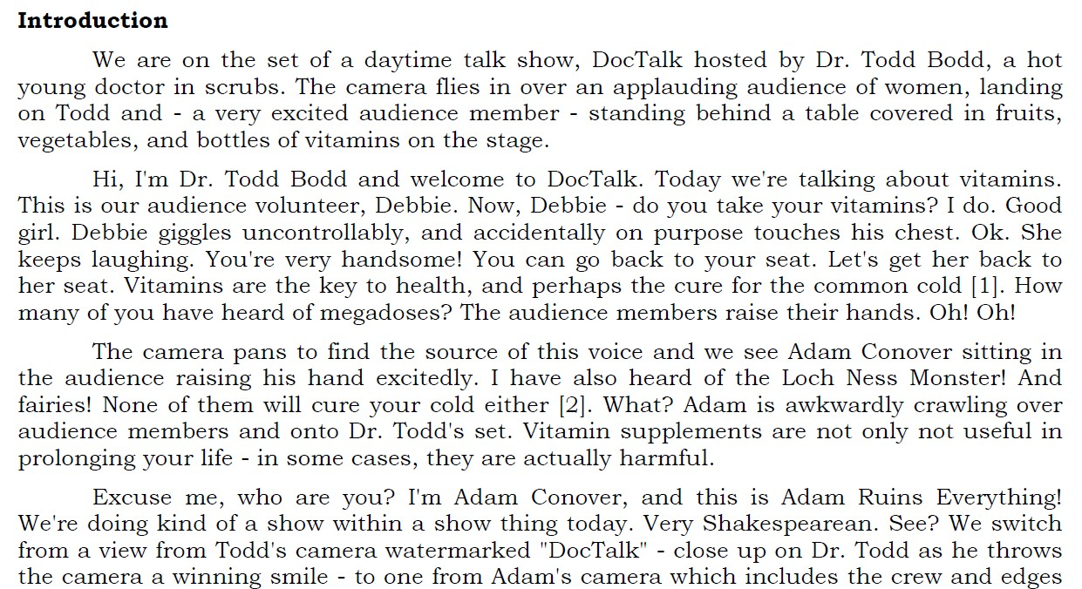
Article Content
Adam’ Ruins Everything script Clearly not a scientific paper
Adam’s article
Vol 2, No 1
https://www.scribd.com/document/357537947/the-possible-irritating-effects-of-nutritional-facts-pdf

Slide 30
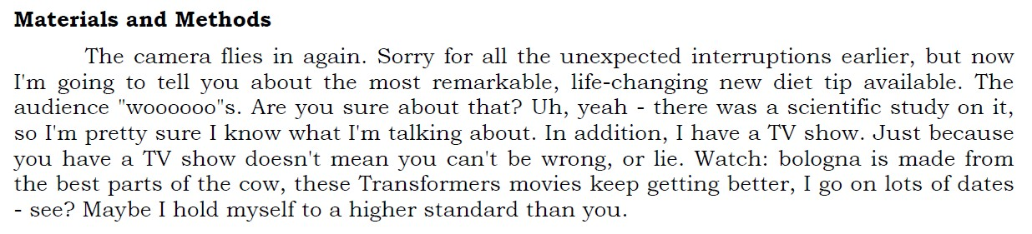
Article Content
Adam’s article Vol 2, No 1
https://www.scribd.com/document/357537947/the-possible-irritating-effects-of-nutritional-facts-pdf

Slide 31
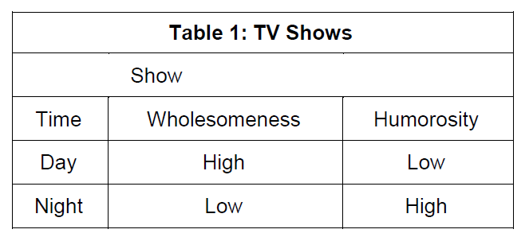
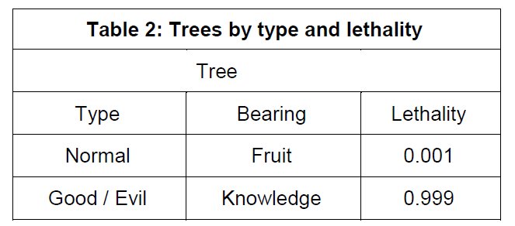
Article Content
https://www.scribd.com/document/357537947/the-possible-irritating-effects-of-nutritional-facts-pdf

Slide 32
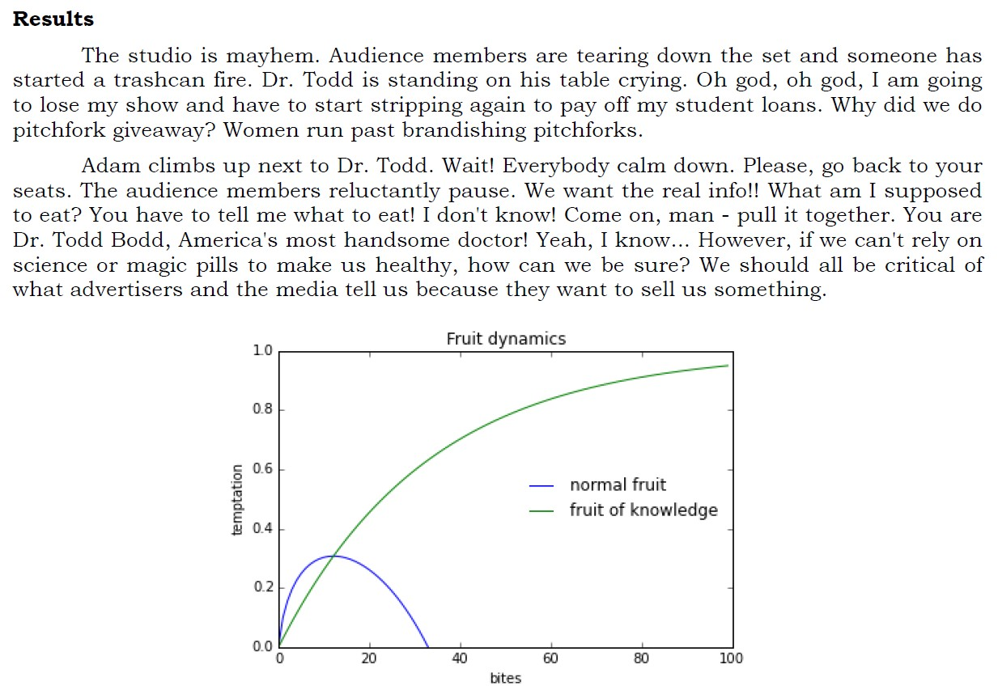
Article Content
Y-axis: Temptation X-axis: Bites
https://www.scribd.com/document/357537947/the-possible-irritating-effects-of-nutritional-facts-pdf

Slide 33
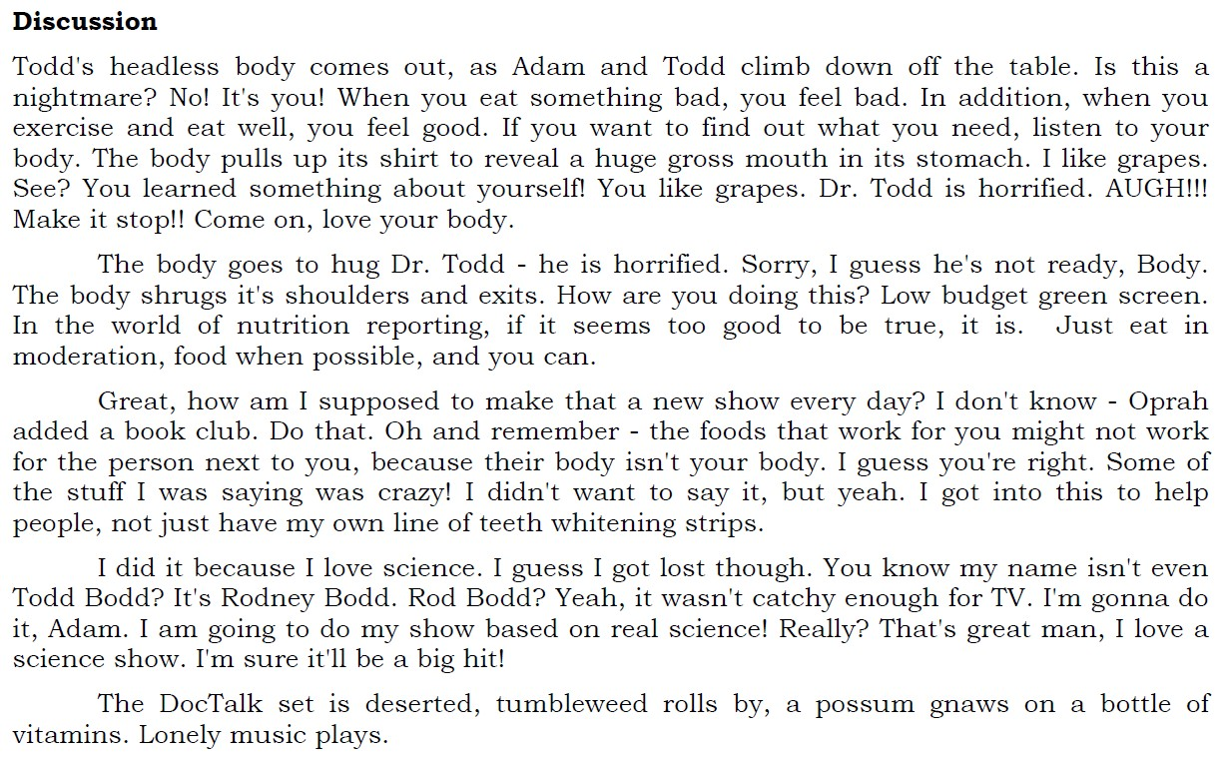
Article Content
Adam’s article Vol 2, No 1
https://www.scribd.com/document/357537947/the-possible-irritating-effects-of-nutritional-facts-pdf

Slide 34
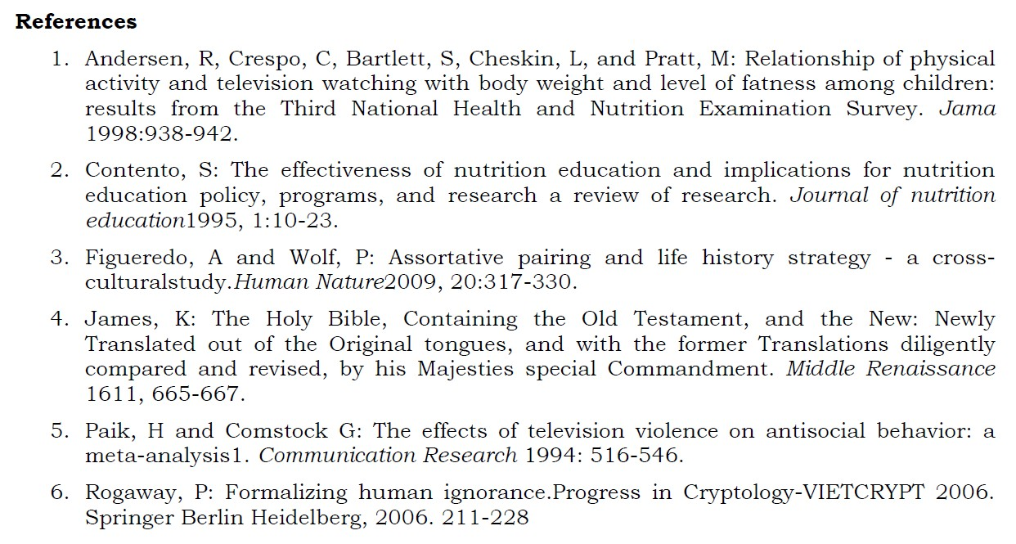
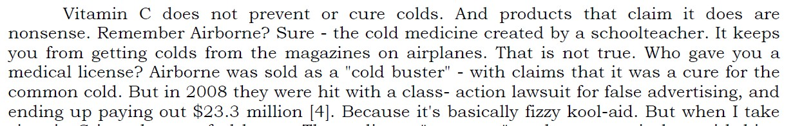
Article Content
Adam’s article
Vol 2, No 1
Citation 4 James, K. The Holy Bible
https://www.scribd.com/document/357537947/the-possible-irritating-effects-of-nutritional-facts-pdf

Slide 35
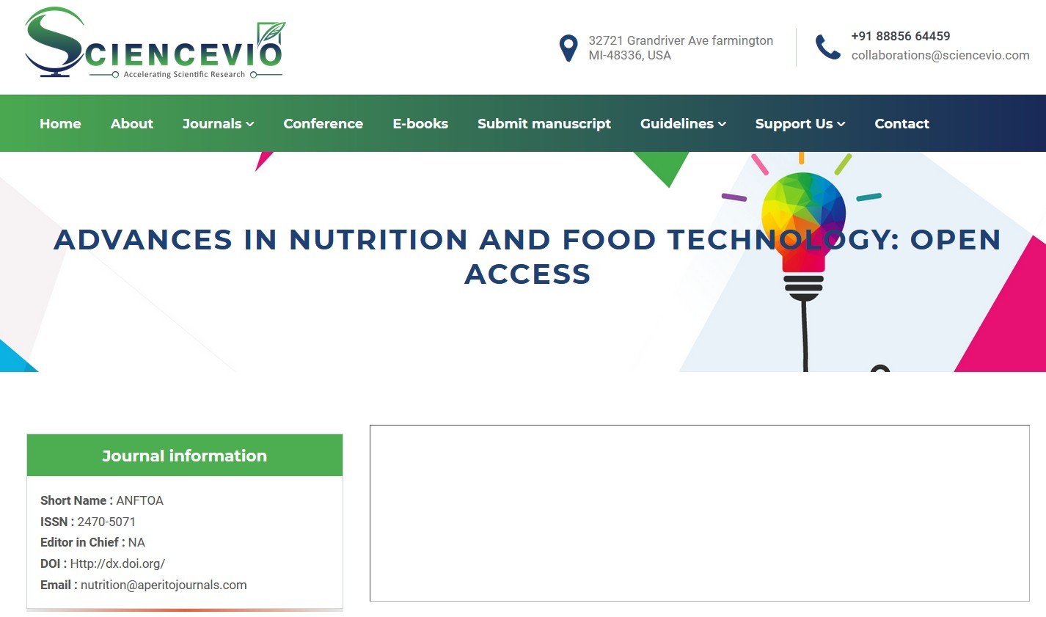
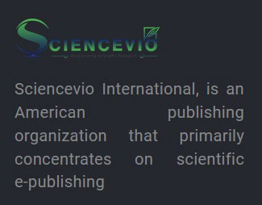
ANFTOA Web Page
https://sciencevio.com/advances-in-nutrition-and-food-technology-open-access

Slide 36
ANFTOA Web Page
Address: Grand River Ave Farmington, MI
Telephone: International number
https://sciencevio.com/advances-in-nutrition-and-food-technology-open-access

Slide 37
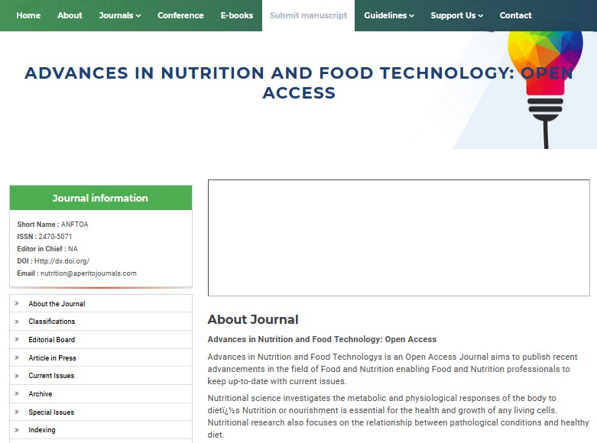
ANFTOA Web Page
https://sciencevio.com/advances-in-nutrition-and-food-technology-open-access

Slide 38
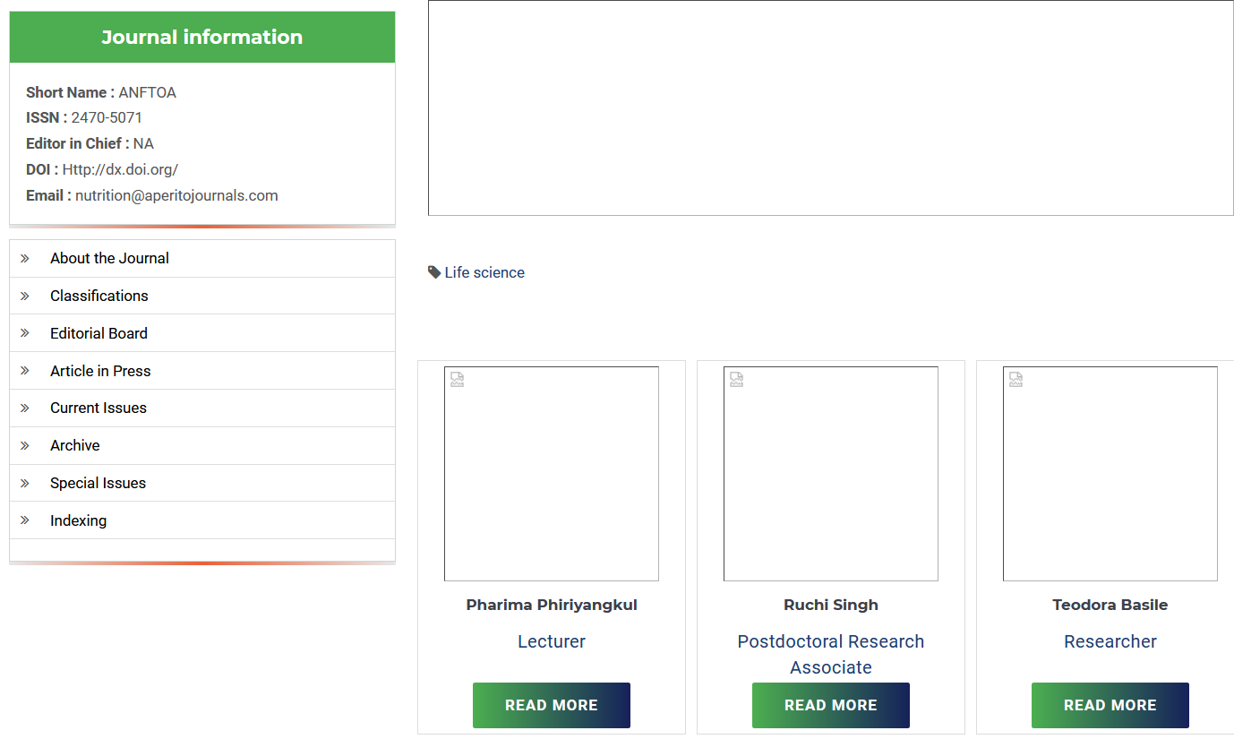
ANFTOA Web Page - Editorial Board
https://sciencevio.com/editorial-board/ZGlsZWVwMjI1Ml85

Slide 39
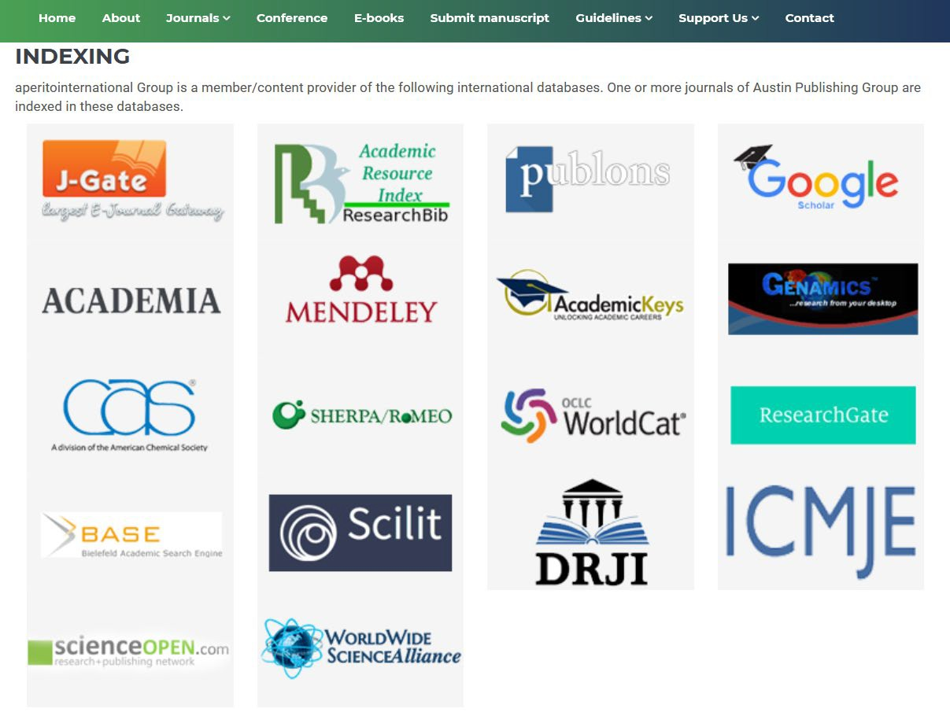
ANFTOA Web Page - Indexing
Not really article indexing services where searchers will come across your article
https://sciencevio.com/indexing

Slide 40
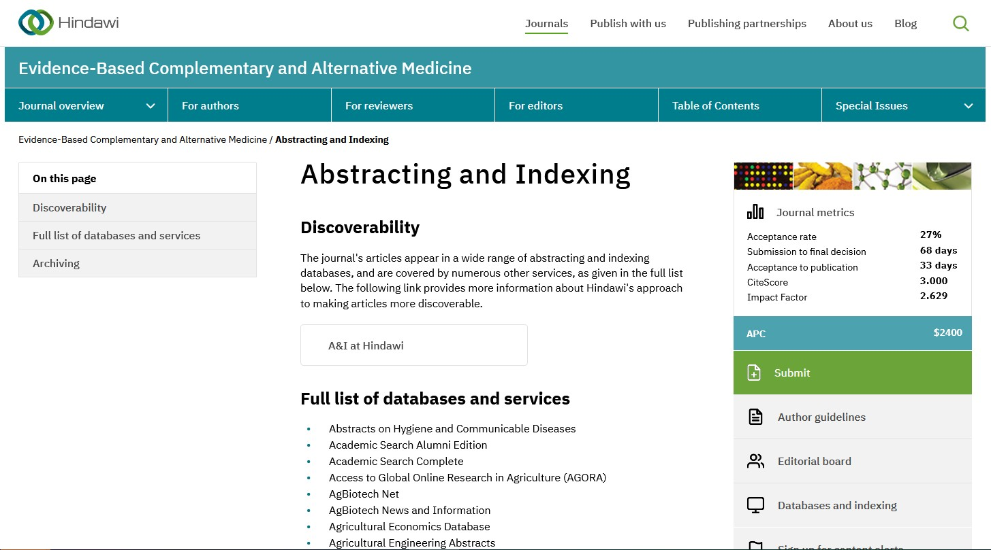
ANFTOA Web Page - Indexing
Do the databases vet? e.g., MEDLINE
Any false claims?
Where can articles be discovered? Are your preferred indexes listed? E.g., WoS, MEDLINE, CINAHL, ERIC
https://www.hindawi.com/journals/ecam/ai/

Slide 41
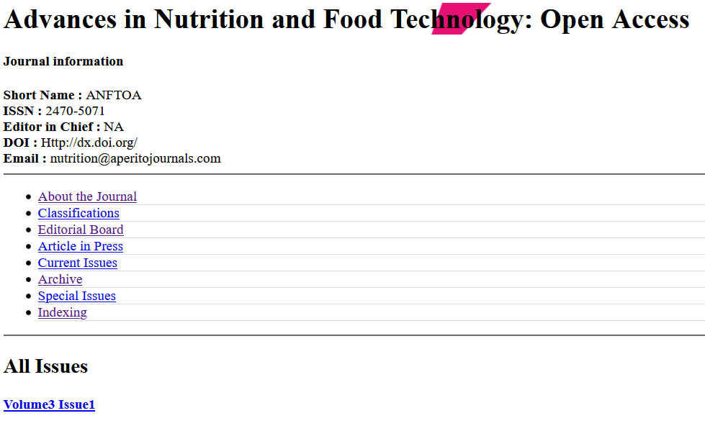
ANFTOA Web Page - Archive Link
Open Access
Where are Volumes 1 and 2?
Clicking on Volume 3 Issue 1 goes nowhere
https://sciencevio.com/archive/ZGlsZWVwMjI1Ml85

Slide 42
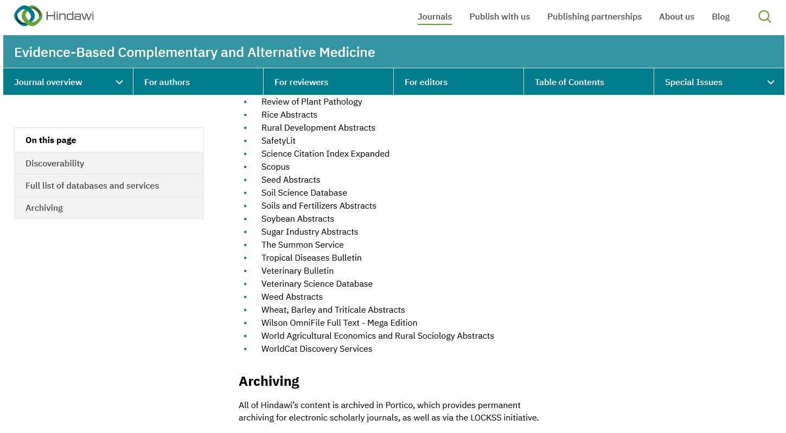
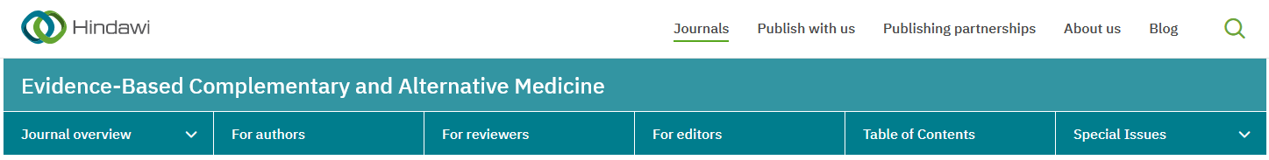
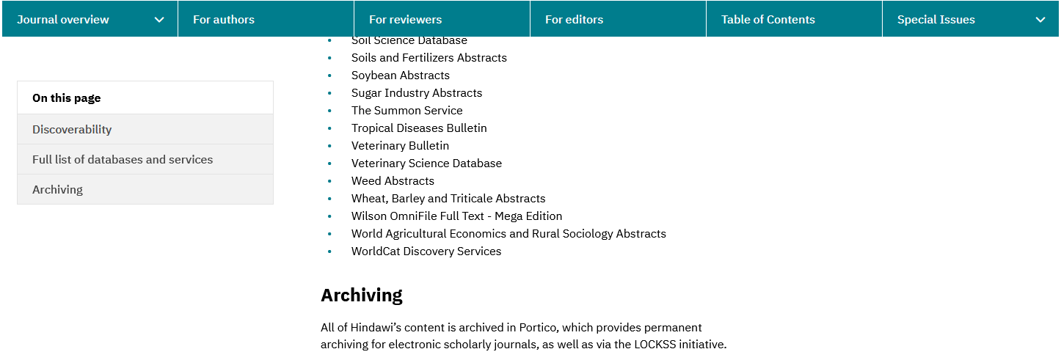
ANFTOA Web Page - Archive Link
Permanent Archiving
- your article will be available permanently
https://www.hindawi.com/journals/ecam/ai/

Slide 43
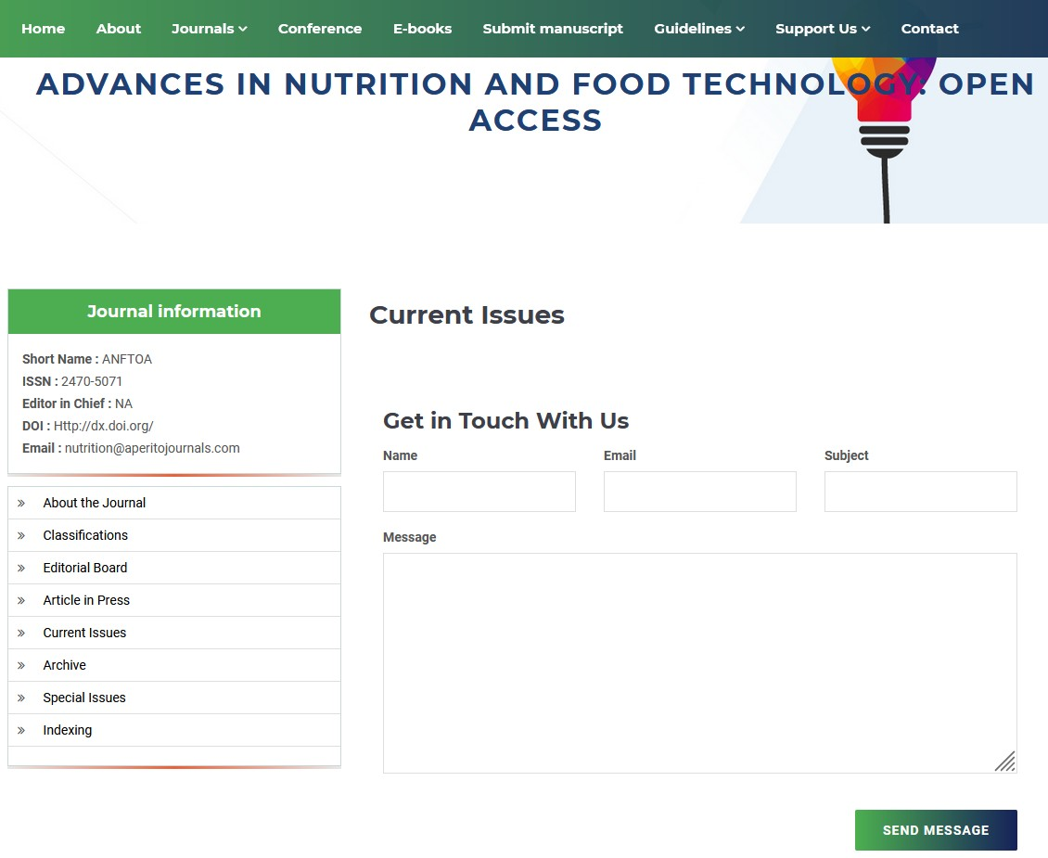
ANFTOA Web Page - Current Issues
https://sciencevio.com/current-issue/ZGlsZWVwMjI1Ml85

Slide 44
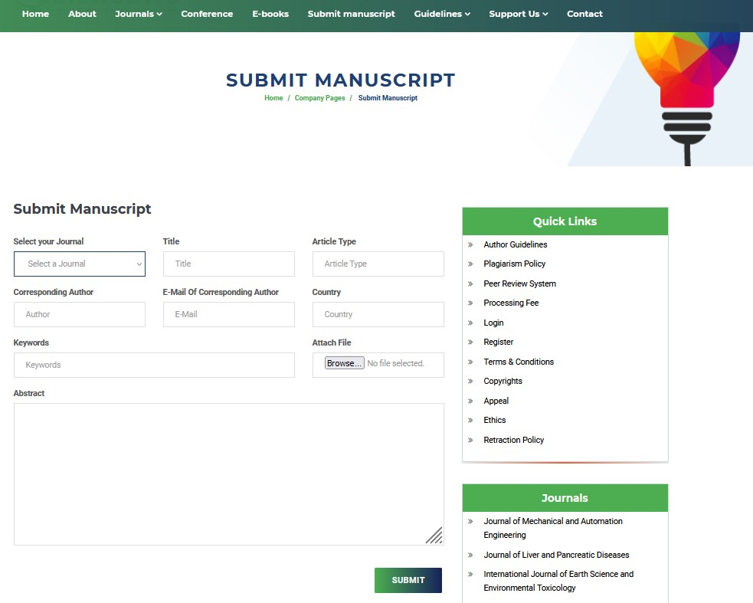
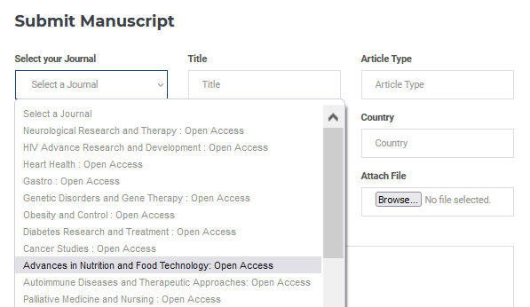
Publisher’s Manuscript Submission Form
Select your Journal
https://sciencevio.com/submit-manuscript

Slide 45
Proactive approaches to ethical scholarship
RCR
On Campus

Slide 46
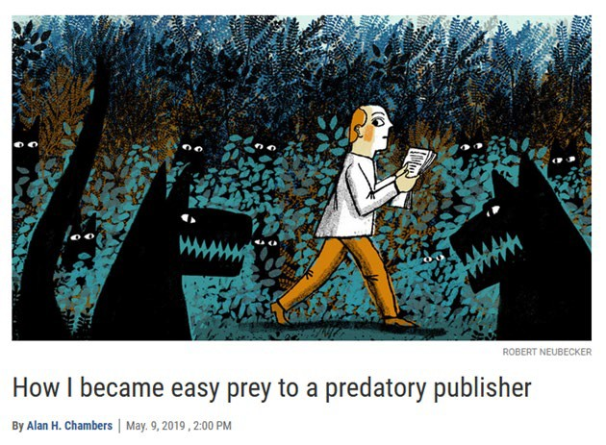
Case Study: A Cautionary Tale
RCR
On Campus

Slide 47
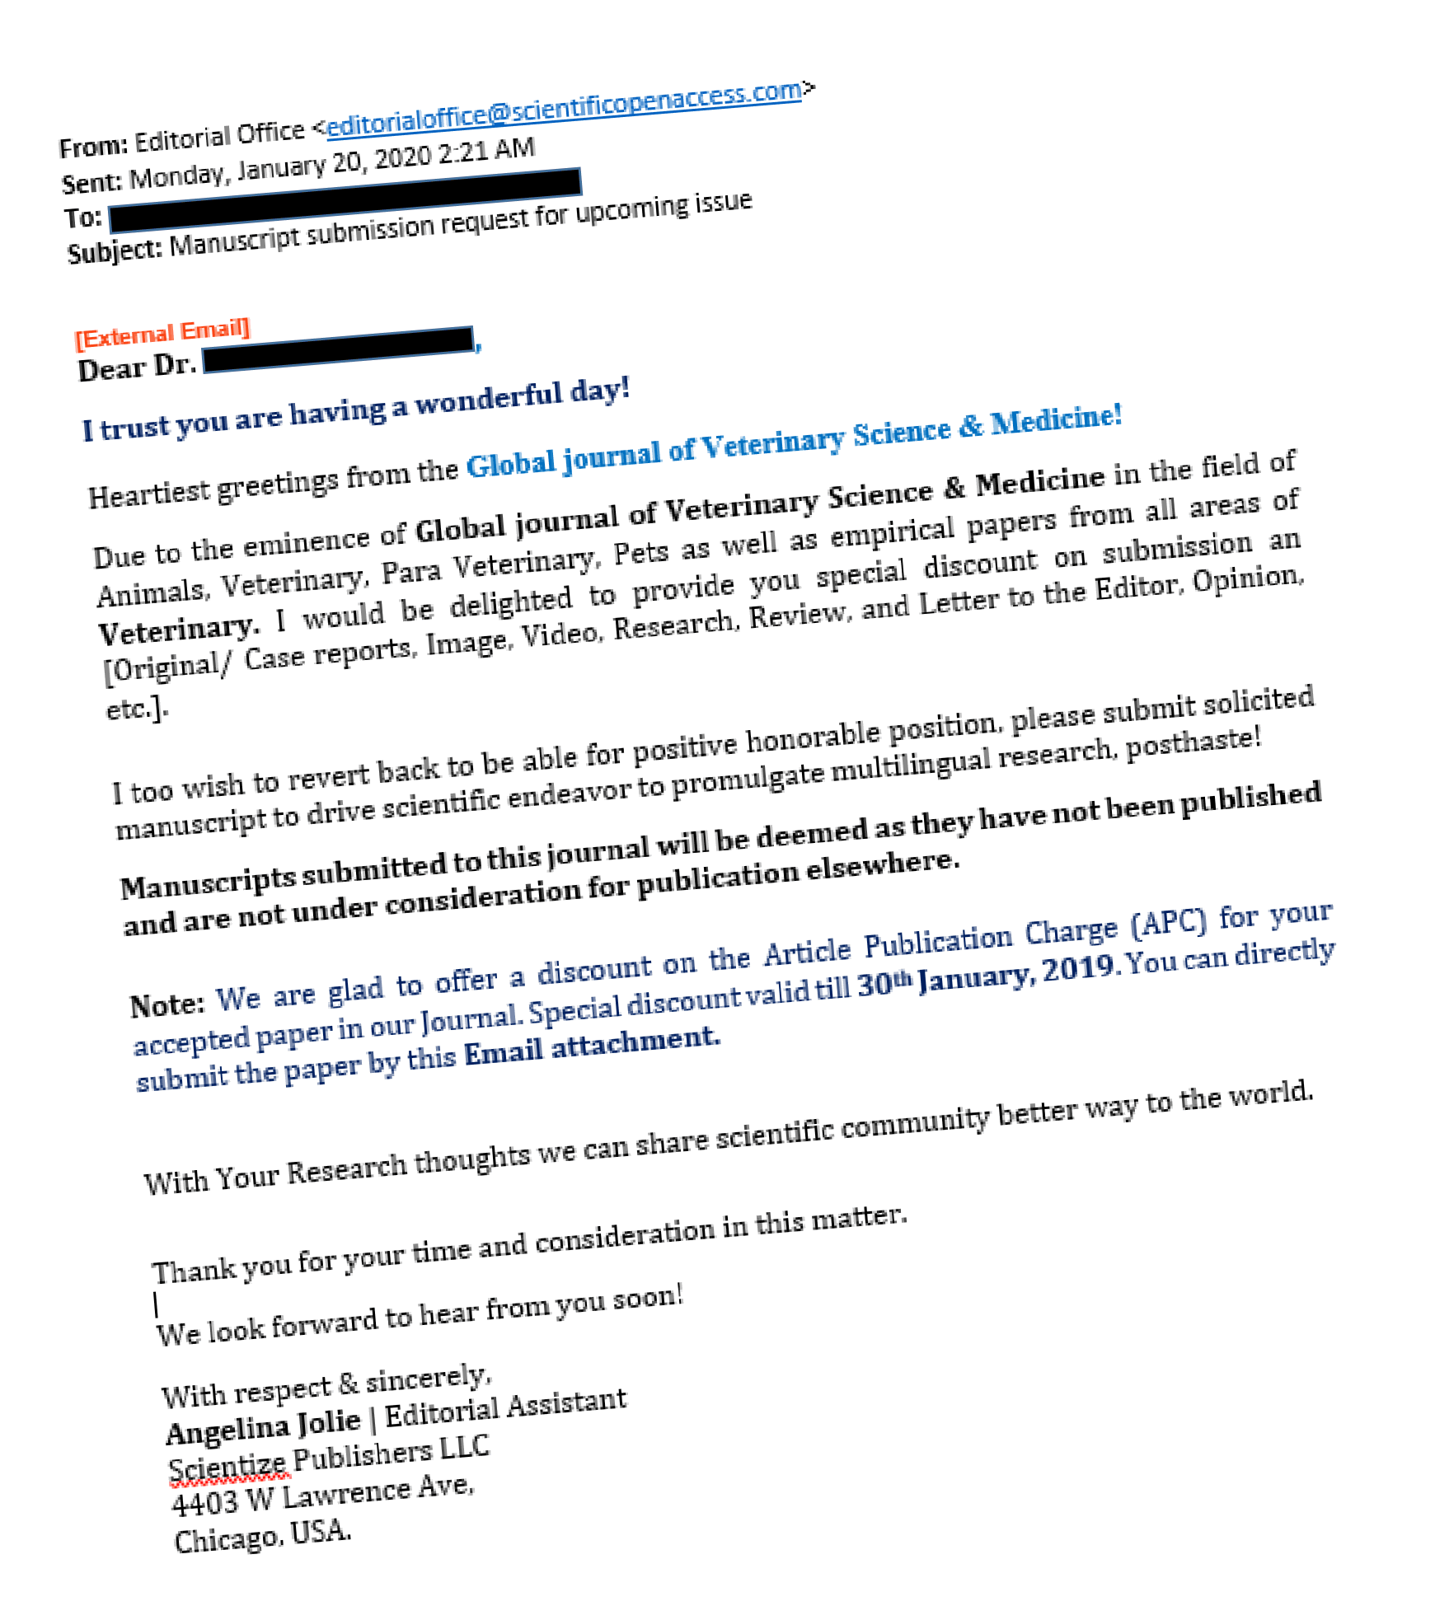
Be suspicious of unsolicited invitations
RCR
On Campus

Slide 48
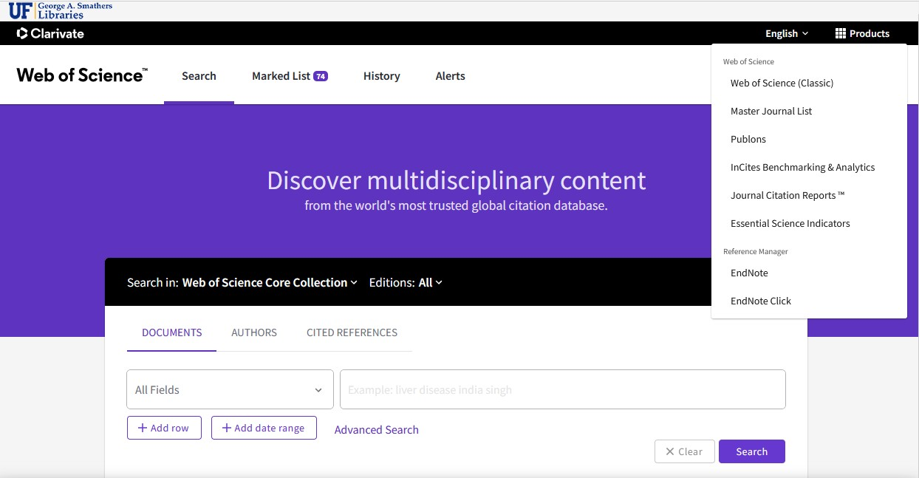
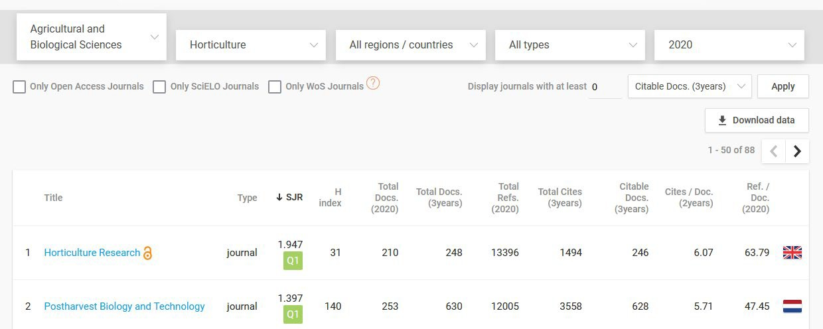
Deciding where to publish your research
Take note where mentors, experts in your field, and colleagues are publishing
Use library resources such as Web of Science’s Journal Citation Report and new Journal Citation Indicator or Elsevier’s free SciMago to identify top-ranked journals
Explore new AI tools that recommend publications for your work (e.g. JANE, Journal Guide, Web of Science Manuscript Match, Springer’s Journal Suggester, etc).
Evaluate the credibility of the publication and publisher before submitting your work
RCR
On Campus

Slide 49
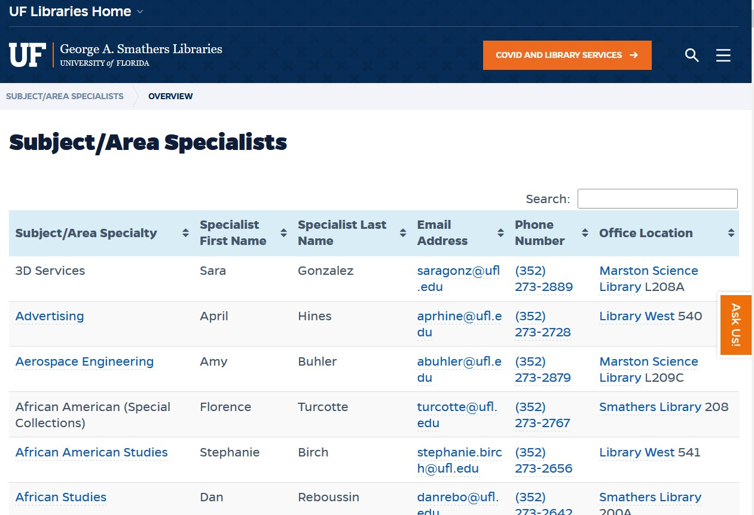
Ask your subject specialist librarian
https://uflib.ufl.edu/specialists/
RCR
On Campus

Slide 50

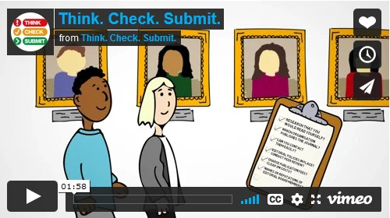
Checklist for warning signs
RCR
On Campus

Slide 51

Resources
Predatory & Questionable Publishing
https://guides.uflib.ufl.edu/predatorypublishing
Think. Check. Submit. https://thinkchecksubmit.org
Think. Check. Attend. https://thinkcheckattend.org/
Navigating Questionable Publishing Practices [17 min presentation to UF Faculty Senate, Jan 2020] https://ufdc.ufl.edu/IR00011093/00001
Additional Readings on Predatory Publishing:
Predatory journals: no definition, no defense https://www.nature.com/articles/d41586-019-03759-y
Readers beware! Predatory journals are infiltrating citation databases Severin & Low https://doi.org/10.1007/s00038-019-01284-3
RCR
On Campus

Slide 52
Things to remember…
Critically appraise where to share your research
Recognize warning signs of fraudulent publishers
Green for credible publishers/publications
Yellow warning – need more research to confirm credibility
Red = stop, this outlet appears untrustworthy
No single tool or list is sufficient to confirm credibility of a publication/publisher
Fraudulent publishing is a separate issue from quality of a publication and reasonable costs to publish
RCR
On Campus

Slide 53

RCR
On Campus

Slide 54
Thank you!
Please take the survey at:
https://ufl.qualtrics.com/jfe/form/SV_1WVLQUcrykr7YFM
RCR
On Campus

Slide 55

If You Suspect Research Misconduct…
Research Misconduct means fabrication, falsification, or plagiarism in proposing, performing, or reviewing research, or in reporting research results.
Questionable Research Practices are reports of careless, irregular, or contentious research practices, as well as authorship disputes, may not meet the standard for research misconduct but may be a research integrity violation.
Make a confidential report to the UF Research Integrity Officer (RIO)
Cassandra C. Farley
(352) 273-3052 | cfarley@ufl.edu
You may also report anonymously UF Compliance Hotline: 877-556-5356
Still not sure if it is Misconduct or a QRP? The RIO can help you better understand the situation. You can speak in hypotheticals as you consider making an official allegation.
RCR
On Campus

