Slide 1
RCR Summer Seminar Series
Export Control Overview
Including an overview of Dual Use Technology
Marsha Pesch
Export Control Officer
UF Research Integrity, Security, & Compliance (RISC)

Slide 2
Reminders
You must log in with UFL email in order to receive certificate credit
Please take the survey after the class—we value your feedback
In order to allow for free flow of ideas and questions, we will not record the session
Slides and other materials will be sent to attendees after the class

Slide 3
RCR Certification
Mentor/Mentee Relationships- Finding the Right Balance
Collaborative Research
Conflicts of Interest
Data Management and Artificial Intelligence
Compliance at UF &
Research Misconduct Overview
Research Misconduct: Plagiarism
Research Misconduct: ORI: The Lab
Ethics of Authorship
Rigors of Peer Review
Reproducibility & Replicability
IRB & Informed Consent
Export Control Overview Including an overview of Dual Use Technology
Putting it All Together
Notes:
Use if you are teaching a core course; move the highlight box to the session you are presenting

Slide 4
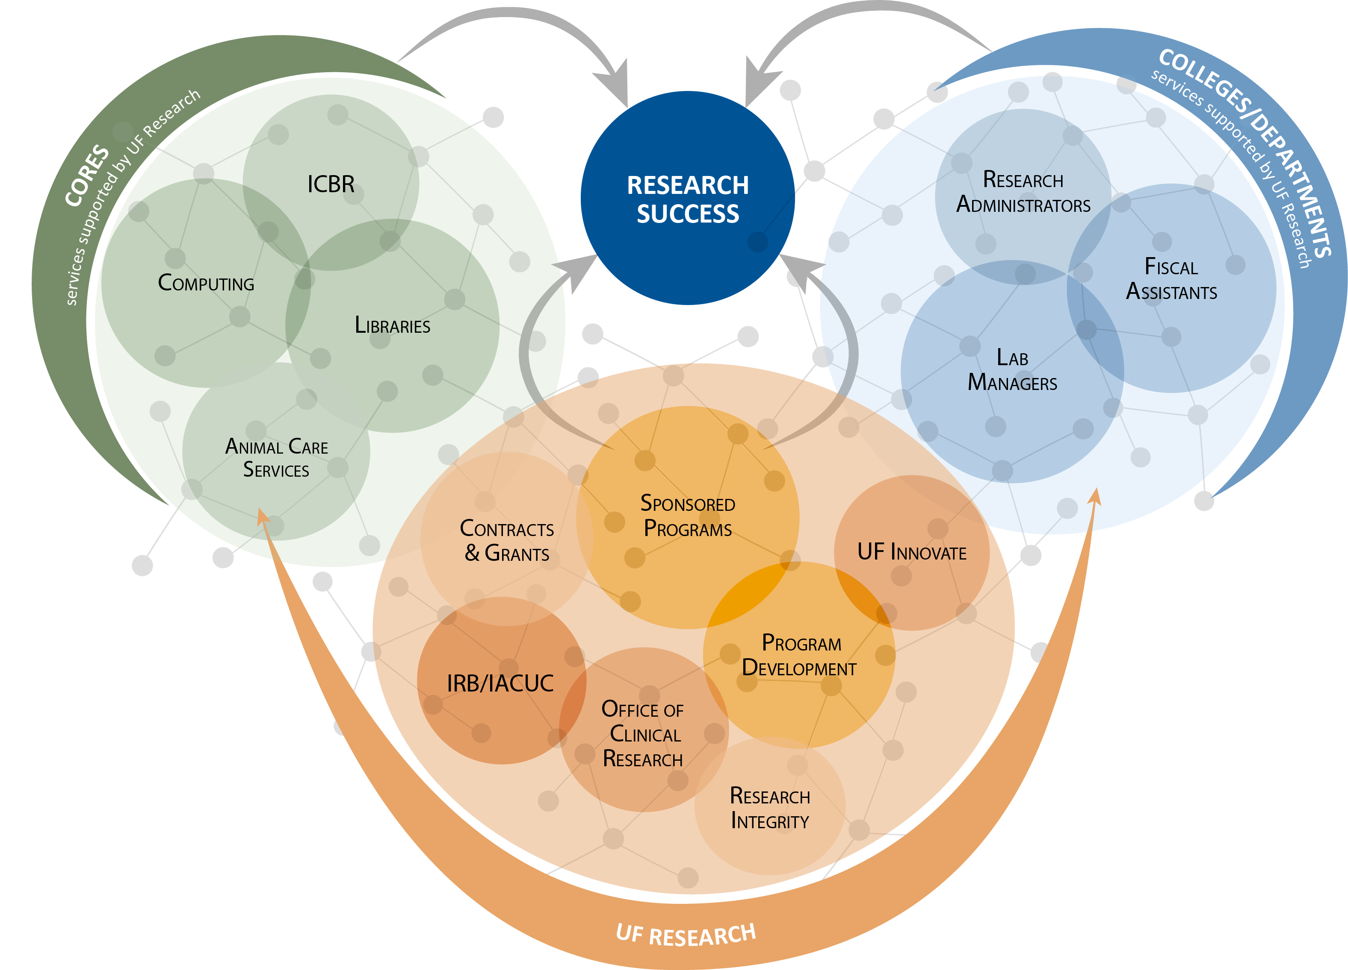
UF Research Enterprise
Notes:
Use to highlight where the presentation topic fits within the research enterprise at UF. (Note: the answer may be everywhere!)

Slide 5
Agenda
Understand Export Control Basics
Export Controls at UF
Export Control Regulations
Understand Key Definitions
Dual-Use
Important Exclusions
Prohibited Activities
Export Control Red Flags
International Collaborations, Travel and Shipping
How Export Controls Apply to RCR

Slide 6
Export Controls At A Glance
United States Export Controls are a complex set of regulations in place to ensure national security, economic stability, prevent the proliferation of weapons of mass destruction, and further U.S. foreign policy.
U.S. Export Control laws govern the transfer of commodities, software, and technical data (information) overseas or to a foreign national within the United States.
Export controls primarily include three sets of regulations:
International Traffic in Arms Regulations (ITAR)
Export Administration Regulations (EAR)
Economic and Trade Sanctions governed by the Office of Foreign Assets Control (OFAC)

Slide 7
Why Do I Need To Know About Export Controls?
Conduct Research involving subjects or technologies listed on U.S. government controlled lists
Research will involve exports outside of the U.S.
Research sponsor indicates your project is controlled
Collaborate with foreign researcher, student or entity, wherever located
Research involves travel, imports, providing something of value, or financial transactions with sanctioned entities or countries

Slide 8
POLL: Who Does Export Controls Apply to at UF?
Every Faculty Member, Staff Member, and Student play an important roll in ensuring compliance with
U.S. Export Controls at UF.

Slide 9
Export Controls at the University of Florida
It is the policy of the University of Florida to comply with all federal and state laws pertaining to exports. All UF projects and programs must adhere to the UF Export Control Policy and all applicable laws.
The Export Control Officer within UF RISC serves as the institutional expert on export control laws and regulations. UF RISC is here to provide guidance to faculty, staff and students.
Contact us anytime: 352-392-9174 exportcontrol@research.ufl.edu

Slide 10
Who Regulates Export Controls?
U.S. Department of Commerce, Bureau of Industry and Security
Export Administration Regulations (EAR) Controls commercial, dual-use, and less sensitive military items
Controlled items are either described on the Commerce Control List (CCL) or designated “EAR99”
U.S. Department of State, Directorate of Defense Trade Controls
International Traffic in Arms Regulations (ITAR) Controls military items
Controlled items are described on the U.S. Munitions List (USML)
U.S. Department of the Treasury Office of Foreign Assets Control
Administers and enforces economic and trade sanctions
Comprehensively Sanctioned: Cuba, Iran, North Korea, Sudan, Syria, Crimea Region of the Ukraine
Note: Other agencies also have a role in limited circumstances, e.g., NRC and DOE.

Slide 11
Key Definitions
Export – Shipment or Transmission of controlled items, technology, software or assistance to a foreign person either outside or inside of the United States.
Export Examples –
Shipping items to other countries
Visual inspection of ITAR-controlled equipment or data
Emails of technical data
Visits
Phone calls or in-person conversations
Placing controlled information in public domain
Presenting at conferences
Hand-carrying controlled items during international travel
Webinar/shared screen with technical data
“Deemed Export” – Release of “technology” or source code to a foreign person is a deemed export to the foreign person’s country of citizenship or permanent residence.

Slide 12
What Do Universities Export?
Controlled technical data and information are the most common items university researchers export.
Activities which may indicate additional controls are necessary:
International travel to sensitive countries especially when bringing any UF-owned item or data.
Transfer/disclosure of controlled items to a foreign national.
International research collaborations.
Participation by a foreign person on a controlled research project.
International shipments or temporary export of equipment, items or software.

Slide 13
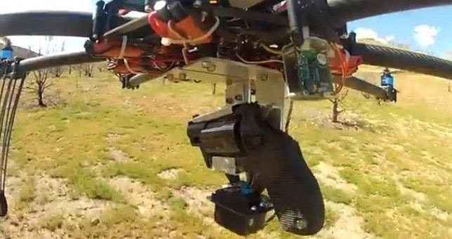
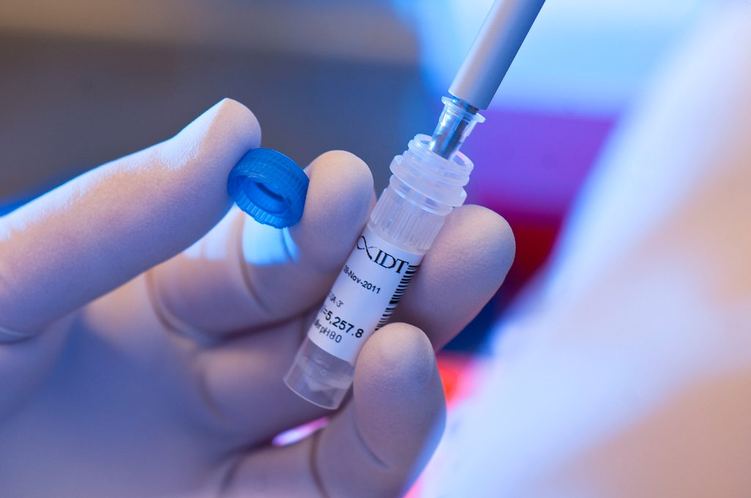
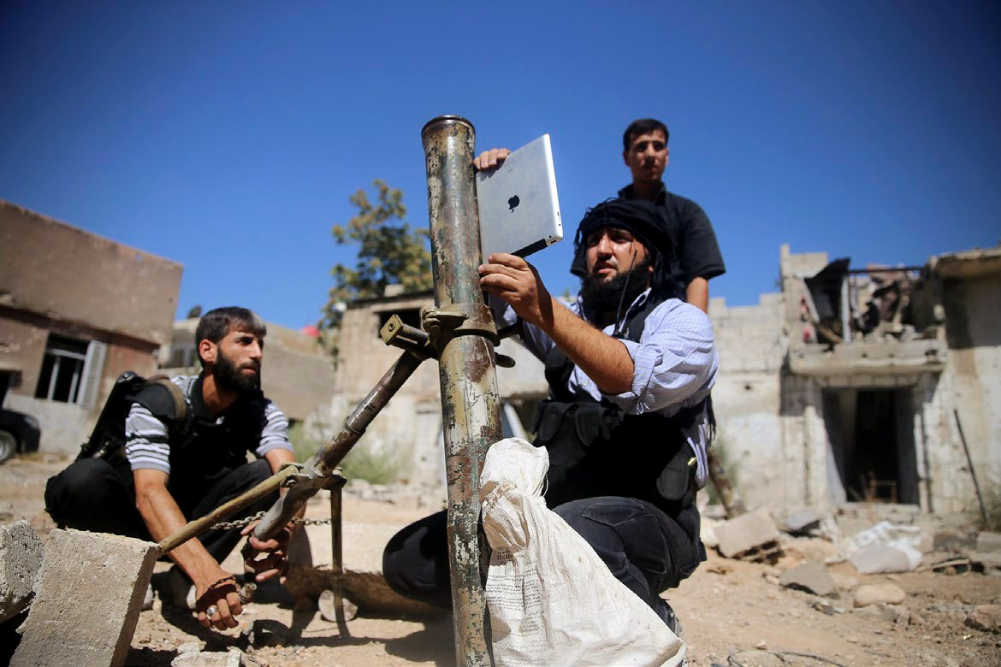
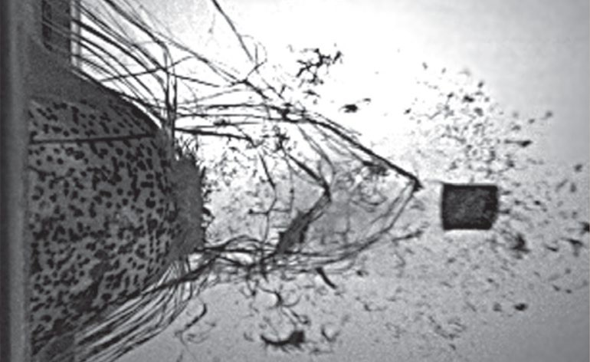
Dual-Use
Dual-Use – BIS is responsible for regulating the export of most commercial items, often referred to as “dual-use” items, which are those having both commercial and military or proliferation applications.

Slide 14
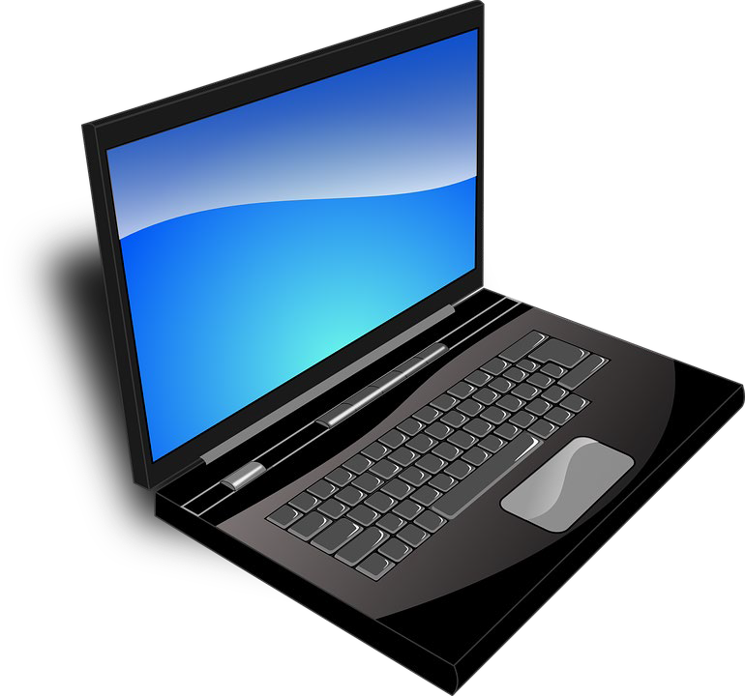
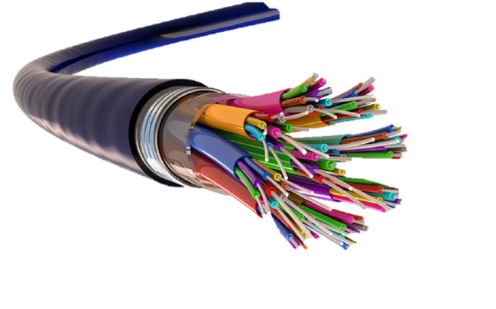
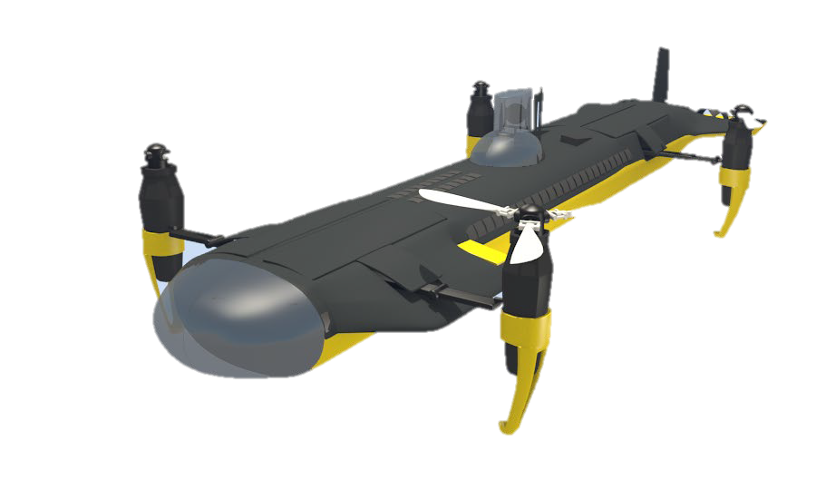
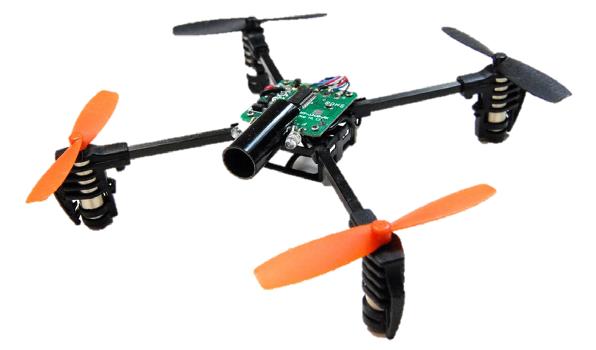
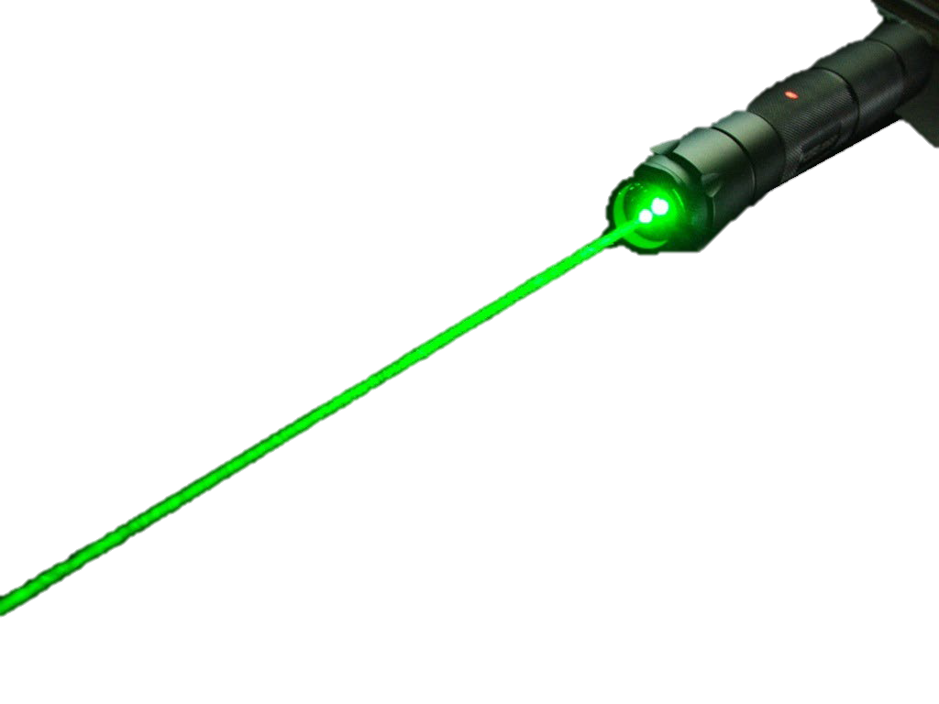
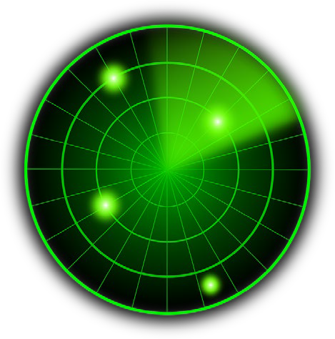
Dual-Use
Electronics
Computers
Aeronautic Systems
Energy Systems
Software
Optics
Space
Marine
Materials
Radar

Slide 15
Dual-Use
Dual-Use Items and Technology may require a license in certain situations:
National security
Foreign Policy
Short Supply
Nuclear Non-Proliferation
Missile Technology
Chemical and Biological Weapons
Regional Stability
Crime Control
Terrorist Concerns

Slide 16
Important Exclusions
Fundamental Research Exclusion
Basic and applied research, AND
At an accredited institution of higher learning in the U.S., AND
Research results are ordinarily published and shared broadly within the scientific community
As long as these conditions are met, the results of the research are not subject to the ITAR or EAR
Fundamental Research does not apply to agreements or awards containing publication, dissemination, or nationality restrictions.

Slide 17
Important Exclusions
Public Domain Exclusion –
Information which is published and generally accessible to the public
Examples include:
published papers
Through unlimited distribution at a conference generally accessible to the public in the United States
information found at libraries
Educational Information Exclusion –
Educational information is defined as information released through catalog classes or labs at institutions of higher learning. Educational Information is not subject to the U.S. Export Regulations.

Slide 18
Export Control Red Flags
Listed Technology USML or CCL
Foreign Travel, Collaboration, or Sponsor
Associated Agreements
NDA or MTA
Military, Space- related sponsors
NASA, DoD, DoE
Contractual Issues
Publication Restrictions
Contractual Issues
FN/Citizenship Restrictions
Cuba, Iran, Syria, North Korea, Crimea Region, China, Russia, Venezuela
Shipping or Physical Exports
High-Risk Sponsors

Slide 19
Why are Export Controls Important?
Export control violations can result in penalties and fines which may apply to an individual, the institution or both.
Loss of Export Privileges
Suspension/Debarment from Government Contracting
Monetary Fines in excess of $1 million per violation
Jail time up to 20 years per violation

Slide 20
Prohibited Activities
Export of controlled goods, technology, or software/source code without a license or other authorization to prohibited destinations, end-users, or end-use
Certain activities with, or some travel to, U.S. sanctioned countries (Balkans, Belarus, Burma, Burundi, Central African Republic, China, Cote d’Ivoire, Cuba, Congo, Iran, Iraq, Lebanon, Liberia, Libya, North Korea, Russia, Somalia, Syria, Crimea Region of Ukraine, Venezuela, Yemen, Zimbabwe)**
Import from, travel to and engagement with comprehensively sanctioned countries must be approved via either general or specific license.
** Sanctions regulations change frequently, call UF RISC for additional information.

Slide 21
International Collaborations and Partners
Two main concerns: (1) access to ITAR or EAR information and (2) working with denied parties or Military End- Users
Valid Visa holders requiring access to controlled equipment and information must have a license or exemption
Denied Party? Request restricted party screening from UF Research Integrity
Physical shipments of commodities, research samples, or equipment

Slide 22
Travel and Conferences
Travel to most countries and bringing typical items with you will not require a license (e.g., standard laptop, cell phone, personal items)
Caution: Comprehensively Embargoed Countries (Crimea Region of Ukraine, Cuba, Iran, North Korea, Syria)
Caution: Countries of Concern (China, Russia, Venezuela)
Caution: Hand-Carry or Shipping Special Equipment (e.g., valued >$2500, infrared camera)
Caution: Do not present or discuss any controlled information, even at domestic conferences

Slide 23
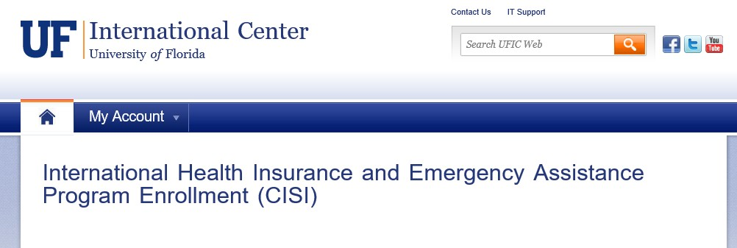
Travel Reminders
Travel Authorizations
myUFL
UFIC Registration
https://internationalcenter.ufl.edu/travel/online-travel-registration
Asset Management Registration
https://myassets.fa.ufl.edu

Slide 24
International Shipping
WHAT
What is being shipped?
What is its Export Control Classification Number?
What is the value of the item(s)?
WHERE
Where are you shipping to?
Is the destination permissible for receipt of this item and its end use?
Is a license required?
Are there Import restrictions at the destination?
WHO
Who are you shipping to?
Are they the ultimate end user?
Have the individuals and their organization(s) been screened against lists for excluded parties?
WHY
What is the end use of the item and is the end use permissible without a License?

Slide 25
Export Control Scenarios to Consider
Before collaboration begins, consider the following:
Are my collaborators on the U.S. denied entity/persons lists?
Contact UFRI for a restricted party screening (RPS).
Will I travel to, import from or interact with a comprehensively sanctioned country or a country of concern?
Severe restrictions will apply and a license may be required in advance.
Will foreign persons come work with me at UF or in foreign countries?
Contact UF RISC for a RPS and license, if needed.
Will I present my research results at domestic or international conferences?
Ok as long as controlled information is not presented and not in a comprehensively embargoed country.
Does my funding contract or grant place restrictions on publications or participation by foreign persons?
If yes, will nullify certain exemptions to export control laws.
Will I ship or hand-carry anything, including data or software?
If controlled or $2500 or more, may require license and Customs filing.

Slide 26
What if My Project Is Export Controlled?
Technology Control Plan (TCP) – An internal UF plan ensuring protection of export controlled articles, software, and technical data.
Commitment to Compliance
Identifies Controlled Articles and Technical Data (CATD)
Categorizes CATD on the USML or CCL
Contractual Terms
Defines Physical Security Requirements
Defines Information Technology Requirements
Certifications

Slide 27
How Does Export Control Apply to RCR
Export Control regulations are an important to all aspects of research.
Shipping internationally may have requirements, no matter what your field of expertise.
Sanctions apply to all individuals on campus who may engage with or travel to countries of concern.
Export Controls does not only affect military research.
While UF RISC manages the export control program, it may have implications to many aspects of UF business.

Slide 28
Need Help? We Are Here!
UF RISC
exportcontrol@research.ufl.edu 352-392-9174
Carter Post
Compliance Specialist cpost@ufl.edu
Marsha Pesch
Associate Director Export Control Officer mpesch@ufl.edu
William Bucha
Compliance Specialist wbucha@ufl.edu

Slide 29
Thank you!
Please take the survey at: https://ufl.qualtrics.com/jfe/form/SV_1WVLQUcrykr7YFM

Slide 30
If You Suspect Research Misconduct…
Research Misconduct means fabrication, falsification, or plagiarism in proposing, performing, or reviewing research, or in reporting research results.
Questionable Research Practices are reports of careless, irregular, or contentious research practices, as well as authorship disputes, may not meet the standard for research misconduct but may be a research integrity violation.
Make a confidential report to the UF Research Integrity Officer (RIO)
Cassandra C. Farley
(352) 273-3052 | cfarley@ufl.edu
You may also report anonymously
UF Compliance Hotline: 877-556-5356
Still not sure if it is Misconduct or a QRP? The RIO can help you better understand the situation. You can speak in hypotheticals as you consider making an official allegation.

