Slide 1


UFIRST:
University of Florida Integrated
Research Support Tool
http://research.ufl.edu/faculty-and-staff/initiatives/ufirst.html

Slide 2
UFIRST Overview
Ultimate goal: A new integrated system that will
Redefine research administration processes
Compliantly route proposals and related documents, collecting useful information along the way
Present information to stakeholders for approval
Provide user-friendly systems for tracking and reporting
http://research.ufl.edu/faculty-and-staff/initiatives/ufirst.html

Slide 3
Preliminary Timeline
July-Aug 2013: Solicit faculty and staff input. View demos of peer processes and systems. Hold intensive process definition sessions with core team. Review requirements and processes with steering committee and executive sponsors.
September 2013: Begin implementation of process changes. Perform a gap analysis between PeopleSoft and new requirements.
October 2013: Determine next institutional steps regarding system improvement or implementation.
http://research.ufl.edu/faculty-and-staff/initiatives/ufirst.html

Slide 4
Project Team
Dee Dee Carver – Division of Sponsored Programs, Proposals
Kristi Cromwell-Cain – Cardiovascular Sciences
Adrienne Fagan – Fifield Shared Services
Nita Fahm – Geological Sciences
Kelley Gentry – College of Engineering
Stephanie Gray - Director, Division of Sponsored Programs
Sarah Kazlauskas – Pathology
Tonia Lambert – College of Public Health & Health Professions
Julia Lednicky – Division of Sponsored Programs, Awards
Jan Machnik – Mechanical & Aerospace Engineering
Karen Pastos – College of Medicine
Dorothea Roebuck – College of Health & Human Performance
Shell Romano – Division of Sponsored Programs, Proposals
Sandra Smith – College of Medicine
Nancy Wilkinson – Institute for Food and Agricultural Sciences
http://research.ufl.edu/faculty-and-staff/initiatives/ufirst.html

Slide 5
Limited or Internal Funding Competitions
Limited: UF reviews proposals for merit before forwarding for sponsor review
Internal: UF reviews proposals for funding out of existing money
Review process, full proposal routing, and award set up can be streamlined if captured in the same system as all external applications.
Flexibility for the awarding entity of internal competitions to determine routing, approvals, and required elements
Improved tracking
  Of awarded internal vs external funds
  To ensure only selected proposals in limited solicitations are submitted to the sponsor
Appropriate security during the application process so PI’s do not know with whom else they are competing
http://research.ufl.edu/faculty-and-staff/initiatives/ufirst.html

Slide 6
Proposal Development
Proposed Features of UFIRST:
Improves budget building by
  Drawing in University salaries (distinguishing 9, 10 & 12 month) and calculating effort and fringe appropriately
  Accurately identifying payroll cost share
  Facilitating identification of non-payroll cost share
  Rolling-up multi-department, multi-year or multi-F&A budget details into customizable combinations
  Validating proper F&A calculation and math
Exports to and imports from Excel
Includes an investigator profile, S2S functionality, proposal development resources and document repository
Includes action item and information dashboard
http://research.ufl.edu/faculty-and-staff/initiatives/ufirst.html

Slide 7
Full Review Proposal Routing
Many proposals will follow a path of full review
Routed in UFIRST
All named faculty and other key personnel
  Provided notification with ability to affirm or deny
  Same notification to their Chair & Dean
Reviewed & approved by
  Any unit providing cost share
  Lead PI’s Chair & Dean
  DSP if contractual obligations exist
  New clarity on expectations for each party’s responsibility
http://research.ufl.edu/faculty-and-staff/initiatives/ufirst.html

Slide 8
Fast Track Proposal Routing
Proposal budget developed in UFIRST
Proposal criteria
  No F&A waivers
  Only 1 F&A rate
  No cost share
  No construction or renovations (existing space suffices)
  Named faculty and key personnel effort within TBD tolerance (i.e. 4 - 50%)
  Under a TBD budget threshold
  To a sponsor in good standing (receivables)
http://research.ufl.edu/faculty-and-staff/initiatives/ufirst.html

Slide 9
Fast Track Proposal Routing
New UF research administration certification
  Department and college research administrative support can be certified to submit on behalf of the institution. Such certification must be maintained through documented competency.
New concept of “fast track eligible personnel”
  Up to date on all required training
  Without conflicts of interest
  In good standing with regards to effort reporting, cost transfers, and compliance requirements, etc.
http://research.ufl.edu/faculty-and-staff/initiatives/ufirst.html

Slide 10
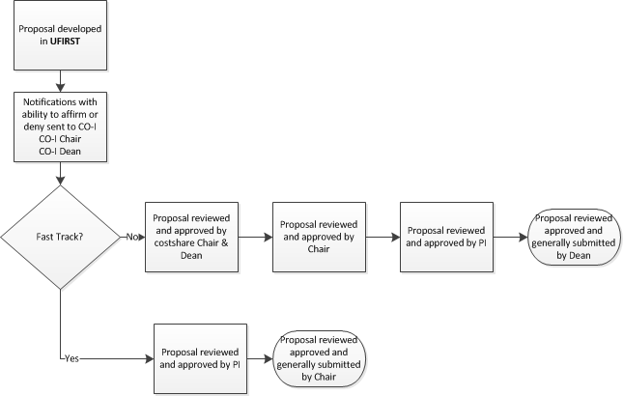
Proposal Routing
http://research.ufl.edu/faculty-and-staff/initiatives/ufirst.html

Slide 11
Supporting Documentation (JIT) & Negotiation Tracking
  How do you want to be notified of the need for additional documentation (IRB approval)?
  What approvals are needed for Revised budgets? JIT?
  How do you want to track negotiations?
  What can we do to increase use of temps if project activities are initiated?
http://research.ufl.edu/faculty-and-staff/initiatives/ufirst.html

Slide 12
Award Setup
  What can be done before award to facilitate a faster release of funds?
  What information would you want to see on an NOA?
  What award reports would be helpful?
http://research.ufl.edu/faculty-and-staff/initiatives/ufirst.html

Slide 13
Award Modifications & Prior Approvals
  What do you do when you need to:
  Change key personnel?
  Reduce effort commitments?
  Request a no cost extension?
  Request a CAS exemption?
  Does it work well?
  Is the process for adding incremental or supplemental funds efficient? How can it be improved?
http://research.ufl.edu/faculty-and-staff/initiatives/ufirst.html

Slide 14
Other ideas
  Subcontracts
  Reporting
  Training
  Security
  Other
http://research.ufl.edu/faculty-and-staff/initiatives/ufirst.html

Slide 15
Questions
http://www.research.ufl.edu/faculty-and-staff/initiatives/ufirst.html
Email: UFIRST@research.ufl.edu
Contact:
Stephanie Gray
Director, Division of Sponsored Programs
Phone: 352/273-4062
http://research.ufl.edu/faculty-and-staff/initiatives/ufirst.html

