Slide 1

RCR Summer Seminar Series 2022
Michelle Leonard Assistant Director, Education & Training Programs | UF Research
Bob Kolb | Assistant Director, Clinical Research | UF CTSI
Cassandra Farley | Research Integrity Officer | UF Research
Terry Selfe | Translational Research & Impact Librarian | UF Health Science Center Libraries
The 2022 RCR Summer Seminar Series is funded in part by the Department of Health and Human Services, Office of Research Integrity grant (#ORIIR210068). Disclaimer: The content is solely the responsibility of the authors and does not necessarily represent the official views of the Dept. of Health and Human Services.

Slide 2

Agenda:
1
RCR Summer Seminar Series
2
Ethics of Authorship
3
Personal and professional benefits from
taking the course.
4
Wrap-up: resources, evaluation, and RIO contact

Slide 3
2022 RCR Summer Seminar Series
Rigors of Peer Review
Mentor/Mentee Relationships
Data Ethics
Collaborative Research
Reproducibility & Replicability
Research Misconduct
Export Control
Avoiding Plagiarism
Safe Research Environments
Ethics of Authorship
RCR Action Plan
The Lab
NIH Data Management Policy
Research Conflicts of Interest
The Research Clinic

Slide 4
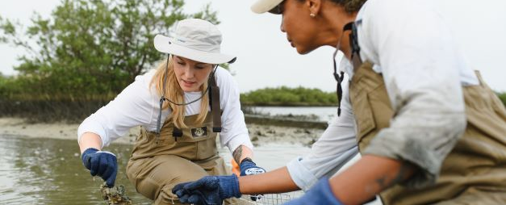
Ethics of Authorship
2022 RCR Summer Seminar Series
JUNE 9, 2022
Suzanne Stapleton
MARSTON SCIENCE LIBRARY
Notes:
Moderator will introduce the speaker(s).
(brief bio)
Suzanne Cady Stapleton is Associate Librarian at the University of Florida George A. Smathers Libraries. As the Agricultural Sciences and Digital Scholarship Librarian she serves as liaison to eleven academic units in the Institute of Food and Agricultural Sciences and provides leadership in digital publishing across campus. Suzanne earned the M. S. from Cornell University, the B. A. from Carleton College. She has conducted agricultural research in the U. S., Mexico, and Central America. Her current research interests are scholarly communication literacy and publishing practices of agricultural scholars. She is President of the U.S. Agriculture Information Network and a member of the American Library Association, Association of College and Research Libraries, and the Library Publishing Coalition.

Slide 5




OBJECTIVES
After this session, participants will be able to:
1
2
3
4
Explain what merits authorship
Define types of authorship
Know resources for guidance
Implement best practices

Slide 6

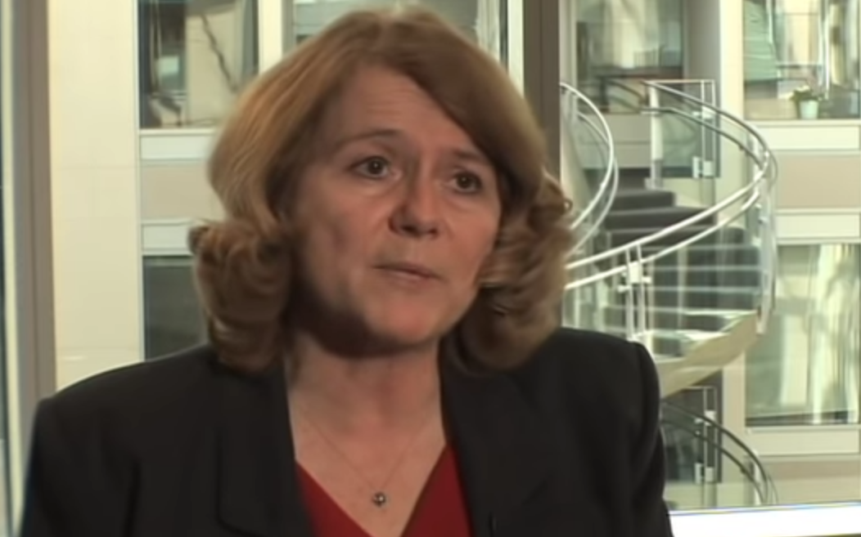
On Being a Scientist A guide to responsible conduct in research
https://www.youtube.com/embed/wIBjGV3OB0o#t=47
The National Academies Press

Slide 7

Have you authored a peer-reviewed publication?
Poll
Peer-review is a key piece to quality control in scholarly publications, especially in STEM fields where new knowledge is typically published as journal articles.
Under peer-review, submitted writing is evaluated by a group of peer experts, in addition to editors.
Other types of authorship:
Thesis or Dissertation
Books
Book chapters
Blogs and websites
Newsletters or news story

Slide 8
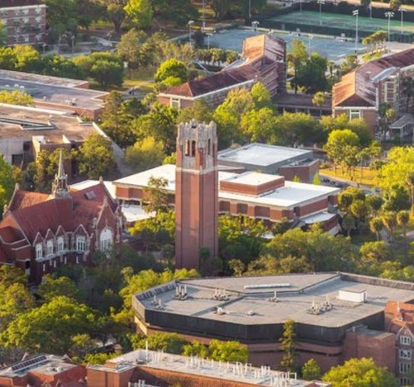
Why is Authorship Important in Academia?

Slide 9
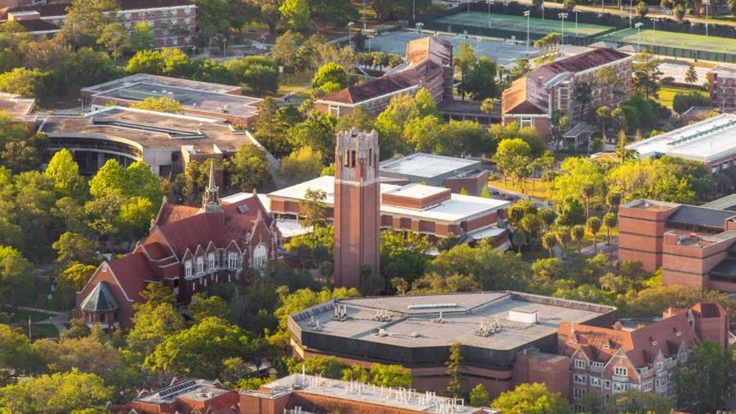
Why is Authorship Important in Academia?
A means to share your knowledge & contribute to the advancement of a field
Credits sources of new knowledge
Primary means to demonstrate expertise & research impact
Professional development & career advancement; used in promotion(s) and awards/honors
“A different way of teaching”
Image: University of Florida

Slide 10

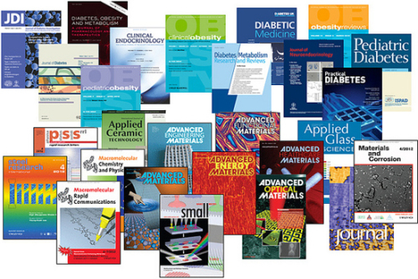
Who is an Author?
Image: #jp-carousel-387 in Ethics Alarms.com

Slide 11
What Contribution Merits Authorship?
Which of the people below should be listed as authors?
Writer
Person who had idea for work
Funder or person who secured funds for research
Data collector
Data analyzer
Lab manager
Correspondent with publisher
Revisions writer
Facility host
Image: #jp-carousel-387 in Ethics Alarms.com

Slide 12
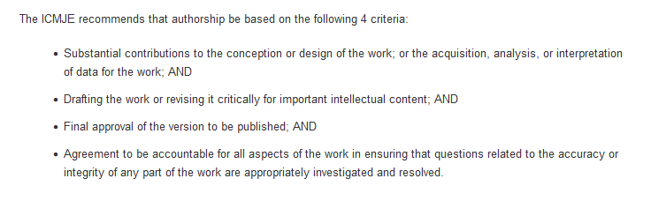
Who is an Author?
ICMJE = International Committee of Medical Journal Editors
http://www.icmje.org/recommendations/browse/roles-and-responsibilities/defining-the-role-of-authors-and-contributors.html
Notes:
If you are unsure, consult reputable resources for guidance!
The ICMJE recommends that authorship be based on four criteria.
“These authorship criteria are intended to reserve the status of authorship for those who deserve credit and can take responsibility for the work. “
“In addition to being accountable for the parts of the work he or she has done, an author should be able to identify which co-authors are responsible for specific other parts of the work. In addition, authors should have confidence in the integrity of the contributions of their co-authors.
All those designated as authors should meet all four criteria for authorship, and all who meet the four criteria should be identified as authors. Those who do not meet all four criteria should be acknowledged”
https://www.icmje.org/news-and-editorials/icmje-recommendations_annotated_may22.pdf

Slide 13

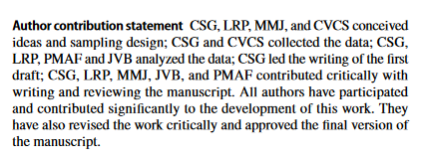
Author Contribution Statement Example
Example: Oecologia (2022) https://doi.org/10.1007/s00442-021-05071-x
Notes:
Some PUBLISHERS provide guidance on what merits authorship.
Some require Author Contribution Statements and publish these along with the articles.
These statements explain what each author’s contribution was to the research and final publication.
Here is an example from Springer-Verlag’s Oecologia.

Slide 14
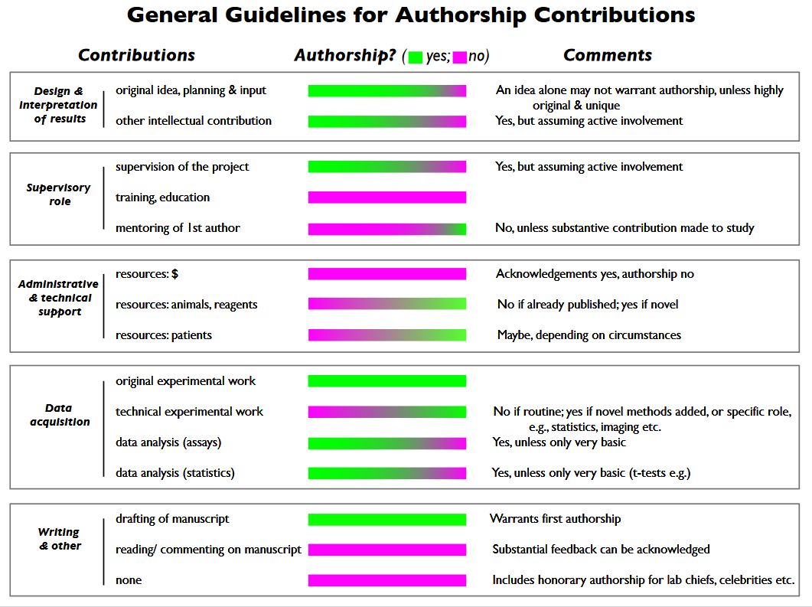
NIH
https://oir.nih.gov/sites/default/files/uploads/sourcebook/documents/ethical_conduct/guidelines-authorship_contributions.pdf
Notes:
Some FUNDERS provide guidance on ethics of authorship.
The National Institutes of Health (NIH) developed a general guideline to assess authorship contributions.
Here, contributions are described in 5 categories (read categories)
Under Authorship, green bars = Yes, Pink bars = No
Comments provide further explanation
You can see that some contributions are clearly related to authorship.
For instance, (bottom category) if a person drafted the manuscript, their contribution warrants authorship.
If a person did NONE of the writing, they are not eligible for authorship according to these guidelines.

Slide 15
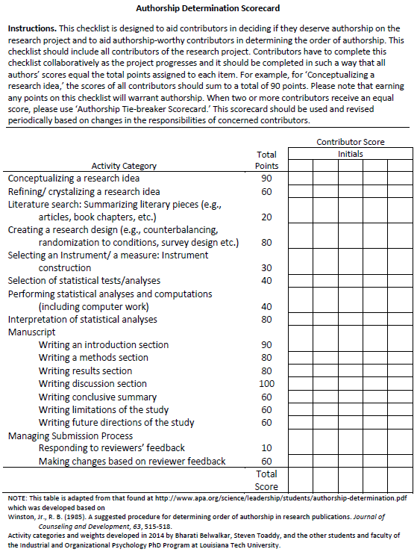
An Authorship Rubric
https://www.apa.org/science/leadership/st udents/authorship-determination- scorecard.pdf
Notes:
The Am. Psychological Assoc created a scorecard for research teams to use.
This is a tool to quantify contributions to aid in deciding who deserves authorship.
Each contributor is assigned a column where points are added, with a max total points permitted for each activity.
This scorecard provides an idea of how different contributions can be valued. Your research team may prefer to assign differently.
From APA website
https://www.apa.org/science/leadership/students/authorship-determination-scorecard.pdf

Slide 16
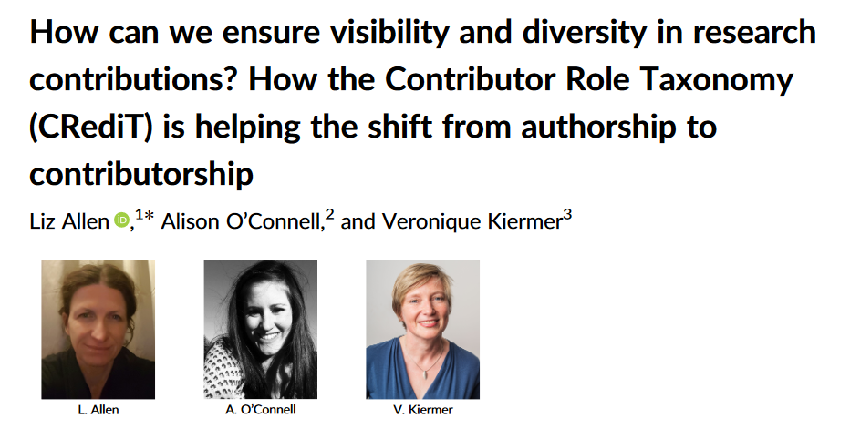
CRediT: Contributor Role Taxonomy
14 Contributor Roles:
Conceptualization
Methodology
Software
Validation
Formal analysis
Investigation
Resources
Data curation
Writing – original
Writing – review/editing
Visualization
Supervision
Project administration
Funding acquisition
Doi.org/10.1002/leap.1210
tenzing website has a form using CRediT: https://doi.org/10.1371/journal.pone.0244611
Notes:
We can see that Authorship extends beyond writing alone.
The Contributor Role Taxonomy (CRediT) is an effort to shift our perspective from Authorship to Contributorship.
CRediT recognizes that research team members today have different expertise to share, some beyond writing, that still merit authorship.
An example might be the research team member who develops unique software for the project.
CRediT is an effort to recognize these broad contributions and standardize language describing them.
Launched in 2014
120 publishers now using this taxonomy
Example: Farewell authors, hello contributors by A. Holcombe (programmer)
Nature commentary 2019: https://doi.org/10.1038/d41586-019-02084-8

Slide 17
COPE’s Minimum Requirements for Authorship
Substantial contribution to the work
Accountable for the work and its published form
COPE = Committee on Publication Ethics
https://publicationethics.org/resources/discussion-documents/authorship
Notes:
If all that seems a bit too complicated, the Committee on Publication Ethics (COPE) boils authorship down to 2 min requirements:
An author should have made
Substantial contribution to the work
And be Accountable for the work and its published form.
COPE definition:
The term authorship can refer to the creator or originator of an idea
(eg, the author of the theory of relativity) or the individual or individuals who develop and bring to fruition the product
that disseminates intellectual or creative works (eg, the author of a poem or a
scholarly article).
Authorship conveys significant privileges, responsibilities, and legal rights;
in the scholarly arena, it also forms the basis for rewards and career advancement.
https://publicationethics.org/files/COPE_DD_A4_Authorship_SEPT19_SCREEN_AW.pdf

Slide 18
“If you want to take credit,
first learn to take responsibility”
Tim Cook, Apple CEO
Commencement Address, Stanford University, 2019
https://www.geekwire.com/2019/apple-ceo-tim-cook-takes-tech-task-privacy-violations-stanford-commencement/
Notes:
It’s important to recognize that authorship is not just recognition and reward.
It also confers responsibility.

Slide 19
Authorship Responsibilities
Confirm that the publication is accurate
Understand and able to explain the publication contents
Legal responsibility for content (including adherence to copyright & licenses)
Future communication about the publication

Slide 20

Important Contributions that may not Merit Authorship
Acknowledgement for:
advising about the statistical analysis
collecting or entering the data
modifying or structuring a computer program
conducting routine observations or diagnoses for use in studies
funding sources
https://www.flickr.com/photos/nihgov/30861587086

Slide 21
If there is more than one author, what is the significance of the order of authors?
It varies….. discipline, research team, journal
Most important author is typically the first author
Examples: amount of contribution, level of seniority, mentor
Tip: Have this discussion PRIOR to writing the article

Slide 22
Types of Authorship Match Up
Terms
Definitions
First/Primary
Senior
Co-author
Corresponding
Guest
Sole
Ghost
Hyperauthorship
The only author
Over 1,000 authors
One of several
Speaks on behalf of all
Most experienced researcher
Most responsible for this publication
Eligible, but not included
Not eligible, but included

Slide 23
Types of Authorship Match Up Answers
First/Primary (f)
Senior (e)
Co-author (c)
Corresponding (d)
Guest (h)
Sole (a)
Ghost (g)
Hyperauthorship (b)
The only author
Over 1,000 authors
One of several
Speaks on behalf of all
Most experienced researcher
Most responsible for this publication
Eligible, but not included
Not eligible, but included
(aka honorary, courtesy)

Slide 24
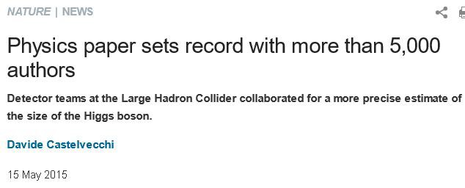
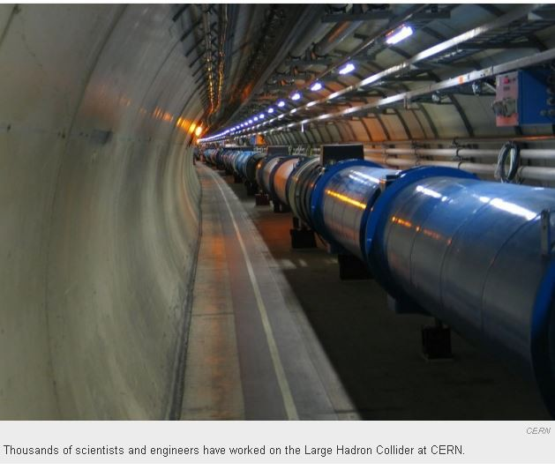
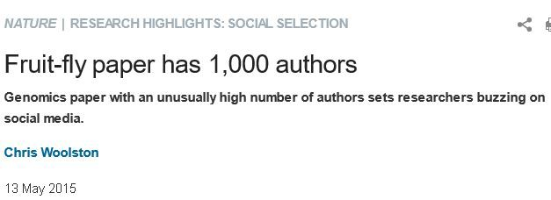
Examples of Hyperauthorship

Slide 25
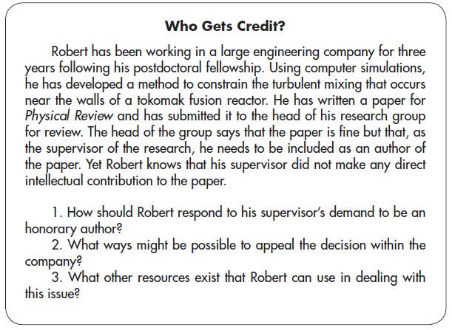
Breakout Discussion: Who Gets Credit?
Citation: On Being A Scientist

Slide 26

Breakout Discussion ReCap: What would you do?
How to respond to
boss’s request for
honorary authorship?
2. Ways to appeal, if
needed?
3. Other resources?
4. How can this be avoided in the future?

Slide 27
Common authorship mistakes
Level of contribution of all authors warrants authorship
Undisclosed conflict of interests
Incomplete literature review
Inaccurate citations
Fail to provide justification for research
Deciding on the appropriate statistical methodology
Self plagiarism
Duplicate publication
Dealing with outliers
Dealing with missing values
Interpreting statistics
Poor explanation of graphical information

Slide 28

Authorship Guidelines
Every lab or research group should have authorship guidelines
Every publication has authorship guidelines
Every conference call for proposals should have authorship guidelines
Best practices include
misconduct policies
Example of Author Misconduct Policy: https://www.entsoc.org/publications/publish/policies/misconduct

Slide 29
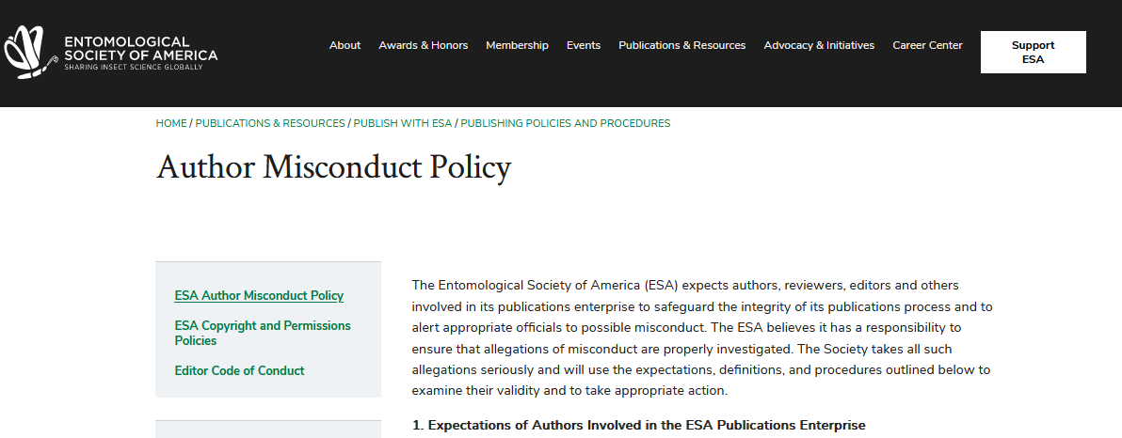
Example of Author Misconduct Policy
https://www.entsoc.org/publications/publish/policies/misconduct

Slide 30
Motivations for Inappropriate Authorship: Identify reasons for Ghost, Guest, Hyperauthorship
Student researcher graduated and left the lab before the paper was submitted
In exchange for previous mentorship
Prominent researcher at same institution, although not involved in this research
All lab members from multiple institutions in a global collaboration
To increase chances of favorable peer review and greater citations by including well-respected author
A 2017 study of more than 12,000 researchers based in the US and found that roughly one-in-three reported adding honorary authors to their publications. Women and junior faculty were the most likely to do so. (Fong)
Citation: https://www.natureindex.com/news-blog/gift-ghost-authorship-what-researchers-need-to-know

Slide 31
Motivations for Inappropriate Authorship: Identify reasons for Ghost, Guest, Hyperauthorship
Student researcher graduated and left the lab before the paper was submitted Ghost
In exchange for previous mentorship Guest
Prominent researcher at same institution, although not involved in this research Guest
All lab members from multiple institutions in a global collaboration Hyperauthorship
To increase chances of favorable peer review and greater citations by including well-respected author Guest
A 2017 study of more than 12,000 researchers based in the US and found that roughly one-in-three reported adding honorary authors to their publications. Women and junior faculty were the most likely to do so. (Fong)
Citation: https://www.natureindex.com/news-blog/gift-ghost-authorship-what-researchers-need-to-know

Slide 32
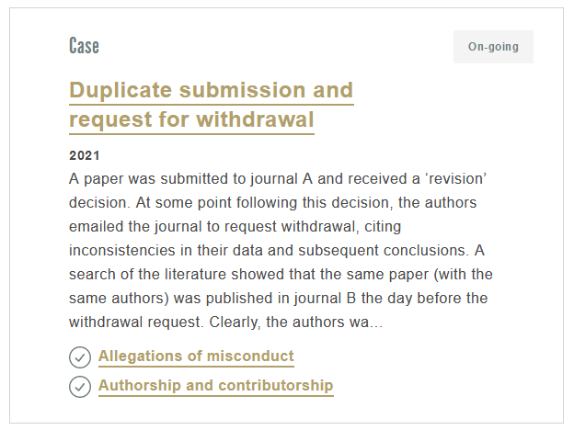

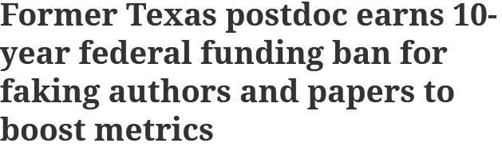
Examples of Authorship Misconduct
Cases in COPE
Cases in Retraction Watch
https://retractionwatch.com/2021/01/28/former-texas-postdoc-earns-10-year-federal-funding-ban-for-faking-authors-and-papers-to-boost-metrics/
http://retractiondatabase.org/RetractionSearch.aspx?
https://publicationethics.org/guidance/Case?classification=2772

Slide 33
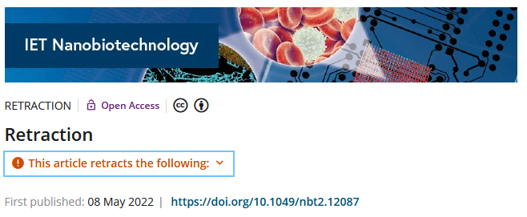
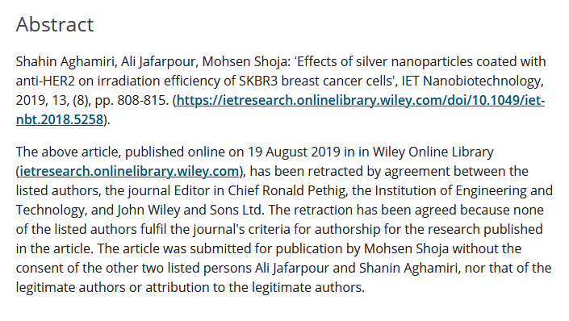
Retraction Due to Unethical Authorship
https://ietresearch.onlinelibrary.wiley.com/doi/10.1049/nbt2.12087

Slide 34
Best practices for ethical authorship
Establish clear expectations for authorship at the beginning of a project
Adhere to professional ethics: give credit where credit is due
Permission to re-use any published images or figures
Proper citations of previously published work
Disclosure of funding sources or any conflict of interests
Consider using a rubric to monitor authorship expectations
Contributions can be dynamic, so re-visit authorship frequently during the project
ALL eligible authors agree to final manuscript version prior to submission

Slide 35
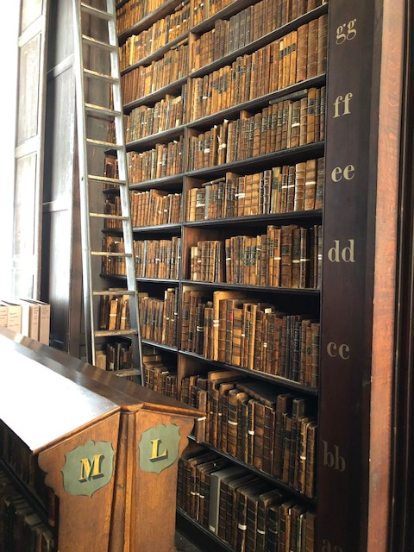
SUMMARY: Ethics of Authorship
Review
1
Authorship confers privileges & responsibilities
2
Establish expectations of authorship and authorship order at the start of each project
3
Be familiar with various types of authorship, including inappropriate authorship
4
Refer to resources for guidance in addressing authorship concerns
Trinity College Library, Photo S. Stapleton

Slide 36
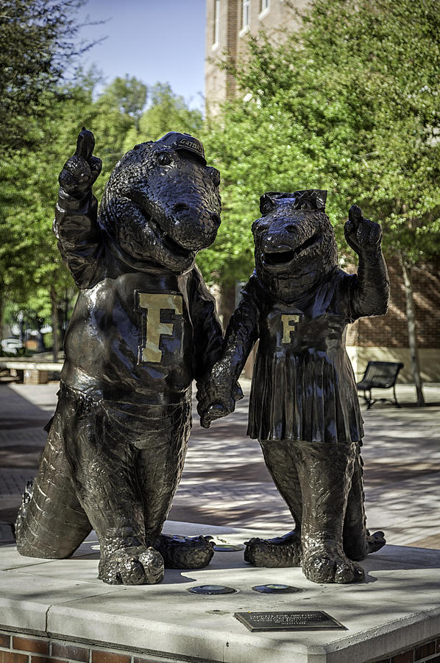
Resources
On Being a Scientist: A guide to responsible conduct of research
https://www.youtube.com/embed/wIBjGV3OB0o#t=47
Retraction Watch
http://retractiondatabase.org/RetractionSearch.aspx?
Committee on Publication Ethics. Discussion Document: Authorship. https://publicationethics.org/files/COPE_DD_A4_Authorship_SEPT19_SCREEN_AW.pdf
APA Determining Authorship https://www.apa.org/science/about/psa/2015/06/determining-authorship
Publisher’s author guidelines
CRediT Contributor Role Taxonomy, https://credit.niso.org/
Holcombe, A. O., Kovacs, M., Aust, F., & Aczel, B. (2020). Documenting contributions to scholarly articles using CRediT and tenzing. PLOS ONE, 15(12), e0244611. https://doi.org/10.1371/journal.pone.0244611

Slide 37
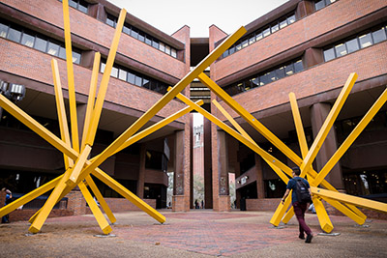
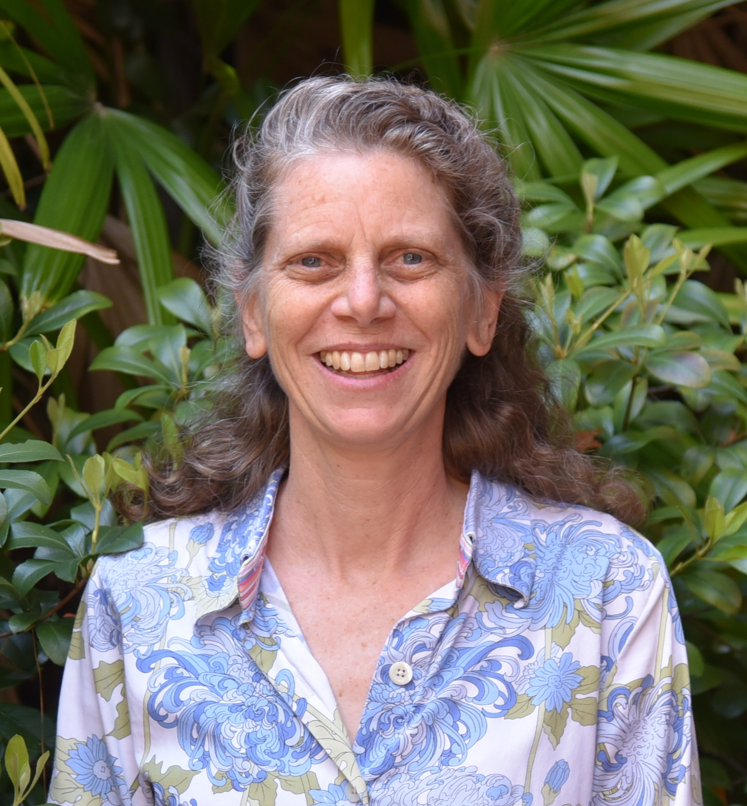
Thank you!
Suzanne Stapleton
Marston Science Library
Suzanne@ufl.edu
@stapletonUF

Slide 38
Extra Time
What if…
Scenario 1
A graduate student in your lab leaves UF and the research team continues research they began. Should this student continue as an author on future publications?
Scenario 2
A staff member who helped collect data for your research says they want to be included as a co-author. How would you respond?

Slide 39

Survey: | 30-day post seminar series bit.ly/rcr2022 | interviews
We value your input! Your feedback helps us improve the RCR Series!

Slide 40

IF YOU SUSPECT RESEARCH MISCONDUCT?
Contact the UF Research Integrity Officer (RIO):
Cassandra Farley | rio@research.ufl.edu | 352-273-3052
Research Misconduct means fabrication, falsification, or plagiarism in proposing, performing, or reviewing research, or in reporting research results.
Questionable Research Practices are reports of careless, irregular, or contentious research practices, as well as authorship disputes, may not meet the standard for research misconduct but may be a research integrity violation.
Make a confidential report to the UF Research Integrity Officer (RIO).
You may also report anonymously UF Compliance Hotline: 877-556-5356

Slide 41

Check out the UF RIO video!
The media layout displays multimedia.
Acknowledgement: The 2022 RCR Summer Seminar Series is funded in part by the Department of Health and Human Services, Office of Research Integrity grant (#ORIIR210068). Disclaimer: The content is solely the responsibility of the authors and does not necessarily represent the official views of the Dept. of Health and Human Services

Slide 42

A podcast devoted to creating a culture of responsible conduct of research and research integrity at the University of Florida. Produced by UF Creative Works, and a team of people across the UF Campus including UF Research, CTSI, the Center for Undergraduate Research, and a group of UF Research Ambassadors. https://research.ufl.edu/research-roundtable-podcast.html Acknowledgement: The 2022 RCR Summer Seminar Series is funded in part by the Department of Health and Human Services, Office of Research Integrity grant (#ORIIR210068). Disclaimer: The content is solely the responsibility of the authors and does not necessarily represent the official views of the National Institutes of Health.

