Slide 1

RCR Summer Seminar Series 2022
Michelle Leonard Assistant Director, Education & Training Programs | UF Research
Bob Kolb | Assistant Director, Clinical Research | UF CTSI
Cassandra Farley | Research Integrity Officer | UF Research
Terry Selfe | Translational Research & Impact Librarian | UF Health Science Center Libraries
The 2022 RCR Summer Seminar Series is funded in part by the Department of Health and Human Services, Office of Research Integrity grant (#ORIIR210068). Disclaimer: The content is solely the responsibility of the authors and does not necessarily represent the official views of the Dept. of Health and Human Services.
Notes:
Lead slide by Michelle. Welcome to the Responsible Conduct of Research Summer Seminar Series, whether you registered for just a few seminars or are enrolled in the RCR Certificate of Completion program, we are glad to have you participate! We have almost xx people in attendance, all with different levels of experience, knowledge and skills. These seminars are developed for the beginner but hopefully those of you with more experience will also find some take-aways, especially as we move to break out rooms to do the exercises, please keep that in mind as you begin your discussions. The goal for this seminar series is to promote a culture of research integrity on campus. To do this, we will learn from others, and have an open dialogue about research using active learning techniques, such as polls, breakout rooms, case studies, and discussions. The sessions will not be recorded so that we may discuss openly and freely. You will receive a copy of the presentation after the session ends.
Michelle will introduce the moderator.

Slide 2
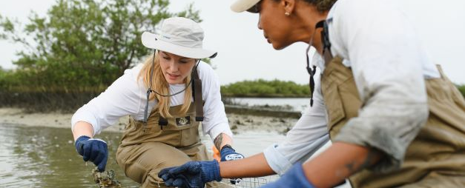
Collaborative Research
2022 RCR Summer Seminar Series
May 31, 2022
Health Service Research, Management and Policy | UF College of Public Health and Health Professions
Health Services ReseHealth Services Research, Management and Policy | UF College of Public Health and Health Professions
Yulia A. Levites Stekalova, Ph.D, MBA
Assistant Professor & Director
Notes:
Moderator will introduce the speaker(s). If the speaker prefers, they can send a brief bio in advance to the moderator, OR, the speaker can do a brief greeting and introduce the topic.

Slide 3
“I look for three things in hiring people. The first is personal integrity, the second is intelligence, and the third is high energy level. But if you don’t have the first, the other two will kill you.”
-Warren Buffet, CEO of Berkshire Hathaway

Slide 4

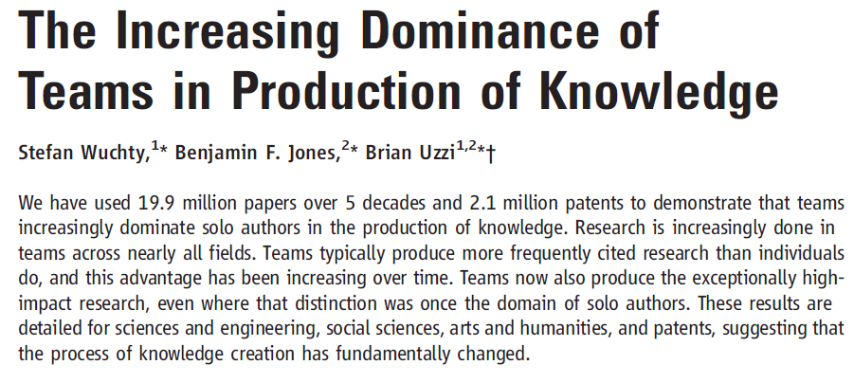
Teams in science

Slide 5
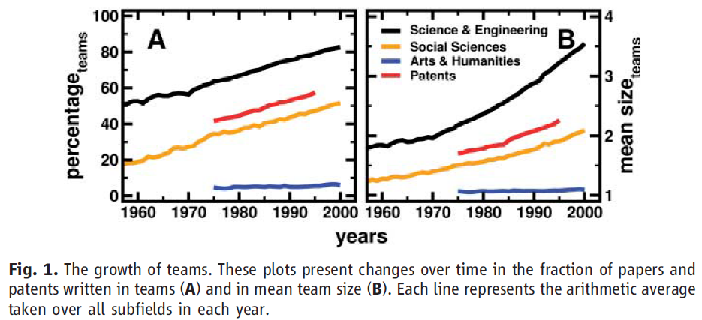
How has team size grown?

Slide 6
Published in Science
“The interdisciplinary approach is becoming one of the prominent characteristics of [science] and represents a synthesizing trend which focuses the specialized research techniques on problems common to a number of separate disciplines.
Such cooperative research has to overcome serious obstacles when operating within the existing departmentalized framework of the universities. It appears that real progress in this direction will be made in institutions which are organized on a permanent and frankly cooperative basis.
Psychologically, interdisciplinary research requires not only abstract, theoretical intelligence…, but also ‘social intelligence.’ Cooperative work is a social art and has to be practiced with patience.”

Slide 7
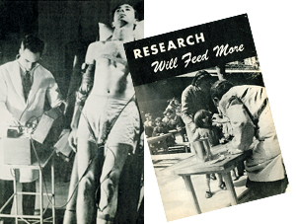
Why was that quote informative?
Anyone involved in collaboration has probably experienced both challenges
What is informative is not just what was said, but when it was said
One of first articles specifically addressing interdisciplinary research (Brozek & Keys, 1944)
Collaborations are [still] challenging,
so what are the tools?
Josef Brozek and Ancel Keys. 1944. General Aspects of Interdisciplinary Research in Experimental Human Biology. Science 100(2606):507-512.

Slide 8
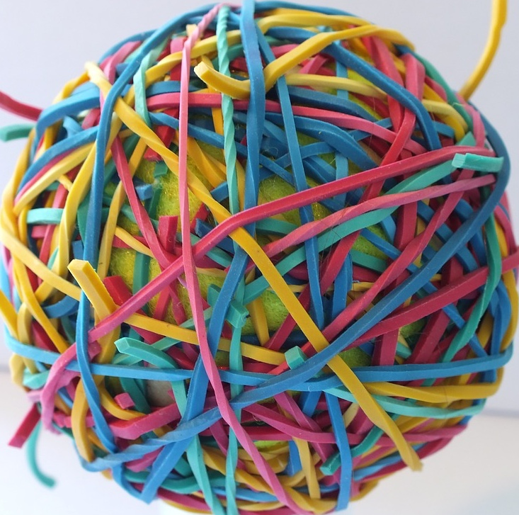
We are facing
tangled
challenges
and complex
contexts
Stokols, D., Hall, K. L., Taylor, B. K., & Moser, R. P. (2008). The science of team science: overview of the field and introduction to the supplement. American journal of preventive medicine, 35(2), S77-S89.
Notes:
no one source of the problem
no single intervention will fix it
no single organization can be the superhero

Slide 9
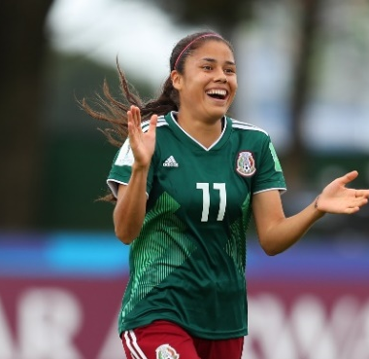
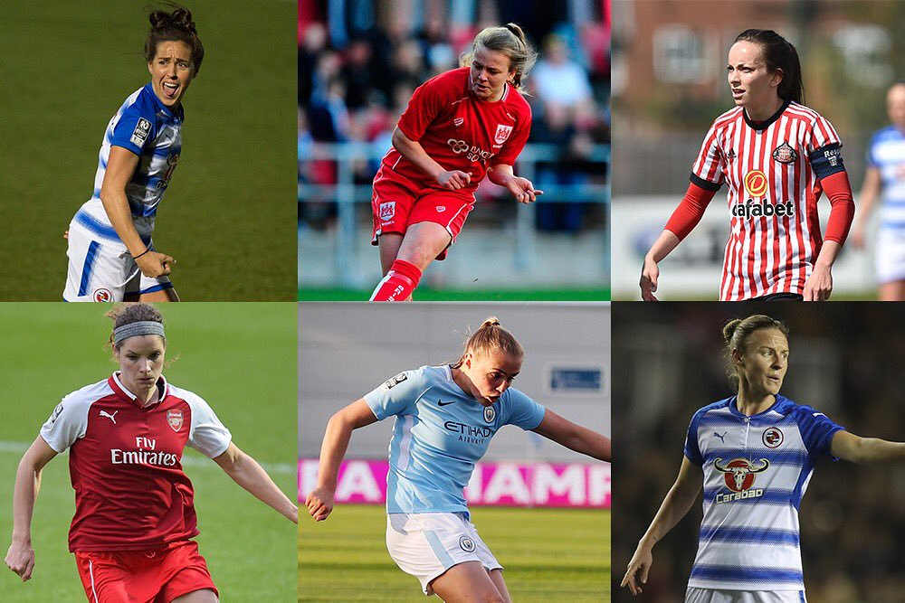
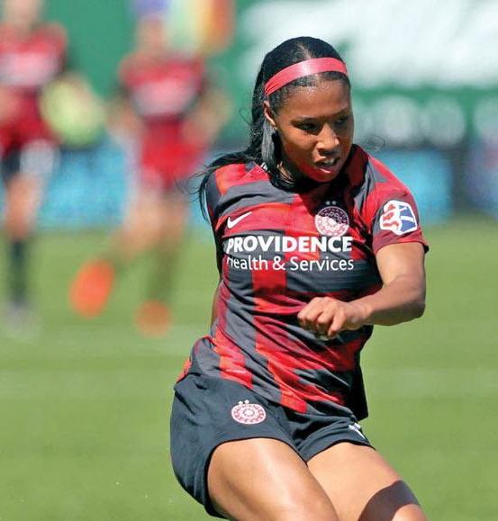
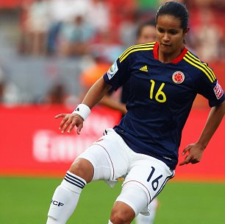
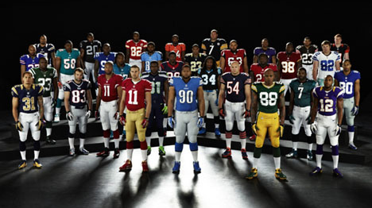
Group vs. Team

Slide 10
Group vs. Team
 | Groups | Teams
Members | Independent | Interdependent
Goals | Individual | Shared
Identity | Individual (me) | Shared (we)
Leadership | Often single | May be shared
Products | Individual | Collective
Reward | Individual | Collective
Cohesion | None/limited | Esprit de corps
Conflict | Reactive | Expected/proactive

Slide 11
Definitions
Teams | two or more people working interdependently (collaborating) towards a shared common goal or task
Team-Building | process of gathering the “right” people & getting them to work together to accomplish a goal/task
Teamwork | the combined action of a group of people, especially when effective and efficient

Slide 12
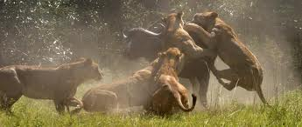
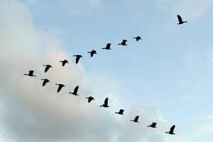
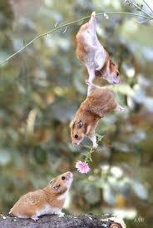
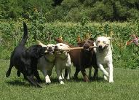
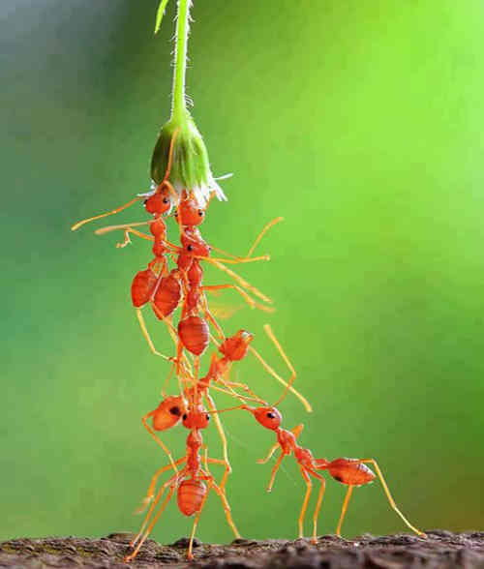
We may be evolutionarily programmed for teamwork
Teams seem to survive better than individuals

Slide 13
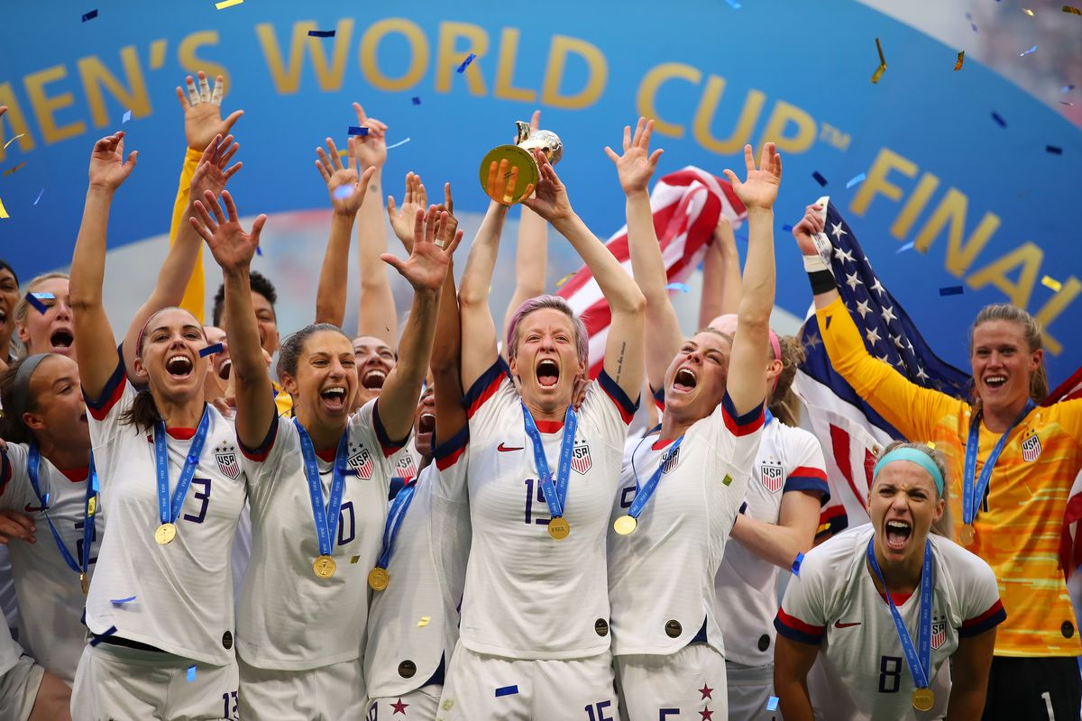
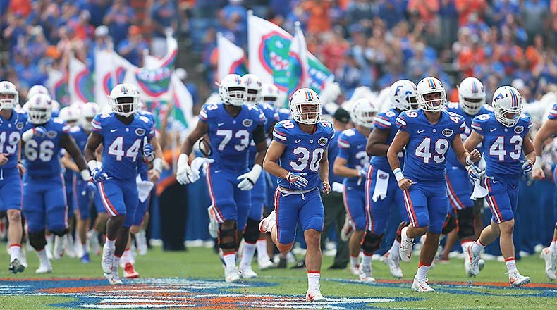
Group vs. Team

Slide 14

Teaming
Teaming is teamwork on the fly. It involves coordinating and collaborating across tasks without the benefit of stable team structures. Teaming calls for developing both affective (feeling) and cognitive (thinking) skills.
Edmondson, A. C. (2012). Teaming: How organizations learn, innovate, and compete in the knowledge economy. John Wiley & Sons.

Slide 15
Teamwork and taskwork
Team: A group of individuals who are dependent on one another to achieve a common goal.
Taskwork: The team’s efforts to produce deliverables to achieve its common goal.
Teamwork: The integration of the behaviors, thoughts, feelings and attitudes of team members as they collaborate to complete tasks to achieve a common goal.
WHO
WHAT
HOW

Slide 16
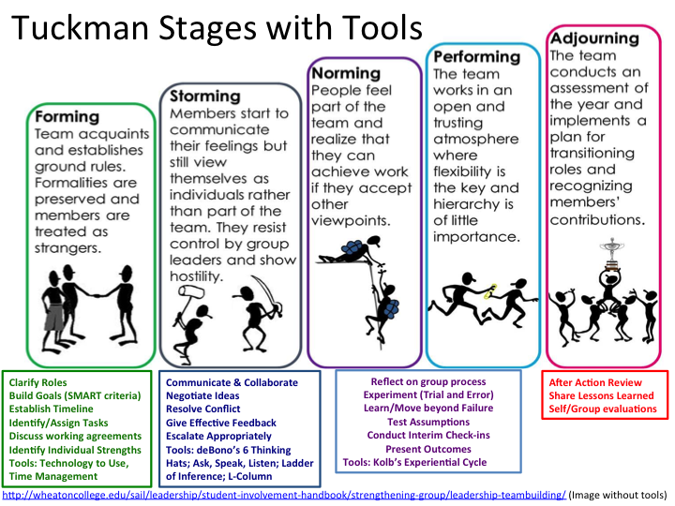
Tuckman model of team formation & performance
Notes:
Bruce Tuckman described four stages that all teams go through when they get together.
Discuss each stage. Consider asking participants for examples of each stage from their experience.
Forming – the pickup sticks symbolize team members having different goals.
Storming – team members may have different ideas about what the goal is or very different ideas about how to reach a goal.
Norming – team members are starting to come around and agree on what the goal is and how to get there.
Performing – everyone agrees about what the goal is and how to reach it.
After Performing, point out that all teams go through these stages. Some teams go through them faster than others. If team some members have worked together before, they might get through Storming more quickly. Some teams never get through Norming all the way to Performing. If something changes, like a team member leaves or a new member joins a team, the team will regress to the Forming and Storming stages, because it is a new team.
Tuckman later added a fifth stage called Adjourning (some have also called it Mourning), because teams usually come to an end when a goal is met or a project is finished. Teams should celebrate their success (remember “Encourage the Heart” from The Leadership Challenge).

Slide 17
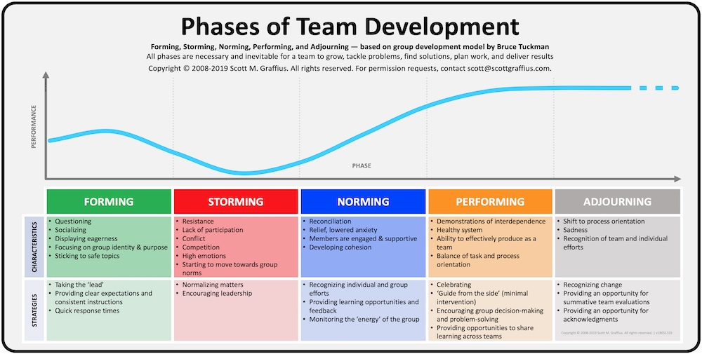

Slide 18

Improving teamwork
Cognition
Coordination
Communication
Context
Composition
Culture
Conflict
Cooperation
Coaching and Leadership

Slide 19
Improving teamwork
Cognition
Coordination
Communication
Context
Composition
Culture
Conflict
Cooperation
Coaching and Leadership

Slide 20
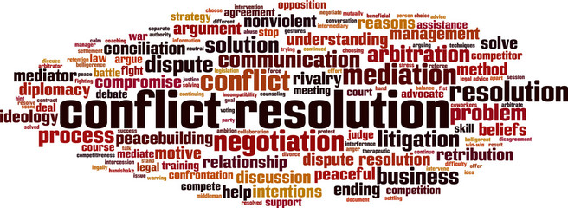
Conflict Management Strategies

Slide 21
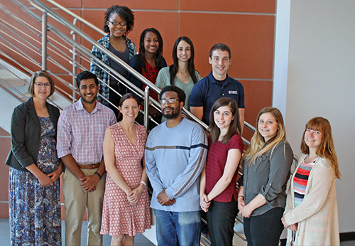
Conflict management
Notes:
What might be a great research team (lab) – everyone looks happy, everyone must be getting along, helping each other in research, etc.
Alfred P. Sloan was CEO of General Motors
Alicia Garza is an American civil rights activist and writer known for co-founding the international Black Lives Matter movement.
Noreena Hertz is an English academic, economist, and author, dubbed by The Observer newspaper as "one of the world's leading young thinkers" and by Vogue magazine as "one of the most inspiring women in the world."
Mahatma Gandhi used nonviolent resistance to lead the successful campaign for India's independence from British rule.

Slide 22
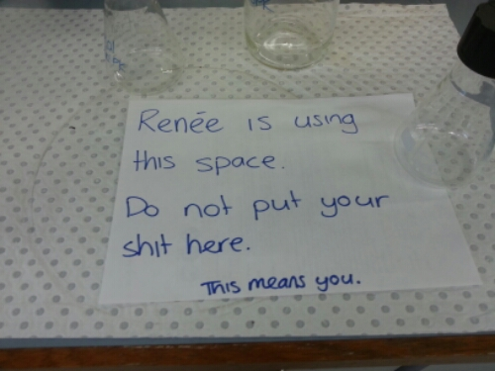
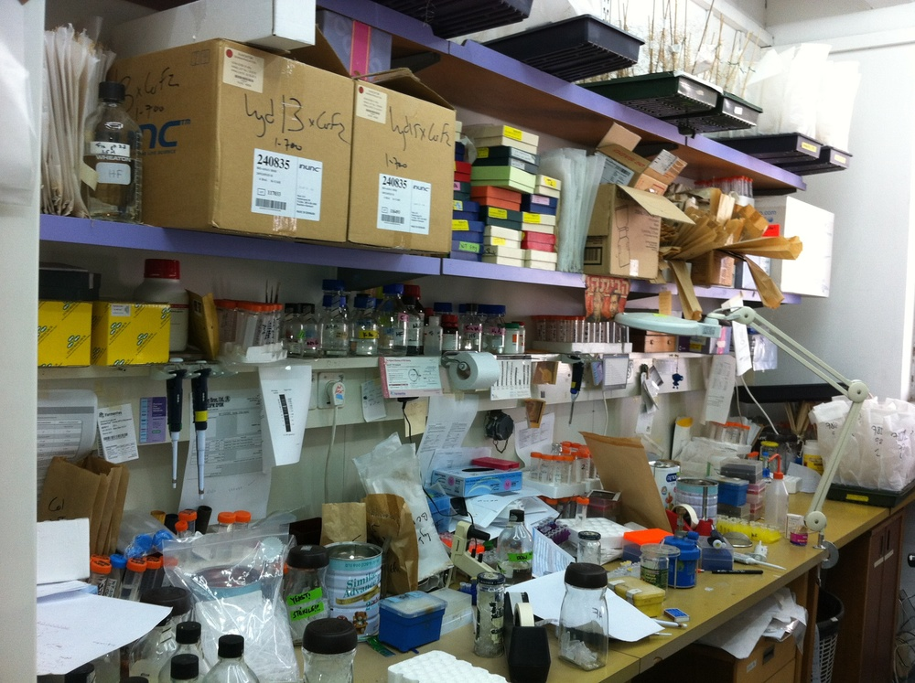
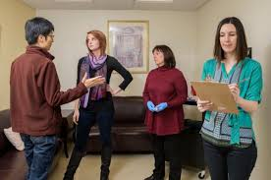
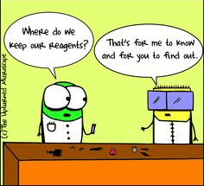
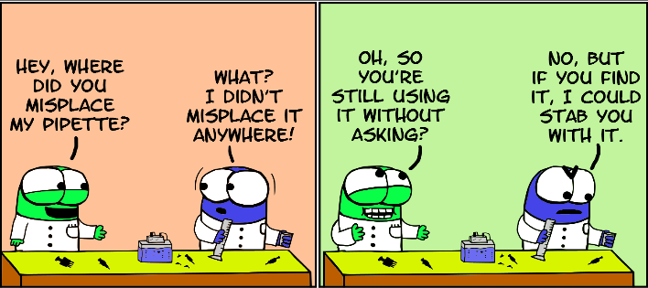
Conflict management
Notes:
What might really be going on in the lab if you take a closer look …
Transition into the fist exercise: have everyone form pairs. One person in each pair makes a fist. The other person has 2 minutes to get them to open their fist. Debrief by asking how many opened their fist, and asking what strategies were used. Which strategies worked, and why? Which strategies did not, and why not?

Slide 23
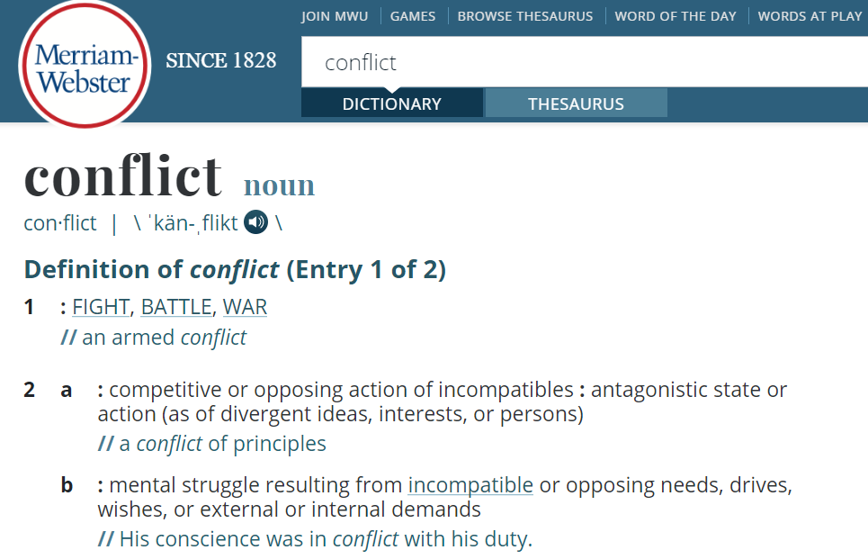

Conflict management strategies
Disagreement or difference
Professional
Interpersonal
Notes:
What kinds of differences are there among your team members?

Slide 24
Recognize differences
“Team science is an exercise in diversity.”
“Differences are at the core of the research team’s strength and … a challenge to their successful functioning …”
Notes:
What kinds of differences are there among your team members?

Slide 25
Cooperate to resolve conflict
The Most Important Question
“What do you want?”
Once you’ve gotten the answer to this, there are three follow-up questions:
What are you doing to get what you want?
Is what you are doing working?
Do you want to figure out another way?
Notes:
What kinds of differences are there among your team members?

Slide 26

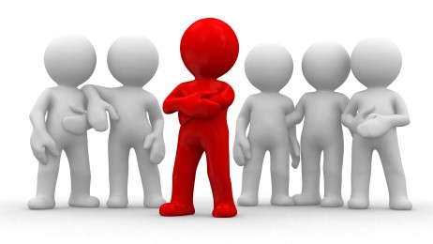
Team Culture
What is your team’s culture?

Slide 27
Foundations of team culture
Team culture rests on shared knowledge

Slide 28
Foundations of team culture
Team culture rests on shared knowledge about values (teamwork) and goals (taskwork)

Slide 29
Foundations of team culture
Shared goals
Knowledge sharing
Communication
Trust
Support
Notes:
Communication: Everyone can access the information they need to do their jobs.
Shared goals: Team members work together toward a shared goal, rather than competing against each other.
Knowledge sharing: Team members don’t hoard information; instead, they make sure everyone can learn, and the company is better for it.
Trust: Team members receive autonomy to do their work without being micromanaged.
Support: Team members help each other get work done when needed, reducing stress and burnout.

Slide 30
Team Culture
What is your team’s culture?
What knowledge is essential for new team members?

Slide 31
Yulia A. Levites Strekalova, PhD, MBA
Assistant Professor, UF PHHP Health Services Research
Director of Educational Development and Evaluation
UF CTSI
yulias@ufl.edu

Slide 32

Survey: | 30-day post seminar series bit.ly/rcr2022 | interviews
We value your input! Your feedback helps us improve the RCR Series!
Notes:
Michelle: survey
30 day post interview announcement

Slide 33

IF YOU SUSPECT RESEARCH MISCONDUCT?
Contact the UF Research Integrity Officer (RIO):
Cassandra Farley | rio@research.ufl.edu | 352-273-3052
Research Misconduct means fabrication, falsification, or plagiarism in proposing, performing, or reviewing research, or in reporting research results.
Questionable Research Practices are reports of careless, irregular, or contentious research practices, as well as authorship disputes, may not meet the standard for research misconduct but may be a research integrity violation.
Make a confidential report to the UF Research Integrity Officer (RIO).
You may also report anonymously UF Compliance Hotline: 877-556-5356
Notes:
Michelle

