Slide 1
RCR Summer Seminar Series 2022
Michelle Leonard Assistant Director, Education & Training Programs | UF Research
Bob Kolb | Assistant Director, Clinical Research | UF CTSI
Cassandra Farley | Research Integrity Officer | UF Research
Terry Selfe | Translational Research & Impact Librarian | UF Health Science Center Libraries
The 2022 RCR Summer Seminar Series is funded in part by the Department of Health and Human Services, Office of Research Integrity grant (#ORIIR210068). Disclaimer: The content is solely the responsibility of the authors and does not necessarily represent the official views of the Dept. of Health and Human Services.
Notes:
Lead slide by Michelle. Welcome to the Responsible Conduct of Research Summer Seminar Series, whether you registered for just a few seminars or are enrolled in the RCR Certificate of Completion program, we are glad to have you participate! We have almost xx people in attendance, all with different levels of experience, knowledge and skills. These seminars are developed for the beginner but hopefully those of you with more experience will also find some take-aways, especially as we move to break out rooms to do the exercises, please keep that in mind as you begin your discussions. The goal for this seminar series is to promote a culture of research integrity on campus. To do this, we will learn from others, and have an open dialogue about research using active learning techniques, such as polls, breakout rooms, case studies, and discussions. The sessions will not be recorded so that we may discuss openly and freely. You will receive a copy of the presentation after the session ends.
Michelle will introduce the moderator.

Slide 2
Agenda:
1
Data Ethics
2
Presentation and Breakout Rooms
3
Learners will benefit from this course by learning more about the ethical uses of patient data and tips to help manage the data
4
Time for Questions at the end!
Notes:
Moderator:
Presenter: insert information
FONT: Lato
Colors: black and blue (hex #005496)

Slide 3
2022 RCR Summer Seminar Series
Rigors of Peer Review
Mentor/Mentee Relationships
Data Ethics
Collaborative Research
Reproducibility & Replicability
Research Misconduct
Export Control
Avoiding Plagiarism
Safe Research Environments
Ethics of Authorship
RCR Action Plan
The Lab
NIH Data Management Policy
Research Conflicts of Interest
The Research Clinic
Notes:
Moderator: It’s not too late to enroll in other sessions. If you want to earn a RCR Certificate that meets NIH, NSF, and USDA RCR requirements, you will need to enroll in all of these sessions. By earning a certificate, this will replace the CITI online, asynchronous training. And of course, you may choose to attend any or all of the sessions. Add link to enroll in the chat: https://research.ufl.edu/rcr/2022-summer-seminar-series-registration/

Slide 4
Data Ethics
2022 RCR Summer Seminar Series
June 28, 2022
Clinical and Translational Science- Informatics and Technology
Christopher P. Barnes
Melissa M. Moreno
Notes:
Moderator will introduce the speaker(s). If the speaker prefers, they can send a brief bio in advance to the moderator, OR, the speaker can do a brief greeting and introduce the topic.

Slide 5
Data Ethics Presentation Objectives
1
2
3
4
Data Ethics; Empathy, Confidentiality, Ownership, and Sharing
Use Case
Data Management tips and Data Type determination
Questions
Notes:
Option for the speaker. The images should be replaced or create a different slide.
It’s best to use an image and text.
Font: Lato.

Slide 6
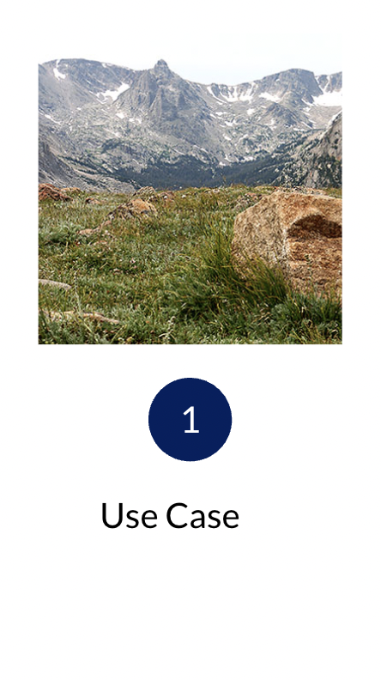
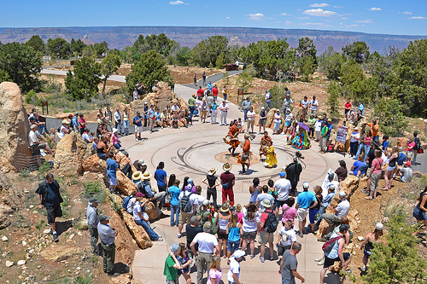

Slide 7
Use Case - Havasupai tribe : Intro
Between 1990 and 1994, DNA samples were solicited from approximately 400 Havasupai tribe members in conjunction with the Diabetes Project led by researchers at ASU.
The Havasupai, a small, isolated tribe living in a remote part of the Grand Canyon, had limited access to fresh food and health care.
To obtain informed consent, ASU researchers made oral statements recruiting the tribal members to the research study. When they agreed, participants were asked to sign informed consent documents written in English (Hart and Sobraske 2003).
Although the consent form said that the samples would be used for research on “behavioral/medical problems,” tribe members were told that their samples would be used specifically for genetic studies on diabetes (Bommersbach 2008; Hart and Sobraske 2003).
Garrison N. A. (2013). Genomic Justice for Native Americans: Impact of the Havasupai Case on Genetic Research. Science, technology & human values, 38(2), 201–223. https://doi.org/10.1177/0162243912470009
Notes:
@Mel presents slides 7 - 10
Between 1990 and 1994, DNA samples were solicited from approximately 400 Havasupai tribe members in conjunction with the Diabetes Project led by researchers at ASU. The stated intent of the project was to understand why more than half of Havasupai adults suffered from type 2 diabetes (Bommersbach 2008). The Havasupai, a small, isolated tribe living in a remote part of the Grand Canyon, had limited access to fresh food and health care. The Diabetes Project included education about diabetes, the collection and testing of blood samples, and genetic association testing. To obtain informed consent, ASU researchers made oral statements recruiting the tribal members to the research study. When they agreed, participants were asked to sign informed consent documents written in English (Hart and Sobraske 2003).

Slide 8
Use Case - Havasupai tribe: The Issue
However, initial studies failed to find a genetic link with type 2 diabetes.
The samples were stored, and subsequently used in other ongoing genetic studies and distributed to researchers for unrelated studies.
The samples were used on other experiments that were not originally consented by the tribe.
Garrison N. A. (2013). Genomic Justice for Native Americans: Impact of the Havasupai Case on Genetic Research. Science, technology & human values, 38(2), 201–223. https://doi.org/10.1177/0162243912470009
Notes:
Although the consent form said that the samples would be used for research on “behavioral/medical problems,” tribe members were told that their samples would be used specifically for genetic studies on diabetes (Bommersbach 2008; Hart and Sobraske 2003).

Slide 9
Breakout Room- Use Case
Do you see any ethics issues with this study and its methods?
(Break Out Room to discuss for 5 min)
Garrison N. A. (2013). Genomic Justice for Native Americans: Impact of the Havasupai Case on Genetic Research. Science, technology & human values, 38(2), 201–223. https://doi.org/10.1177/0162243912470009

Slide 10
Use Case - Havasupai tribe: The Issue
Havasupai participants alleged that researchers had failed to make clear that the samples may be used for studies on schizophrenia and that no expanded informed consent was sought.
Since mental illness is highly stigmatized in the Havasupai culture, tribe members asserted that they would not have consented to such research had they been properly informed (Bommersbach 2008; Hart and Sobraske 2003).
The tribe also alleged that researchers gained illegal access to Havasupai medical records by entering the local medical clinic and removing secured files without permission from tribal officials or clinic administrators (Hart and Sobraske 2003).
Garrison N. A. (2013). Genomic Justice for Native Americans: Impact of the Havasupai Case on Genetic Research. Science, technology & human values, 38(2), 201–223. https://doi.org/10.1177/0162243912470009
Notes:
Havasupai participants alleged that researchers had failed to make clear that the samples may be used for studies on schizophrenia and that no expanded informed consent was sought. Since mental illness is highly stigmatized in the Havasupai culture, tribe members asserted that they would not have consented to such research had they been properly informed (Bommersbach 2008; Hart and Sobraske 2003). The tribe also alleged that researchers gained illegal access to Havasupai medical records by entering the local medical clinic and removing secured files without permission from tribal officials or clinic administrators (Hart and Sobraske 2003).

Slide 11
Section 2- Data Ethics, Empathy, Confidentiality, Ownership and Sharing

Slide 12
Data Confidentiality- Data Ethics Principles; why do we do this?
Protect vulnerable populations who could be harmed by the profession's activities;
Protect/enhance the good reputation of and trust for the profession;
Establish the profession as a distinct moral community worthy of autonomy from external control and regulation;
Provide a basis for public expectations and evaluation of the profession;
Serve as a basis for adjudicating disputes among members of the profession and between members and nonmembers;
Create institutions resilient in the face of external pressures; and
Respond to past harms done by the profession.
Hand D. J. (2018). Aspects of Data Ethics in a Changing World: Where Are We Now?. Big data, 6(3), 176–190. https://doi.org/10.1089/big.2018.0083

Slide 13
Data Ownership- Ethical Issues with participant data and considerations
The pervasiveness of modern data technology means we might legitimately regard it as an aspect of societal infrastructure.
The interconnectedness of data.
The dynamic nature of data.
Real-time and online analysis and decision-making, as data arrive.
Synergistic analysis through merging and combination of data sets.
Lack of space, time, and social context limitation on scope of data (data may describe and be used regardless of where, when, and for what purpose they were collected).
Ability to use for unexpected purposes and to reveal unexpected information (this is the core purpose of data mining).
Risk of exceptional intrusiveness since it is impossible to avoid having data about individuals stored in multiple databases.
Potential for misuse, privacy breach, blackmail, and other crimes
Hand D. J. (2018). Aspects of Data Ethics in a Changing World: Where Are We Now?. Big data, 6(3), 176–190. https://doi.org/10.1089/big.2018.0083
Notes:
The pervasiveness of modern data technology means we might legitimately regard it as an aspect of societal infrastructure, in the same way that mathematics, language, transport, and so on are infrastructural.
The interconnectedness of data. Data on travel may be used for discovering things far beyond mere travel patterns; data on purchases are not solely relevant to purchases; and so on.
The dynamic nature of data. Modern data sets often evolve and accumulate over time so that they may permit discoveries in the future that they do not permit today.
Real-time and online analysis and decision-making, as data arrive.
Synergistic analysis through merging and combination of data sets.
Lack of space, time, and social context limitation on scope of data (data may describe and be used regardless of where, when, and for what purpose they were collected).
Ability to use for unexpected purposes and to reveal unexpected information (this is the core purpose of data mining).
Risk of exceptional intrusiveness since it is impossible to avoid having data about individuals stored in multiple databases.
Potential for misuse, privacy breach, blackmail, and other crimes.
Subtle ownership issues (“my” data might also be your data; I can sell “my” data while retaining them, and so on, as discussed in detail below).

Slide 14
Data Sharing - IRB sharing guidelines
Data Sharing in Research Modified: November 2019 Background:
Effective on October 1, 2015, the NIH implemented a mandatory data sharing policy. The reason stated is, “Data sharing advances the NIH mission by facilitating the validation of research results, and allowing the strength of analyses to be increased by combining datasets, providing access to unique data that cannot be readily replicated, informing future research, increasing the return on investment of scientific research, and accelerating the translation of research results into knowledge, products, and procedures to improve the public health.” As of 1 July 2018, manuscripts submitted to International Committee of Medical Journal Editors (ICMJE) journals that report the results of clinical trials must contain a data sharing statement. Some other funding agencies also have data sharing requirements attached to their funding.
https://irb.ufl.edu/wp-content/uploads/Data-Sharing-in-Research.pdf
Notes:
This could be Mels’ last slide that is a way to launch into Chris’s slides about HOWTO make a data management plan.

Slide 15
Date Sharing - FAIR Principles
Findable
The first step in (re)using data is to find them. Metadata and data should be easy to find for both humans and computers. Machine-readable metadata are essential for automatic discovery of datasets and services, so this is an essential component of the FAIRification process.https://www.go-fair.org/fair-principles/
Accessible
Once the user finds the required data, she/he/they need to know how they can be accessed, possibly including authentication and authorisation.
Interoperable
The data usually need to be integrated with other data. In addition, the data need to interoperate with applications or workflows for analysis, storage, and processing.
Reusable
The ultimate goal of FAIR is to optimise the reuse of data. To achieve this, metadata and data should be well-described so that they can be replicated and/or combined in different settings.
https://www.go-fair.org/fair-principles/

Slide 16
Breakout Room- Data Confidentiality
What data confidentiality mean? (Break out room 5 min)

Slide 17
Do not put personally identifiable, sensitive, or confidential information about NIH-supported research or participants on portable electronic devices such as laptops, CDs, or flash drives. If you must use such devices, encrypt your data.
Limit access to personally identifiable information through password protection and other means.
Transmit research data only when you know the recipient's systems are secure.
Understand that even if FISMA does not apply, you are responsible for protecting sensitive and confidential data and preventing disclosure, release, or loss of sensitive personal information.
What is Data Confidentiality?
https://www.niaid.nih.gov/research/data-security#:~:text=Do%20not%20put%20personally%20identifiable,such%20devices%2C%20encrypt%20your%20data.
Notes:
If you provide collected sensitive information to NIAID as a condition of your award, NIAID is responsible for protecting the transfer.
In the event of a data security breach, do the following:
Follow your institute's policy.
Inform your NIAID program officer and grants management or contracting officer.
Your institute will pay expenses to address the breach out of indirect costs.

Slide 18
https://venturebeat.com/2022/02/26/why-the-ethical-use-of-data-and-user-privacy-concerns-matter/
Data Confidentiality-
Ethical Principles for Data-driven decision making
Empathy
Data control
Transparency
Accountability
Equality
Notes:
Empathy — Data ultimately involves and affects human beings. By focusing on the human being at the center of every data transaction, analysts can make more ethical decisions when it comes to applying that data.
Data control — Our data is an extension of ourselves. In turn, organizations should prioritize user ownership and control of their own data. The user decides what they’re comfortable with, and organizations should support that.
Transparency — Everyone has encountered Terms of Service (ToS) agreements too lengthy and jargon-filled for the average user to understand. An ethical approach to data management makes it clear to the user what data is being collected and why.
Accountability — An organization is responsible for maintaining the security of the information it collects. This means a consistent, cutting-edge security process must be maintained if data is to be utilized.
Equality — You might think that data can’t be biased, and while that might be true, our means of gathering, collecting, and applying data can be. Evaluate your process to ensure that it doesn’t reflect prejudice of any kind, conscious or unconscious.

Slide 19
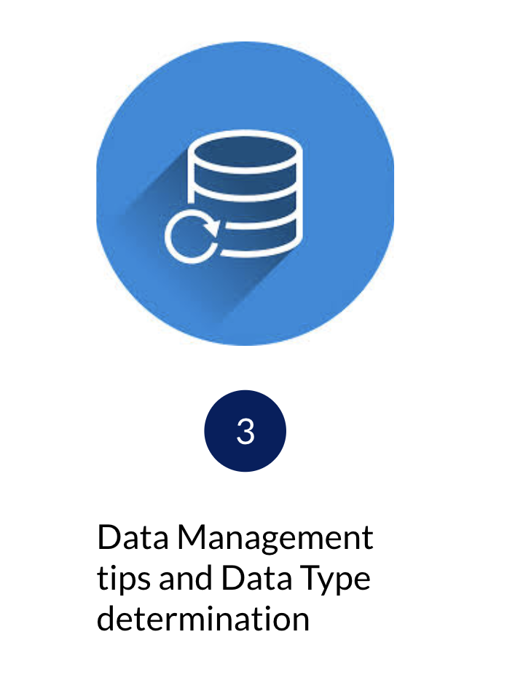
Section 3- Data Management
Is it ethical to take good care of the data you are entrusted with?
What is does good data management involve?
(Break out room 5 min)
Notes:
@ Chris presents slides 11 - 17

Slide 20
Have a data management plan!
Most cases of mishandling data result from not having a plan or not following your plan.

Slide 21
Data Management - Workflow
(Use the Checklist and WRITE IT DOWN)
Data Management Plan Worksheet: https://goo.gl/wC98VO
Define your basic data requirements. (write a scenario)
Define type of data you will store.
Determine how much data you will store.
Determine how you will secure the data.
Define the source(s) of your data.
Determine how you will load (input) the data. (RedCap anyone?)
Define how you will process (aka analysis ) the data.
Define how you will output (aka access/report ) the data?
Finally, Determine what resources you need to do all of the above.
Notes:
Option for content layout; change pix

Slide 22
So where do you start; data managements 7 Ps
Prior
Proper
Planning
Prevents
Pretty
Poor
Performance
Notes:
Option for content layout; change pix

Slide 23
Data Management- Understand Your Data Types
Text Based Data
Data limited to characters and numbers
Blood Pressure, Drug Dosage, Demographics
Binary Data
Images (Pictures, Graphs, X-Rays)
Structured Data stored in encoded groups of BITS designed to be read by a machine.
A combination of both
This decision influences all other decisions about the design and management of your data.

Slide 24
Data Management - Understand your tools
Data Analysis
Data Storage
MySQL, Postgres, REDCap, etc
Dedicated Server
External hard drives (only for backups)
Python
R
Matlab
Tableau
etc…
Notes:
Not understanding or knowing the safe and secure ways of using a tool can lead to mishandling of data. Example, using default passwords for SQL servers or not using encryption for connections can lead to disclosing data to third parties.

Slide 25
Data Management-
What’s wrong with only keeping data locally?
Harder to share with collaborators
If your computer is lost, stolen or breaks you lose your data and work
It is your responsibility to make sure that the data you are entrusted with is backed up, secured, and available to use for its intended purpose without any foreseeable burden in accessing or sharing the data.

Slide 27
Thank you!
Christopher P. Barnes and Melissa Moreno
Website
CTS-IT
cpb@ufl.edu
melimore86@ufl.edu
https://www.ctsi.ufl.edu/research/study-design-and-analysis/informatics-consulting/
Notes:
Feel free to use or create your own.
Font: Lato
Michelle will place the evaluation survey link into the chat.

Slide 28
Survey: | 30-day post seminar series bit.ly/rcr2022 | interviews
We value your input! Your feedback helps us improve the RCR Series!
Notes:
Michelle: survey
30 day post interview announcement

Slide 29
IF YOU SUSPECT RESEARCH MISCONDUCT?
Contact the UF Research Integrity Officer (RIO):
Cassandra Farley | rio@research.ufl.edu | 352-273-3052
Research Misconduct means fabrication, falsification, or plagiarism in proposing, performing, or reviewing research, or in reporting research results.
Questionable Research Practices are reports of careless, irregular, or contentious research practices, as well as authorship disputes, may not meet the standard for research misconduct but may be a research integrity violation.
Make a confidential report to the UF Research Integrity Officer (RIO).
You may also report anonymously UF Compliance Hotline: 877-556-5356
Notes:
Michelle

Slide 30
Check out the UF RIO video!
The media layout displays multimedia.
Acknowledgement: The 2022 RCR Summer Seminar Series is funded in part by the Department of Health and Human Services, Office of Research Integrity grant (#ORIIR210068). Disclaimer: The content is solely the responsibility of the authors and does not necessarily represent the official views of the Dept. of Health and Human Services
Notes:
Michelle: Resources

Slide 31
A podcast devoted to creating a culture of responsible conduct of research and research integrity at the University of Florida. Produced by UF Creative Works, and a team of people across the UF Campus including UF Research, CTSI, the Center for Undergraduate Research, and a group of UF Research Ambassadors. https://research.ufl.edu/research-roundtable-podcast.html Acknowledgement: The 2022 RCR Summer Seminar Series is funded in part by the Department of Health and Human Services, Office of Research Integrity grant (#ORIIR210068). Disclaimer: The content is solely the responsibility of the authors and does not necessarily represent the official views of the National Institutes of Health.
Notes:
Michelle: check us out! Submit ideas!!!

