Slide 1

RCR Summer Seminar Series 2022
Michelle Leonard Assistant Director, Education & Training Programs | UF Research
Bob Kolb | Assistant Director, Clinical Research | UF CTSI
Cassandra Farley | Research Integrity Officer | UF Research
Terry Selfe | Translational Research & Impact Librarian | UF Health Science Center Libraries
The 2022 RCR Summer Seminar Series is funded in part by the Department of Health and Human Services, Office of Research Integrity grant (#ORIIR210068). Disclaimer: The content is solely the responsibility of the authors and does not necessarily represent the official views of the Dept. of Health and Human Services.
Notes:
Lead slide by Michelle. Welcome to the Responsible Conduct of Research Summer Seminar Series, whether you registered for just a few seminars or are enrolled in the RCR Certificate of Completion program, we are glad to have you participate! We have almost xx people in attendance, all with different levels of experience, knowledge and skills. These seminars are developed for the beginner but hopefully those of you with more experience will also find some take-aways, especially as we move to break out rooms to do the exercises, please keep that in mind as you begin your discussions. The goal for this seminar series is to promote a culture of research integrity on campus. To do this, we will learn from others, and have an open dialogue about research using active learning techniques, such as polls, breakout rooms, case studies, and discussions. The sessions will not be recorded so that we may discuss openly and freely. You will receive a copy of the presentation after the session ends.
Michelle will introduce the moderator.

Slide 2
2022 RCR Summer Seminar Series
Rigors of Peer Review
Mentor/Mentee Relationships
Data Ethics
Collaborative Research
Reproducibility & Replicability
Research Misconduct
Export Control
Avoiding Plagiarism
Safe Research Environments
Ethics of Authorship
RCR Action Plan
The Lab
NIH Data Management Policy
Research Conflicts of Interest
The Research Clinic
Notes:
Moderator: It’s not too late to enroll in other sessions. If you want to earn a RCR Certificate that meets NIH, NSF, and USDA RCR requirements, you will need to enroll in all of these sessions. By earning a certificate, this will replace the CITI online, asynchronous training. And of course, you may choose to attend any or all of the sessions. Add link to enroll in the chat: https://research.ufl.edu/rcr/2022-summer-seminar-series-registration/

Slide 3
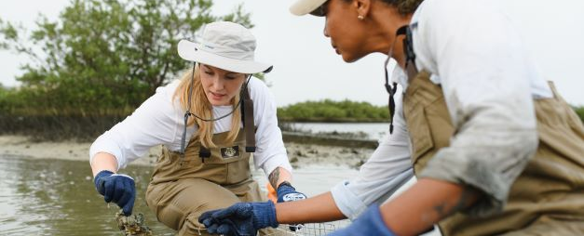
Rigors of Peer Review
2022 RCR Summer Seminar Series
JUNE 23, 2022
Suzanne Stapleton & Tara Cataldo
MARSTON SCIENCE LIBRARY
Notes:
Moderator will introduce the speaker(s). If the speaker prefers, they can send a brief bio in advance to the moderator, OR, the speaker can do a brief greeting and introduce the topic.

Slide 4

Agenda:
1
What is Peer Review?
2
Types of Peer Review
3
Examples of Peer Review Misconduct
4
Constructive Peer Review
5
Best Practices & Recommendations

Slide 5




OBJECTIVES
1
2
3
4
Recognize the foundational value of peer review to development of new knowledge
Critique various types and processes of peer review
Demonstrate aspects of constructive peer review
Learn the peer review process from both author and reviewer perspectives

Slide 6
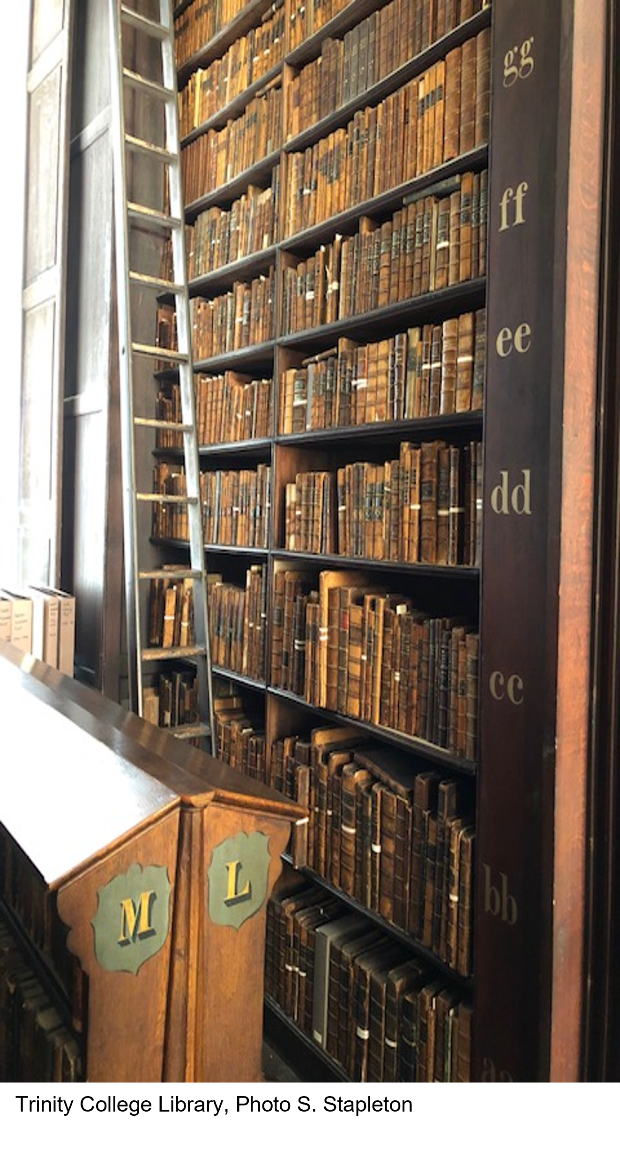
Peer Review
Importance
"Peer review is how we ensure the overall quality of our work, how we support each other, how we can push and constructively challenge each other to be truly innovative, how we can make sure that our work connects with and is relevant for others, and how we can drive impact and change that are appropriately targeted at the needs of different communities."
Köhler et al. https://doi.org/10.1017/iop.2019.121
Notes:
Peer reviewing is “the cornerstone of our profession, on which we need to build all other endeavors”

Slide 7
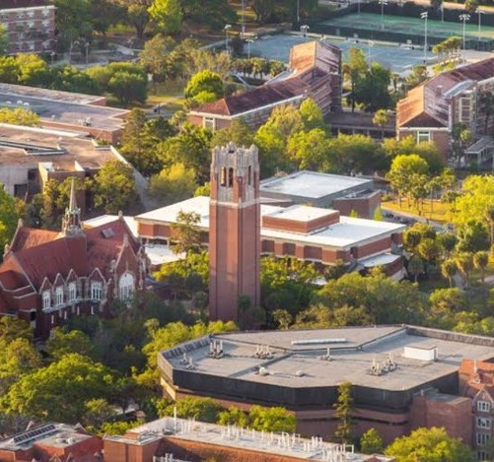
PART 1
What Authors Need to Know about Peer Review
Poll
Have you authored a
peer reviewed publication?
Notes:
[Tara]
Poll: Have you authored a peer reviewed publication?
Yes; No (not yet)

Slide 8
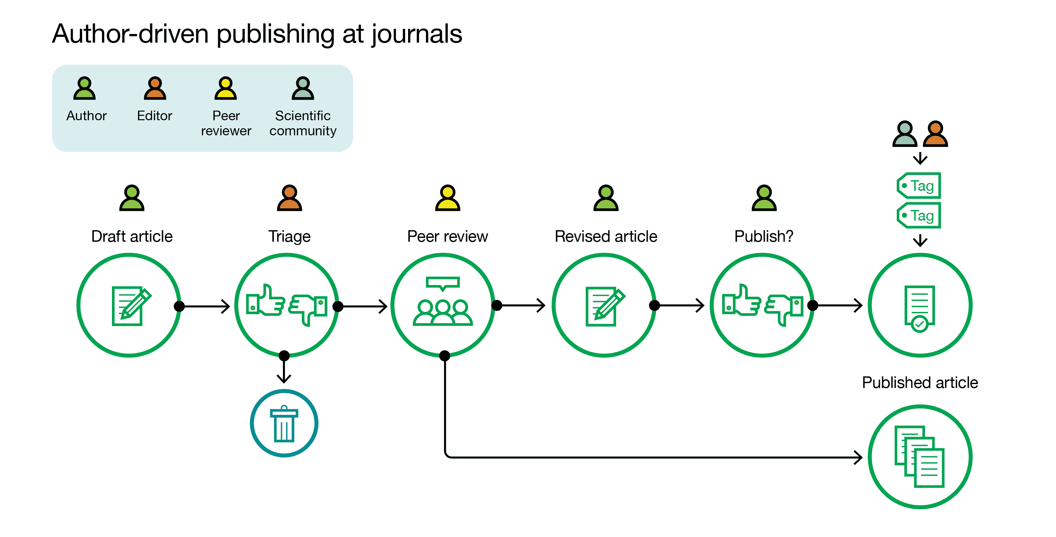
Publishing Process:
https://asapbio.org/digital-age
Notes:
Before we understand the peer review process, we need to understand the publishing process. Briefly…
Author writes a paper: review or original research
Find a journal that meets the scope
Initial review by the journal editor
Identifies and sends manuscript to reviewers
Reviewer submits recommendations to the editor
Authors receive notification and follow next steps
GOAL: get published!

Slide 9
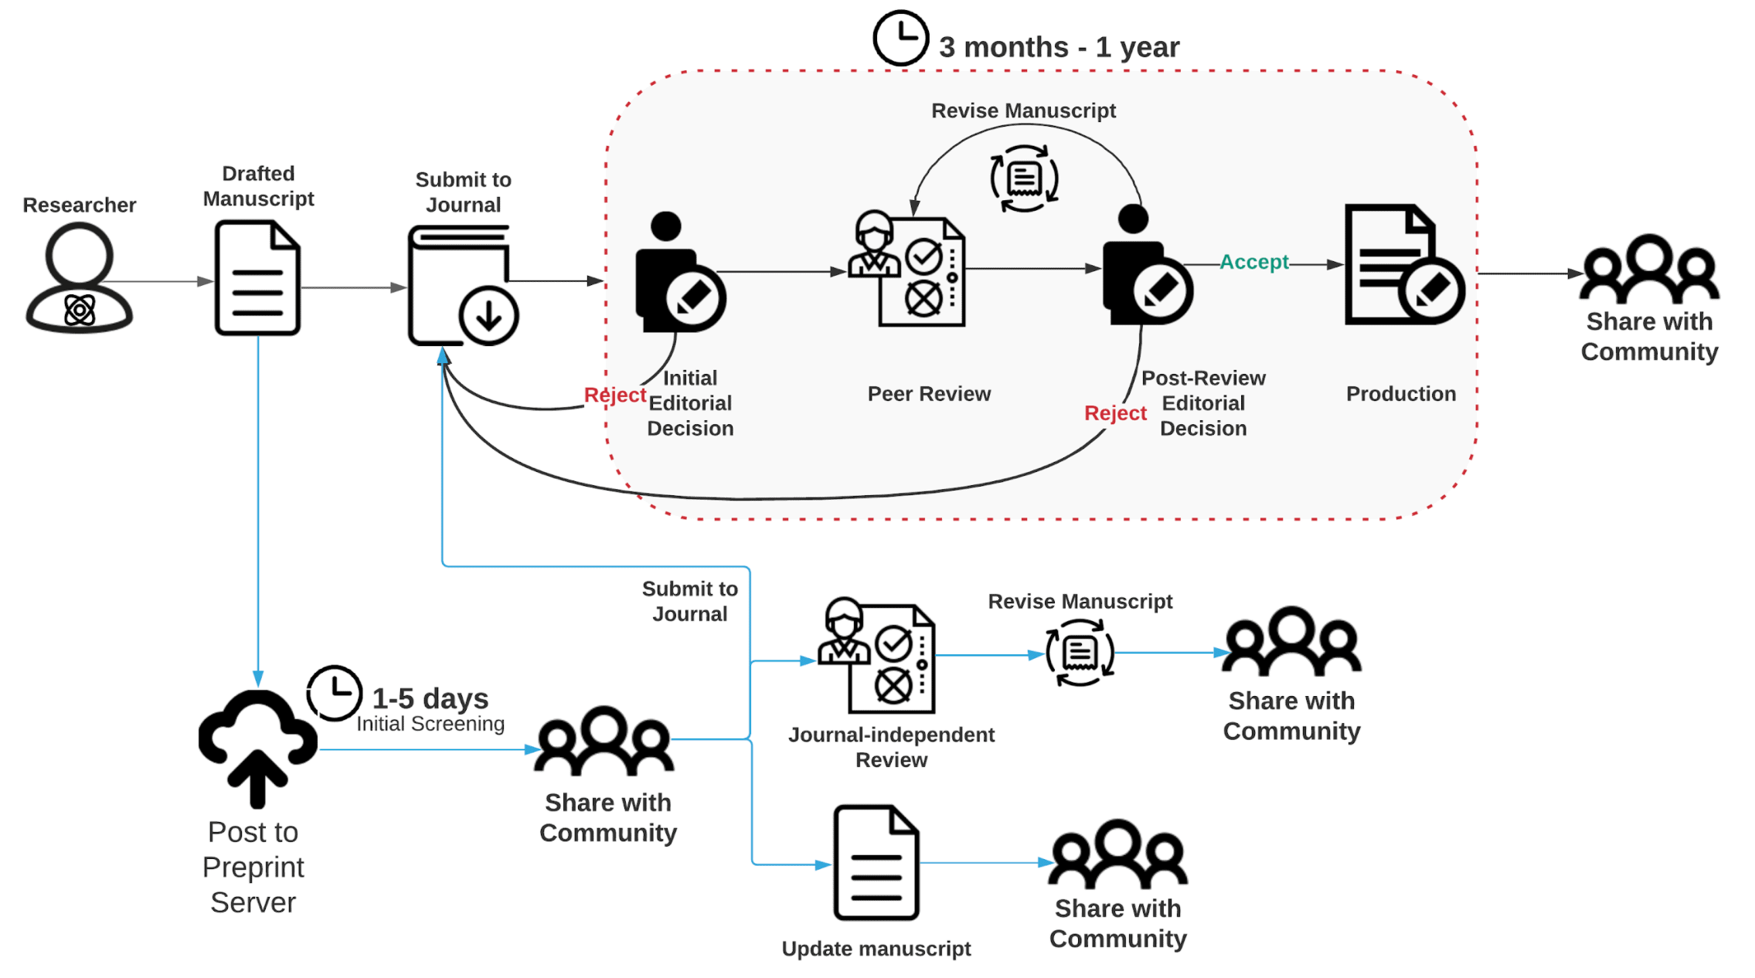
Publishing Process: Enter Preprints
https://asapbio.org/course-on-preprints
Notes:
What is a preprint?
A preprint is a scientific scholarly manuscript without peer-review and has not yet been accepted by a journal, typically submitted to a public server/ repository by the author.
My adaptation from https://vocabularies.coar-repositories.org/resource_types/c_816b/ [which is adapted from https://asapbio.org/preprint-info/preprint-faq#qaef-637 ]
A preprint is a scholarly manuscript posted by the author(s) in an openly accessible platform, usually before or in parallel with the peer review process. (COPE https://publicationethics.org/files/u7140/COPE_Preprints_Mar18.pdf )

Slide 10
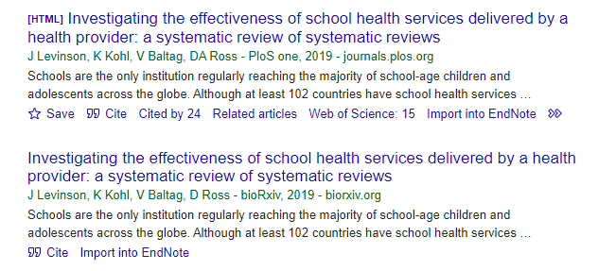
Publishing Process: Enter Preprints

Slide 11
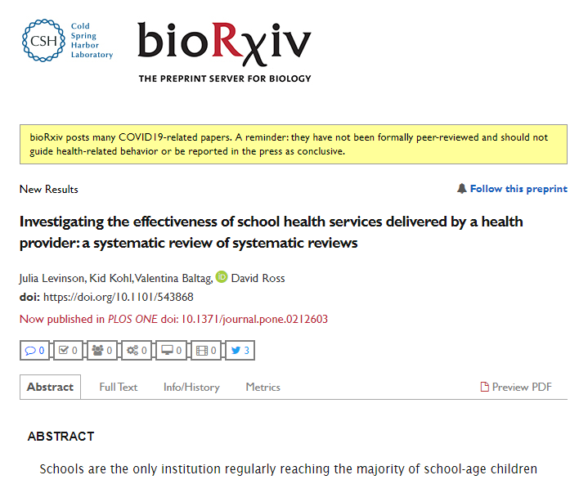
Notes:
https://www.biorxiv.org/content/10.1101/543868v1.abstract

Slide 12
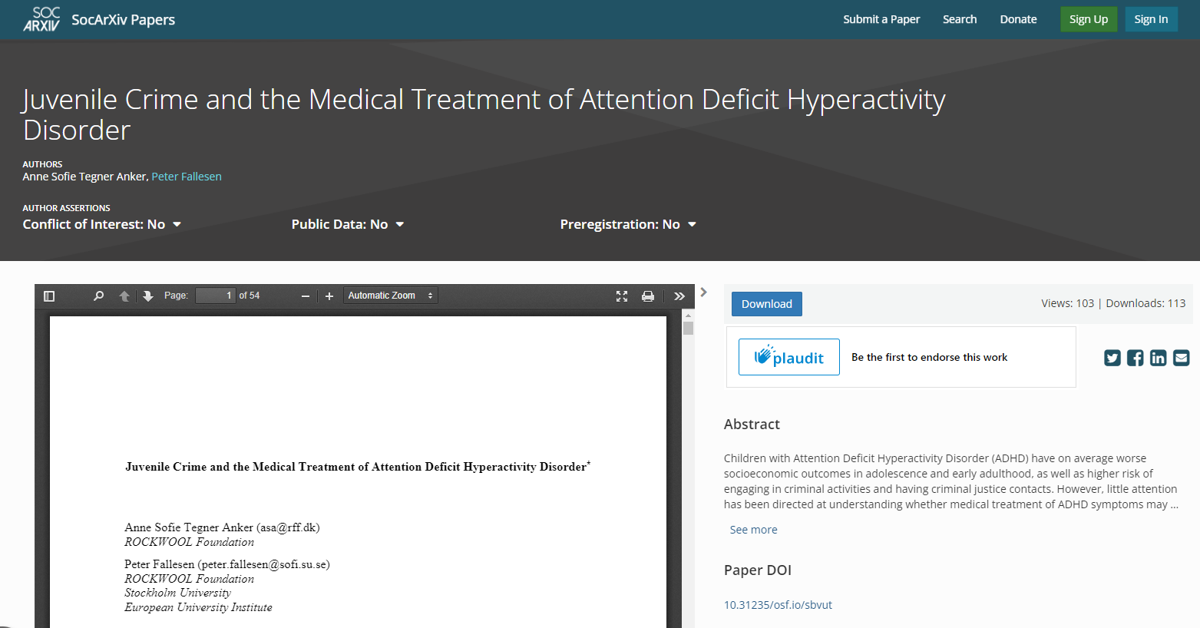
Notes:
https://osf.io/preprints/socarxiv/sbvut/

Slide 13
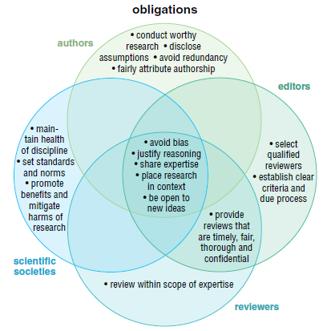


Jones, NL., 2011. American Scientist
Notes:
Everyone has a part to play in the peer review process

Slide 14
Types of peer review
Notes:
Most common

Slide 15
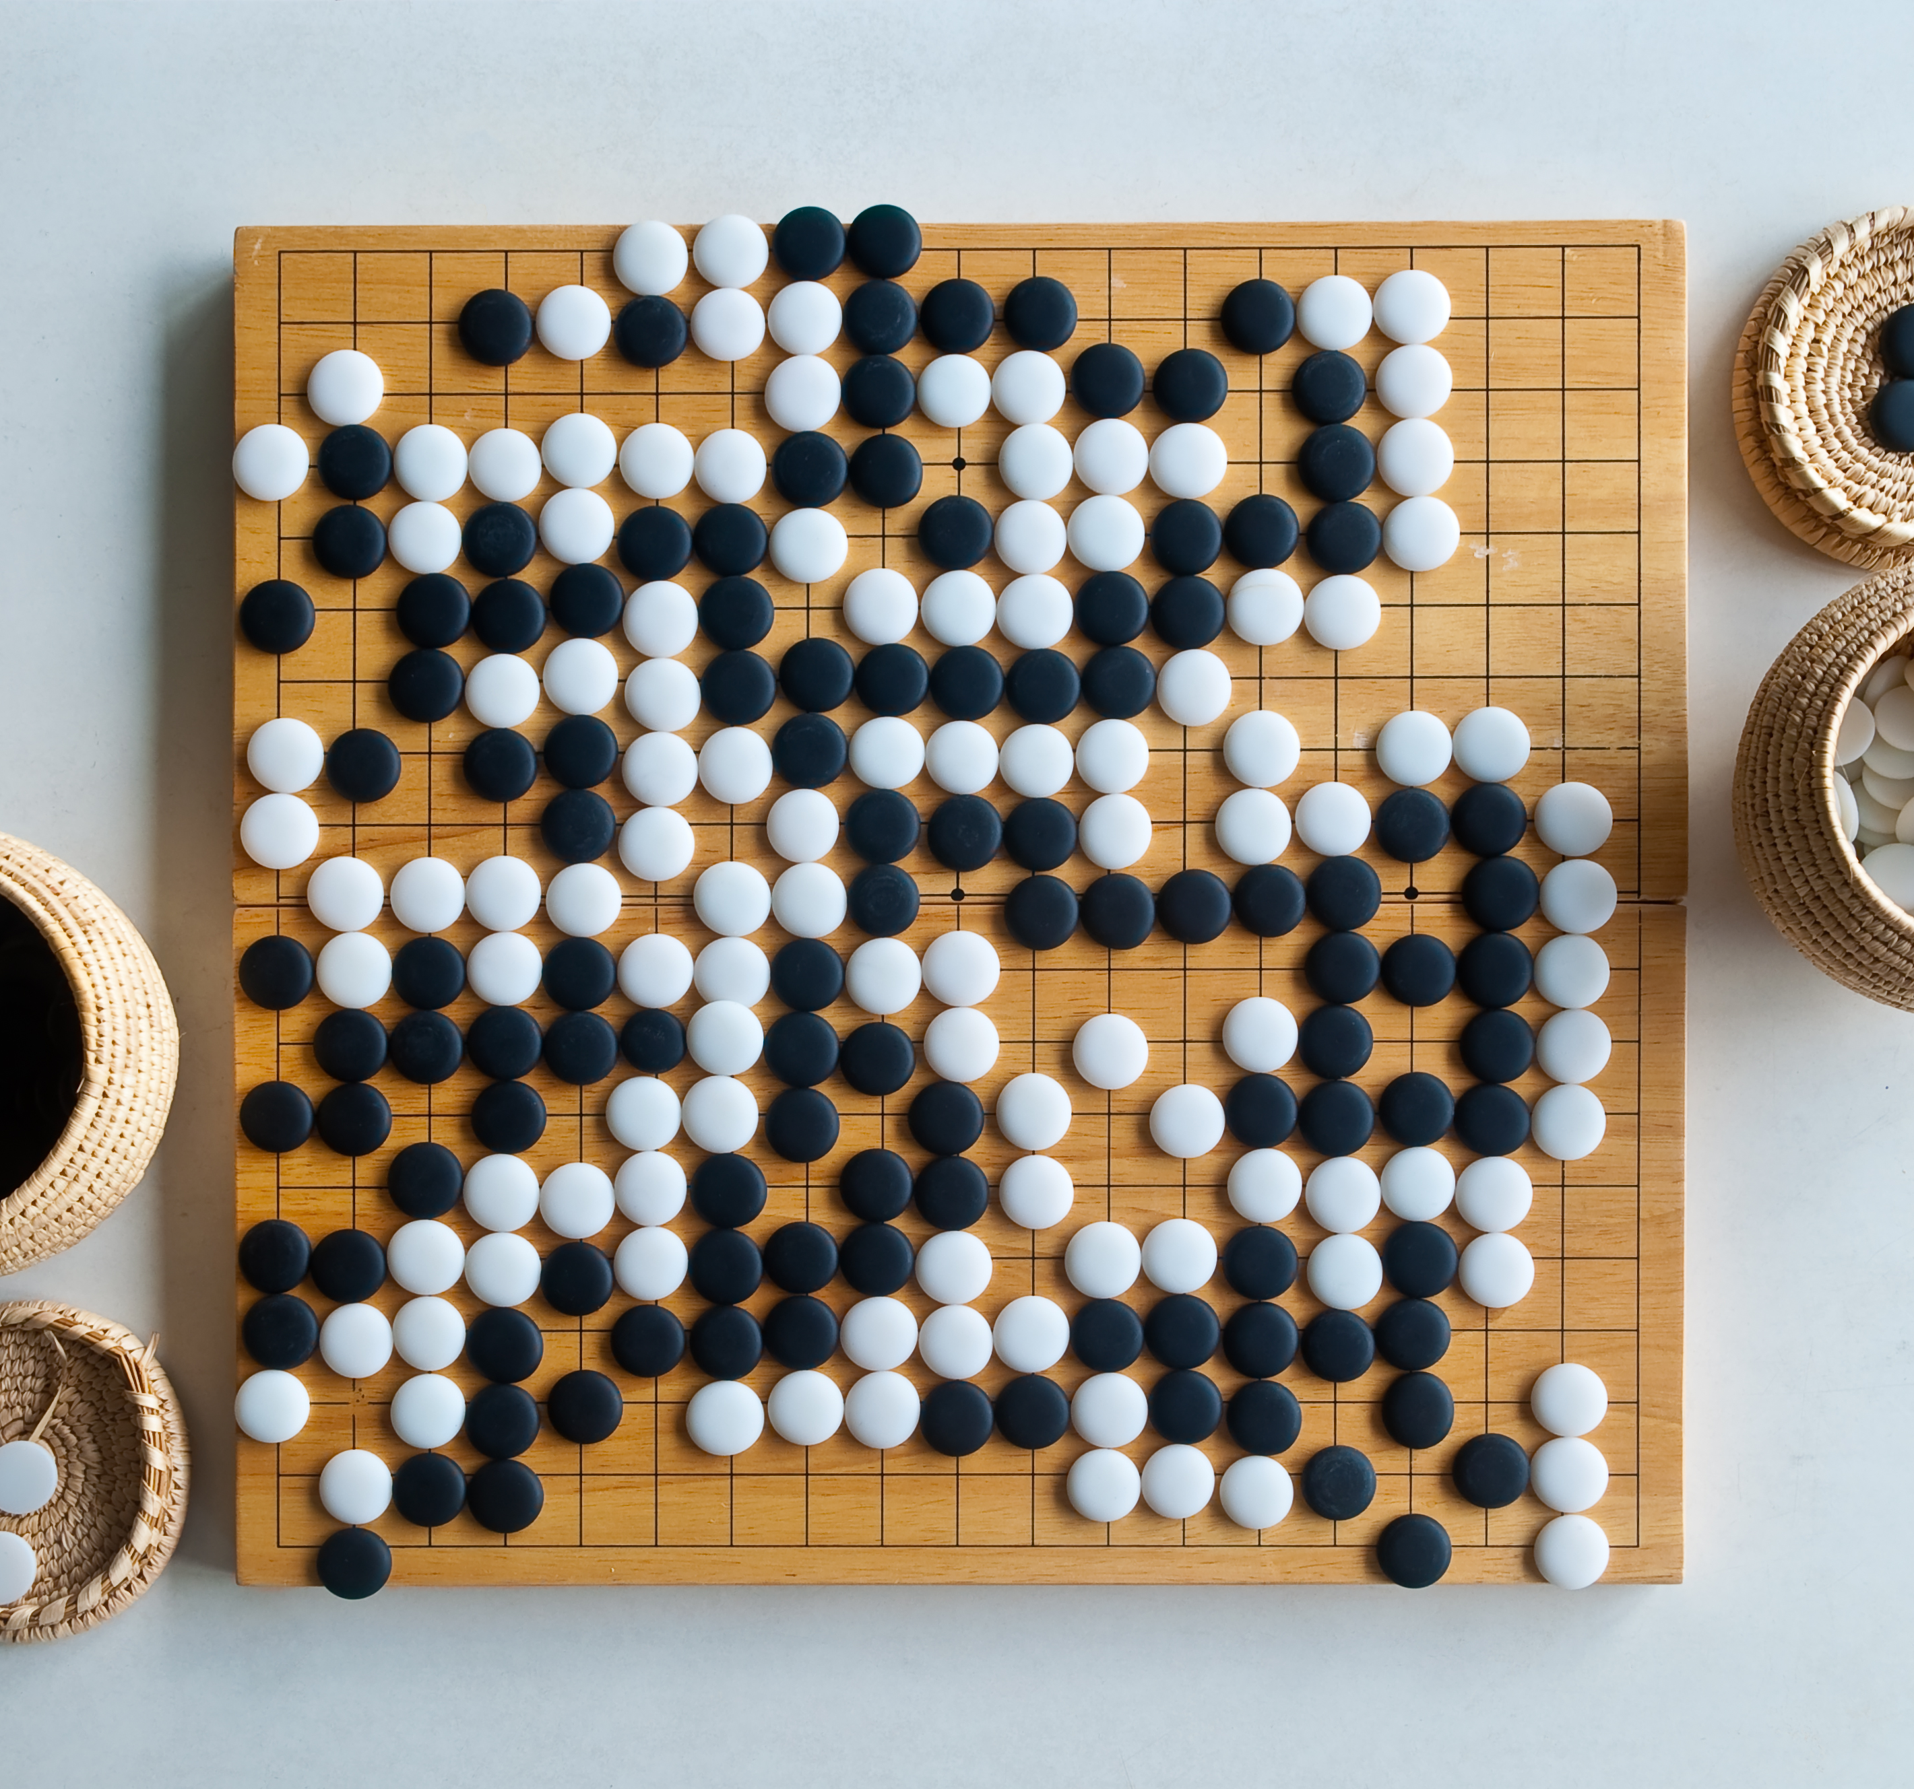
MATCHING GAME
Notes:
JAMBOARD https://jamboard.google.com/d/1mhgH4Oe6NUoocEItPkc7sLGDGAYslPaEH6K-YRfOCt8/edit?usp=sharing
Do NOT put link into Chat.
Participants enter choices for definitions into Chat.

Slide 16

Type of peer review
1
Open
2
Cascading/waterfall/portable/transferable
3
Single Anonymous
4
Double Anonymous
5
Collaborative
6
Post publication
Notes:
For shared slides: take a screen shot of the Jamboard with all the definitions aligned?

Slide 17
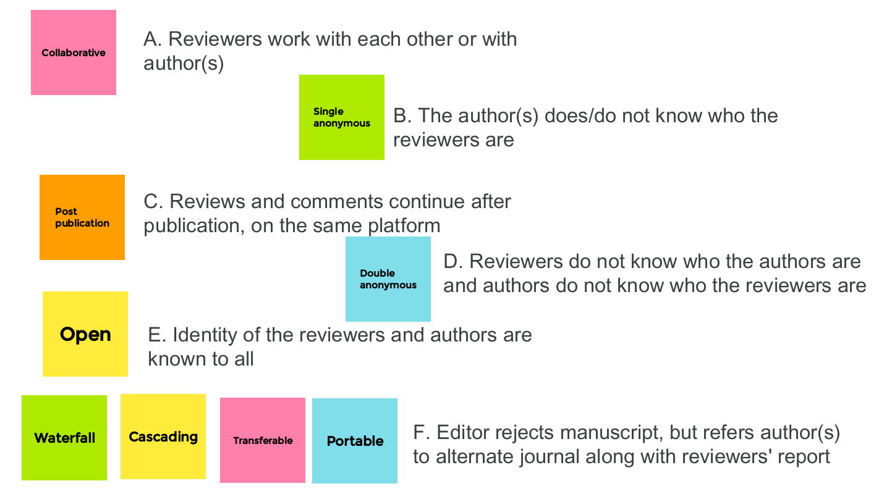

Slide 18
Journal Article Versions
Author’s Original (AO)
Submitted manuscript under review (SMUR)
Preprint (P)
PEER-REVIEW PROCESS
Author’s Manuscript (AM)
Author Accepted Manuscript (AAM)
Post-print (PP)
Version of Record (VoR)
Notes:
https://www.niso.org/publications/niso-rp-8-2008-jav

Slide 19


Slide 20
Examples of Peer Review Misconduct
Notes:
Need to see the big picture. Many parts.

Slide 21
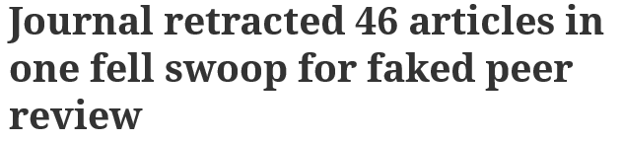

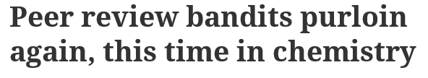
Examples of what goes wrong…..
Notes:
https://retractionwatch.com/2020/07/30/journal-retracted-46-articles-in-one-fell-swoop-for-faked-peer-review/
https://retractionwatch.com/2020/04/09/agriculture-researcher-up-to-15-retractions-for-fake-peer-review/
https://retractionwatch.com/2020/04/29/peer-review-bandits-purloin-again-this-time-in-chemistry/
https://www.washingtonpost.com/news/morning-mix/wp/2015/08/18/outbreak-of-fake-peer-reviews-widens-as-major-publisher-retracts-64-scientific-papers/

Slide 22
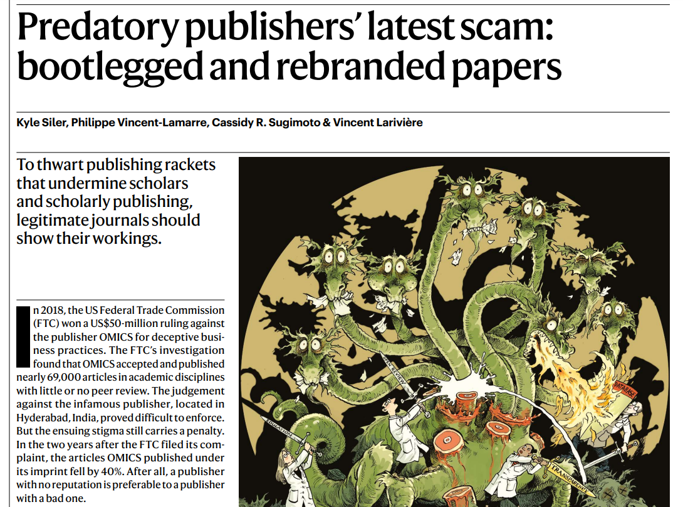
Notes:
https://media.nature.com/original/magazine-assets/d41586-021-02906-8/d41586-021-02906-8.pdf

Slide 23

DISCUSSION
The future of peer review
Peer review is time consuming
Peer review is flawed and biased
AI can do peer review better
Notes:
Image: https://www.flickr.com/photos/158301585@N08/43267970922/in/photostream/

Slide 24
DISCUSSION
The future of peer review
AI peer reviewers unleashed to ease publishing grind
https://www.nature.com/articles/d41586-018-07245-9
Read – 5 minutes
Discuss
Notes:
https://www.nature.com/articles/d41586-018-07245-9
Put link in chat

Slide 25
Would you be comfortable with AI
tools being used to peer review your
work? Why or why not?
If you have concerns, what are they?
Notes:
Share Jamboard in chat: https://jamboard.google.com/d/1v-YFD0GoSz2j2fPqdcJS2aypLp-ysmyzjQEFCkCDPiE/edit?usp=sharing

Slide 26
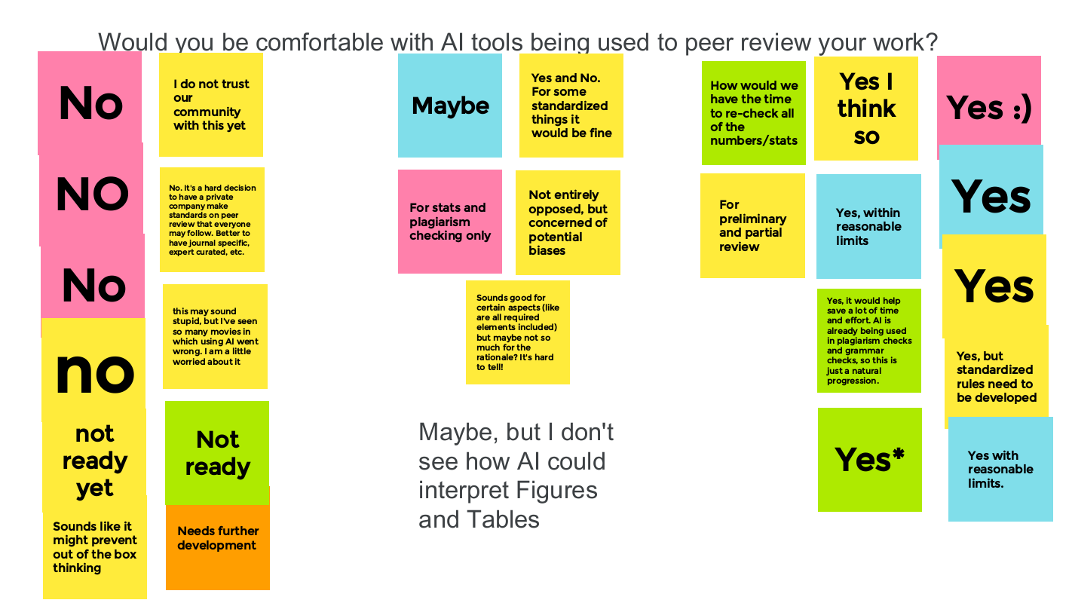
Notes:
https://jamboard.google.com/d/1v-YFD0GoSz2j2fPqdcJS2aypLp-ysmyzjQEFCkCDPiE/edit?usp=sharing

Slide 27
PART 2
What Reviewers Need to Know about Peer Review
Poll
Have you served as a
Peer Reviewer?
Notes:
[Suzanne]
Part 2.
Becoming a Peer Reviewer
Poll #2 Have you served as a peer-reviewer?
Yes
No (not yet)

Slide 28
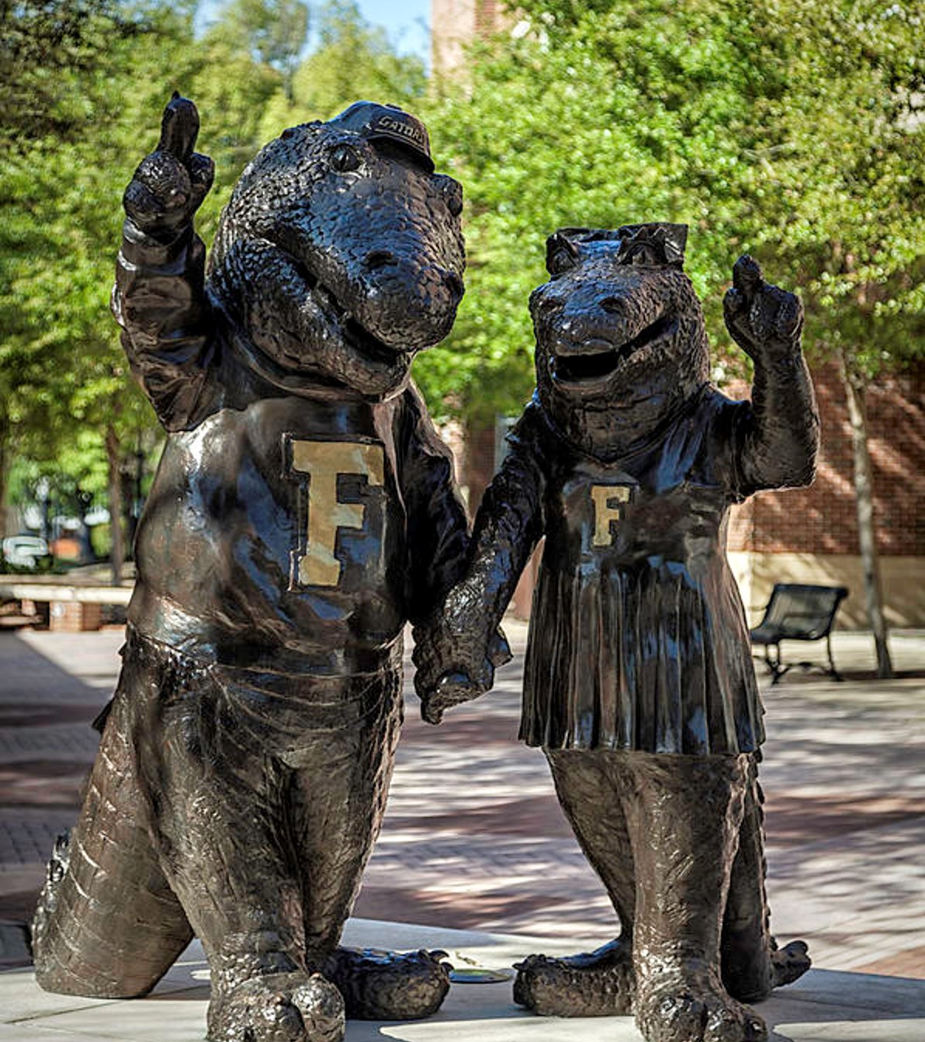
Becoming a Reviewer
When to Accept an Invitation
Topic
Content aligns with your expertise and area(s) of interest
Timeline
Only accept invitation if you can complete the review by the deadline
Conflict of Interest
If you have any doubt about competing interests, consult with the Editor
Notes:
Becoming a Reviewer: When to Accept an Invitation
COPE’s guidelines for reviewers:
“When approached to review, agree to review only if you have the necessary expertise to assess the manuscript and can be unbiased in your assessment. It is better to identify clearly any gaps in your expertise when asked to review.”
Source pg 5 of https://publicationethics.org/files/cope-ethical-guidelines-peer-reviewers-v2_0.pdf
Predatory publishers: be wary of unsolicited invitations – check the sender, the journal url.

Slide 29
Constructive Peer Review
Notes:
We’re going to spend some time discussing how to provide a constructive peer review.

Slide 30

Develop Your Method for Review
How to Conduct the Review
Read the full submission,
including all figures and tables
Read journal’s guidelines for reviewers
Close reading of manuscript
Check literature cited
Notes:
Modify this image, adding Authors & Conclusion:
https://sites.middlebury.edu/middsciwriting/by-genre/journal-article/

Slide 31
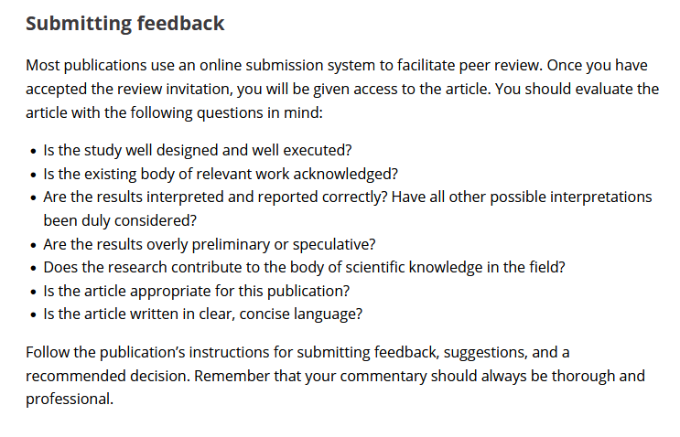
Example of Publisher’s Reviewer Guidelines
https://journals.ieeeauthorcenter.ieee.org/submit-your-article-for-peer-review/become-an-ieee-reviewer/
Notes:
Close reading of the submission
IEEE Author Center: Become an IEEE Reviewer
https://journals.ieeeauthorcenter.ieee.org/submit-your-article-for-peer-review/become-an-ieee-reviewer/
F1000 Reviewer Guidelines: https://f1000research.com/for-referees/guidelines

Slide 32
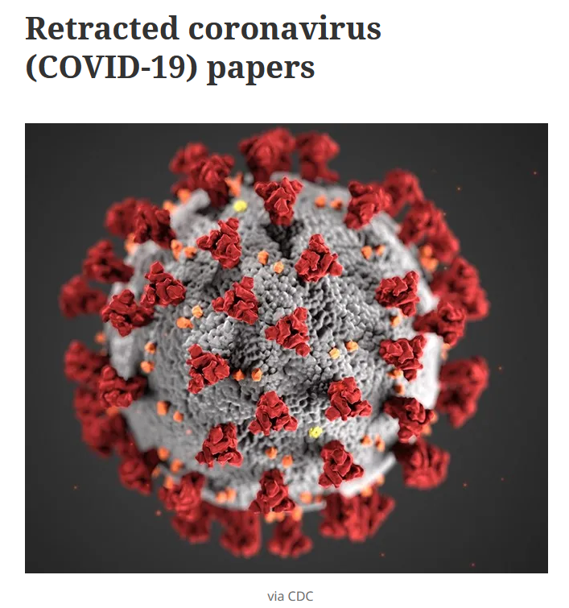
Misconduct in Peer Review
“People are either willfully or negligently not checking references.”
Ivan Oransky, co-founder of Retraction Watch
https://retractionwatch.com/retracted-coronavirus-covid-19-papers/
https://www.science.org/content/article/many-scientists-citing-two-scandalous-covid-19-papers-ignore-their-retractions
Notes:
Close reading of the submission includes careful checking of cited literature. If a manuscript has been retracted, that should be stated or the original not cited.
Ivan Oransky, co-founder of Retraction Watch, an online database of retracted scholarly publications, said
“People are either willfully or negligently not checking references”. He reports that this is common practice among authors.
An article by Charles Piller in Science (1/15/2021) reports that after 2 high-profile articles about COVID-19 treatments were retracted for poor science, publications continued to cite the original articles without reference to their retractions. “Oransky estimates that in biomedicine, up to 90% of citations to retracted papers don’t mention their fall from grace” according to C. Piller.
I’ve been anticipating the need for reviewers to devote more time to checking submissions’ citations. Not just for whether they include important relevant literature on the topic but also to ensure that they do not include articles with ethical violations.
Since new knowledge is built upon the foundation of prior knowledge, it is critical that peer reviewers participate in building a strong, credible foundation.
A number of citation management programs integrate with Retraction Watch to check for any retractions in a list of references (e.g. scite.ai, Zoetero, and RedacTek, according to C. Piller. The Library Catalog will indicate if a journal article has been retracted.

Slide 33
ELEMENTS of a CONSTRUCTIVE REVIEW
Three things to keep in mind
Supportive & respectful
Provide the big picture AND detailed examples
Impartial, unbiased
See also 10 Simple Rules for Reviewers https://doi.org/10.1371/journal.pcbi.0020110
Notes:
BMJ “ Constructively critique the article and help editors assess its importance and originality”
See also 10 Simple Rules for Reviewers
Esp. Rules 3, 4 and 9
https://doi.org/10.1371/journal.pcbi.0020110

Slide 34
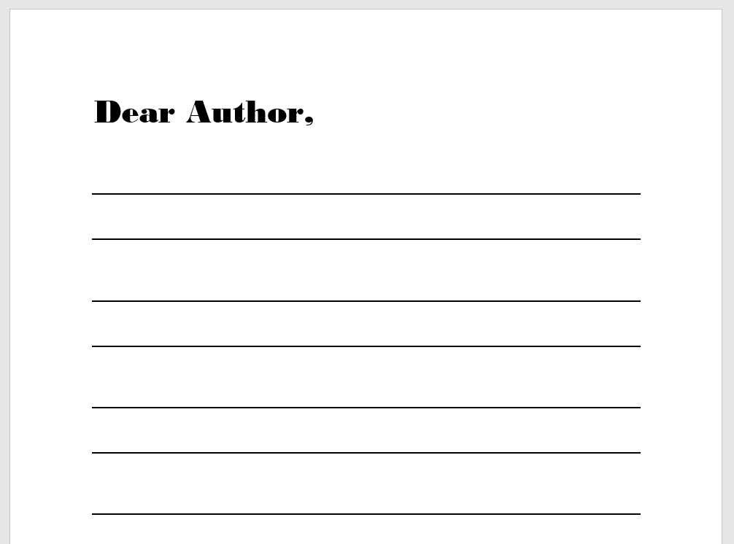
Comments to Author(s)
Supportive suggestions to improve the manuscript
Short letter
Summary of main findings
Comment on context and relevancy
Identify areas for improvement, grouped as major or minor issues
Attach detailed examples or a marked-up file
Comments to Author
Notes:
Comments to Author(s) (traditional, double-anonymous type of peer review)
Summary of main findings: demonstrate your understanding of the article
Comment on context & relevancy (novelty & importance, innovation AND validity)
Areas for improvement might include info for reproducibility/transparency
Support your comments with specific examples & references. Remember your goal is to help the author improve their submission through your evaluation.

Slide 35
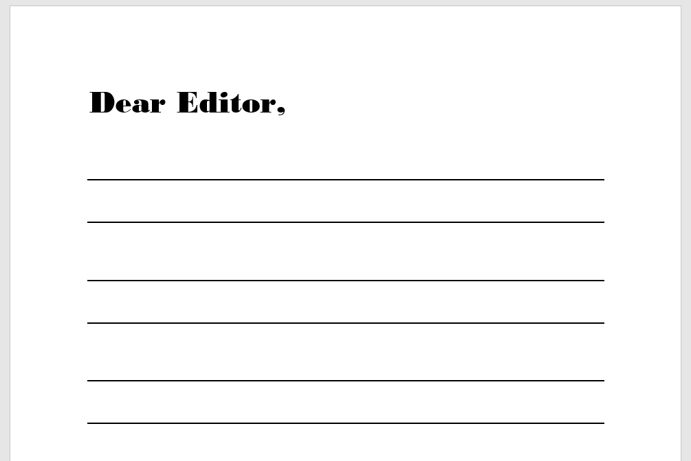
Comments to Editor
Offer a recommendation for the Editor’s decision
Confidential*
Provide your subject-specific perspective on strengths & weaknesses
* Depending on type of review
Explain/Justify your recommendation
Acknowledge any limitations in your perspective
Comments to Editor
Notes:
Comments to Editor
Confidential (in traditional anonymous review)

Slide 36
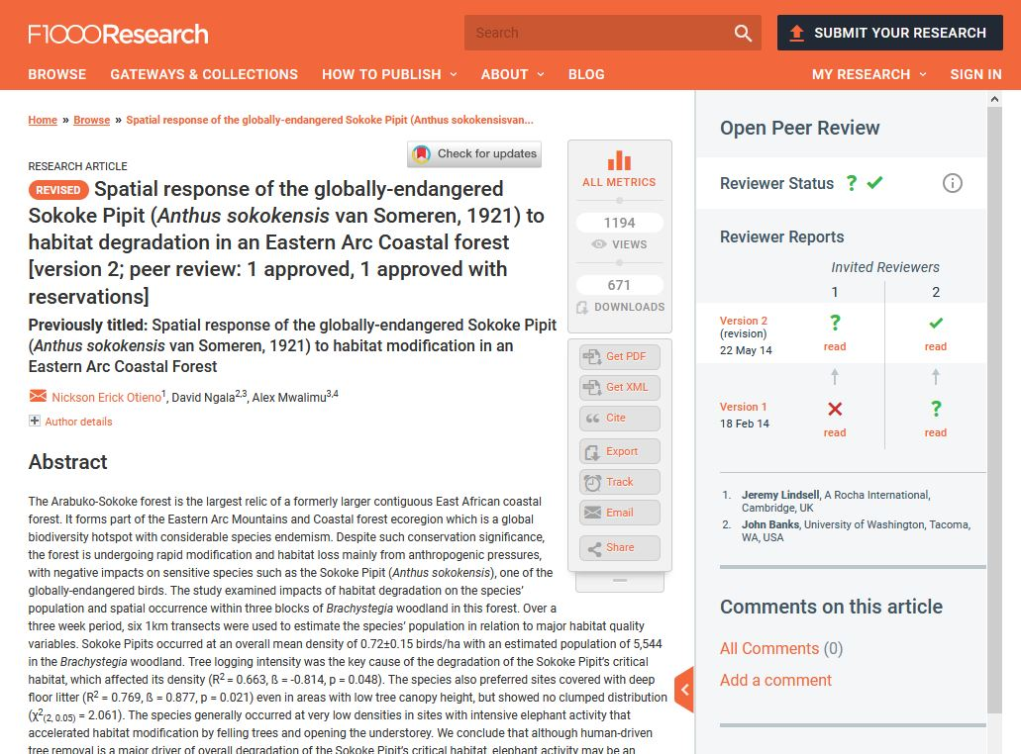
Example of a Constructive Review from F1000 Open Peer Review
https://f1000research.com/for-referees/peer-reviewing-tips
Notes:
Example of Constructive Review
F1000Research uses an open peer review system.
Point out Reviewers Names, Reviewers Recommendations.
Click on Recommendations to see Reviewer’s Comments to Authors.
https://f1000research.com/for-referees/peer-reviewing-tips

Slide 37
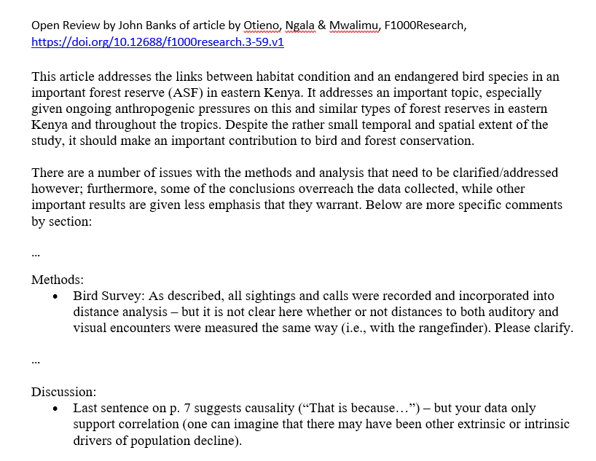
Summary & context
Areas for improvement
Specific examples
https://f1000research.com/for-referees/peer-reviewing-tips
Notes:
Example of Constructive Review from F100 Research
Here is an excerpt of a review by John Banks of an original submission that was revised and published in 2014.
What details do you see in this review that make it constructive? [Chat or Speak up]
-places work in context “important topic”, “important contribution”
-rigor: need to clarify methods & analysis, conclusions should not “overreach the data”
-specific comments to address (Methods, Discussion p 7)
-tone: ”Please clarify”
https://f1000research.com/for-referees/peer-reviewing-tips

Slide 38
Be Constructive
“Be constructive, view your reviewer role as an opportunity to help improve the paper you are reviewing.”
B. Maclver, Stanford University

Slide 39
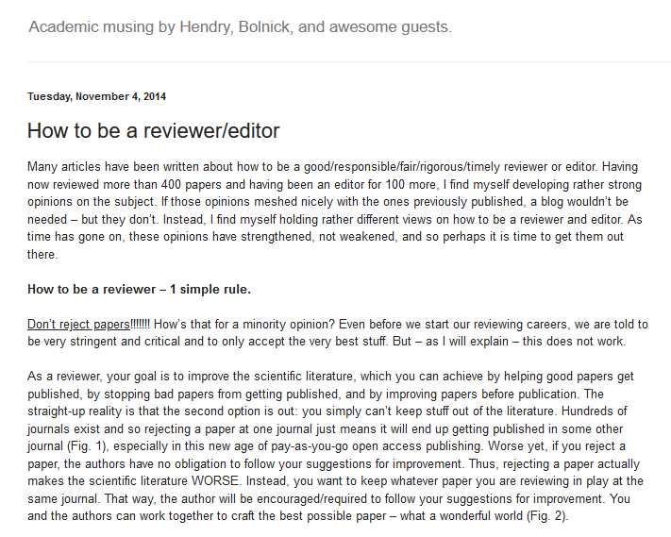
Discussion
“How to be a reviewer --- one simple rule:
Don’t reject papers!!!!!”
Andrew Hendry, 11/4/2014
Eco Evo Eco Evo blogpost, 11/4/2014. https://ecoevoevoeco.blogspot.com/2014/11/how-to-be-reviewereditor.html
Notes:
Discussion on a provocative thought.
1 simple rule: Don’t reject papers!!!!
“As a reviewer, your goal is to improve the scientific literature, which you can achieve by helping good papers get published, by stopping bad papers from getting published, and by improving papers before publication.” Andrew Hendry, 11/4/2014
What do you think? [enter reactions, thoughts, comments into Chat]
Is the paper a good idea but poorly executed?
Even if the science is well done, does it advance knowledge in the field?
How much time is it worth working with authors to improve a manuscript?
“How to be a reviewer/editor” blogpost by Andrew Hendry
https://ecoevoevoeco.blogspot.com/2014/11/how-to-be-reviewereditor.html

Slide 40
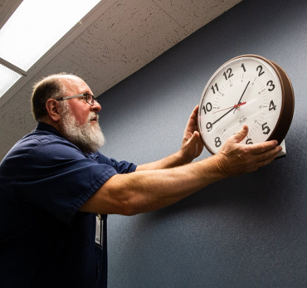
Good Reviews Take Time
Image: Evan Frost, MPR News, 11/1/2019
Notes:
Good Reviews Take Time
Likely you will need to set aside several time to be able to focus on the work at hand.

Slide 41
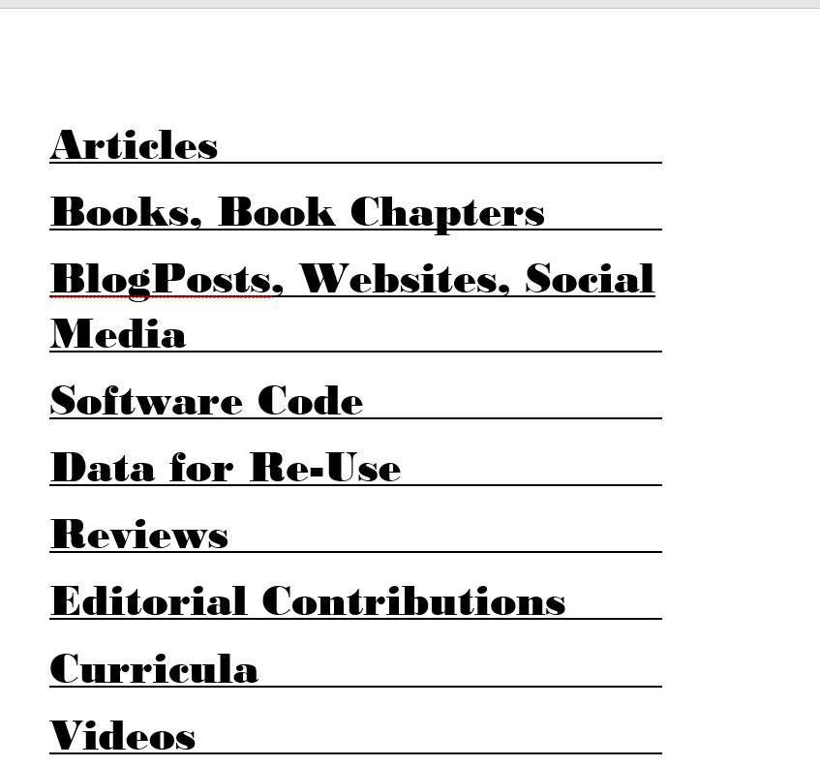
Are Reviews Scholarly Products?
How can Peer Reviewers be recognized for their contributions?
Notes:
Are Reviews Scholarly Products?
Poll #3
Do you think reviews by peer reviewers are scholarly products?
Yes
No
I’m not sure
How can Peer Reviewers be recognized for their contributions?
Write your ideas in Chat or Jamboard.
Publisher options:
Provide reviewers free access to one of their products, (e.g. Elsevier –Scopus)
Annual Acknowledgement in the journal
Financial reward –payment uncommon, discount on purchases
Certificate
Open/ Transparent Peer Review: e.g. F1000Research gives credit by publishing your name & institution, assigns DOI to your review
Track views of your review. Offers 20% discount on APC for your next authored work. Author-led peer review model.
https://f1000research.com/for-referees/incentives
Post Print Reviews:

Slide 42
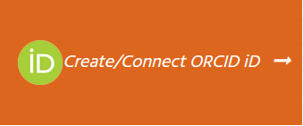
Examples of Reviewer Recognition Services
CV & Resume
Professional Website
ORCiD
Google Scholar Profile
Reviewer Credits (https://www.reviewercredits.com/)
Publons (https://publons.com/about/home/)
Notes:
https://scholarlykitchen.sspnet.org/2021/10/12/recognition-in-peer-review/

Slide 43
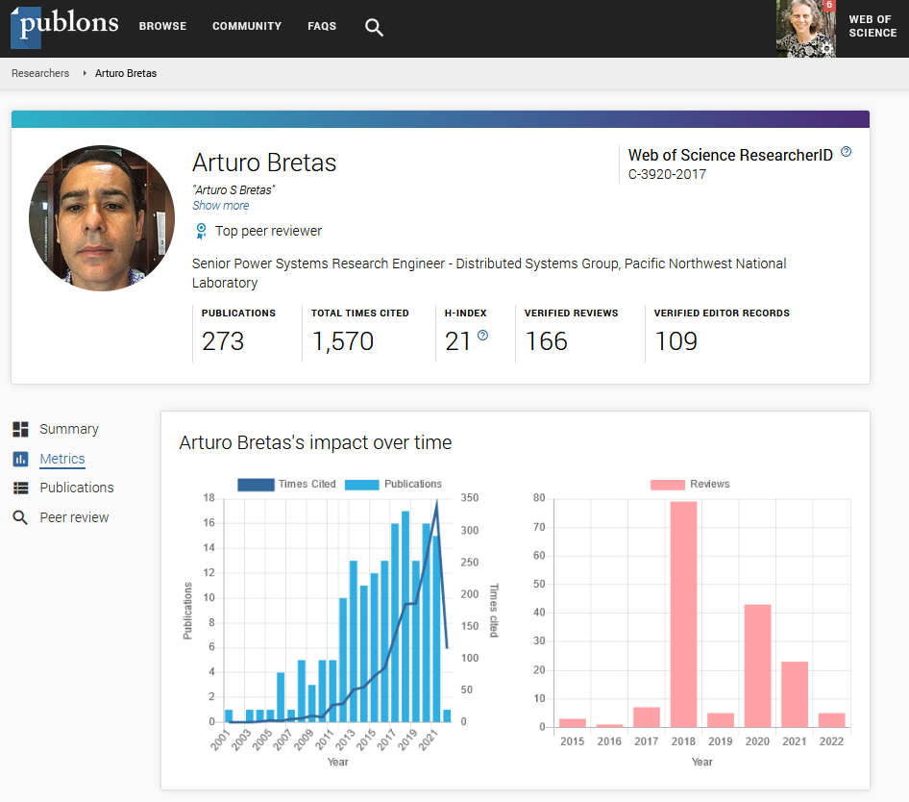
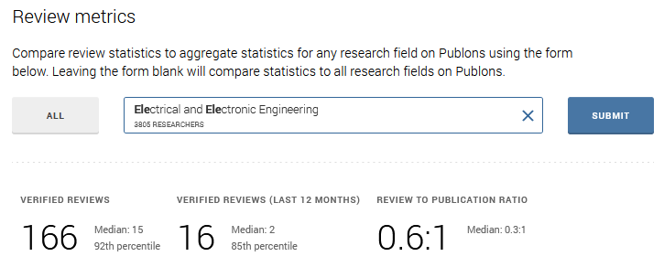
Publons from Web of Science Group
Verified peer review
Recognition for your contributions as a reviewer
Publons Public Profile Metrics for Arturo Bretas, UF Electrical & Computer Engineering
Notes:
Web of Science Publons – designed to verify and recognize peer reviewers.
Reviews verified with Publisher without compromising anonymity
Displayed after article published
Displays journal(s) you reviewed for
Compare your output of reviews to others in your field
review to publication ratio
Post publication review: scoring for quality & Significance
What else can this data be used for?
CV & grant applications
Institutions (honorifics, promotion)
Publishers & Editors (recommending reviewers)
Private vs public profile
Metrics based only on Web of Science Core Collection
UF: 2006 (1,984 UF + UF IFAS 11 + College of Pharmacy 11) 6/21/2022
UF: 1,967 (UF + UF IFAS+ UF College of Medicine + College of Dentistry + College of Pharmacy + College of Medicine JAX) 7/29/2020

Slide 44
Reviewers are Rated
Editors and Publishers rate their Reviewers on:
Timeliness
Quality of Review
Good Communication
Notes:
Reviewers are rated
Editors & Publishers rate their Reviewers
At the Springer journal where I worked, reviewers were rated on timeliness, quality of review, and good communication
Low ratings lead to fewer invitations
Be honest and fair to authors – do not accept if cannot complete on time, unbiased, recuse if conflict of interest, provide a thorough review, communicate in an effort to improve the publication (not to criticize the authors), maintain good communication with the editor

Slide 45
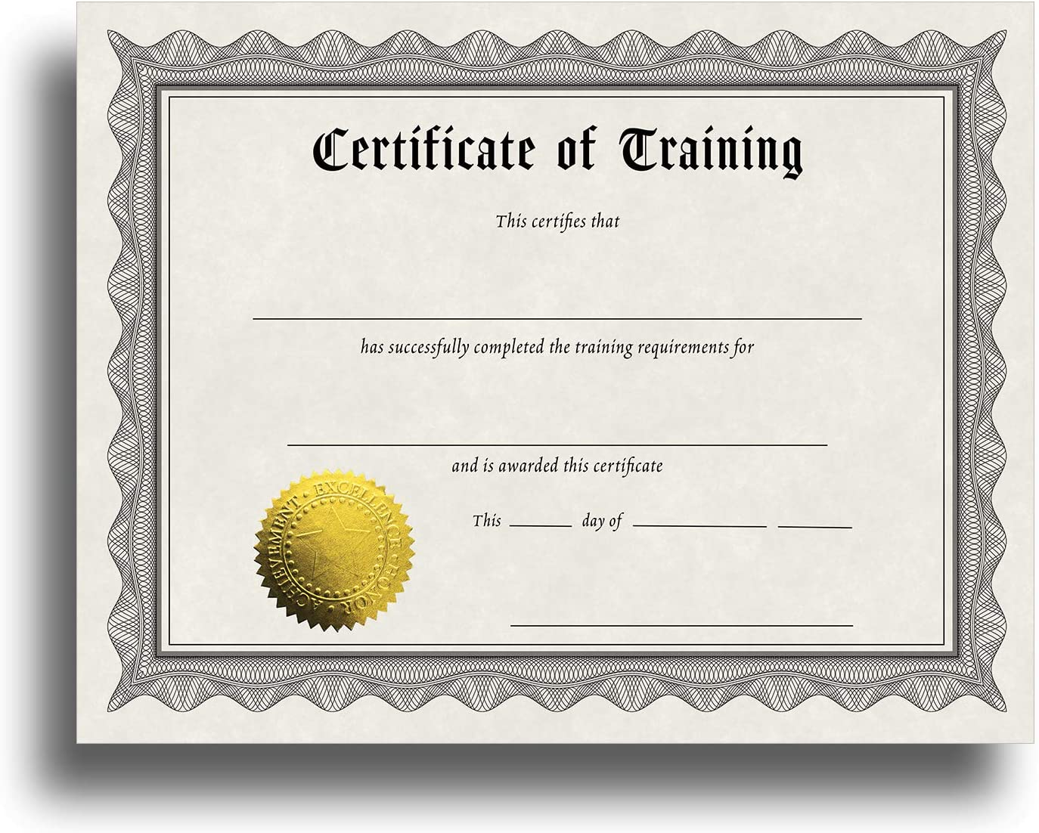
Develop Skills as a Reviewer: Trainings & Certifications
Web of Science Academy
Training package for The BMJ’s peer reviewers
IOP Publishing Peer Review Excellence training & certification
Publisher programs (e.g. Wiley, Elsevier, Springer)
Notes:
Publons Academy video: https://play.vidyard.com/bnfagcQ9QJmz3GYkeDGfXf
Reviewer Training & Certifications
Web of Science Academy
https://webofscienceacademy.clarivate.com/learn
The BioMedical Journal Reviewer Training
https://www.bmj.com/about-bmj/resources-reviewers/training-materials
IOP Publising Peer Review Excellence: https://ioppublishing.org/peer-review-excellence/
The Optical Society OSA Reviewer Certification
https://www.osapublishing.org/reviewer_certification/?module=getting_started

Slide 46
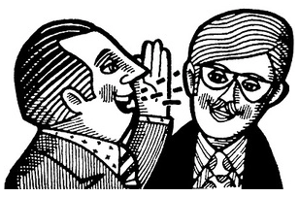
Case Study: Peer Review Misconduct
The Corresponding Author of a manuscript submitted for peer review contacted all Co-authors asking them to propose comments to give to one of the Peer Reviewers. Suggested comments for minor revision from the Co-authors were sent by the Corresponding Author to one of the Reviewers. The Reviewer submitted these comments as their own and recommended a Minor Revision to the Editor.
One Co-author reported this breach of ethical
peer review to the publisher.
What action should the journal take?
Image: Economic Times
Notes:
Current, on-going Case Study from COPE Forum
Read. Ask if Questions.
https://publicationethics.org/case/possible-peer-review-manipulation

Slide 47
Breakout Room Instructions
Discuss this case study
Propose two actions that the journal editor or publisher should take in response to this situation.
Select one person to report back
Breakout rooms will be open for 4 minutes

Slide 48

Case Study: Recommended Responses
Notes:
For each breakout group, please type into chat the two actions that your group decided the journal should take.

Slide 49
Case Study: Peer Review Misconduct
COPE Forum Advice:
Withdraw the publication
Report misconduct to Author & Reviewers’ institutions
Provide training in ethical review to all Reviewers
Remind Editors of their responsibilities
Look for other publications by these authors and/or this Reviewer
Remove unethical Reviewer from journal’s reviewer pool
COPE Case no. 22-03; https://publicationethics.org/case/possible-peer-review-manipulation
Notes:
Case Study: COPE (current)
https://publicationethics.org/case/possible-peer-review-manipulation
Remind Editors of their responsibilities:
not to rely solely on reviewers recommended by authors
No co-authorship with authors within last 3-5 yrs
Vet potential reviewers for expertise & prior conduct

Slide 50
Best Practices & Recommendations

Slide 51
Best Practices
1
Agree to review in your area of expertise
2
Declare all competing interests
3
Do not use information obtained during your review
4
Respect journal guidelines for confidentiality
5
Use resources for reviewer training and practice

Slide 52
Guidance for Ethical Peer Review
Committee on Publication Ethics (COPE)’s Ethical Guidelines for Reviewers
Council of Science Editors
The Office of Research Integrity
International Committee of Medical Journal Editors, ICMJE
Notes:
ORI has case studies of misconduct and 4 trainings from other institutions on ethical peer review, https://ori.hhs.gov/peer-review-0

Slide 53
Recommendations
The skills you develop as a Reviewer
will benefit your skills as an Author.
Develop “Feedback Literacy”
Complete reviewer training and certification
Practice
Serve as a co-reviewer or junior reviewer
Learn from mentors and published open reviews
Volunteer to review!
For explanation of “Feedback Literacy” see https://doi.org/10.1002/leap.1378
Notes:
Recommendations: The skills you develop as a Reviewer will benefit your skills as an Author
Reviewer certification
Practice
Serve as a co-reviewer
Learn from mentors
Volunteer!

Slide 54
Selected Resources
Bourne, PE & A Korngreen (2006). 10 Simple rules for reviewers, https://doi.org/10.1371/journal.pcbi.0020110
Sense about Science (2012). Peer Review; The nuts and bolts: A guide for early career researchers, https://senseaboutscience.org/activities/peer-review-the-nuts-and-bolts/
Chong, S. W. (2021). Improving peer-review by developing reviewers’ feedback literacy, Learned Publishing 34(3):461-467. https://doi.org/10.1002/leap.1378
Meadows, Al. & K. Wulf (2019). Quality is Multi-Dimensional: How many ways can you define quality in peer review? The Scholarly Kitchen blog, 9/16/2019.
https://scholarlykitchen.sspnet.org/2019/09/16/quality-is-multi-dimensional-how-many-ways-can-you-define-quality-in-peer-review/
Notes:
Resources
10 Simple rules for reviewers by P E Bourse & A Korngreen, https://doi.org/10.1371/journal.pcbi.0020110
Standing up for Science 3: Peer Review; The nuts and bolts: A guide for early career researchers
https://senseaboutscience.org/activities/peer-review-the-nuts-and-bolts/
Quality is Multi-Dimensional: How many ways can you define quality in peer review? The Scholarly Kitchen blog, 9/16/2019.
https://scholarlykitchen.sspnet.org/2019/09/16/quality-is-multi-dimensional-how-many-ways-can-you-define-quality-in-peer-review/
More examples listed at: https://authorservices.wiley.com/Reviewers/journal-reviewers/tools-and-resources/index.html
F1000Research Peer Reviewing Tips
https://f1000research.com/for-referees/peer-reviewing-tips
F1000Research Peer Review Examples
https://f1000research.com/for-referees/peer-reviewing-tips/examples
Other tools: Academic Accelerator (e.g. Acceptance rate) https://academic-accelerator.com/Acceptance-Rate/Oecologia

Slide 55
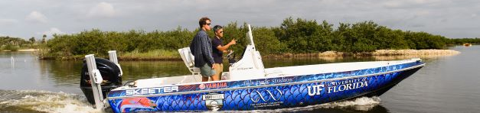
Thank you!
Tara Cataldo & Suzanne Stapleton
Marston Science Library
ttobin@ufl.edu
Suzanne@ufl.edu
https://marston.uflib.ufl.edu/
UFMarston

Slide 56

Survey: | 30-day post seminar series bit.ly/rcr2022 | interviews
We value your input! Your feedback helps us improve the RCR Series!
Notes:
Michelle: survey
30 day post interview announcement

Slide 57

IF YOU SUSPECT RESEARCH MISCONDUCT?
Contact the UF Research Integrity Officer (RIO):
Cassandra Farley | rio@research.ufl.edu | 352-273-3052
Research Misconduct means fabrication, falsification, or plagiarism in proposing, performing, or reviewing research, or in reporting research results.
Questionable Research Practices are reports of careless, irregular, or contentious research practices, as well as authorship disputes, may not meet the standard for research misconduct but may be a research integrity violation.
Make a confidential report to the UF Research Integrity Officer (RIO).
You may also report anonymously UF Compliance Hotline: 877-556-5356
Notes:
Michelle

Slide 58
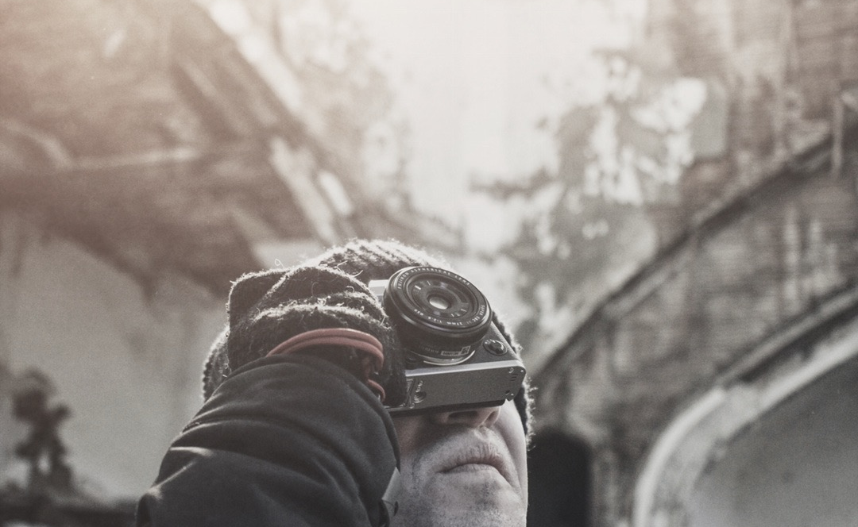
Check out the UF RIO video!
The media layout displays multimedia.
Acknowledgement: The 2022 RCR Summer Seminar Series is funded in part by the Department of Health and Human Services, Office of Research Integrity grant (#ORIIR210068). Disclaimer: The content is solely the responsibility of the authors and does not necessarily represent the official views of the Dept. of Health and Human Services
Notes:
Michelle: Resources

Slide 59

A podcast devoted to creating a culture of responsible conduct of research and research integrity at the University of Florida. Produced by UF Creative Works, and a team of people across the UF Campus including UF Research, CTSI, the Center for Undergraduate Research, and a group of UF Research Ambassadors. https://research.ufl.edu/research-roundtable-podcast.html Acknowledgement: The 2022 RCR Summer Seminar Series is funded in part by the Department of Health and Human Services, Office of Research Integrity grant (#ORIIR210068). Disclaimer: The content is solely the responsibility of the authors and does not necessarily represent the official views of the National Institutes of Health.
Notes:
Michelle: check us out! Submit ideas!!!

