Slide 1

RCR Summer Seminar Series 2022
Michelle Leonard Assistant Director, Education & Training Programs | UF Research
Bob Kolb | Assistant Director, Clinical Research | UF CTSI
Cassandra Farley | Research Integrity Officer | UF Research
Terry Selfe | Translational Research & Impact Librarian | UF Health Science Center Libraries
The 2022 RCR Summer Seminar Series is funded in part by the Department of Health and Human Services, Office of Research Integrity grant (#ORIIR210068). Disclaimer: The content is solely the responsibility of the authors and does not necessarily represent the official views of the Dept. of Health and Human Services.
Notes:
Lead slide by Michelle. Welcome to the Responsible Conduct of Research Summer Seminar Series, whether you registered for just a few seminars or are enrolled in the RCR Certificate of Completion program, we are glad to have you participate! We have almost xx people in attendance, all with different levels of experience, knowledge and skills. These seminars are developed for the beginner but hopefully those of you with more experience will also find some take-aways, especially as we move to break out rooms to do the exercises, please keep that in mind as you begin your discussions. The goal for this seminar series is to promote a culture of research integrity on campus. To do this, we will learn from others, and have an open dialogue about research using active learning techniques, such as polls, breakout rooms, case studies, and discussions. The sessions will not be recorded so that we may discuss openly and freely. You will receive a copy of the presentation after the session ends.
Michelle will introduce the moderator.

Slide 2
2022 RCR Summer Seminar Series
Rigors of Peer Review
Mentor/Mentee Relationships
Data Ethics
Collaborative Research
Reproducibility & Replicability
Research Misconduct
Export Control
Plagiarism: Pitfalls & Prevention
Safe Research Environments
Ethics of Authorship
RCR Action Plan
The Lab
NIH Data Management Policy
Research Conflicts of Interest
The Research Clinic
Notes:
Moderator: It’s not too late to enroll in other sessions. If you want to earn a RCR Certificate that meets NIH, NSF, and USDA RCR requirements, you will need to enroll in all of these sessions. By earning a certificate, this will replace the CITI online, asynchronous training. And of course, you may choose to attend any or all of the sessions. Add link to enroll in the chat: https://research.ufl.edu/rcr/2022-summer-seminar-series-registration/

Slide 3

Plagiarism: Pitfalls & Prevention
2022 RCR Summer Seminar Series
June 7, 2022
UF Research
Michelle Leonard
Assistant Director, Education & Training Programs
Notes:
Moderator will introduce the speaker(s). If the speaker prefers, they can send a brief bio in advance to the moderator, OR, the speaker can do a brief greeting and introduce the topic.

Slide 4

Agenda:
1
Program Overview
2
Today’s topic: plagiarism
3
Definitions, discussions, and case study analysis
4
Wrap-up: resources, evaluation, and RIO contact

Slide 5




OBJECTIVES
1
2
3
4
Identify the different types of plagiarism.
Discuss the reasons why plagiarism occurs.
Analyze examples of plagiarism using case studies.
Evaluate the consequences of plagiarism.
Notes:
Option for the speaker. The images should be replaced or create a different slide. Poll 1

Slide 6

Plagiarism:
Regulations and Norms
Federal:
Rules and regulations
Professional:
Publishers, Societies, Organizations
Institutional:
UF Regulation 1.0101 and
UF Student Honor Code
Notes:
We have the federal rules and regs from PHS and others. Professional organizations and journals will often have their own rules. And then at the institutional level, at UF, we have a research integrity regulation and associated policy. ity Regulation (1 page) and its associated policy to implement procedures (8 pages). As we said, UF uses the federal PHS definition of plagiarism. UF policy and procedures are overseen by UF RISC, which is where I work. ​
​
And there is also the Student Honor Code, which contains expanded definitions of plagiarism, targeted for students doing classwork. Honor Code violations go to Dean of Students Office. ​
​
Polls 1&2

Slide 7
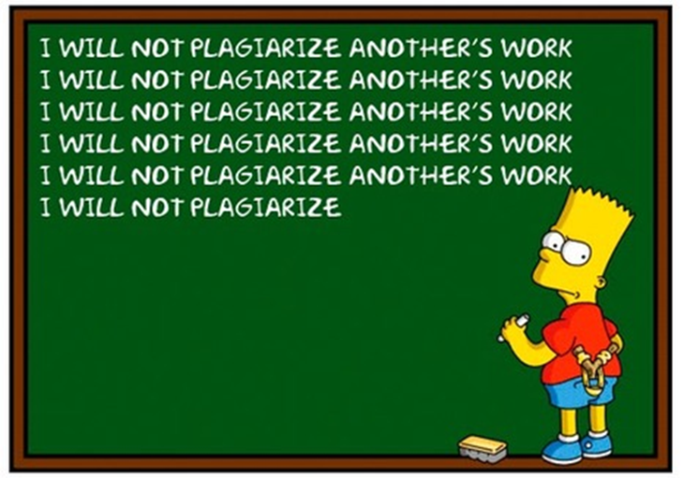
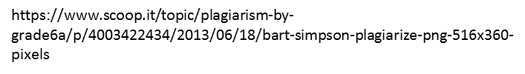
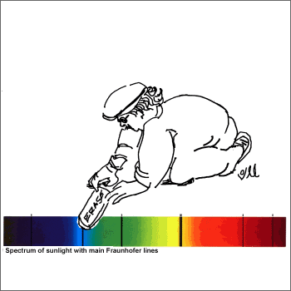
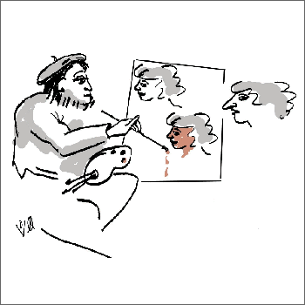
Federal: FFP
Fabrication of data
Making up data or results and recording or reporting them.
Falsification of data
Manipulating research materials, equipment, or processes, or changing or omitting data or results that the research is not accurately represented in the research record.
Plagiarism
The appropriation of another person’s ideas, processes, results, or works without giving proper appropriate credit.
Source: 42 CFR § 93.103
https://ori.hhs.gov/education/products/RIandImages/guidelines/list.html
Notes:
Excludes differences of opinion and authorship disputes.
Dept Health & Human Services set the gold standard for the definition, in the Code of federal regulations or CFR, section 42 part 93. division of Public Health Service, agency NIH.
UF uses this definition. ​

Slide 8

1
NSF findings
2
Case Study
10 year review of plagiarism in grant proposals.
Analyze a recent case.

Slide 9
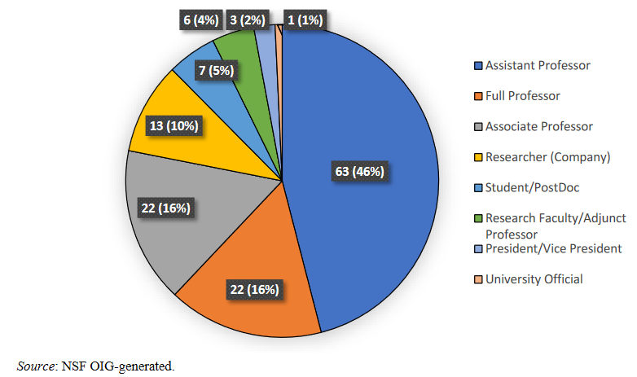
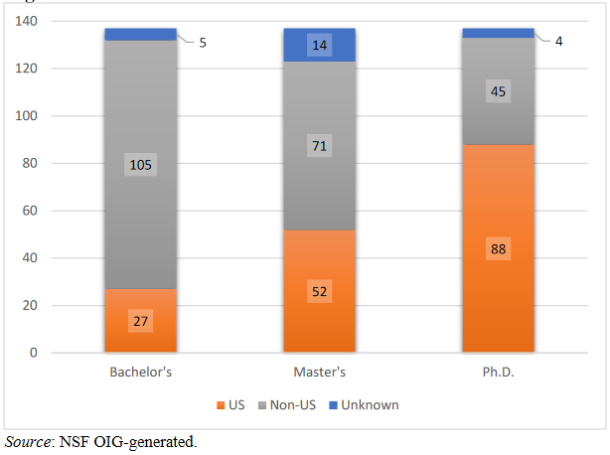
NSF:
From 2007-2017, NSF analyzed acts of plagiarism in 320 NSF proposals. This examination included 134 cases, 137 subjects, 106 unique institutions.
Subject’s Occupation
Subject’s Education
https://oig.nsf.gov/sites/default/files/reports/2022-03/Strategies%20to%20Prevent%20Plagiarism_I-18-002-PR.pdf
Notes:
129 of the 137 subjects (94%) were either principal investigators (PI) or co-PIs (118 PIs and 11 co-PIs) on NSF proposals
Subjects received their non-U.S. education in 36 different countries; the most frequent countries were China (30 subjects), India (27 subjects), Canada (9 subjects), and Korea (7 subjects).
Launch poll 2

Slide 10
NSF OIG for Plagiarism, FY 2007-2017
Report on Research Compliance, 19(6). https://bit.ly/3NuVaHl
Reasons for plagiarism by investigators.
134 cases
137 individuals
106 institutions
320 proposals
Notes:
Percentages indicate the percentage of the 137 subjects who gave that reason. Because subjects often gave
Multiple reasons, the sum of the percentages does not equal 100.
I’m fond of saying all actions have consequences. Subjects face consequences from the funder and the institution. What do you think should be some of the outcomes.

Slide 11
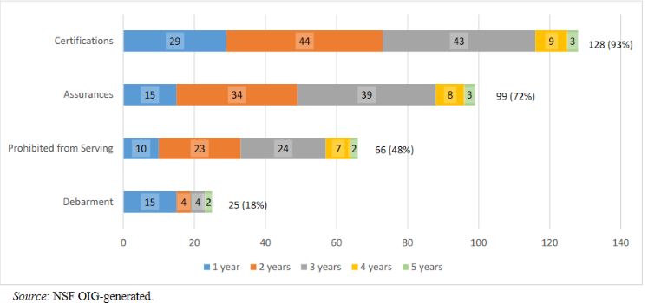
Outcomes
Notes:
What do you think about the outcomes?

Slide 12
Case Study
Dr. Terry Magnuson wore two hats at the University of North Carolina at Chapel Hill. He is the Kay M. & Van L. Weatherspoon Eminent Distinguished Professor of Genetics in the UNC College of Medicine, and founder of the genetics department. He was the research vice chancellor since 2016. Dr. Magnuson was an elected member of the National Academy of Medicine, the American Academy of Arts and Sciences, and the American Association for the Advancement of Science.
In spring of 2022, there were instances of plagiarism discovered in an application to the National Cancer Institute. These instances were discovered during the grant application peer review. According to ORI, “The institution conducted an assessment, questioned the respondent, who then admitted to the misconduct, and the institution notified ORI.”
ORI found that Dr. Magnuson engaged in research misconduct by intentionally, knowingly, or recklessly plagiarizing text from the following three (3) online articles and one (1) published paper.
Dr. Magnuson entered into a Voluntary Settlement Agreement: research supervised from Feb 2022 – Jan 2024. Grant applications must be submitted to the Vice Dean SOM 30 days prior to the grant application for submission, certification to ORI that data are accurately reported, and that is no supervision plan is provided to ORI, then his participation was not proposed on a research project.

Slide 13
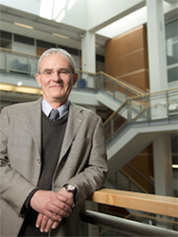
Case Study: Dr. Magnuson’s response
“A “mistake” that occurred when he failed to correct text he previously entered as a “placeholder.” He knew time was short to address reviewer comments but didn’t want to let his lab staff down by not completing the resubmission.”
“…wake-up call to PI’s that they should not be trying to write proposals that demand concentrated and focused attention if one is under the burden of pressing administrative duties, and they should rigorously screen those proposals before submission, especially if multiple people are contributing.”
He did not apologize and blamed his schedule for the plagiarism.

Slide 14

Case Study: Discussion
What circumstances do you think make this case uncommon?
Do you agree with Dr. Magnuson that ‘others’ should have caught his plagiarism?
Were the consequences too harsh, too lenient, or adequate?
Notes:
He only resigned from the Vice Chancellor position after faculty outcry. It had been days since this release of the findings.

Slide 15

Professional:
Organizations, Societies Publications
Professional organizations, societies, or associations have an ethical code of conduct.
Every reputable publisher has a statement on their definition of plagiarism.
Notes:
Option for content layout; change pix

Slide 16
5 most common types of plagiarism:
Using words and phrases from a variety of sources, and creating new sentences
When the words and phrases you are using are too similar to those of the original source
Taking the exact words from an original source and adding to it
Passing off another’s writing as your own
Reusing your own work without acknowledgement
Stealing
Patchwriting
Misquoting
Self plagiarism
Insufficient paraphrasing
Notes:
Let’s move on to types of plagiarism. Research shows and UF has identified the top 5 types of plagiarism. Let’s match the type to the definition, starting with stealing.
Stealing: D
Patch-writing: A
Misquoting: C
Self-plagiarism: E
Insufficient paraphrasing: B
Some people do not know that self-plagiarism is a thing. It is a thing, and it can be found in grant applications, articles. If you cite yourself from a previous work, you have to credit it. And the more self cites you have, the lower the journal impact rating is. So self-plagiarism could happen because someone doesn’t know they should cite themselves, or they think they can skip a few, but then it would also look like an attempt to artificially inflate a journal impact score. So, don’t do it.
Insufficient paraphrasing: Taking an author’s words and changing them slightly, without quoting the actual text is plagiarism.
Patch writing: Using words and phrases from a source text that may or may not be acknowledged and patching them together into new sentences.
Say it in your own words. If you have ever plagiarized by someone else, and you discovered it by reading the plagiarism, you know when you come to the sentence or sentences that you wrote. People’s writing styles are distinct.
These five types of plagiarism are defined in the Honor Code

Slide 17

Potential participants of
the 6th World Conference on
Research Integrity
committed plagiarism!
https://retractionwatch.com/2019/01/10/even-potential-participants-of-a-research-integrity-conference-commit-plagiarism-organizers-learn/
Notes:
Recently the 430 abstracts submitted for the 6th World Conference on Research Integrity (WCRI) were peer reviewed. After an alarming report of apparent plagiarism from one of the 30 reviewers, text similarity checking was conducted on all the abstracts received using Turnitin.
This identified 12 suspected cases of plagiarism and 18 suspected cases of self-plagiarism. Abstracts with a Turnitin Similarity Index above 30% (ranging from 37% to 94%) were further assessed and labelled as potential self-plagiarism if overlapping texts had at least one author in common.
We did not investigate the 18 cases of suspected self-plagiarism further, but decided to exclude them from oral presentation and to consider them as eligible for poster presentation only. 12 cases of suspected plagiarism, 6 had also applied for a travel grant. The reviewers – who were not informed about the results of the text similarity check – recommended 5 of the 12 abstracts with suspected plagiarism for rejection because of being out of the scope or of low quality. Ironically 2 of the abstracts had plagiarism as its topic. We demanded an explanation from all presenters of suspected plagiarized abstracts and decided to reject the abstracts if no credible explanation would be provided.

Slide 18
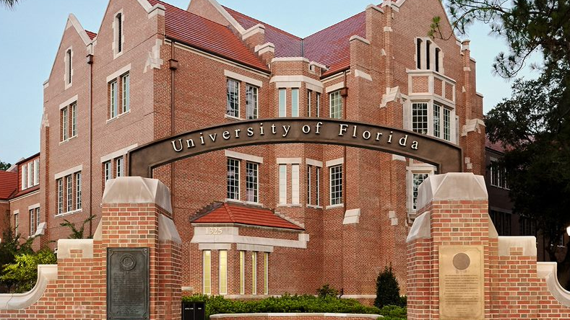
Notes:
Student Honor Code, and UF Regulation 1.0101 (Research integrity)

Slide 19
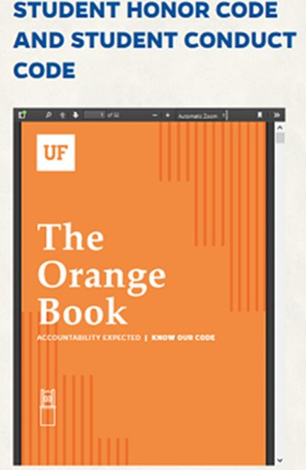

UF Honor Code:
Defines plagiarism:
Stealing, misquoting, insufficiently paraphrasing, or patch-writing.
Self-plagiarism, which is the reuse of the student’s own submitted work, or the simultaneous submission of the student’s own work, without the full and clear acknowledgment and permission of the faculty to whom it is submitted. ​
3. Submitting materials from any source without proper attribution. ​
4. Submitting a document, assignment, or material that, in whole or in part, is identical or substantially identical to a document or assignment the Student did not author.​
Photo Caption
Notes:
Not research misconduct in the federal sense….

Slide 20
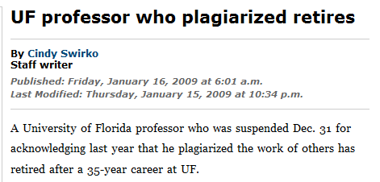
Case study: Is this plagiarism?
Rivenburg wrote:
"Indeed, with the exception of furniture and major appliances, it is possible to outfit an entire home in Christian products - bird feeders to body lotions, luggage to lamps.“
Twitchell in Shopping for God wrote:
"Indeed, with the exception of furniture and major appliances, it is possible to outfit your entire self and home in Christian products - bird feeders to body lotions, luggage to lamps."
Notes:
Rivenberg is the original author. He discovered several passages from his work plagiarized. He called the Department chair where Twitchell worked at UF. And…he ended up leaving.
Wrap up with action items

Slide 21
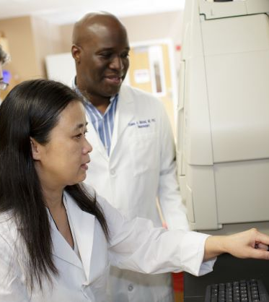
Prevention: A call to action
Foster a culture of research integrity.
1
Publicize the UF research misconduct policy.
2
3
Establish RCR training.
Consult campus resources: Writing Studio, UF Research Development Office, mentor...
4
5
Notes:
Findings from the NSF report suggest the top 3 action items that we are already doing at UF!

Slide 22

IF YOU SUSPECT RESEARCH MISCONDUCT?
Contact the UF Research Integrity Officer (RIO):
Cassandra Farley | rio@research.ufl.edu | 352-273-3052
Research Misconduct means fabrication, falsification, or plagiarism in proposing, performing, or reviewing research, or in reporting research results.
Questionable Research Practices are reports of careless, irregular, or contentious research practices, as well as authorship disputes, may not meet the standard for research misconduct but may be a research integrity violation.
Make a confidential report to the UF Research Integrity Officer (RIO).
You may also report anonymously UF Compliance Hotline:
877-556-5356
Notes:
Michelle

Slide 23

A podcast devoted to creating a culture of responsible conduct of research and research integrity at the University of Florida. Produced by UF Creative Works, and a team of people across the UF Campus including UF Research, CTSI, the Center for Undergraduate Research, and a group of UF Research Ambassadors. https://research.ufl.edu/research-roundtable-podcast.html Acknowledgement: The 2022 RCR Summer Seminar Series is funded in part by the Department of Health and Human Services, Office of Research Integrity grant (#ORIIR210068). Disclaimer: The content is solely the responsibility of the authors and does not necessarily represent the official views of the National Institutes of Health.
Notes:
Michelle: check us out! Submit ideas!!!

Slide 24
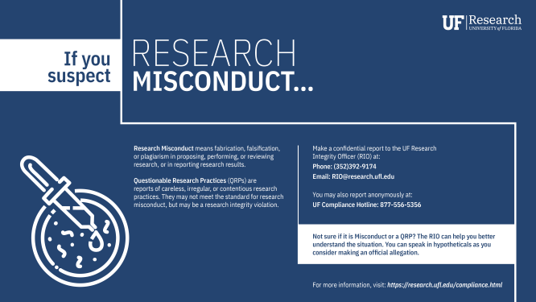
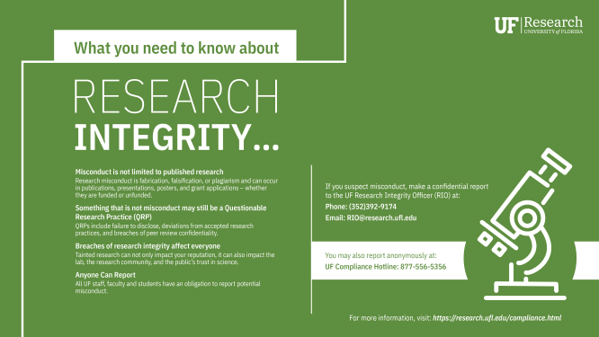
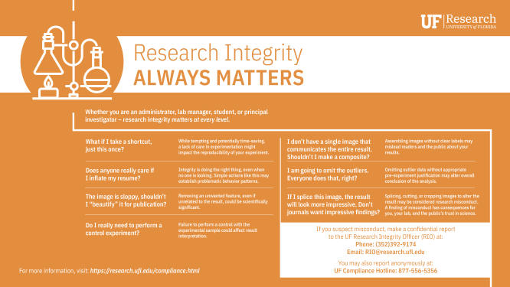

Slide 25
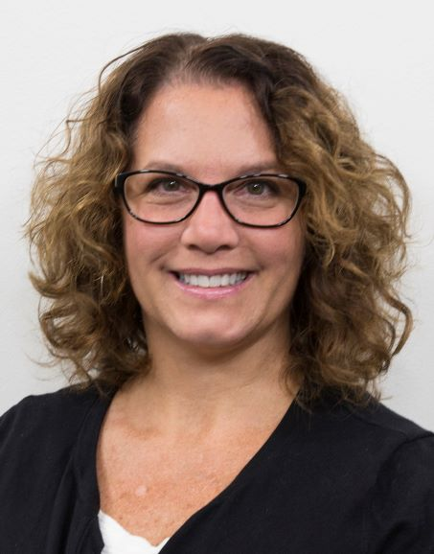
Contact me!
Questions?
mleonard@research.ufl.edu
220 Grinter Hall
352-273-1252
Michelle Leonard |UF Research
Assistant Director, Education and Training Programs

Slide 26

Survey: | 30-day post seminar series bit.ly/rcr2022 | interviews
We value your input! Your feedback helps us improve the RCR Series!
Notes:
Michelle: survey https://ufl.qualtrics.com/jfe/form/SV_7POD6AD5WivaJFA
30 day post interview announcement

