Slide 1
RCR Summer Seminar Series 2022
Michelle Leonard | Assistant Director, Education & Training Programs | UF Research
Bob Kolb | Assistant Director, Clinical Research | UF CTSI
Cassandra Farley | Research Integrity Officer | UF Research
Terry Selfe | Translational Research & Impact Librarian | UF Health Science Center Libraries
The 2022 RCR Summer Seminar Series is funded in part by the Department of Health and Human Services, Office of Research Integrity grant (#ORIIR210068). Disclaimer: The content is solely the responsibility of the authors and does not necessarily represent the official views of the Dept. of Health and Human Services.
Notes:
Lead slide by Michelle. Welcome to the Responsible Conduct of Research Summer Seminar Series, whether you registered for just a few seminars or are enrolled in the RCR Certificate of Completion program, we are glad to have you participate! We have almost xx people in attendance, all with different levels of experience, knowledge and skills. These seminars are developed for the beginner but hopefully those of you with more experience will also find some take-aways, especially as we move to break out rooms to do the exercises, please keep that in mind as you begin your discussions. The goal for this seminar series is to promote a culture of research integrity on campus. To do this, we will learn from others, and have an open dialogue about research using active learning techniques, such as polls, breakout rooms, case studies, and discussions. The sessions will not be recorded so that we may discuss openly and freely. You will receive a copy of the presentation after the session ends.
Michelle will introduce the moderator.

Slide 2
2022 RCR Summer Seminar Series
Rigors of Peer Review
Mentor/Mentee Relationships
Data Ethics
Collaborative Research
Reproducibility & Replicability
Research Misconduct
Export Control
Avoiding Plagiarism
Safe Research Environments
Ethics of Authorship
RCR Action Plan
The Lab
NIH Data Management Policy
Research Conflicts of Interest
The Research Clinic
Notes:
Moderator: It’s not too late to enroll in other sessions. If you want to earn a RCR Certificate that meets NIH, NSF, and USDA RCR requirements, you will need to enroll in all of these sessions. By earning a certificate, this will replace the CITI online, asynchronous training. And of course, you may choose to attend any or all of the sessions. Add link to enroll in the chat: https://research.ufl.edu/rcr/2022-summer-seminar-series-registration/

Slide 3
Research Conflict of Interest
Amber Moore
Associate Director
Chris Mullaney
Compliance Analyst
UF Research Integrity, Security and Compliance (RISC)
coi@research.ufl.edu
Notes:
Moderator will introduce the speaker(s). If the speaker prefers, they can send a brief bio in advance to the moderator, OR, the speaker can do a brief greeting and introduce the topic.

Slide 4
UF Research Integrity, Security and Compliance
Research Integrity
(Includes RM and QRP)
International Engagements and Collaboration
Research Conflict of Interest
Export Control
Facility Security
Other UF Research Services: IRB, IACUC, Animal Care

Slide 5
Poll Question
What is your level of experience with Research COI?
I have:
A research COI management plan
Worked on a study with a conflicted investigator
Assisted an investigator in disclosing to an IRB or institution
No direct experience with research COI (yet!)

Slide 6
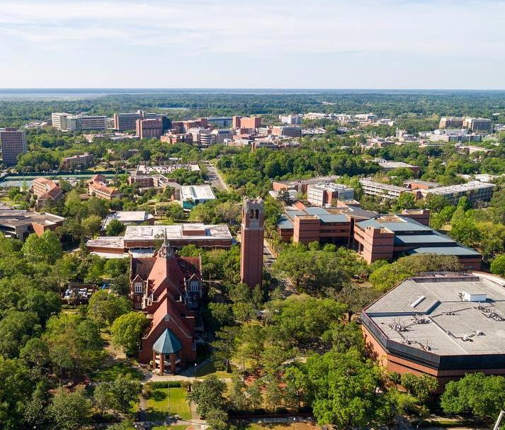
Research Conflict of Interest (RCOI)
RCOI administers UF’s Conflict of Interest in Research Policy. Our office reviews and manages Significant Financial Interests that have the potential to bias research to ensure compliance with sponsor COI regulations.
RCOI partners with the COI Program (UFOLIO), Division of Sponsored Programs (UFIRST) and UF Institutional Review Boards (myIRB and WIRB Checklist) to receive disclosures of Significant Financial Interests.
RCOI serves as a resource to staff, students and faculty on conflicts of interest related to research.

Slide 7
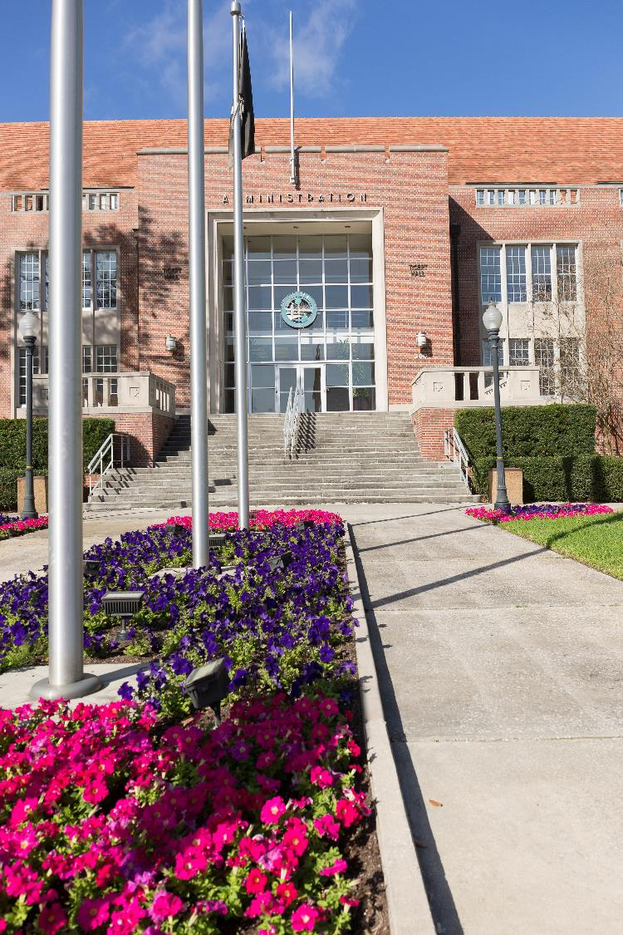
UF Conflicts of Interest Program
The UF Conflicts of Interest (COI) Program is an office established under the purview of the Provost and Senior Vice President for Academic Affairs.
The UF COI Program administers UFOLIO (UF Online Interest Organizer), UF’s online reporting system for Outside Activities and certain financial interests (prospective approval).
In collaboration with campus partners, the UF COI Program seeks to identify and manage conflicts of interest that could undermine institutional integrity.

Slide 8
Case Study
Dr. Hammond is a highly-respected researcher who has several research grants, both federal and non-federal funding. Dr. Hammond is also on an advisory board for DrugMaker Inc., a pharmaceutical company, and has received between $10,000 and $20,000 over the past 12 months for advising.
Dr. Hammond advises on a particular disease state and the company’s clinical trial progression for relevant treatments.
DrugMaker Inc. is conducting a multi-center, placebo-controlled, double-blinded, Phase 3 clinical trial, and Dr. Hammond proposes to be the PI for one of the trial sites.
The trial will enroll 2,500 patients, and the UF investigational site will enroll 12 patients.
Dr. Hammond and all UF study staff will be blinded to the treatment and control groups.
DrugMaker Inc. is using a Clinical Research Organization to monitor the study and perform data analysis.

Slide 9
Poll question
Dr. Hammond is proposing to engage in research that is:
Prohibited
Generally considered unethical
Allowable if reviewed
Allowable and does not require review

Slide 10
Federal Regulation & Policy
Key elements of the PHS and NSF COI policies:
Individual financial conflicts of interest
Disclosure required for actual financial interests (within specified timeframes)
Disclosure prior to proposal submission and annually
Investigators (“anyone responsible for design, conduct or reporting”) must disclose
Specific thresholds for what is considered a Significant Financial Interest
Reporting obligations to the sponsor (varies by sponsor)
Subrecipient compliance
Training requirements (PHS)
Public accessibility (PHS)
Retrospective review for non-compliance (PHS)

Slide 11
Types of Conflicts of Interest (Research Projects/Contracts)
Individual (PHS and NSF COI policies, UF Research COI Policy)
In the context of research, an individual conflict of interest exists when an investigator’s private interests may compromise, or have the appearance of compromising, an investigator’s professional judgment in the design, conduct or reporting of the research.
Institutional (no federal requirement, best practice and risk mitigation)
In the context of research, an institutional conflict of interest may exist when the institution or one of its senior officials has a financial interest related to research.
Organizational (contractual language and FAR clauses)
Government is typically concerned about three things: unequal access to information, biased ground rules, and impaired objectivity.

Slide 12
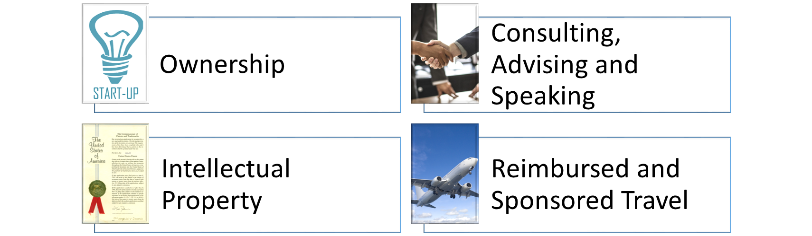
Significant Financial Interests
Thresholds: RCOI Website and Policy

Slide 13
Management of Research COIs

Slide 14
Management of Research COIs
Management is aimed at:
Reducing opportunity for bias
Preserving public trust
Protecting human subjects
For interventional human subjects research, there is a rebuttable presumption that the UF interested investigators and/or UF, if also financially interested, should not conduct the research.
Presumption can be overcome if compelling circumstances exist.

Slide 15
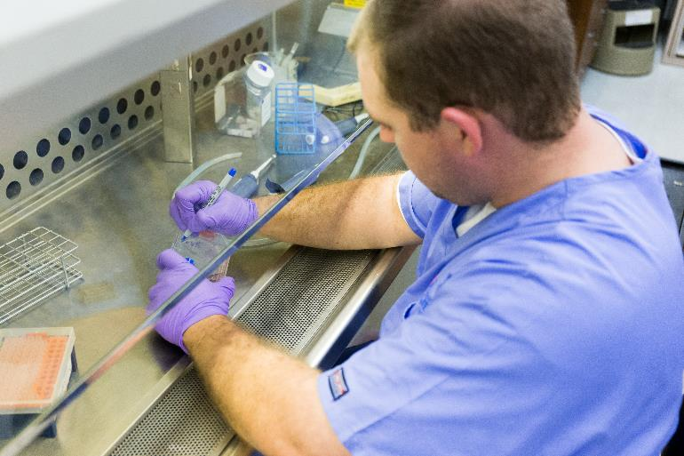
Special Considerations for Human Subjects Research
Compelling Circumstances
the nature of the research;
the magnitude of the significant financial interest and the degree to which it is related to the research;
the extent to which the significant financial interest could be directly and substantially affected by the research;
the degree of risk to the human subjects involved that is inherent in the research protocol;
the extent to which the conflicted Investigator is uniquely qualified to perform a research study with important public benefit, and;
the extent to which the FCOI is amenable to effective oversight and management.

Slide 16
What is a COI management plan?
The purpose of a COI management plan is to document management of potential conflict(s) of interest related to the research and includes:
A summary of the research purpose, aims & procedures
Any relevant approvals (human, animal, etc.)
The role of the investigator in the study
Outside entities involved in the research
Amount and nature of interest
Trainees working on the study
Inherent controls
Additional controls
Compelling circumstances, if applicable
Summary of discussion/rationale
Monitoring schedule

Slide 17
Inherent Controls
What are the inherent qualities of the study that protect against or neutralize bias on the part of an investigator?
Management plan identifies inherent controls such as:
Investigators blinded to treatment groups
Low percentage of enrollment at the investigator’s site
Non-interested co-investigators conducting the research and/or data analysis
External, non-interested lab involved in sample and/or data analysis
Objective endpoints
Early stage/pilot research that requires additional studies prior to commercialization
External monitor

Slide 18
Additional Controls
What additional controls can be added to the study to that may also protect against bias on the part of an investigator?
Institution may also add controls such as:
Public disclosure in presentations and publications
Safe harbor for students
Disclosure to human subjects research participants through informed consent
Notification to research personnel on the study
Limited role for interested investigator (e.g. does not obtain consent or recruit)
External IRB review (for institutional conflicts)
Monitoring of research by an independent reviewer(s) or DSMB
Reduction or elimination of SFI or severance of relationships

Slide 19
Case Study

Slide 20
Case Study
Dr. Hammond is a highly-respected researcher who has several research grants, both federal and non-federal funding. Dr. Hammond is also on an advisory board for DrugMaker Inc., a pharmaceutical company, and has received between $10,000 and $20,000 over the past 12 months for advising.
Dr. Hammond advises on a particular disease state and the company’s clinical trial progression for relevant treatments.
DrugMaker Inc. is conducting a multi-center, placebo-controlled, double-blinded, Phase 3 clinical trial, and Dr. Hammond proposes to be the PI for one of the trial sites.
The trial will enroll 2,500 patients, and the UF investigational site will enroll 12 patients.
Dr. Hammond and all UF study staff will be blinded to the treatment and control groups.
DrugMaker Inc. is using a Clinical Research Organization to monitor the study and perform data analysis.

Slide 21
Breakout Room
What are the inherent controls?
What additional controls would be appropriate for this research?
What questions do you have for Dr. Hammond?
Upon return, type (or copy) your responses into the chat when cued.

Slide 22
Case Study: Inherent Controls
Investigators blinded to treatment groups
Low percentage of enrollment at the investigator’s site
Monitoring of research and data analysis by CRO
Additional questions:
What are the roles of the interested investigator?
Are the study endpoints objective?
Does the study include any non-interested faculty/physicians?

Slide 23
Case Study: Additional Controls
Dr. Hammond may not obtain informed consent.
The informed consent document will contain COI disclosure language.
Dr. Hammond must disclose the interest to research personnel and in resulting publications or presentations.
Additional questions:
Are there trainees working on the study?
Should there be an independent data reviewer?
Is this study being reviewed by an external IRB?

Slide 24
Federal and State Regulations
PHS Regulation | https://www.govinfo.gov/content/pkg/FR-2011-08-25/pdf/2011-21633.pdf
NSF Proposal & Award Policies & Procedures Guide | https://www.nsf.gov/bfa/dias/policy/
Florida State Statute 112.313 (Standards of conduct for public officers, employees of agencies, and local government attorneys) | http://www.leg.state.fl.us/statutes/index.cfm?App_mode=Display_Statute&Search_String=&URL=0100-0199/0112/0112PARTIIIContentsIndex.html
Florida State Statute 1012.977 (Disclosure of contracts that affect the integrity of state universities or entities) | http://www.leg.state.fl.us/Statutes/index.cfm?App_mode=Display_Statute&Search_String=&URL=1000-1099/1012/Sections/1012.977.html

Slide 25
University of Florida Online Resources
Research COI | UFRI | https://research.ufl.edu/compliance.html
UF COI Program | https://coi.ufl.edu/
UFOLIO | https://compliance.ufl.edu/ufolio/
Disclosing Foreign Activities | https://research.ufl.edu/foreign-activities-disclosure.html
UFIRST | https://grants.research.ufl.edu

Slide 26

Survey: | 30-day post seminar series bit.ly/rcr2022 | interviews
We value your input! Your feedback helps us improve the RCR Series!
Notes:
Michelle: survey
30 day post interview announcement

Slide 27

If You Suspect Research Misconduct…
Contact the UF Research Integrity Officer (RIO):
Cassandra Farley | rio@research.ufl.edu | 352-273-3052
Research Misconduct means fabrication, falsification, or plagiarism in proposing, performing, or reviewing research, or in reporting research results.
Questionable Research Practices are reports of careless, irregular, or contentious research practices, as well as authorship disputes, may not meet the standard for research misconduct but may be a research integrity violation.
Make a confidential report to the UF Research Integrity Officer (RIO).
You may also report anonymously UF Compliance Hotline: 877-556-5356
Notes:
Michelle

Slide 28
Check out the UF RIO video!
The Role of the RIO!
The media layout displays multimedia.
Acknowledgement: The 2022 RCR Summer Seminar Series is funded in part by the Department of Health and Human Services, Office of Research Integrity grant (#ORIIR210068). Disclaimer: The content is solely the responsibility of the authors and does not necessarily represent the official views of the Dept. of Health and Human Services
Notes:
Michelle: Resources

Slide 29

A podcast devoted to creating a culture of responsible conduct of research and research integrity at the University of Florida. Produced by UF Creative Works, and a team of people across the UF Campus including UF Research, CTSI, the Center for Undergraduate Research, and a group of UF Research Ambassadors. https://research.ufl.edu/research-roundtable-podcast.html Acknowledgement: The 2022 RCR Summer Seminar Series is funded in part by the Department of Health and Human Services, Office of Research Integrity grant (#ORIIR210068). Disclaimer: The content is solely the responsibility of the authors and does not necessarily represent the official views of the National Institutes of Health.
Notes:
Michelle: check us out! Submit ideas!!!

