Slide 1
RCR Summer Seminar Series 2022
Michelle Leonard | Assistant Director, Education & Training Programs | UF Research
Bob Kolb | Assistant Director, Clinical Research | UF CTSI
Cassandra Farley | Research Integrity Officer | UF Research
Terry Selfe | Translational Research & Impact Librarian | UF Health Science Center Libraries
The 2022 RCR Summer Seminar Series is funded in part by the Department of Health and Human Services, Office of Research Integrity grant (#ORIIR210068). Disclaimer: The content is solely the responsibility of the authors and does not necessarily represent the official views of the Dept. of Health and Human Services.
Notes:
Lead slide by Michelle. Welcome to the Responsible Conduct of Research Summer Seminar Series, whether you registered for just a few seminars or are enrolled in the RCR Certificate of Completion program, we are glad to have you participate! We have almost xx people in attendance, all with different levels of experience, knowledge and skills. These seminars are developed for the beginner but hopefully those of you with more experience will also find some take-aways, especially as we move to break out rooms to do the exercises, please keep that in mind as you begin your discussions. The goal for this seminar series is to promote a culture of research integrity on campus. To do this, we will learn from others, and have an open dialogue about research using active learning techniques, such as polls, breakout rooms, case studies, and discussions. The sessions will not be recorded so that we may discuss openly and freely. You will receive a copy of the presentation after the session ends.
Michelle will introduce the moderator.

Slide 2
2022 RCR Summer Seminar Series
Rigors of Peer Review
Mentor/Mentee Relationships
Data Ethics
Collaborative Research
Reproducibility & Replicability
Research Misconduct
Export Control
Avoiding Plagiarism
Safe Research Environments
Ethics of Authorship
RCR Action Plan
The Lab
NIH Data Management Policy
Research Conflicts of Interest
The Research Clinic
Notes:
Moderator: It’s not too late to enroll in other sessions. If you want to earn a RCR Certificate that meets NIH, NSF, and USDA RCR requirements, you will need to enroll in all of these sessions. By earning a certificate, this will replace the CITI online, asynchronous training. And of course, you may choose to attend any or all of the sessions. Add link to enroll in the chat: https://research.ufl.edu/rcr/2022-summer-seminar-series-registration/

Slide 3
Introduction to Research Misconduct
Cassandra Farley
Director & RIO
Amber Moore
Associate Director & Deputy RIO
UF Research Integrity, Security and Compliance (RISC)
rio@research.ufl.edu
Notes:
Moderator will introduce the speaker(s). If the speaker prefers, they can send a brief bio in advance to the moderator, OR, the speaker can do a brief greeting and introduce the topic.

Slide 4
UF Research Integrity, Security and Compliance
Research Integrity
(Includes RM and QRP)
International Engagements and Collaboration
Research Conflict of Interest
Export Control
Facility Security
Other UF Research Services: IRB, IACUC, Animal Care

Slide 5
Principles and Decision Making--Breakout Room
“Our principles define our identity and tell the world what to expect from us, as well as how we expect others to behave. Principles apply to ethics choices in all aspects of our lives”
–Susan Liataud, The Power of Ethics
Quick Intro: Name, Department, Role
What are your top 3-5 principles?
How do your principles influence your…
Decisions day-to-day?
Goals?
Research?

Slide 6
What are Your Principles?
Family
Freedom
Loyalty
Connection
Creativity
Humanity
Success
Respect
Diversity
Generosity
Integrity
Love
Openness
Advancement
Forgiveness
Faith
Wisdom
Honesty
Kindness
Communication
Learning
Excellence
Quality
Commonality
Strength
Hard work
Clarity
Leadership
Renewal
Contentment
Friendship
Courage
Community
Compassion
Knowledge
Patience
Wellness
Gratitude
Achievement
Others…

Slide 7
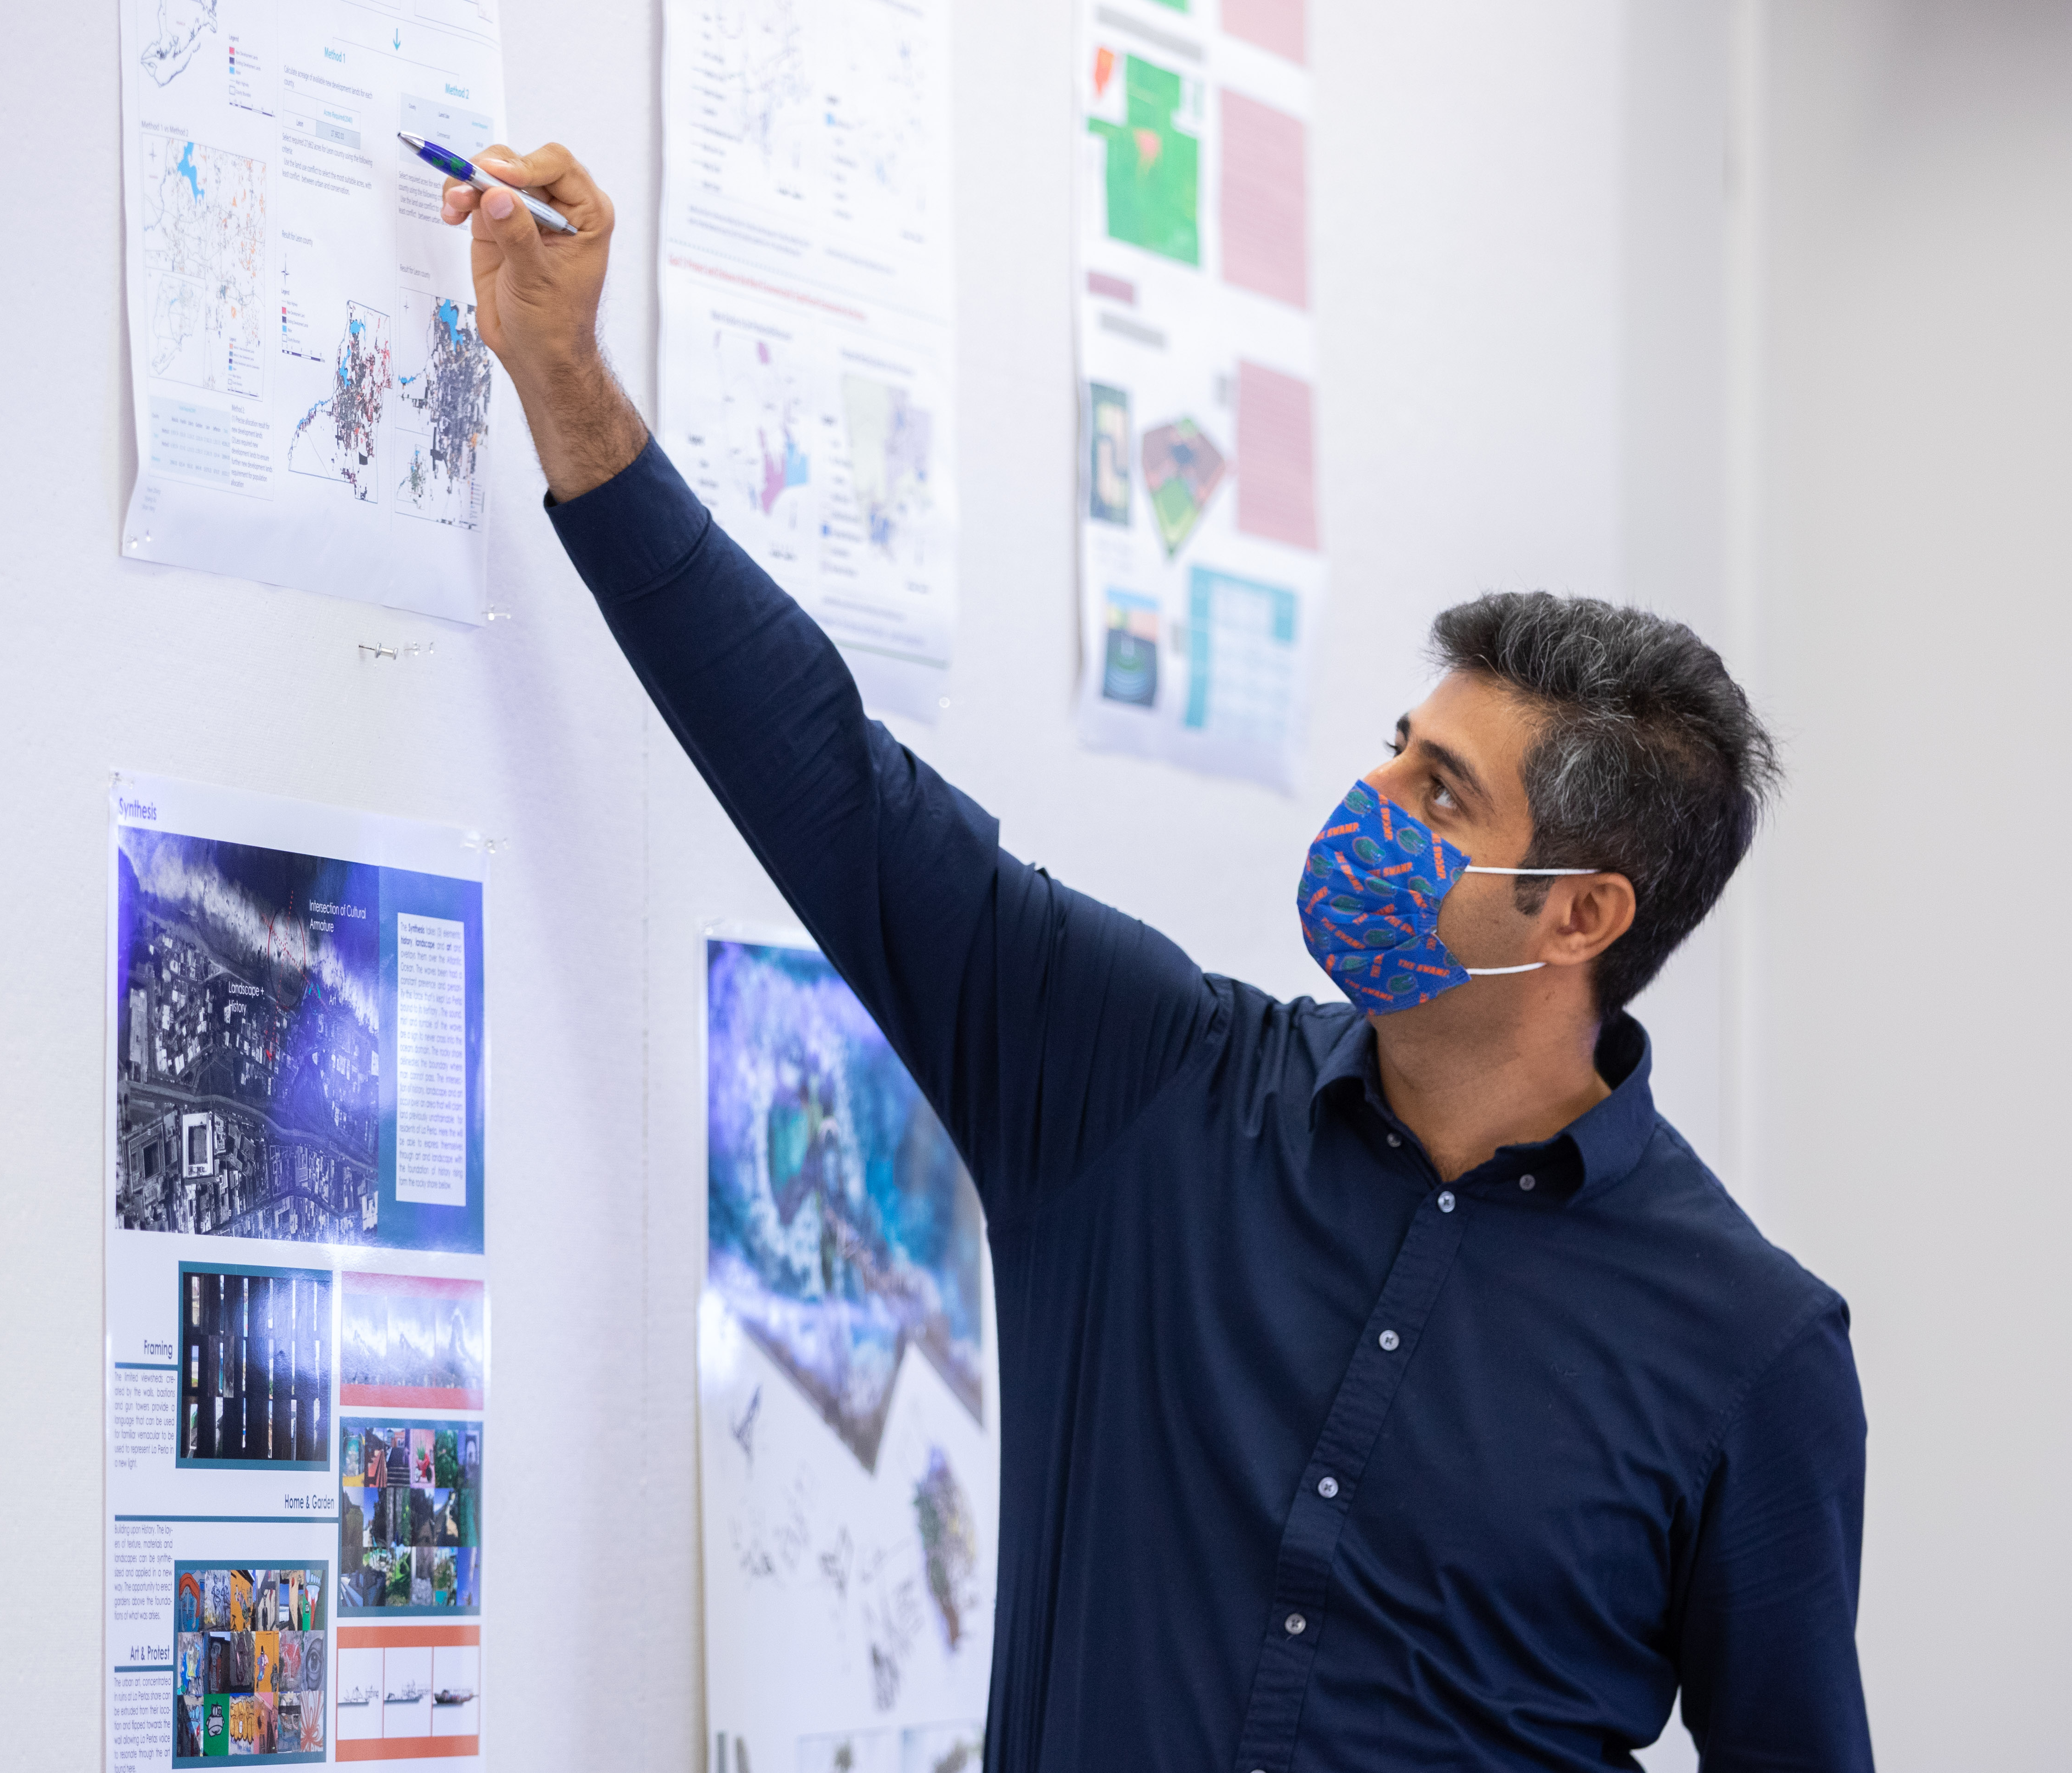
What is Research Integrity?
National Academy of Sciences Definition:
Honesty and fairness in proposing, performing, and reporting research;
Accuracy and fairness in representing contributions to research proposals and reports;
Proficiency and fairness in peer review;
Collegiality in scientific interactions, communications and sharing of resources;
Disclosure of conflicts of interest;
Protection of human subjects in the conduct of research;
Humane care of animals in the conduct of research;
Adherence to the mutual responsibilities of mentors and trainees.

Slide 8
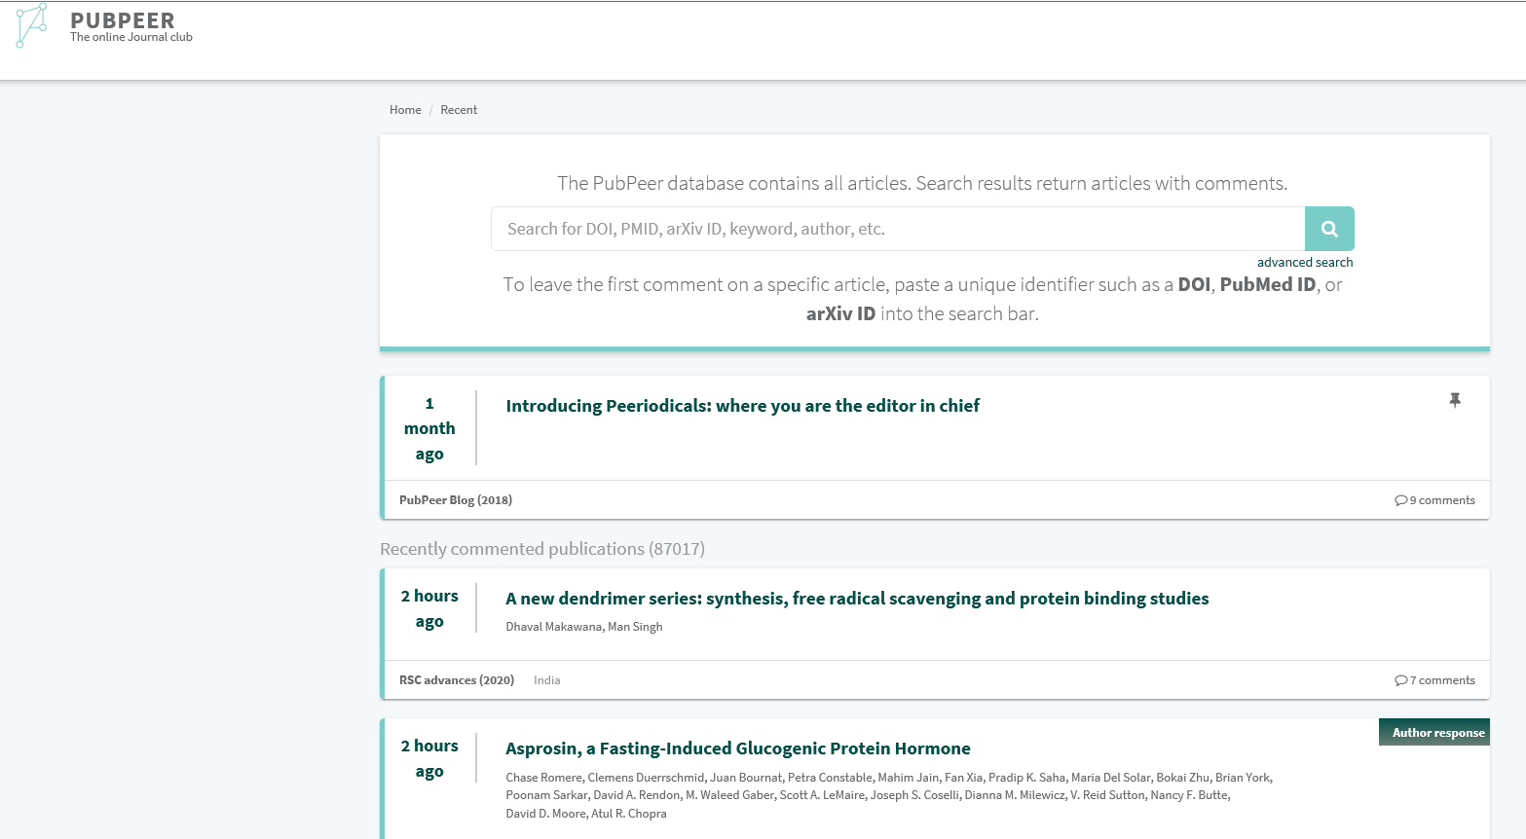
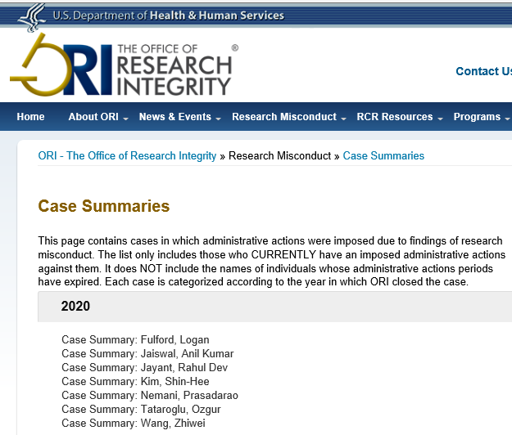
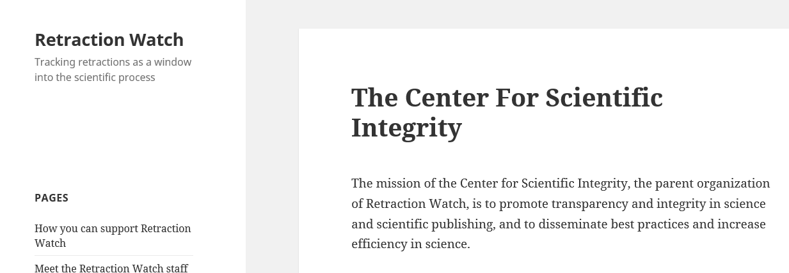
Who Cares?
Scientific Community
Sponsors
Public
Journals and Publications

Slide 9
Rules and Regulations

Slide 10
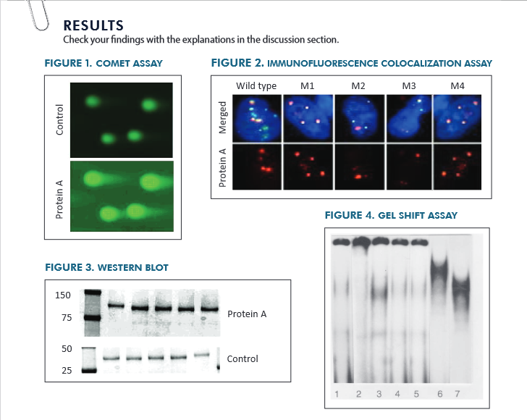
Can you spot the research misconduct?

Slide 11
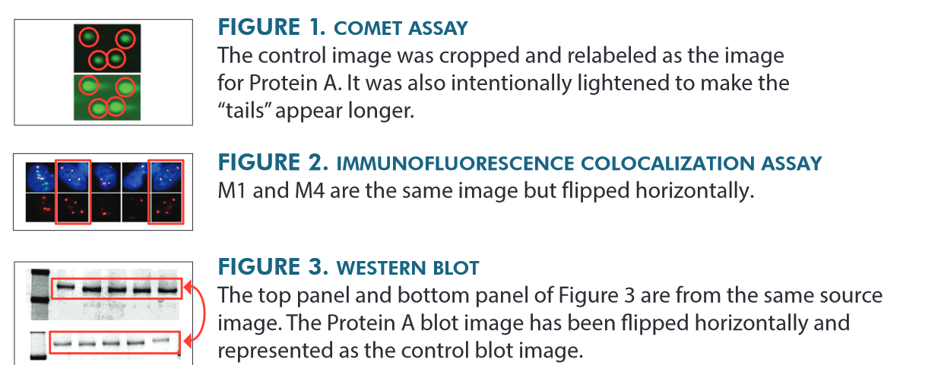
Source: https://ori.hhs.gov/sites/default/files/2020-05/11.%20Can%20you%20Spot%20Scalable.pdf

Slide 12
Research Misconduct at a Glance
UF Regulation 1.0101 – Research Integrity
Regulation and associated policy closely follow PHS policy
The RM process is highly regulated
Proceedings confidential
Consequences are severe
Process designed to ensure due process
UF employees and students have an obligation to report and an obligation to participate in RM proceedings
Notes:
U.S. Department of Health and Human Services (HHS), 42 C.F.R. parts 50 and 93; Public Health Service Policies on Research Misconduct
“Institutions and institutional members have an affirmative duty to protect PHS funds from misuse by ensuring the integrity of all PHS supported work, and primary responsibility for responding to and reporting allegations of research misconduct”
NSF Research Misconduct regulation, 49 C.F.R. § 689
“Awardee institutions bear primary responsibility for prevention and detection of research misconduct and for the inquiry, investigation, and adjudication of alleged research misconduct.”

Slide 13
Research Misconduct
Research misconduct means fabrication, falsification, or plagiarism in proposing, performing, or reviewing research, or in reporting research results.
Does not include honest error, differences of opinion, or authorship disputes.
Fabrication | Falsification | Plagiarism
Making up data or results and recording or reporting them | Manipulating research materials, equipment, or processes, or changing or omitting data or results such that the research is not accurately represented in the research record | The appropriation of another person’s ideas, processes, results, or works without giving appropriate credit

Slide 14
Quick Detour: Students and RM
UF Student Honor Code
(3) Violations of the Student Honor Code. Every University Student is subject to the following Honor Pledge:
We, the members of the University of Florida community, pledge to hold ourselves and our peers to the highest standards of honesty and integrity by abiding by the Student Honor Code. On all work submitted for credit by Students at the University of Florida, the following pledge is either required or implied: “On my honor, I have neither given nor received unauthorized aid in doing this assignment.”
…
(c) False or Misleading Information.
…
3. A Student must not use or present fabricated information, falsified research, or other findings if the Student knows or reasonably should be aware that the information, research, or other finding is fabricated or falsified.
…
(e) Plagiarism. A Student must not represent as the Student’s own work all or any portion of the work of another.

Slide 15
Allegation Review Process
An inquiry (60 days) is warranted if:
the allegation falls within the definition of Research Misconduct, and
is sufficiently credible and specific so that potential evidence of Research Misconduct may be identified.
An investigation (120 days) is warranted if:
there is a reasonable basis for concluding that the allegation falls within the definition of Research Misconduct, and
preliminary fact finding from the inquiry indicates the allegation may have substance.
Allegation Assessment
Intake of allegation and initial review
Who did what, where, when, how?
Notes:
Good faith, specific, understanding what it means to make an allegation

Slide 16
Finding of Research Misconduct
There is a significant departure from accepted practices of the relevant research community; and
The misconduct is committed intentionally, knowingly, or recklessly; and
The allegation is proven by a preponderance of the evidence.
Fabrication, falsification or plagiarism occurred; and

Slide 17
Consequences of Research Misconduct
Recovery of Funds
Name published in Federal Register and on website
Suspension or debarment
Restricted from serving on federal committees, boards, etc.
Fines and jail time
UF Actions
Retraining
Article Retraction
Degree withdrawal
Supervision
Federal Actions
Termination
Reprimand

Slide 18
Case Study – Duke University
Lab technician Erin Pott-Kant had a knack for getting good results sought by researchers. When new tech Thomas joined the lab and performed similar tasks, he became suspicious of her work because the error rates were too low and he was unable to replicate her results. “Erin always got these experiments to work!” the supervising scientist once yelled. Thomas raised his concerns, but nothing changed. At this time, Duke was the nation’s eighth-largest NIH recipient, with more than 800 grants totaling $475 million.
Thomas filed a whistleblower lawsuit alleging fabrication of data, and ORI agreed, determining that Pott-Kant had engaged in research misconduct by knowingly and intentionally fabricating research data in 117 figures and 2 tables in 39 published papers, 3 manuscripts, and 2 research records, while supported by NIH funds. As a result, Pott-Kant is permanently excluded from working with any U.S. agency. Duke agreed to pay a $112.5 million fine.

Slide 19
Breakout Room: Duke Case
1.) Do you think a case like this (scale, funding, etc.) is common? Uncommon? Why?
2.) What principles do you think motivated Pott-Kant to falsify results? What principles motivated the whistleblower?
3.) What role, if any, do you think the faculty lab leader played? Do you think the faculty member bears any responsibility?
4.)What principles guided this Duke lab? What principles should guide a lab? Is there overlap?

Slide 20
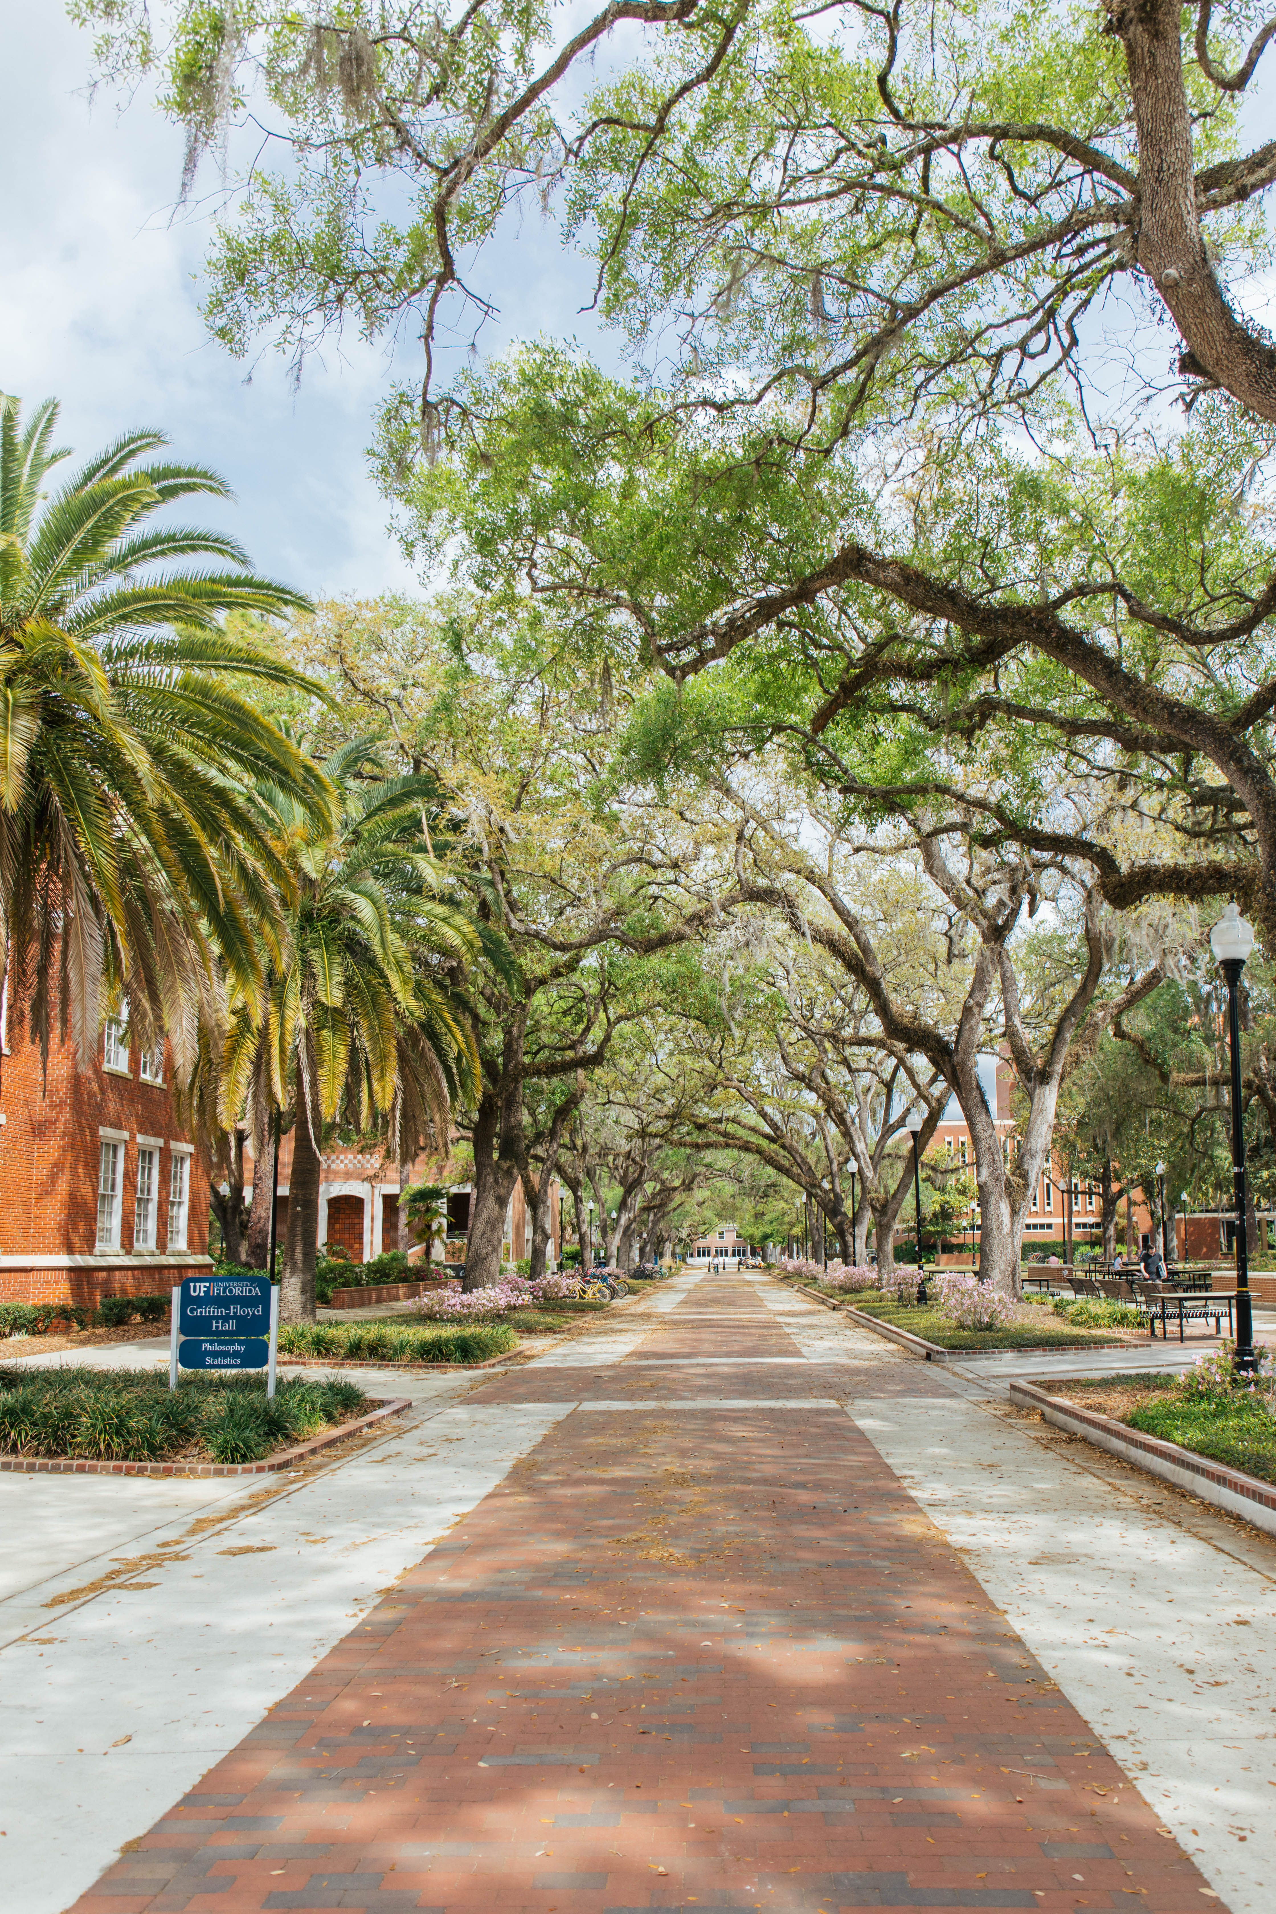
What if it isn’t Research Misconduct?
Careless, irregular, or contentious research practices may not meet the standard for research misconduct, but may be a research integrity violation.

Slide 21
Research Integrity Deviations
Failure to disclose: failing to disclose outside activities or financial interests
Breach of confidentiality: taking or releasing the ideas or data of others when there was an understanding or expectation of confidentiality
Dishonesty in publication: knowingly publishing material that will mislead readers (e.g., misrepresenting data or research progress; omitting contributors)
Failure to report observed research misconduct: failing to report observed, suspected, or apparent research misconduct by others
Retaliation: taking adverse action against an individual for having reported allegations
Directing or encouraging others to engage in any of the above listed offenses
Property violations: stealing, tampering with, or destroying research property of others
Notes:
Careless, irregular, or contentious research practices. May not meet the standard for research misconduct, but may be a research integrity violation.

Slide 22
Research Integrity Deviations in Practice
Using confidential NIH proposals to “train” graduate students and postdocs how to perform reviews
Violation of confidentiality agreement reviewer sign
Not disclosing receiving funding from an international granting agency on current and pending documents
A recent study¹ published in Educational Researcher found that:
Use of QRPs was prevalent in education research. For example, [the authors] found that nearly 46% reported an exploratory finding as having been predicted, 67% reported having omitted some analyses from published studies. If researchers only report a portion of the analyses they run, readers do not get the full story.²
Studies in other fields show similar findings
Often called questionable or detrimental research practices
https://www.forbes.com/sites/jonathanwai/2021/05/10/how-improving-research-practices-can-enhance-education-research-and-policy/?sh=b4f4cde56c38
https://journals.sagepub.com/doi/full/10.3102/0013189X14545513
Notes:
If DRPs are this widespread, what does this mean for science?
Does knowing this change the way you view scientific publications?
What does it mean to you?
As a researcher?
As a taxpayer?
As a patient? Voter? Student? Consumer?

Slide 23
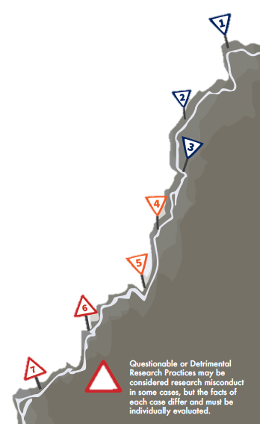
Why this Matters: The RM Slippery Slope…
TAKING SHORTCUTS Lack of care in experimentation that might impact reproducibility
CHEATING Such as puffery, which is inflating your resume, can establish dangerous behavior patterns
“BEAUTIFICATION” OF IMAGES Removing an unwanted feature, even if unrelated to the result, could be scientifically significant
LACK OF APPROPRIATE CONTROLS Failure to perform a control with the experimental sample could affect result interpretation
COMPOSITE IMAGES Assemblies of images that are not clearly labeled, such as a montage of cell images from the same experiment but not labeled as such.
OUTLIERS Omitting outlier data without appropriate pre-experiment justification which alters the overall conclusion of the analysis
IMAGE MANIPULATION Splicing, cutting, or cropping images; without properly documenting changes, that alters the results or falsely claims a result which was not obtained.
!
Source: Office of Research Integrity https://ori.hhs.gov/infographics

Slide 24
Closing Thoughts
Educate yourself, know what the right thing is, and do it
Incorporate ethical behaviors, professionalism, and accountability into your work everyday
Always practice the responsible conduct of research—if you don’t know, ask!
If you see something suspicious, ask questions, say something
Remember, acts of research misconduct destroy your reputation, the public’s confidence in science, and the scientific record
Make ethical decisions—find a framework that works for you

Slide 25
Survey: | 30-day post seminar series bit.ly/rcr2022 | interviews
We value your input! Your feedback helps us improve the RCR Series!
Notes:
Michelle: survey
30 day post interview announcement

Slide 26
If You Suspect Research Misconduct…
Contact the UF Research Integrity Officer (RIO):
Cassandra Farley | rio@research.ufl.edu | 352-273-3052
Research Misconduct means fabrication, falsification, or plagiarism in proposing, performing, or reviewing research, or in reporting research results.
Questionable Research Practices are reports of careless, irregular, or contentious research practices, as well as authorship disputes, may not meet the standard for research misconduct but may be a research integrity violation.
Make a confidential report to the UF Research Integrity Officer (RIO).
You may also report anonymously UF Compliance Hotline: 877-556-5356
Notes:
Michelle

Slide 27
Check out the UF RIO video!
The Role of the RIO!
The media layout displays multimedia.
Acknowledgement: The 2022 RCR Summer Seminar Series is funded in part by the Department of Health and Human Services, Office of Research Integrity grant (#ORIIR210068). Disclaimer: The content is solely the responsibility of the authors and does not necessarily represent the official views of the Dept. of Health and Human Services
Notes:
Michelle: Resources

Slide 28
A podcast devoted to creating a culture of responsible conduct of research and research integrity at the University of Florida. Produced by UF Creative Works, and a team of people across the UF Campus including UF Research, CTSI, the Center for Undergraduate Research, and a group of UF Research Ambassadors. https://research.ufl.edu/research-roundtable-podcast.html Acknowledgement: The 2022 RCR Summer Seminar Series is funded in part by the Department of Health and Human Services, Office of Research Integrity grant (#ORIIR210068). Disclaimer: The content is solely the responsibility of the authors and does not necessarily represent the official views of the National Institutes of Health.
Notes:
Michelle: check us out! Submit ideas!!!

