Slide 1
AGREEMENTS

Slide 2
What’s New
Look(more like Awards)
Linking of Agreements to Awards
Requirement of proposal for specific agreements
Electronic FCOI & ACF before sent to DSP
Workflow States
Legacy Agreements (What’s that?)
Additional Stop Lights
Agreement Modifications
Sponsor Email
Activities
Notes:
Auto triage of DSP/OCR workflow based on subject matter of work

Slide 3
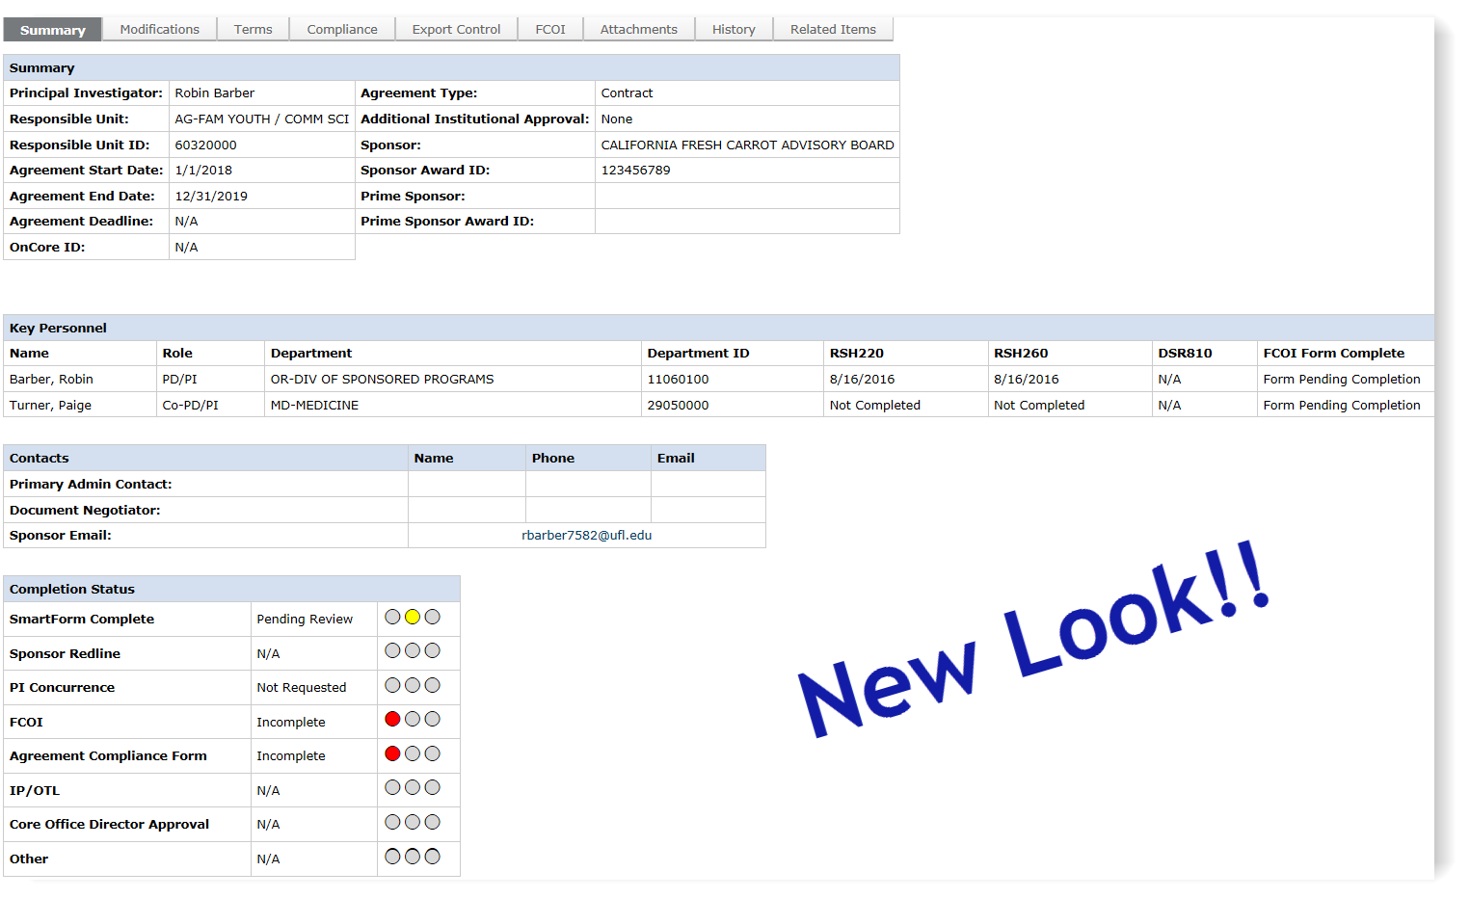
New Look
Notes:
UNIT CONTACT should be the person most able to help facilitate review questions and or PI engagement

Slide 4
Linking of agreements
Related Items Tab
Links everything together now YAY!!!
You can now get to proposal, agreement & award from here

Slide 5
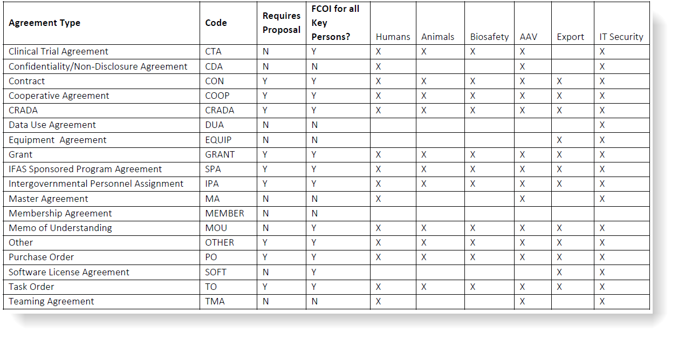
Compliance Form Matrix
Compliance form Sections Required

Slide 6
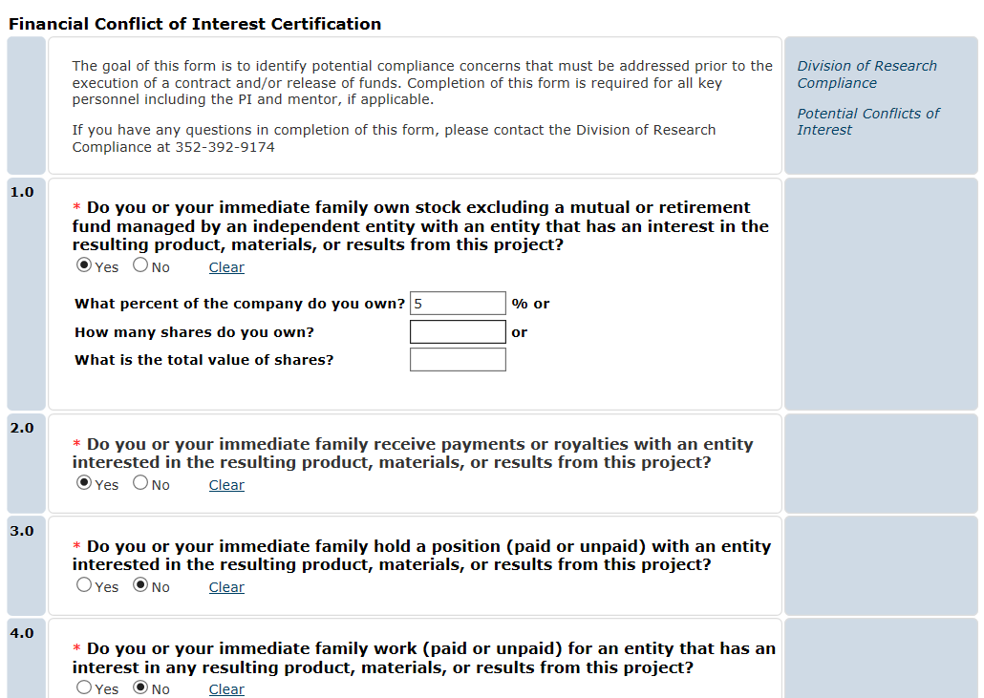
Fcoi form
Has to be completed before it can be sent to DSP for review
Depending on the PI’s answers the agreement may need to go to DRC for review. You will see the state change to “DRC Review”.
Notes:
ACF and FCOI must be completed before DSP or OCR can process the proposal request

Slide 7
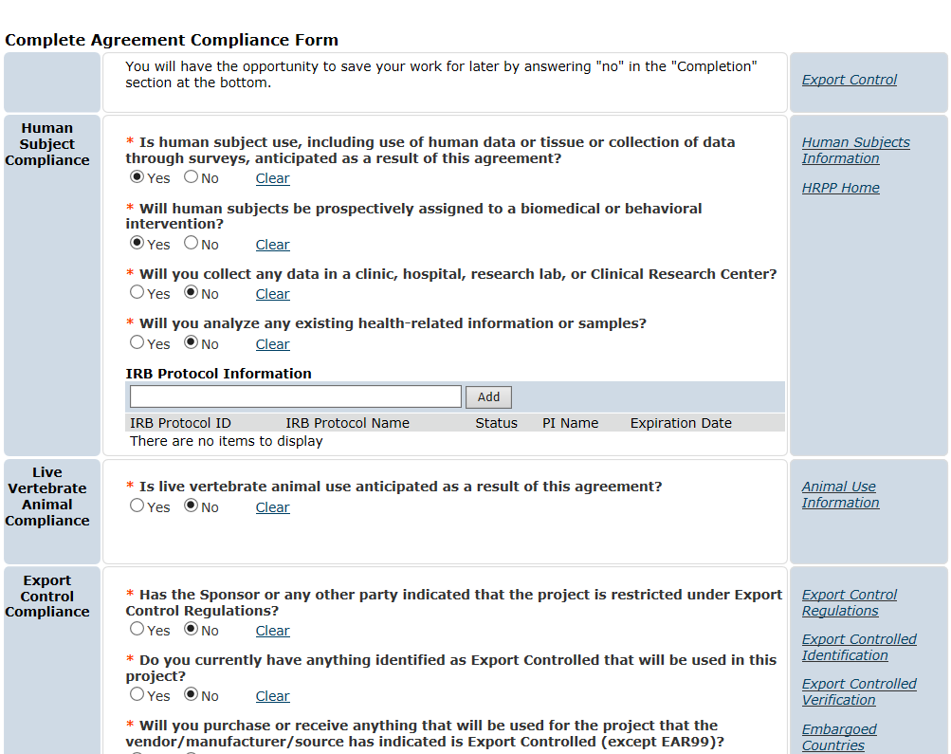
ACF form
Has to be completed before it can be sent to DSP for review
Depending on the PI’s answers the agreement may need to go to OCR for review.
**Note: the state will not change. A “OCR” water mark will appear at top of Work Space
Notes:
Activities now required on most agreements regardless of sponsor type (New activity for Industry CTA)
Human subjects questions align more with NIH clinical trial definitions (spot to plug that new logic as well)

Slide 8
Workflow States
Available to users depending on the state of the agreement:
Pending Compliance Activities
Under Negotiation
Hold
DRC Review
Pending UF Signature
Withdrawn
Pending Sponsor Signature
Fully Executed – Pending Follow Up
Terminated by Core Office
Terms Not Reached
Fully Executed
Notes:
More workflow states than in previous AGR module (easier to see where it is at without extra emails)

Slide 9
Legacy agreements
These are agreements that are in place before the new agreements module rolls out
New Legacy Agreement section will now appear in your inbox
Notes:
Legacy agreements can be converted at time of modification in the new AGR module

Slide 10
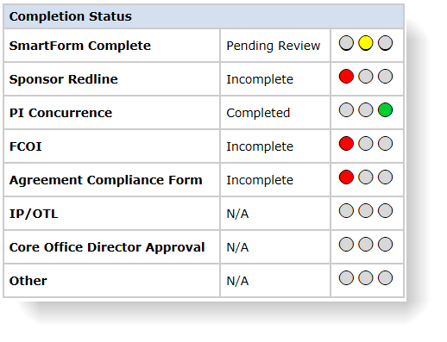
Stop lights
No Light – no action needed or action hasn’t been requested
Red Light – nothing has been completed on this action by department or core office
Yellow Light – action is incomplete and work still needs done either by department or core office
Green Light – action has been completed
*** Note – IP/OTL, Core Office Director Approval & Other stop lights are all Core Office driven activities

Slide 11
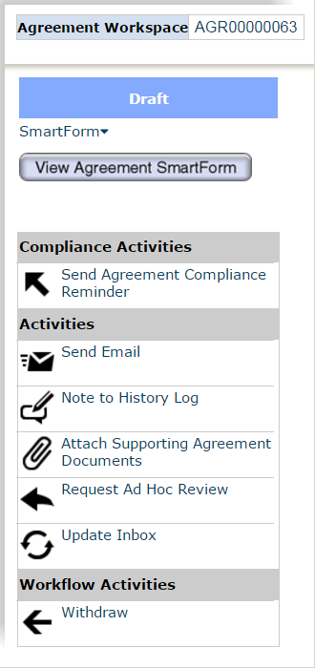
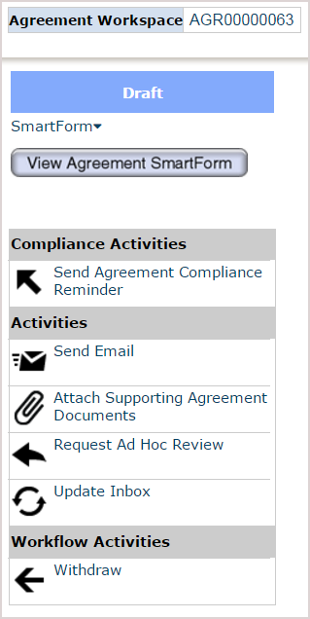
Activities
Note to History Log will only be available if a Document Negotiator hasn’t been assigned yet

Slide 13
Agreement testing
Try it out for yourself: https://qat-grants.research.ufl.edu/
Questions: ufirst@research.ufl.edu

Slide 14
Go Live
**ROLLOUT FRIDAY, NOVEMBER 17th**
Open Lab will be held at the HUB Building on the below dates:
Monday, November 20th 9am – 11am
Wednesday, November 29th 9am – 11am
Wednesday, December 6th 9am – 11am
Wednesday, December 13th 9am – 11am
Wednesday, December 20th 9am – 11am

Slide 15
QUESTIONS

