Slide 1
DSP Update
USDA F&A & Match
Equipment Rental
Staffing Update
NIH Salary Cap
UFIRST Enhancement Release

Slide 2
Activities & Interests Reporting AND Grants Other Support
Stephanie Gray, Assistant Vice President for Research
April 18, 2019
Notes:
Time: 1 min
Terra
Introductions

Slide 3
Credit also to:
Gary Wimsett
Terra DuBois
Chris Hass
Gwynn Cadwallader
Notes:
Time: 1 min
Terra
Introductions

Slide 4
We will cover…
Key Principles
Current Landscape
Activities & Interests
Changes/Clarifications in Agency Requirements
UFIRST Changes regarding International Activities – DRCGS support
Visiting Persons
Notes:
Time: 1 min
Terra
Introductions

Slide 5
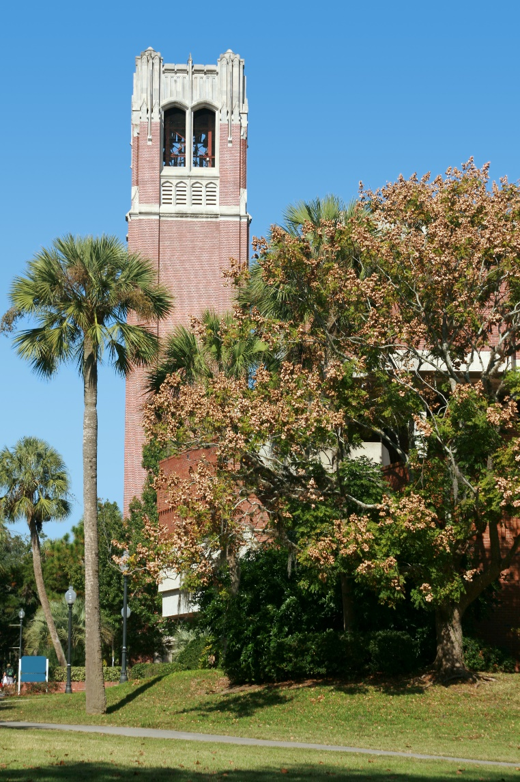
What are the Key Principles?
UF is an institution of public trust.
Employees must respect that status and conduct their affairs in ways that will not compromise the integrity of the University or that trust. As a reviewer, you have a role.
Common sense must prevail in the interpretation of COI policies.
What to disclose?
Notes:
Time: 1 min
Gary
Example: Promotional activity

Slide 6
What should I be mindful of?
Primary loyalty must be to UF.
Employees do not have a “given” right to engage in outside activities. Saying NO is an option.
It’s not just conflicts of interest. Conflicts of commitment are important and there are as many scenarios as there are employees.
A series of allowable activities can add up to a conflict of commitment. Expert witness services can be an example of this.
Notes:
Time: 1 min
Gary

Slide 7
Notes:
Time: 2 min

Slide 8
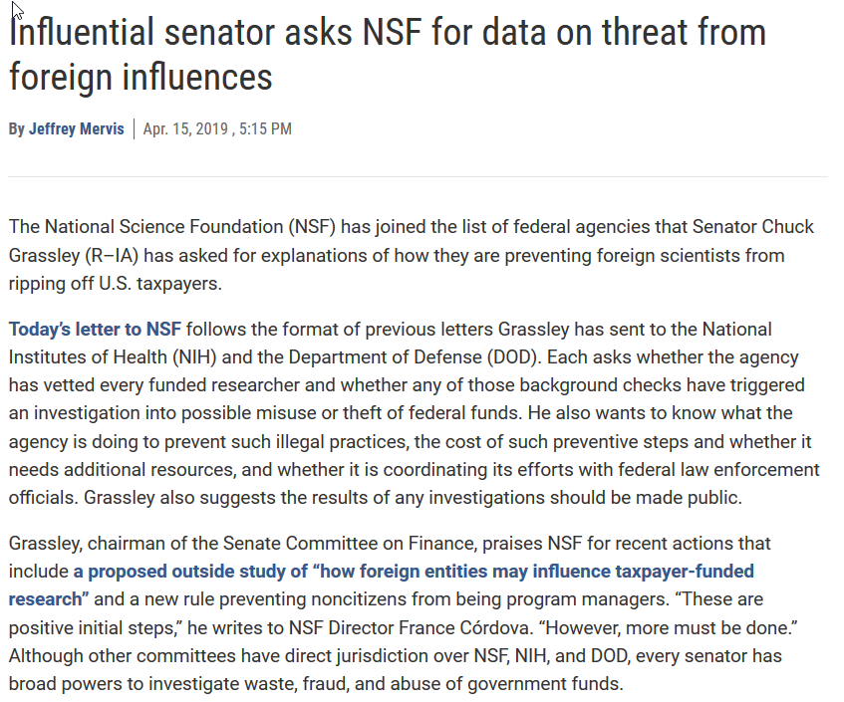
Notes:
Time: 2 min

Slide 9
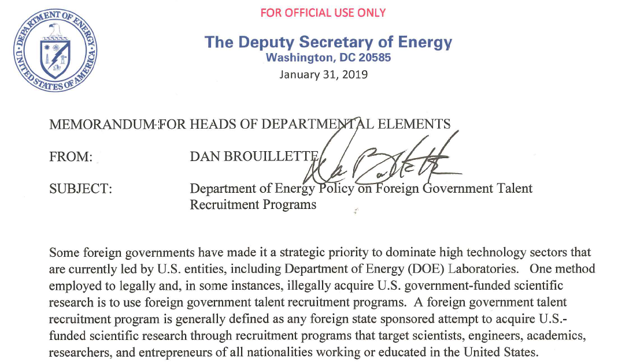
Notes:
Time: 2 min

Slide 10
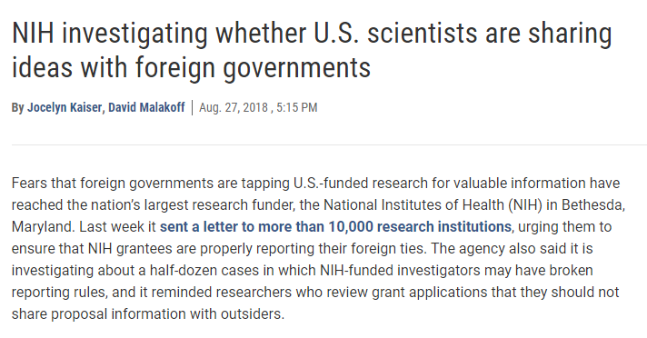
Notes:
Time: 2 min

Slide 11
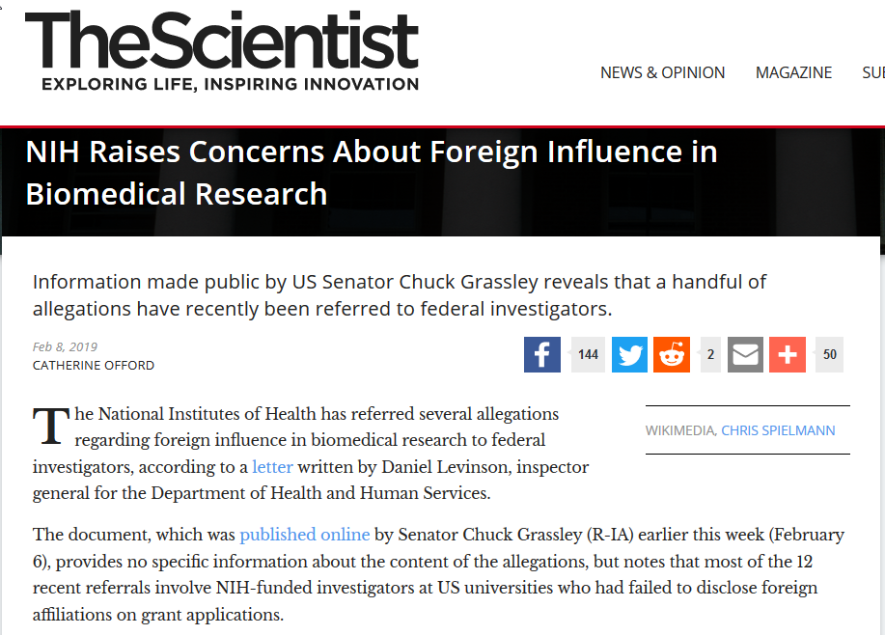
Notes:
Time: 2 min

Slide 12
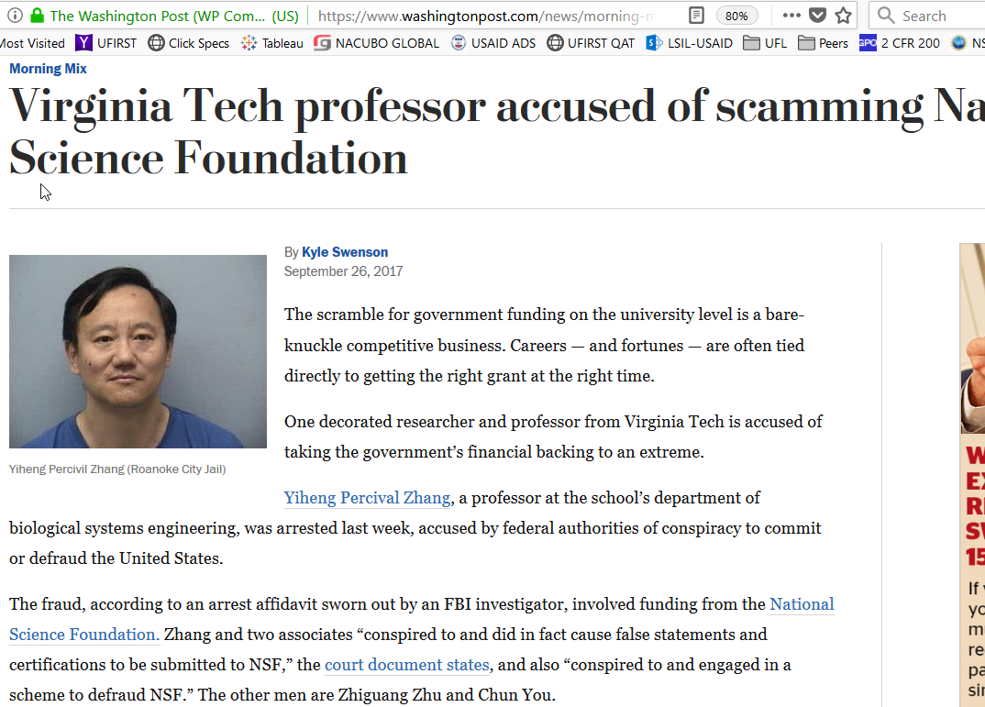
Notes:
Time: 2 min

Slide 13
What does this mean for UF research?
Increasing awareness of required disclosures:
Disclose to sponsors → “other support” and “foreign components” in proposals and annual reports
Disclose to UF → Activities and Interests
Heightened scrutiny of activities with partners in high risk countries
Certain activities with foreign governments might have negative implications for U.S. grant funding
Notes:
Time: 1 min
Terra

Slide 14
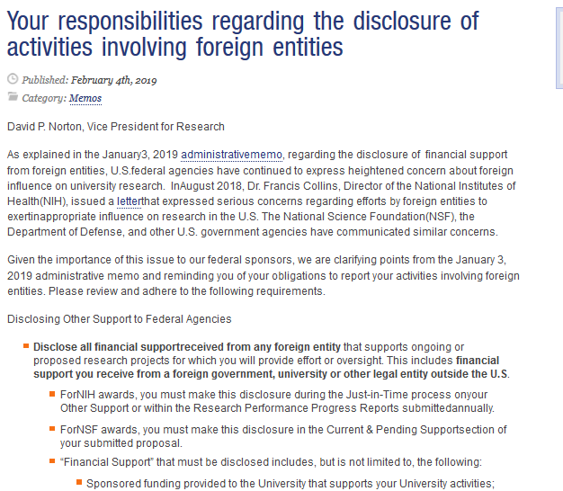
UF Admin Memo
Notes:
Time: 1 min
Terra

Slide 15
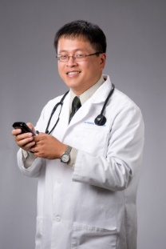
What Activities & Interests to disclose?
Work, positions, and financial interests that fall outside regular job duties for UF.
Consulting, Employment, Contractual Relationship
Business Owner, Officer, Board Member, etc.
Speaking and Advisory Boards
Writing, Editing, Publishing
Time commitment
Involves other UF Personnel or Students
Outside Teaching/Research
Notes:
Time: 1 min
Gary

Slide 16
How you can help?
You often are in the best position to know what’s going on in your departments! If you see something, say something.
Have they disclosed? How do you know?
Frequent foreign travel?
Visitors in your lab?
Gmail emails?
“When you hear hoof beats think of horses not zebras.” But think of zebras too.
Contact your Chair, Associate Dean, or DRCGS!
Notes:
Time: 1 min
Gary or Chris

Slide 17
Changes in Other Support Requirements
They call it clarifying but…
Federal agency interpretation of “support” is much more broad than just sponsored projects as previously interpreted
Generally includes any support not just cash to operate and disseminate
Failure to disclose is fraud
Notes:
Time: 1 min
Gary or Chris

Slide 18
Sponsor are changing their Other/Current & Pending Support Requirements
Must disclose all support received. This includes:
Sponsored funding
Gifts supporting your UF activities
Students, postdocs, or visiting scholars working with you at UF who are paid or supported by a non-UF entity
Salary, stipend, honoraria, expense reimbursements, directly paid travel
Doesn’t fit easily into the sponsors’ current forms
Notes:
Time: 1 min
Terra

Slide 19
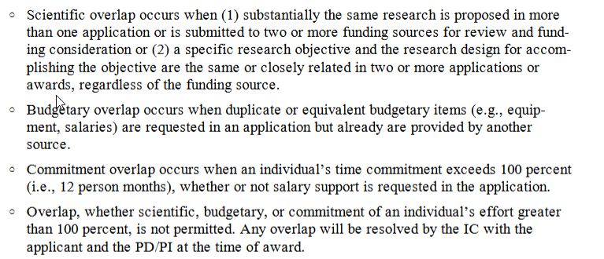
NIH Other Support
Notes:
Time: 1 min
Terra

Slide 20
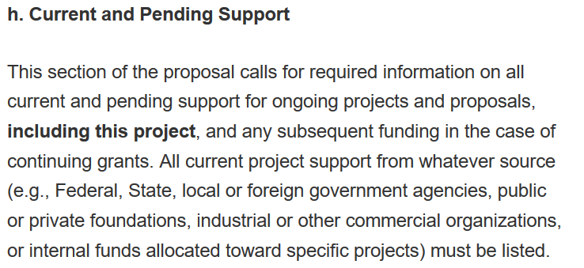
NSF Current & Pending Support
Notes:
Time: 1 min
Terra

Slide 21
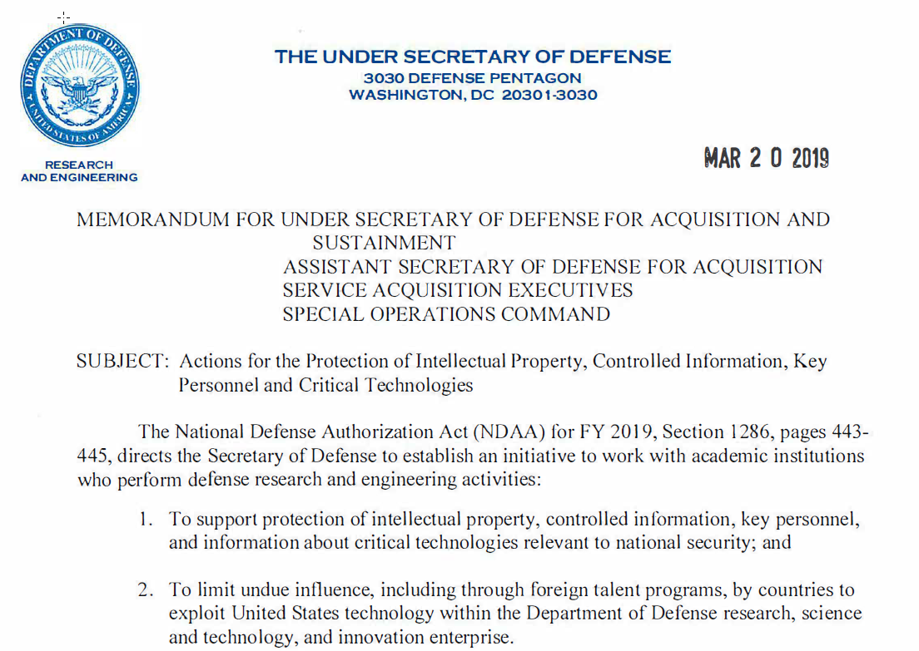
DOD Current & Pending Support
Notes:
Time: 2 min

Slide 22
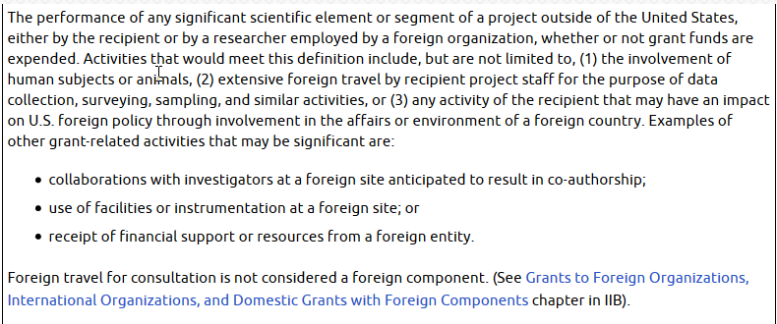
Other changes & clarifications from Sponsors
For NIH, applications & RPPRs require “foreign component”
Performance of any significant scientific element of a project outside of the U.S., whether or not grant funds are expended
Includes things like “deemed” export. NIH re-affirmed that non-US citizens working in the US is the same as a “foreign” component.
Update on your RPPR!!
Notes:
Time: 1 min
Terra

Slide 23
UFIRST & UF support for International
Expanded UF questions launched this spring
To identify projects where UF is implementing programs abroad
More support for services execution
More detailed review of on the ground programs where execution and implementation is higher risk
Notes:
Time: 1 min
Terra

Slide 24
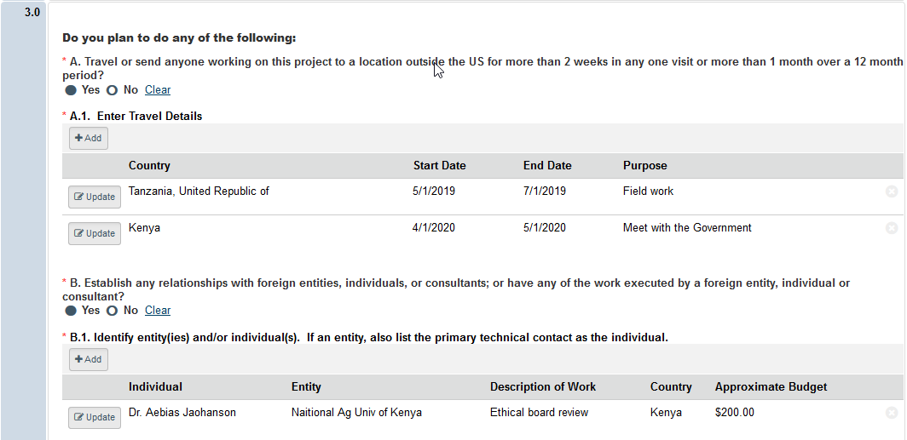
Increased UF support for international activities performed under UF sponsored programs
Notes:
Time: 1 min
Terra

Slide 25
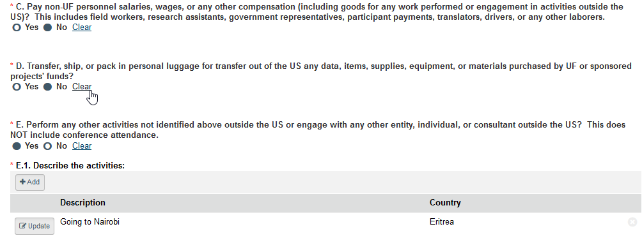
Increased UF support for international activities performed under UF sponsored programs
Notes:
Time: 1 min
Terra

Slide 26
Increased UF support for international activities performed under UF sponsored programs
Notes:
Time: 1 min
Terra

Slide 27
Visiting Persons
Persons unpaid in UF labs is great free work, but….
Have they been vetted?
Who is paying for them to be here?
What are they taking back?
If concerns, UFIC & DRCGS can help!
Notes:
Time: 1 min
Terra

Slide 28
…we know what you know…
But it’s a moving target

Slide 29
Questions?
Notes:
Time permitting

