Slide 1
NIH and NSF
Non-compliant Examples
Amber Hardie
Ron Lester
Division of Sponsored Programs (DSP)

Slide 2
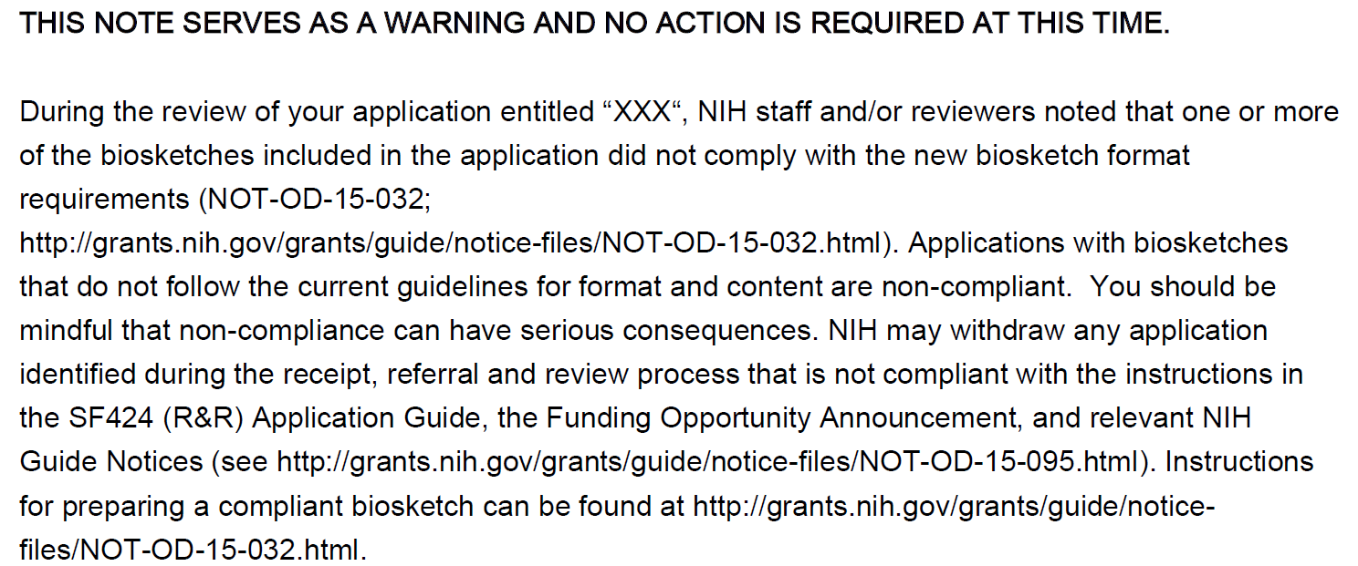

Slide 3
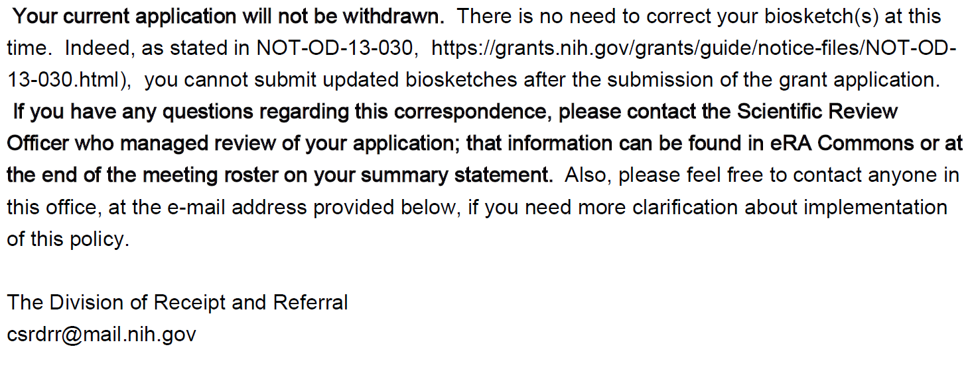

Slide 4
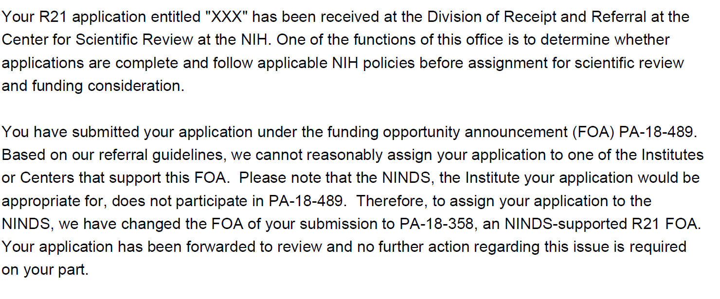

Slide 5
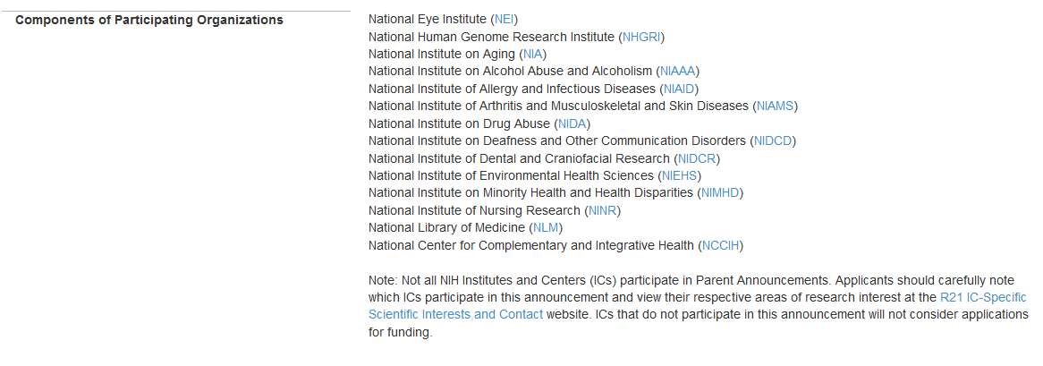

Slide 6
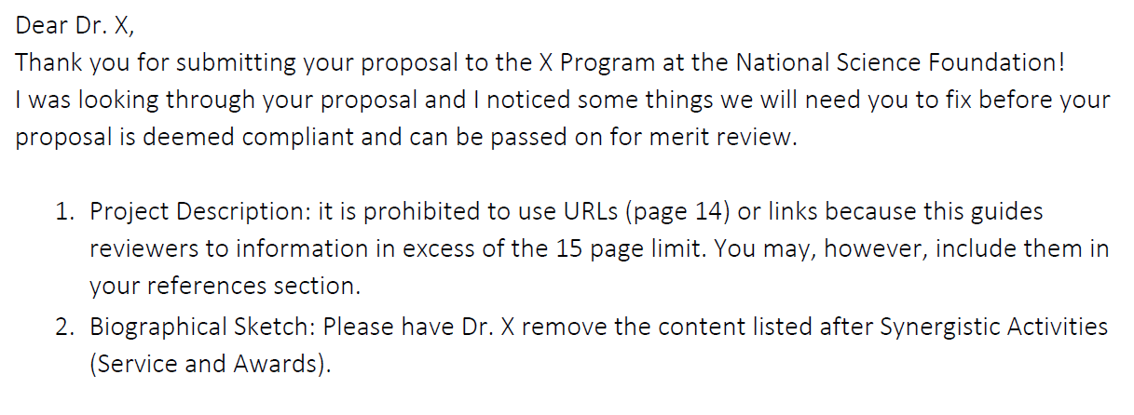

Slide 7
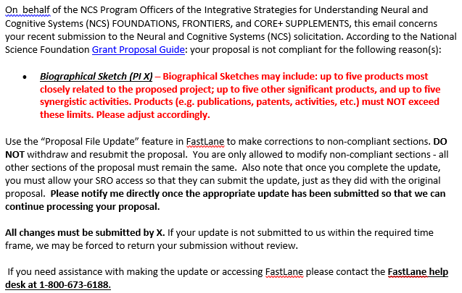

Slide 8
