Slide 1
Faculty Meetings
Terri Dildine
Mechanical and aerospace engineering
tdildine@ufl.edu
Kelly wilder
Ifas Shared services center
kelly87@ufl.edu
Brittini Balch
Ifas Shared services center
bsbalch@ufl.edu

Slide 2
Key Workflows
Setup
Award Kickoff Meeting
Award Establishment Checklist
New Faculty Orientation
PI Meetings – Monthly and Effort
Prior to the Meeting workflow
Status Review meetings
Award Closeout
Closeout Checklist
Forms Completion
Notes:
Terri
Three Phases of Award Management
Setup – new faculty member orientation
Continuous Review
Closeout
How do we work to give the Faculty members the information they need to complete their research, while ensuring that all award requirement are met throughout the life of the award?
COMMUNICATION, COMMUNICATION,COMMUNICATION!! Does not have to be in person, what works best for PI

Slide 3
Establishment of Award
Initial meeting with Faculty Member
Within the first month of receiving the award
Highlight Important award terms and conditions
Ensure all effort/deliverables are set up in Ufirst
Review awarded budget
Notes:
Terri -When an award is received:
Within the first month –set up meeting
Highlight Important award terms and conditions for the PI such as: effort commitments, publication restrictions, reporting requirements, deadlines
Ensure all deliverables are set up in Ufirst so emails will be released to faculty and RA staff
Review awarded budget with the PI and update any internal spreadsheets that are reviewed with the faculty member

Slide 4
Establishment of Award
Initial meeting with Faculty Member
Get PI Confirmation of effort
Review terms if any rebudget is needed
Subawards – review
Coordinate with other Departments
Notes:
Get PI confirmation of initial effort allocation for personnel assigned to project and update distribution
Plan for any major equipment purchases (for short term awards, ensure that you mention the 120 days prior to closeout requirements)
If any rebudgeting is required, remember to review terms if sponsor approval is needed
If a subaward is included, ensure this is being processed in Ufirst, as well as review the subrecipient monitoring plan
As needed, work with the PI on the coordination budget with other departments and confirm any cost share requirements from all projects on the award.

Slide 5
Monthly Meetings
Monthly meetings with your faculty can ensure that balances, payroll and expenditures are monitored appropriately.
Monthly meetings also aid in establishing relationships of trust and understanding with your faculty.
For monthly meetings RA prepares:
Agenda
Account Summary/myinvestiGator – balances, payroll reconciliation and projections, etc
Status updates to current agreements or awards
Notes:
Brittini - Goal is to check in monthly with Pis

Slide 6
Monthly Meetings
Sample Agenda
Current awards – Tools: account summary/myinvestiGator
Review award balances – Rebudget necessary?
Review ends dates – Will a NCE be necessary?
Review current payroll and payroll projections – Any changes to payroll? Terminations?
IF 9 month, review summer plan for summer escrow/salary savings if applicable.
Update on status of new agreements, new awards, other action items
Check in regarding any updated submissions – request RFP
Be sure to follow up with email outlining what was discussed and assigning action items.
Notes:
Brittini

Slide 7
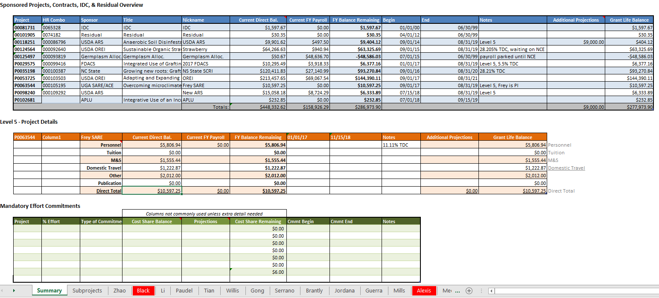
Account Summary Example
Notes:
Brittini - General concepts of the tool – monitor and manage awards
Summarize projects, individual personnel and where they are being paid, sandbox

Slide 8
Effort Meeting
Meeting with faculty during effort can ensure that effort is submitted correctly the first time and provides a chance to update faculty on balances, payroll, etc.
For effort meetings RA prepares:
Agenda
Account Summary/myinvestiGator – update, reconcile payroll and prepare projections
Effort reports for faculty and employees – allocate to 100% based off FAR, effort detail, appointment, commitments etc.
Any outstanding action items from or for PI
Notes:
Kelly - Effort meetings are minimum

Slide 9
Effort Meeting
Sample effort meeting agenda
Review account summary/myinvestiGator for balances and payroll
Review effort reports for employees and faculty
Update on status of new agreements, new awards, other action items
Check in regarding any updated submissions – request RFP
Be sure to follow up with email outlining what was discussed and assigning action items.
Notes:
Kelly

Slide 10
Award Closeout
Start this process early (at least 60-90 days prior to closeout) – See closeout checklist
Review Expenditures – Are there any outstanding charges?
Make sure salary is distributed, encumbrances are closed, and all invoices from subcontractors are approved and paid
Fixed price awards – Update the closeout letter with the appropriate distribution of the remaining funds.
Notes:
Terri - Review Expenditures to ensure all are reasonable, allocable, and allowable costs made in support of the performance of the project
If large amounts of residual amount –have all expenditures been applied – are we doing the budgeting accurately

Slide 11
Don’t forget your partners – Core Offices
Include your partners in Contracts and Grants (C&G), Cost Analysis, and the Division of Sponsored Programs (DSP) when making decisions on the best process to use when making changes, updates, etc.
Modifications to the award, no cost extensions, changes in PI, updates to effort, closeout invention forms, property forms, requests to change the budget, are all types of updates that can require assistance from one of the members from the above teams.
Notes:
Kelly

Slide 12
QUESTIONS??
Kelly wilder
Ifas Shared services center
kelly87@ufl.edu
Brittini Balch
Ifas Shared services center
bsbalch@ufl.edu
Terri Dildine
Mechanical and aerospace engineering
tdildine@ufl.edu

