Slide 1
Office of Research Organization Chart
Vice President for Research
David Norton
Research Program Development
Sponsored Programs
Contracts & Grants
Research Compliance
Research Operations & Services
UF Innovate

Slide 2
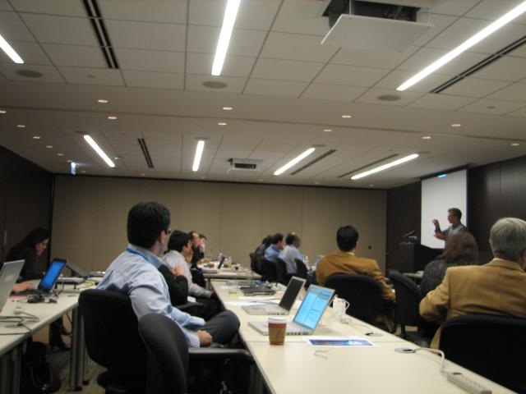
Division of Research Program Development
Services Provided
Assist faculty to find research funding
Coordinate Limited Submission Opportunities
Coordinate Internal Grant Programs
Support Large Proposal Submissions ( >$2.5Million )
Team building/Collaboration collisions
http://research.ufl.edu/finding-funding.html
E-mail: programdevelopment@research.ufl.edu
Office:(352) 392-4804

Slide 3

Finding Funding
RPD emails out Funding Opportunities to faculty
Faculty can search/personalize funding opportunities using
    OpportunitiesManager at UF http://my.research.ufl.edu/programdevelopment/fundingopportunities/opportunitiesmanager.aspx
    Pivot: http://research.ufl.edu/finding-funding/cos-pivot-funding-database.html
Request a personalized funding search from RPD: http://research.ufl.edu/finding-funding/request-a-funding-search.html

Slide 4

Limited Submission Program
Sponsors may restrict the number of applications an institution can submit in response to a given funding opportunity.
RPD coordinates the internal review process & selection of the best UF proposal(s). (Approx 700 per year). Sometimes deadlines are short!
Using the InfoReady Review portal! https://ufresearch.infoready4.com/CompetitionSpace/
  Letters of Intent or Concept Paper or Preliminary Proposals are requested from faculty
  The best proposal is selected by “ad-hoc” review committees comprised of UF faculty members
  Evaluation results are approved by Vice President for Research
  Anonymized reviewer comments are shared with faculty

Slide 5

Internal Seed Grants
Research Opportunity Fund Seed Grant - $1.3M each yr
    Annual competition
    Multidisciplinary research
    Two-year awards – maximum request $100,000
Funding to prepare for larger collaborative grants
UFRF Research Professorship awards
Fine Arts and Humanities Scholarship Enhancement Fund

Slide 6

Assistance with Proposal Preparation and Writing
Large Center type proposals – complex, multiple colleges, and multiple institutions ($2.5M)
Proposals of strategic importance to a college/unit
Obtaining and writing administrative sections – resources, management plans
Grant writing Resources and Boilerplate Text: http://research.ufl.edu/dsp/proposals/grantsmanship-resources.html
Grant coordination
http://www.clipartkid.com/funding-proposal-cliparts/

Slide 7
Assistance with Proposal Preparation and Writing
Presubmission review – scientific (internal and external); non-technical (Red Team review)
Grants consultants – Proposal Development Experts
Graphic design, editing
DRPD checklist http://research.ufl.edu/research-program-development/research_program_development_docs/DRPD-Proposal-Assistance-Checklist.pdf
Site visits
Coordinating team building activities
http://www.clipartkid.com/funding-proposal-cliparts/

Slide 9
How does DRPD interface with
departmental administrators/DSP/C&G/
DRPD is pre-preaward
DRPD does not work on budgets
Work closely with departmental and DSP staff in the preparation of the proposal
DRPD helps faculty with finalizing the technical portions, and administrative parts of the proposal
Units/DSP does the final review – and submission to the sponsor

