Slide 1
Subawards-A Primer

Slide 2
What this is not…

Slide 3
Outgoing Subawards at UF
FY17 -- 480 subawards/roughly $37 million
FY18 to date – 86 subawards/$5.1 million

Slide 4
Roles & Responsibilities
Division of Sponsored Programs – Outgoing Subaward Team
Conducts a risk assessment of all subawardees
Prepares the appropriate outgoing subaward document and any amendments thereafter.
Ensures outgoing subawards are complete, incorporate sponsor flow-down provisions and are in compliance with all regulations.
Finalizes the subaward and collects authorized official signatures.
Distributes fully signed subaward and any amendments thereafter to PI, Department staff, and C&G Accounting Services.
Works with PI in the event subrecipient performance or programmatic issues arise during the period of performance; works with subrecipient to identify and implement a corrective action plan; notifies sponsor as needed.
Maintains data in the FFATA Subaward Reporting System (FSRS).

Slide 5
Roles & Responsibilities
Principal Investigator (PI)
PIs have the primary responsibility for subrecipient monitoring.
Maintain regular contact with the subrecipient’s PI.
Collect, review and retain subrecipient’s technical/performance reports as required by the terms of the subaward.
Verify the subrecipient work is conducted in a timely manner and that the results delivered are in line with the proposed statement of work.
Review and approve subrecipient invoices to ensure charges are reasonable based on activities confirmed through regular contact with the Subrecipient PI.
Approve the final invoice only when all required reports have been obtained.
Promptly contact Contracts and Grants Accounting Services with concerns about subrecipient expenditures or DSP with any indication that the subrecipient is not fulfilling its obligations under the subaward.

Slide 6
Roles & Responsibilities
Department Fiscal/Grant Administrators
The level of involvement of Department fiscal or grant staff support varies, however it should be clearly defined at the local level and include the following:
Act as liaison between PIs and DSP/C&G.
Prepare/gather all documentation for outgoing subawards and send to DSP.
Assist PIs in their subrecipient monitoring responsibilities.
Assist in the review of subrecipient invoices
Ensure subrecipient invoices are approved by the PI and returned to Contracts and Grants Accounting Services on a timely basis.
Request clarification from the subrecipient regarding any unusual or excessive charges invoiced by the subrecipient.

Slide 7
Roles & Responsibilities
Contracts and Grants Accounting Services
Receives invoices for payment from Subrecipients.
Issues and collects PIs approval to pay invoice using the subrecipient payment certification form.
Assists in the reviews of invoices prior to payment to ensure that all invoices are consistent, with subaward requirements, costs are within the project period, review invoices for unallowable costs and other inconsistencies; and ensure cumulative amount of the invoice does not exceed the total amount of the subaward.
Provides assistance to PIs and Department staff in the event budgetary/financial issues that may arise during the period of performance.

Slide 8
Important to remember…
UF, when awarding subawards, is responsible:
For due diligence
Ensuring financial adequacy of the subrecipient
Verifying the subrecipient is not debarred or suspended
Making a risk determination
Ensuring that funds are spent for authorized purposes in compliance with laws, regulations and provisions of the prime.
Award terms and conditions from the Prime flow down to the subaward.
Ensuring that performance goals (statement of work) are achieved. If we are paying them, they must deliver.

Slide 9
Working with International Subrecipients and Small Organizations
Many international subrecipients or small organizations may not be familiar with requirements under federal awards such as obtaining a DUNS number and registering in the federal System for Award Management (SAM).
2 CFR 200 (Uniform Guidance, specifically Appendix I) requires that all recipients are registered in SAM.gov before funds can be released.
They most likely will not be aware of the Uniform Guidance and federal cost principles.

Slide 10
Further, many international and small organizations do not have a federally negotiated indirect cost rate. If the subrecipient does not have a current federally negotiated rate in place they have the following options:
Use a de minimis F&A rate of 10% MTDC (note: the 10% rate will apply to ANY subsequent subawards to this institution/organization until it obtains a Federally negotiated F&A rate or elects to negotiate an F&A rate with UF).
Negotiate an F&A rate with their Cognizant Federal Agency; or
Elect not to charge F&A.

Slide 11
Changes to existing subawards
Similar to the award flexibilities UF gets, subawards have the same (i.e. rebudgeting thresholds) and don’t need to ask UF for prior approval
Some changes at sub need UF approval but they generally don’t need sponsor approval (i.e. need for additional funds)
Only need SPONSOR prior approval when the change to the sub is significant enough to impact the award between UF & the sponsor (i.e. Sub PI is key person on the UF award)
Contact DSP to discuss changes to existing subawards
Inclusion of new subawards not in UF’s original budget:
Sponsor specific and award condition specific
May or may not need SPONSOR prior approval
Contact DSP to discuss the addition of new subawards

Slide 12
KELLIE CRAWFORD
Division Of Sponsored Programs

Slide 13
PROPOSAL STAGE
PI/Departmental Administrator
Identify Partner (Subawardee)
Assess Work
What is the partner doing?
Subaward v. Vendor v. Consultant
Vendors & Consultants not MTDC!
Subaward | Vendor | Consultant
Intellectually significant portion of programmatic effort | Goods and Services provided within normal business operations | Service provided within normal business operation
Responsible for programmatic decision making | No programmatic decision making | Provides an expert opinion
Work performed by the subrecipient’s personnel, using their personnel at their facilities | Operates in a competitive environment | No programmatic decision making, but uses knowledge and expertise in field
 | Fee for Service | No stake in outcome of project

Slide 14
DSP can help with this! Call us!
PROPOSAL STAGE
PI/Departmental Administrator
Consider qualifications of partner
Need advances/cash flow issues?
Trustworthy accounting systems? Effort System? Property Management System?
Need fixed price subaward? Even if budgeted, if fixed price, requires sponsor prior approval
Should they be a vendor? F&A budgets differ dramatically
Debarred or Suspended?
Any history of lack of performance?
Submit scope of work, budget and letter of intent to DSP with UF proposal
DSP
Reviews documentation with proposal submission
Supports you in the qualifications/risk/mitigation conversation

Slide 15
WHEN A SUBAWARD IS NOT PART OF THE ORIGINAL PROPOSAL/AWARD
When a Subrecipient is not disclosed in the submitted proposal, what approvals needed?
Determined on a case by case basis
Agency by Agency
Award by Award

Slide 16
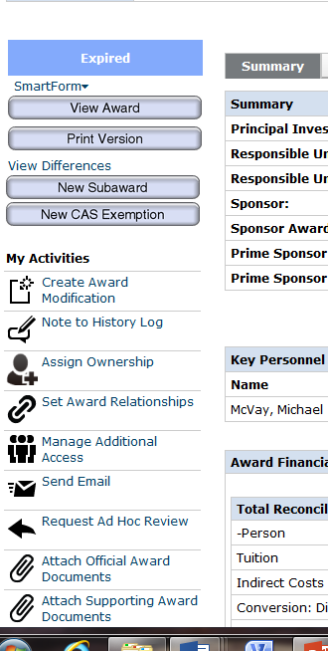
SUBAWARD PROCESS: AWARD SETUP
Department: Request in UFIRST
New Subaward button on award workspace
Information Needed
Subrecipient PI name/contact information
Subrecipient Admin name/contact information
CLEAR Scope of Work to be performed by Subrecipient PI
Any Special Conditions
SUBMIT FOR REVIEW
UFIRST Subaward will go from DRAFT to DSP REVIEW
Instructional Guide:
http://hr.ufl.edu/learn-grow/just-in-time-training/myufl-toolkits/grants/

Slide 17
SUBAWARD PROCESS
Activity
UFIRST State
DSP Reviews Scope of Work and Budget
IF DSP Requests changes
Budget/SOW missing
Budget/SOW don’t match
IF DSP ACCEPTS, New Subaward created in DSP Subaward Tool
DSP Review
Pending Responsible Unit Edits
Under Negotiation
ANY RECORD IN UFIRST UNDER NEGOTIATION – FIND CURRENT DETAILED STATUS IN THE DSP SUBAWARD TOOL

Slide 18
SUBAWARD PROCESS: DSP SUBAWARD TOOL
DSP Activity
DSP Subaward Tool State
Generates the Subcontract
Each award is read to ensure proper terms are flowed down
Scope of work and budget are reviewed
DSP Sends to PI and DSP/PI agree on final version
DSP Sends to Subawardee for review, negotiations & signature
DSP Sends to DSP AO
Fully Executed – sent to C&G, PI, Dept Admin & Subawardee
DRAFT
SENT TO PI
SENT TO SUB
SENT TO AO
COMPLETE
Only when DSP Subaward Tool is complete do we return to UFIRST to update the UFIRST record to Complete

Slide 19
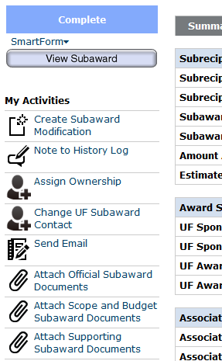
HOW DO I REQUEST A MODIFICATION TO THE SUBAWARD?
Department: Request in UFIRST
Create Subaward Modification activity on subaward workspace
Documentation Needed
Purpose of the modification
Supporting documents
Updated Budget/Scope of Work
PI Changes
Additional Special Conditions
SUBMIT FOR REVIEW in UFIRST
UFIRST Subaward will go from DRAFT to DSP REVIEW
http://hr.ufl.edu/learn-grow/just-in-time-training/myufl-toolkits/grants/

Slide 20
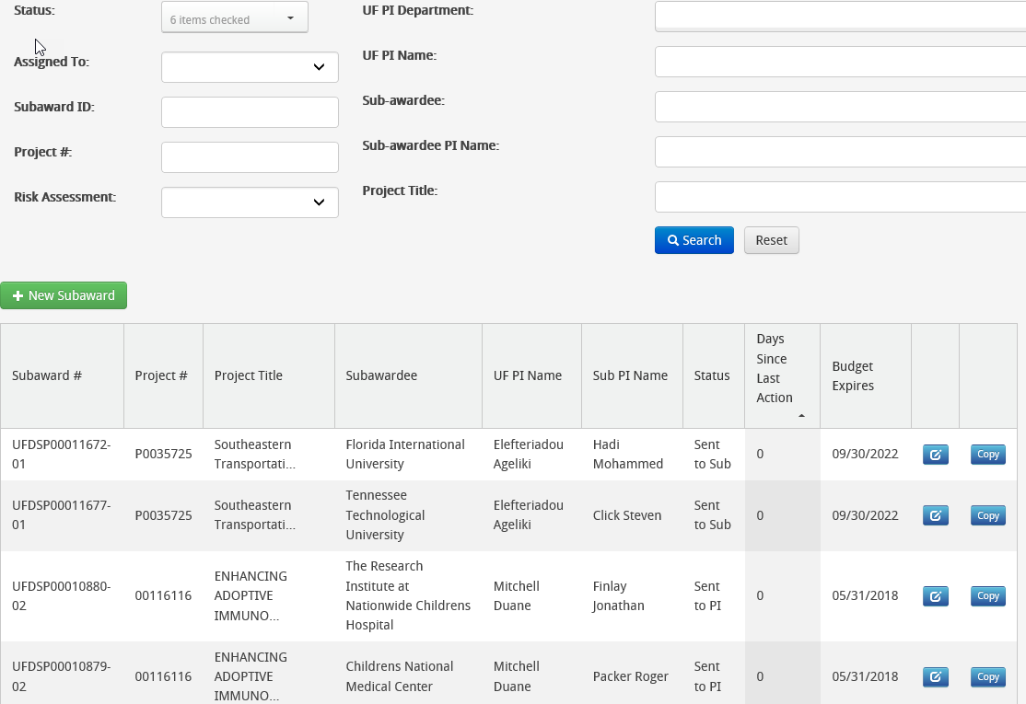
TRACKING SUBAWARDS
DSP Subaward Tracking Tool
Used to generate, route, approve and track subawards
Gatorlink ID needed
Subawards can be searched by:
DSP Subaward Number (UFDSP000XXXXX)
Project Number
UF PI Name
Subrecipient Name
Subrecipient PI Name
http://my.research.ufl.edu

Slide 21
CASSANDRA FARLEY & MISSI HORVATH
Contracts & Grants

Slide 22
C&G SET-UP & MANAGEMENT
DSP forwards the executed subaward agreement and encumbrance form to C&G
C&G completes vendor set up process if needed & encumbers the subaward funded amount
C&G sets up the subaward in the C&G database in preparation to process all invoice and modification transactions
Monitors subaward for the life of agreement:
Invoicing
Financials
Annual audits
Closeout

Slide 23
SUBAWARD INVOICE REVIEW PROCESS
Subawardee submits invoice to C&G
C&G reviews, reconciles invoice and asks for clarification as needed
PI reviews invoice and signs certification form, if appropriate
C&G sends invoice and PI certification form to PI and department
Once approved, C&G processes the invoice and remits payment
At-risk awards receive additional GA review

Slide 24
C&G INVOICE REVIEW
C&G reviews every invoice for:
General demographic information: subawardee name, subaward number, etc.
Authorized signature
Invoice period: is the invoice within the period of performance?
Current and cumulative expenses
F&A rate and applied F&A expense
Cost Share, if applicable

Slide 25
AT-RISK SUBAWARDS
Some subrecipients are considered at-risk
Lack of experience as an awardee
Insufficient internal controls
Lack of a financial management system
Additional Requirements
Full supporting documentation
Standardized invoice template
Additional monitoring
Other considerations
Advances
Translations
Currency Conversions

Slide 26
SUPPORTING DOCUMENTATION
Expense Type | Documentation Required
Salaries | Timesheets, effort certifications
Contracts | Copies of invoices
Travel | Identify name of traveler, location, purpose and dates of travel Include copies of receipts/invoices and per diem rate used
Equipment | Identify type of equipment purchased Include copies of invoices
Stipends & Participant Support | Name of participant, stipend amount, signature acknowledging receipt, stipend purpose
Other Expenses | Copies of receipts and invoices Itemize all expenses

Slide 27
PI CERTIFICATION
PIs are asked to review invoices at a high level
Are the expenditures expected?
Are they consistent with work completed and progress to date?
If PIs have concerns about expenses, missing deliverables or performance, they should not sign the certification
C&G can engage the subawardee for clarification, additional documentation, more information, etc

Slide 28
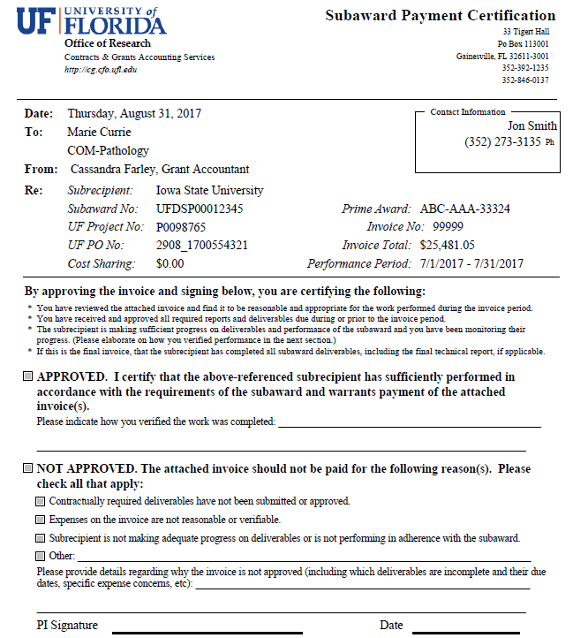
Award Information
Review Criteria
Approval & Justification
Signature

Slide 29
SUBAWARD CLOSEOUT
C&G receives a final invoice in accordance with subaward terms
Invoice is sent to the PI for review/approval
PI should not approve if deliverables and/or subagreement terms have not been met
Please notify C&G immediately if you believe invoice should not be paid
Upon invoice approval
Invoice is paid
PO is finalized and encumbrance is released
Subaward is marked ‘closed’ internally
Final invoice must be submitted and approved before C&G submits final invoice to the Prime Sponsor
Late submission of final invoices may result in non-payment to subawardee

Slide 30
Case Study #1
You are currently in year 1 of a federal grant. The total grant value is $300,000. The PI tells you that he wants to issue a subaward to another university for some work that his colleague there is going to help him with. The subaward value is $75,000. You look at the awarded budget, but there is no reference to this other university collaborating on the project.
How would you advise your PI?

Slide 31
Case Study #2
The Subcontract Manager in the central office is working on issuing a subaward on an NSF-funded project to UF. Reading through the documents, she discovers that:
This subaward replaced another subaward on the original submission.
Documents from the subawardee indicate the revised budget includes the following in the budget justification: “UF will provide in-kind services valued at $24,900 in Year 1 and $25,400 in Year 2 for salary for UF personnel."
The staff person who worked on the original submission and revised budget is no longer with the central department.
The change was made post submission but pre-award through a budget revision, but there is no documentation of the official submission through FastLane.
What are the areas for concern? How do you address them?

Slide 32
Case Study #3
You are currently in the process of closing out a federal award and your PI has been asked to sign off on the final subaward invoice. The PI comes to you and refuses to sign stating that the sub has not performed any of the agreed upon work.
What do you do?

Slide 33
Case Study #4
A PI has a DoD task order that includes a subaward to a small, employee owned R&D company.
Prior to receiving funding for the second budget period, the subaward PI notifies UF that he will be stepping down from his position in the company and, therefore, he can no longer be the PI for the subaward.
He recommends that another researcher from a partner non-profit R&D organization be named the new PI for the subaward, explaining that he had not drawn salary from this project in a long time and that “most of the research and expenditures in this subaward” were being carried out by the recommended researcher and his company.
The subaward PI assures UF that this had been discussed with the sponsor’s program manager and the lead PI at UF, and that everyone involved had already approved the change.
At the same time….

Slide 34
A new RA in the department is reviewing the backup submitted with the subaward invoices and discovered these invoices include costs with questionable direct benefit to the project, including many items that UF would deem as indirect costs, such as office supplies and bulk computer data storage devices.
In addition, the backup for the subaward’s travel expenses showed that the project funds were being used to support frequent meals at local restaurants for researchers on the project to discuss the progress of the work.
What are the areas for concern? How do you address them?

Slide 35
Questions?

