Slide 1
Temporary (TEMP) Projects
Joshua Pesch, Sponsored Programs Manager
Division of Sponsored Programs

Slide 2
Objectives
Define a TEMP project
Determine when a TEMP can be requested
Identify where campus can go for additional support

Slide 3
What is a TEMP?
A new project setup prior to the release of funds
Can be requested under a brand new award or an active award (such as a new project for the upcoming budget period)
A temporary project is not limited to a specific amount of time or budget
The Unit Fiscal Authority (UFA), in consultation with the department, determines how much budget will be released and for how long the funds will be available

Slide 4
What do I need to request a TEMP?
UFIRST Proposal
UFIRST PRO needed if new award
Unit Fiscal Authority Approval
Occurs within the UFIRST record and is
needed to confirm that the unit who approved advanced spending will cover expenses if funding does not arrive
Backup Documentation
Include any pertinent backup documentation and attach to UFIRST record, such as award letter or confirmation from sponsor

Slide 5
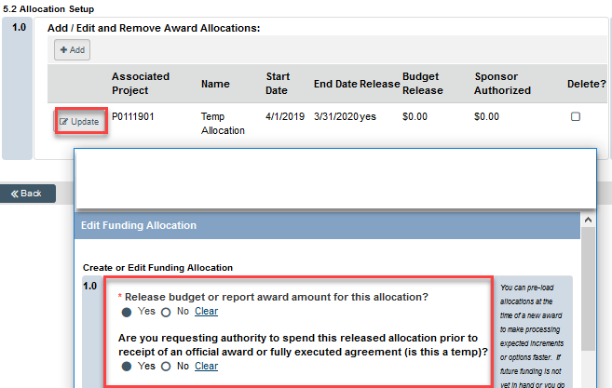
How do I request a TEMP?
A TEMP release is requested on the UFIRST Allocation Setup screen, page 5.2
Answering “yes” to the second question below will designate the request as a Temporary release

Slide 6
How do I request a TEMP?
Instructional Guides available:
https://learn-and-grow.hr.ufl.edu/toolkits-resource-center/financial-toolkits/grants/
Requesting a New Temporary Release Project
Making a Temporary Project Permanent

Slide 7
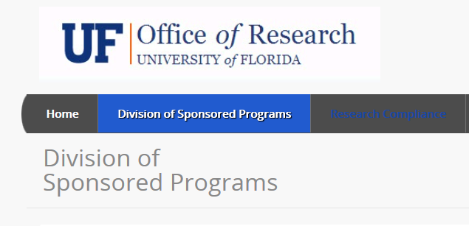
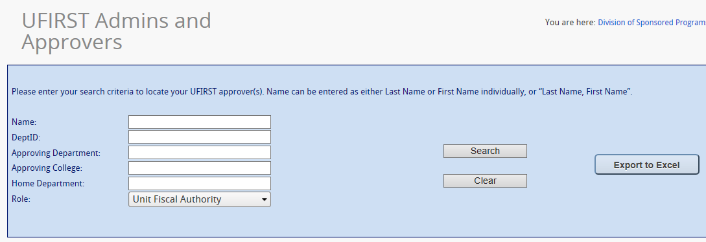
How do I know who my UFA is?
http://my.research.ufl.edu/DivisionofSponsoredPrograms.aspx
Division of Sponsored Programs- > UFIRST Admins and Approvers

Slide 8
What does DSP need in order to process a TEMP?
Approved UFIRST Proposal and UFIRST Award
UFA approval- obtained within UFIRST record
UFIRST Award / Modification routed to DSP

Slide 9
Why do I need a TEMP?
Provides chartfield string to assist with purchasing and payroll assignment
Reduces need to process cost-transfers
Minimizes use of departmental funds

Slide 10
Important!
It is always up to the Unit to decide if a TEMP is warranted
Before requesting a TEMP, consider any sponsor rules or restrictions that would negatively impact setup, such as FDACS agreements
DSP does not decide who qualifies for a TEMP
DSP does not approve TEMP requests (the Unit Fiscal Authority does)

Slide 11
Need Additional Help?
UF Financial Toolkits:
https://learn-and-grow.hr.ufl.edu/toolkits-resource-center/financial-toolkits/grants/
DSP Website
https://research.ufl.edu/dsp/award-management/fiscal-management/temporary-release-of-funds.html
UF Awards
ufawards@ufl.edu
DSP owner assigned to Award / Award Modification

Slide 12
Special thanks
Daniel Bonilla
LaNeshia Chaney
Devin Dissell
Kevin Gates
Chris Hackett
Lindsey Jones
Irina Maslova
Stacey Sandrey
Debbie Thigpen

