Slide 1
Sponsored Programs Training Update
Steve Slater
UF Training & Organizational Development

Slide 2
RAFT Cohort
RAFT Forum
RAFT Training Classes

Slide 3
RAFT Cohort
Designed for employees with 12 months or fewer of grants management experience
A 12-week, intensive training series
Covers the range of sponsored programs activities from pre-award to post-award
Applications for the Fall semester will be open later this summer

Slide 4
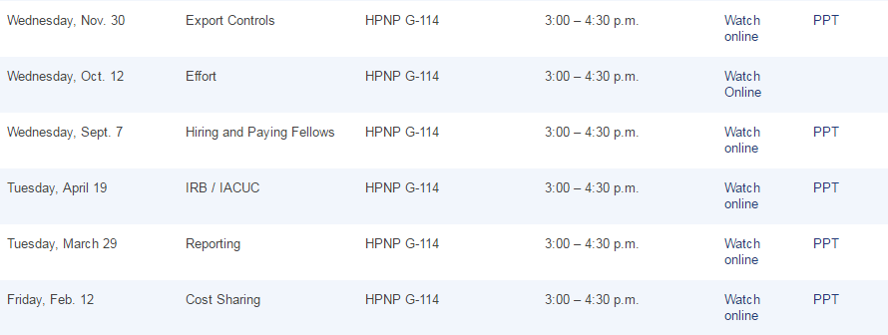
RAFT Forum
The RAFT Forum covers special topics of interest to the grants community, while also providing an open channel for solutions, contacts, and information.

Slide 5
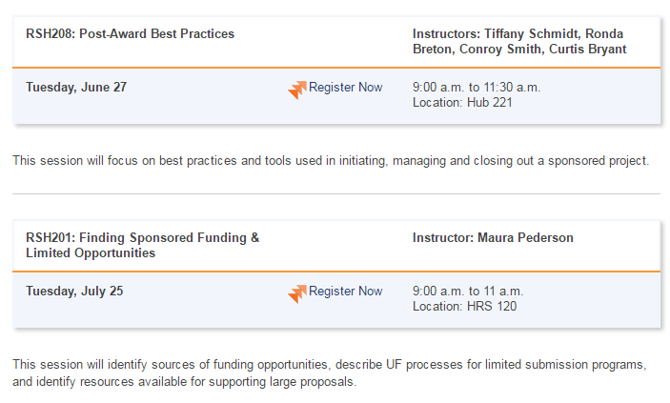
RAFT Training Classes
Monthly training classes open to all employees.
Internet access available for remote employees.

Slide 6
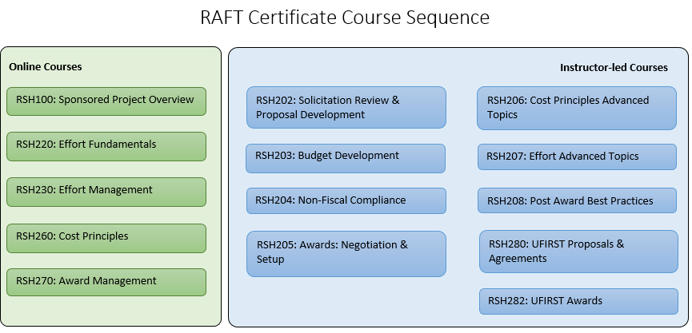
RAFT Certificate
Available to all employees.
Five online classes, nine instructor-led classes

Slide 7
Other Training Available
RSH100: Sponsored Project Overview
RSH200: Effort Reporting
RSH210: Space Allocation
RSH220: Effort Fundamentals
RSH230: Effort Management
RSH260: Cost Principles
RSH270: Award Management
RSH290: The Auditor’s Perspective
RSH320: Human Subject Payments

Slide 8
Other Training Available
RSH330: Export Controls Annual Review
PST130: Reconciliation
PST270: Academic Activities Reporting
PRO323: Post-Award Overview
PMA010: Project Management

Slide 9
Even More Training…
UFIRST: RSH280, RSH281, RSH282
Privacy Courses: PRV800, PRV801
IRB Courses: IRB800, IRB801, IRB802, IRB820
Informed Consent Courses: CTS800, CTS801, CTS805
Good Clinical Practice
myinvestiGator

Slide 10
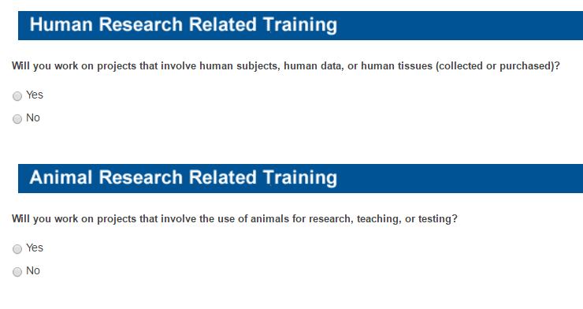
Online Training Improvement
Researcher Training Utility
http://research.ufl.edu/rtu.html

Slide 11
Online Training Improvement
Enhancements to myTraining and more…
One-click registration
Expanded implementation of training reminders
Improving high-traffic, online courses
Revising curriculum-based courses
Understanding the faculty training burden

Slide 12
Questions?

